Slide 1

New Tax Preparer Training – Session 2
Tax Year 2021 Dec. 11 and Dec 14, 2021

Slide 2

Agenda
Any Questions from Last Week?
Tax Regulation Changes
Advanced Scenarios 7-9
Next Steps

Slide 3
Changes for TY 2021

Slide 4
Changes For TY 2021
Recent Tax law changes related to Certification
  For HSA reimbursement, OTC items now qualify
  Just for 2021, Child/Dependent Care Credit is refundable
  EIC age limits changed (appears to be just for 2021)
Update on EIC (EITC) not in IRS pubs yet:
  https://support.taxslayerpro.com/hc/en-us/articles/4402545759898-2021-Earned-Income-Tax-Credit-s
Publication 4491 (pages iv-x) has summary of Tax Changes
Much more detail will be covered in January

Slide 5
Tax Training Overview

Slide 6
Volunteer Testing For TY 2021
Tests
  For Tax Preparers
    Volunteer Standards of Conduct
    Intake/Interview and Quality Review
    Advanced Certification
  For Site Coordinators
    Volunteer Standards of Conduct
    Intake/Interview and Quality Review
    Advanced Certification
    Site Coordinator Test

Slide 7
Certification Training Overview
Review of scenario notes
Figure out answers collectively or individually (depending on complexity and the need for Taxslayer)
Review key places to find relevant information
Walk through of scenario answers
Clarification/discussion about which answers are correct and why

Slide 8
Training Publications
Pub 6744 – VITA/TCE Volunteer Assistor’s Test/Retest
  https://www.irs.gov/pub/irs-pdf/f6744.pdf
Pub 4012 – VITA/TCE Volunteer Resource Guide
  https://www.irs.gov/pub/irs-pdf/p4012.pdf
Pub 4491 – VITA/TCE Training Guide
  https://www.irs.gov/pub/irs-pdf/p4491.pdf
Pub 17 – Your Income Federal Tax
  Additional coverage of tax law and how to prepare taxes
  https://www.irs.gov/pub/irs-pdf/p17.pdf
Pub 4961 – Volunteer Standards of Conduct
  https://www.irs.gov/pub/irs-pdf/p4961.pdf
Pub 5101 – Intake Interview Quality Review
  https://www.irs.gov/pub/irs-pdf/p5101.pdf

Slide 9
Advanced Certification Scenarios
(Requre Taxslayer Input)

Slide 10
Scenario 7
Gilbert and Tara Washington

Slide 11
Adv. Scenario 7 Interview Notes (pg 81)
Gilbert is an elementary school teacher at a public school . Gilbert and Tara are
married and choose to file Married Filing Jointly on their 2021 tax return.
Gilbert worked a total of 1,280 hours in 2021. During the school year, he spent $500
on unreimbursed classroom expenses .
Tara retired in 2018 and began receiving her pension on October 1st of that year .
She explains that this is a joint and survivor annuity. She has already recovered
$1,013 of the cost of the plan .
Gilbert settled with his credit card company on an outstanding bill and brought the
Form 1099-C to the site . They aren’t sure how it will impact their tax return for tax
year 2021 . The Washingtons determined that they were solvent as of the date of
the canceled debt .
Tara won $3,000 gambling at a casino and had additional lottery winnings of $150.
Tara has documented casino losses of $1,500.
Their son, Chandler, is in his second year of college pursuing a bachelor’s degree in
Logistics at a qualified educational institution. He received a scholarship and the
terms require that it be used to pay tuition. Box 2 was not filled in and Box 7 was not
checked on his Form 1098-T for the previous tax year . The Washingtons provided
Form 1098-T and an account statement from the college that included additional
expenses. The Washingtons paid $450 for books required for Chandler’s courses.
This information is also included on the College statement of account .
Chandler does not have a felony drug conviction .
The Washington’s received the third Economic Impact Payment (EIP3) in the
amount of $4,200 in 2021.
They are all U .S . citizens with valid Social Security numbers .

Slide 12
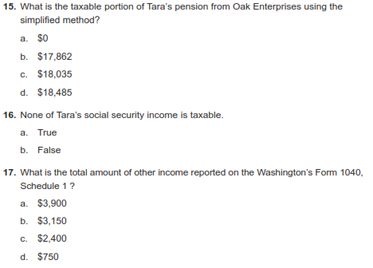
Adv. Scenario 7 Test (pg 90)
D-37, 1099-R
(Worksheet in return)
D-46
D-1, W-2G, 1099-C, Interview

Slide 13
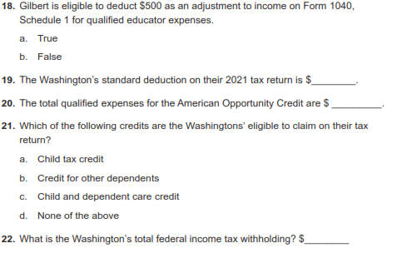
Adv. Scenario 7 Test (pg 90)
E-4
26,450
F-2
3655
J-1
G-4
1098-T, Interview
6669
W-2, 1099-R, SSA-1099

Slide 14
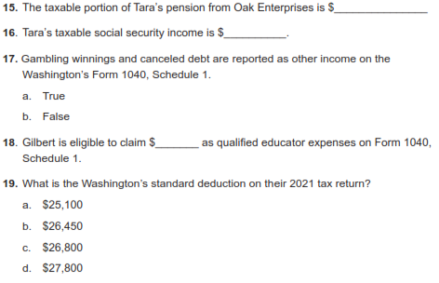
Adv. Scenario 7 Retest (pg 117)
18,035
17,937
D-53, Schedule 1
250

Slide 15
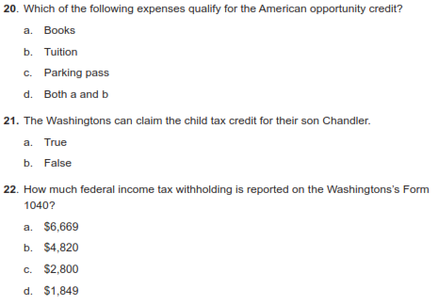
Adv. Scenario 7 Retest (pg 117)
J-1

Slide 16
Adv. Scenario 7 Questions
Test
  Question 15
  Question 16
  Question 17
  Question 18
  Question 19
  Question 20
  Question 21
  Question 22
Retest
  Question 15
  Question 16
  Question 17
  Question 18
  Question 19
  Question 20
  Question 21
  Question 22
C
$18,035
B
$17,937
A
A
B
$250
$26,450
B
$3655
D
B
B
$6669
A

Slide 17
Scenario 8
Cynthia Simon

Slide 18
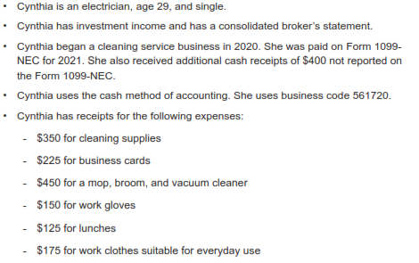
Adv. Scenario 8 Interview Notes (pg 91)

Slide 19
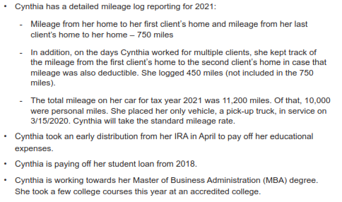
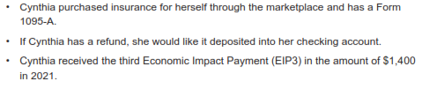
Adv. Scenario 8 Interview Notes (pg 91)

Slide 20
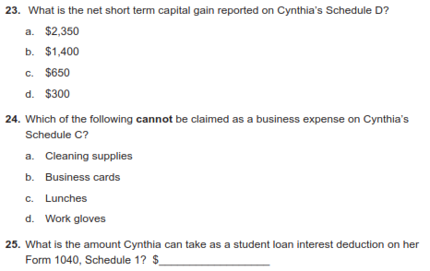
Adv. Scenario 8 Test (pg 103)
1099-B
D-20, Schedule C instructions line 24B
2500
E-11

Slide 21
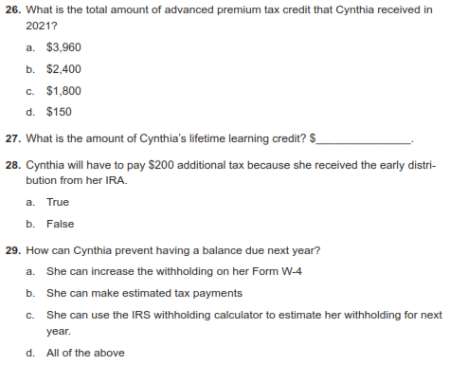
Adv. Scenario 8 Test (pg 103)
1095-A, Col C
400
J-4/5, Form 8863
H-4/5

Slide 22
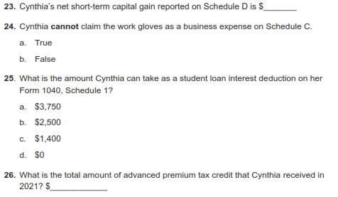
Adv. Scenario 8 Retest (pg 118)
650
1800

Slide 23
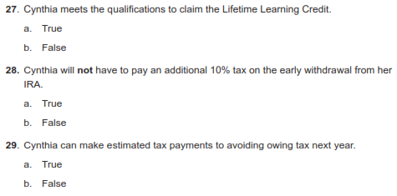
Adv. Scenario 8 Retest (pg 118)
J-4/5

Slide 24
Adv. Scenario 8 Questions
Test
  Question 23
  Question 24
  Question 25
  Question 26
  Question 27
  Question 28
  Question 29
Retest
  Question 23
  Question 24
  Question 25
  Question 26
  Question 27
  Question 28
  Question 29
C
$650
C
B
$2500
B
C
$1800
$400
A
B
A
D
A

Slide 25
Scenario 9
Richard Cook

Slide 26
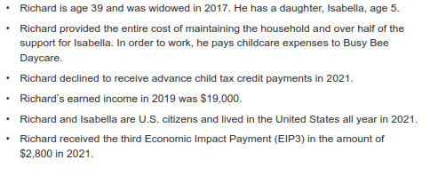
Adv. Scenario 9 Interview Notes (pg 104)

Slide 27
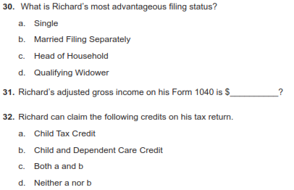
Adv. Scenario 9 Test (pg 110)
B-8/9
41,580
G-2/3, G10

Slide 28
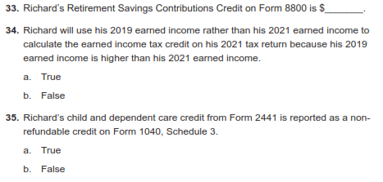
Adv. Scenario 9 Test (pg 110)
100
G-15,Form 8880
I-1
G-10

Slide 29
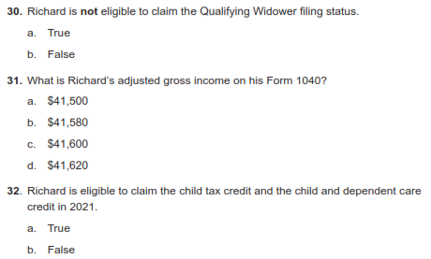
Adv. Scenario 9 Retest (pg 119 – first one)

Slide 30
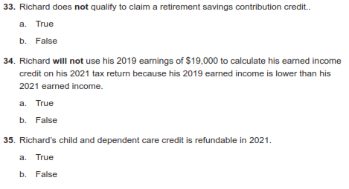
Adv. Scenario 9 Retest (pg 119 – first one)
G-15,Form 8880
I-1

Slide 31
Adv. Scenario 9 Questions
Test
  Question 30
  Question 31
  Question 32
  Question 33
  Question 34
  Question 35
Retest
  Question 30
  Question 31
  Question 32
  Question 33
  Question 34
  Question 35
C
A
$41,580
B
C
A
$100
B
B
A
B
A

Slide 32
Next Steps

Slide 33
Next Training
Home-Brew scenarios and detail process discussions (ZOOM unless situation changes)
  January 8th
  January 15th
  January 22nd
Greeter Training
  January 4th (ZOOM)
Details to come on site status and shift sign-ups

Slide 34
Login links
Taxslayer “Springboard” – access to Practice Lab and eventually live Taxslayer
  Search on: Taxslayer Springboard
https://vita.taxslayerpro.com/
IRS Link-and-Learn for certification
  Search on: Link and Learn Home
https://www.linklearncertification.com/d/

Slide 35
Practice Lab
Practice Lab is a great place to try out the system if you are unable to attend a January training
Practice is important!!
Highly recommend using the system on your own before trying to complete with a real person starting around 1/24 (best guess)

Slide 36
Taking the Test
If you run into problems accessing the Practice Lab or Certification Site, let us know
Make sure to complete:
  Volunteer Standards of Conduct
  Intake/Interview and Quality Review
  Advanced Certification
Once all three tests are completed and passed, print off and sign Form 13615
Return Form 13615 to Meredith either in person or via email meredith.hershner@uweci.org
Certification target date is January 7th, 2021

Slide 37
VITA Shirts
If you did not get the link to order long-sleeve VITA T-shirts, let us know
These are provided by the program

Slide 38
Questions?
Thank you! See you in January

Slide 39
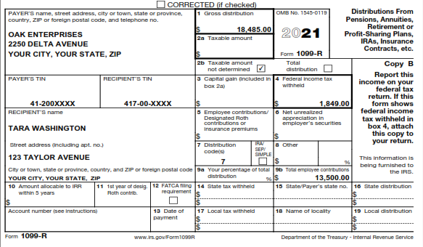
Adv. Scenario 7 Additional Info

Slide 40
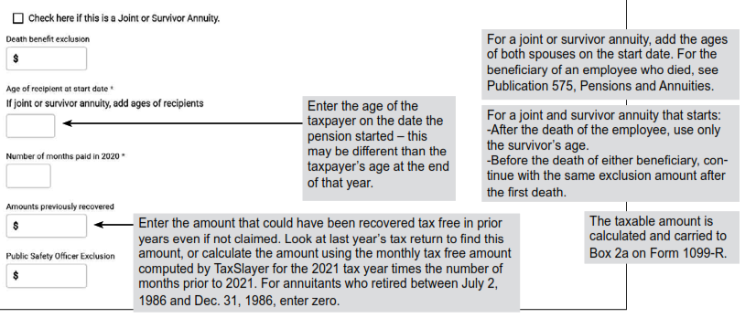
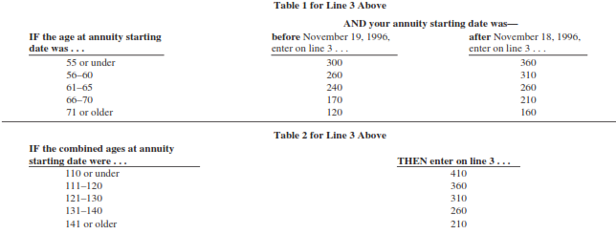
Adv. Scenario 7 Additional Info

Slide 41
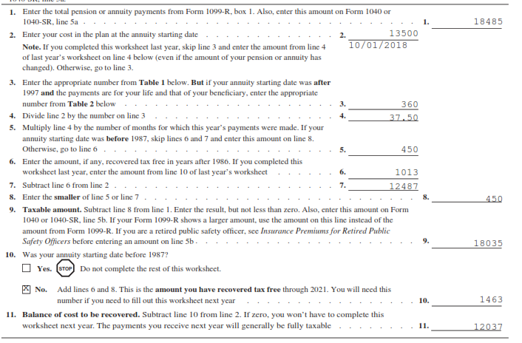
Adv. Scenario 7 Additional Info

Slide 42
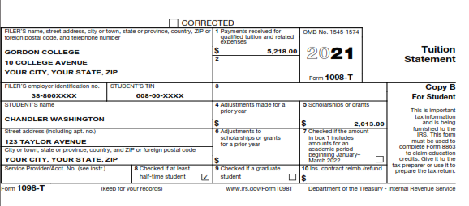
Adv. Scenario 7 Additional Info

Slide 43
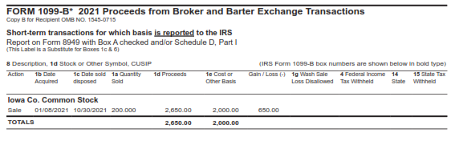
Adv. Scenario 8 Additional Info

Slide 44
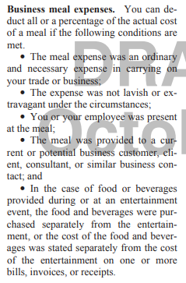
Adv. Scenario 8 Additional Info

Slide 45
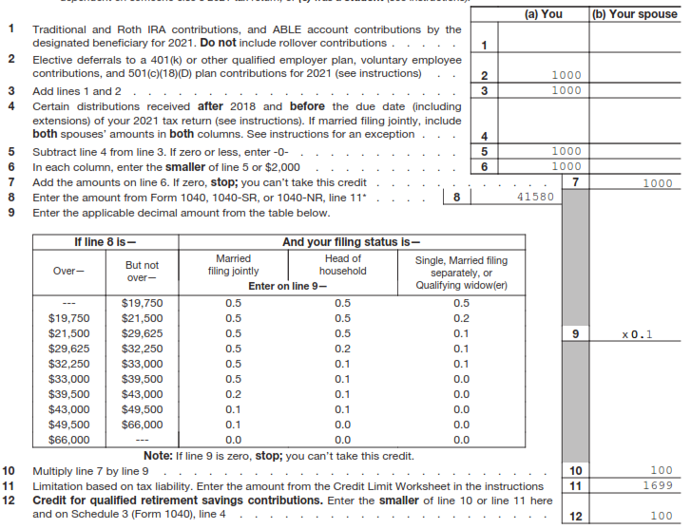
Adv. Scenario 9 Additional Info

