Slide 1
Tax Preparer Training – Session 2
Tax Year 2022 Dec. 7, 2022

Slide 2
Agenda
Overview Reminder
Advanced Certification Scenarios 1-6
Out-of-Scope
Next Steps and Updates from Meredith
(we’ll take a 15 minute break somewhere)

Slide 3
Tax Training Overview

Slide 4
Volunteer Testing For TY 2022
Tests
For Tax Preparers
Volunteer Standards of Conduct
Intake/Interview and Quality Review
Advanced Certification
For Site Coordinators
Volunteer Standards of Conduct
Intake/Interview and Quality Review
Advanced Certification
Site Coordinator Test

Slide 5
Tax Certification Training
We recommend you go through the scenarios beforehand and choose your answers, but do NOT take the certification test until after the training sessions are done
We will review certification scenarios
Review key places to find relevant information
Poll participating volunteers for their choice on answers
If needed, clarification/discussion about which answers are correct and why

Slide 6
Training Publications
Form 6744 – VITA/TCE Volunteer Assistor’s Test/Retest
https://www.irs.gov/pub/irs-pdf/f6744.pdf
Pub 4012 – VITA/TCE Volunteer Resource Guide
https://www.irs.gov/pub/irs-pdf/p4012.pdf
Pub 4491 – VITA/TCE Training Guide
https://www.irs.gov/pub/irs-pdf/p4491.pdf
Pub 17 – Your Federal Income Tax – Tax Guide
Additional coverage of tax law and how to prepare taxes
https://www.irs.gov/pub/irs-pdf/p17.pdf

Slide 7
Certification Tests

Slide 8
Requirements
All VITA volunteers preparing and doing Quality Review on client returns must
Pass the Volunteer Standards of Conduct (VSC) certification test with a score of 80% or higher.
Pass the Intake/Interview and Quality Review certification test with a score of 80% or higher
Pass the Advanced Course certification test with a score of 80% or higher
Agree to comply with the VSC by signing and dating Form 13615 prior to working at a site.
Electronically generated by certification process
Do NOT manually download and fill out the form

Slide 9
Advanced Certification Scenarios
(Not requiring Taxslayer)

Slide 10
Scenario 1
Chris Spalding

Slide 11
Adv. Scenario 1 Interview Notes
Scenario and initial test questions Pub 6744 pg. 68

Slide 12
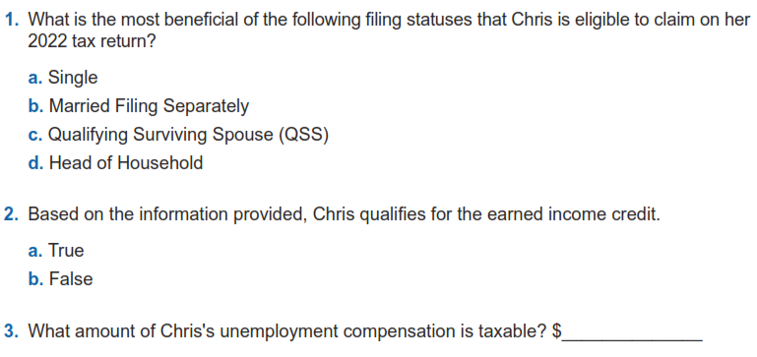
Adv. Scenario 1: Questions
B-10
I-3/4
$1,800
D-1
Notes:
This article clarifies information provided on page 10 of IRS Publication 5307, Tax Reform Basics for Individuals and Families for the repeal of deduction for alimony payments under the Tax Cuts & Jobs Act of 2017.
Alimony or separation payments paid to a spouse or former spouse under a divorce or separation agreement, such as a divorce decree, a separate maintenance decree, or a written separation agreement, may be alimony for federal tax purposes. Alimony or separation payments are deductible if the taxpayer is the payer spouse. Receiving spouses must include the alimony or separation payments in their income.
Beginning Jan. 1, 2019, alimony or separate maintenance payments are not deductible from the income of the payer spouse, or includable in the income of the receiving spouse, if made under a divorce or separation agreement executed after Dec. 31, 2018.
This also applies to a divorce or separation agreement executed on or before Dec. 31, 2018, and modified after December 31, 2018, as long as the modification:
changes the terms of the alimony or separate maintenance payments; and
states that the alimony or separate maintenance payments are not deductible by the payer spouse or includable in the income of the receiving spouse.
On the other hand, generally alimony or separate maintenance payments are deductible from the income of the payer spouse and includable in the income of the receiving spouse, if made under a divorce or separation agreement executed on or before Dec. 31, 2018, even if the agreement was modified after December 31, 2018, so long as the modification is not one described in the preceding paragraph.

Slide 13
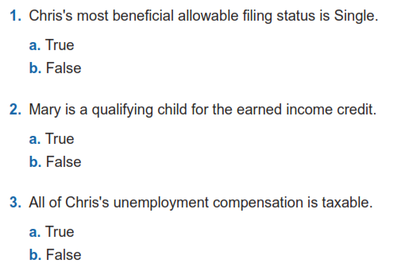
Adv. Scenario 1: Retest Questions
B-10
I-3/4
D-1
Retest Pub 6744 Pg 103
Notes:
This article clarifies information provided on page 10 of IRS Publication 5307, Tax Reform Basics for Individuals and Families for the repeal of deduction for alimony payments under the Tax Cuts & Jobs Act of 2017.
Alimony or separation payments paid to a spouse or former spouse under a divorce or separation agreement, such as a divorce decree, a separate maintenance decree, or a written separation agreement, may be alimony for federal tax purposes. Alimony or separation payments are deductible if the taxpayer is the payer spouse. Receiving spouses must include the alimony or separation payments in their income.
Beginning Jan. 1, 2019, alimony or separate maintenance payments are not deductible from the income of the payer spouse, or includable in the income of the receiving spouse, if made under a divorce or separation agreement executed after Dec. 31, 2018.
This also applies to a divorce or separation agreement executed on or before Dec. 31, 2018, and modified after December 31, 2018, as long as the modification:
changes the terms of the alimony or separate maintenance payments; and
states that the alimony or separate maintenance payments are not deductible by the payer spouse or includable in the income of the receiving spouse.
On the other hand, generally alimony or separate maintenance payments are deductible from the income of the payer spouse and includable in the income of the receiving spouse, if made under a divorce or separation agreement executed on or before Dec. 31, 2018, even if the agreement was modified after December 31, 2018, so long as the modification is not one described in the preceding paragraph.

Slide 14
Scenario 2
Adam and Lisa Garcia

Slide 15
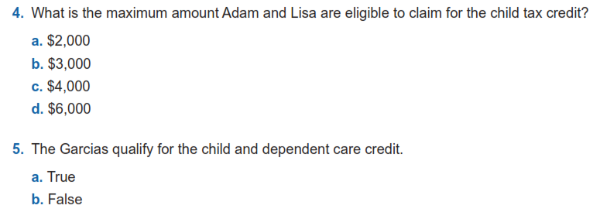
Adv. Scenario 2 Interview Notes
G-2
G-3: Assuming no additional tax credit, need form 8812 calculations
G-10
Scenario and initial test questions Pub 6744 pg. 69

Slide 16
Adv. Scenario 2: Retest Questions
G-2
G-10
Retest Pub 6744 Pg 104
Notes:
This article clarifies information provided on page 10 of IRS Publication 5307, Tax Reform Basics for Individuals and Families for the repeal of deduction for alimony payments under the Tax Cuts & Jobs Act of 2017.
Alimony or separation payments paid to a spouse or former spouse under a divorce or separation agreement, such as a divorce decree, a separate maintenance decree, or a written separation agreement, may be alimony for federal tax purposes. Alimony or separation payments are deductible if the taxpayer is the payer spouse. Receiving spouses must include the alimony or separation payments in their income.
Beginning Jan. 1, 2019, alimony or separate maintenance payments are not deductible from the income of the payer spouse, or includable in the income of the receiving spouse, if made under a divorce or separation agreement executed after Dec. 31, 2018.
This also applies to a divorce or separation agreement executed on or before Dec. 31, 2018, and modified after December 31, 2018, as long as the modification:
changes the terms of the alimony or separate maintenance payments; and
states that the alimony or separate maintenance payments are not deductible by the payer spouse or includable in the income of the receiving spouse.
On the other hand, generally alimony or separate maintenance payments are deductible from the income of the payer spouse and includable in the income of the receiving spouse, if made under a divorce or separation agreement executed on or before Dec. 31, 2018, even if the agreement was modified after December 31, 2018, so long as the modification is not one described in the preceding paragraph.

Slide 17
Scenario 3
Jenny Smith

Slide 18
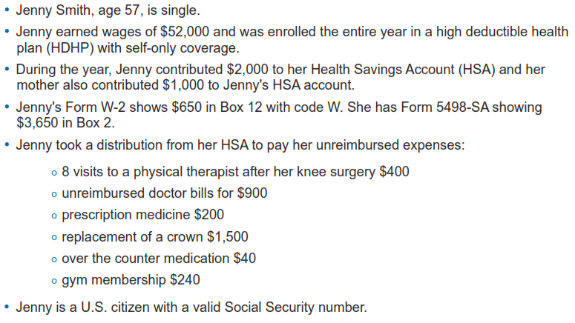
Adv. Scenario 3 Interview Notes
Scenario and initial test questions Pub 6744 pg. 70

Slide 19
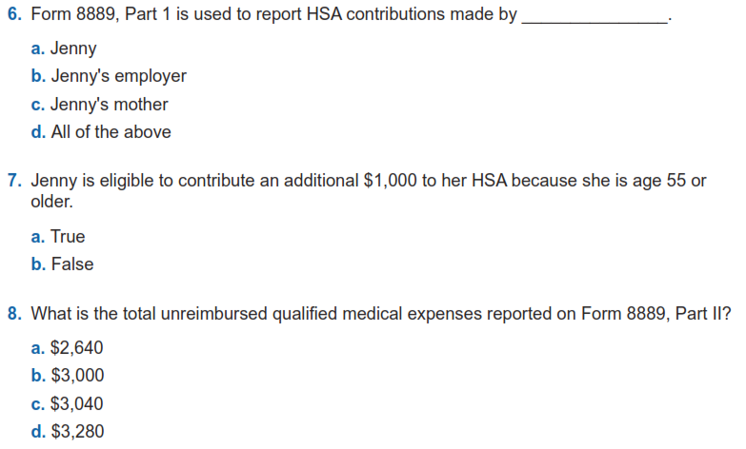
Adv. Scenario 3 Questions
E-7, form 8889

Slide 20
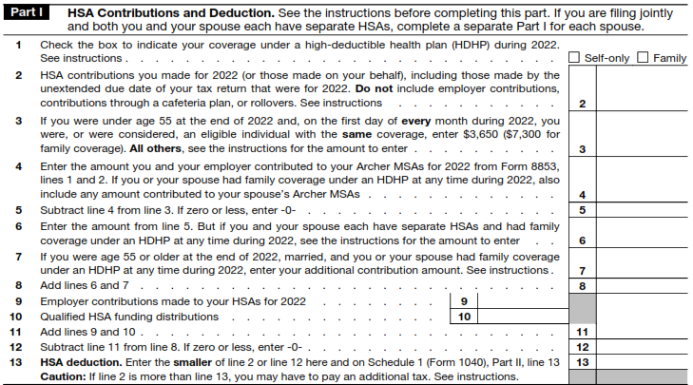
Adv. Scenario 3 Questions
Form 8889

Slide 21
Adv. Scenario 3 Questions
E-7, form 8889
E-7
E-9
Scenario and initial test questions Pub 6744 pg. 70

Slide 22
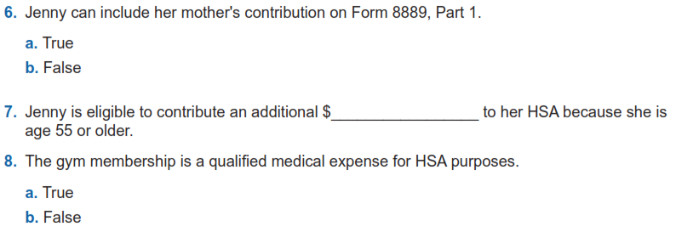
Adv. Scenario 3 Retest Questions
E-7
$1,000
E-7
E-9
Retest Pub 6744 Pg 105

Slide 23
Scenario 4
Alice Adams

Slide 24
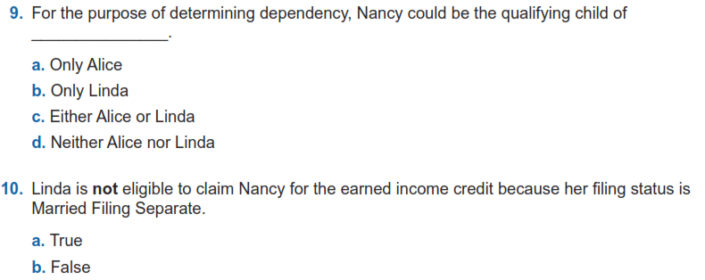
Adv. Scenario 4 Interview Notes
C-1/2 , Example on C-2
Scenario and initial test questions Pub 6744 pg. 71
Check B-10 flow for why she is MFS
I-2/3, Footnote 4 on I-2

Slide 25
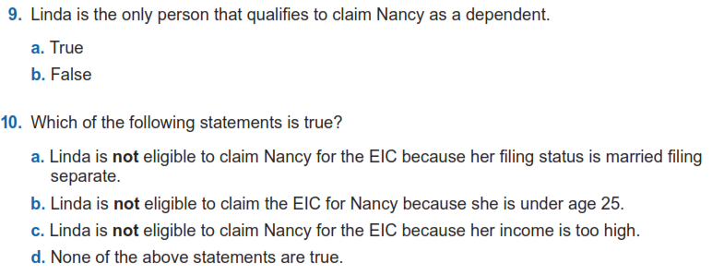
Adv. Scenario 4 Retest Questions
C-1/2 , Example on C-2
Revisit: a) B-10 flow I-2, and I-2 Footnote 4;
b) and c) I-2
Retest Pub 6744 Pg 106

Slide 26
Scenario 5
Ellen Black

Slide 27
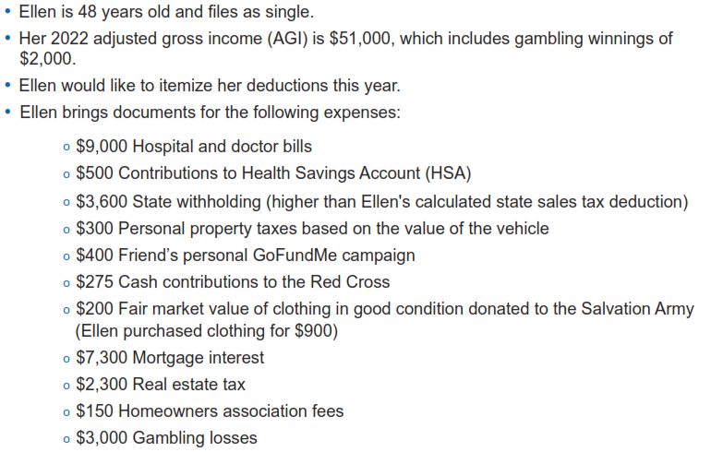
Adv. Scenario 5 Interview Notes
Scenario and initial test questions Pub 6744 pg. 72

Slide 28
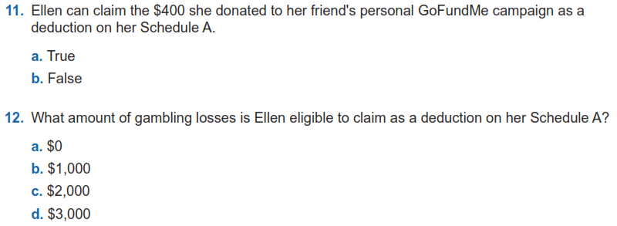
Adv. Scenario 5 Questions
F-4, question 14
F-12

Slide 29
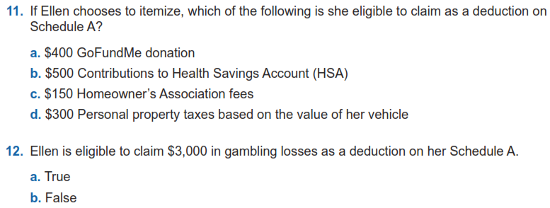
Adv. Scenario 5 Retest Questions
F-4, question 14
Top of E-6, Form 8889
F-11
F-8
F-12
Retest Pub 6744 Pg 107

Slide 30
Scenario 6
John Ward

Slide 31
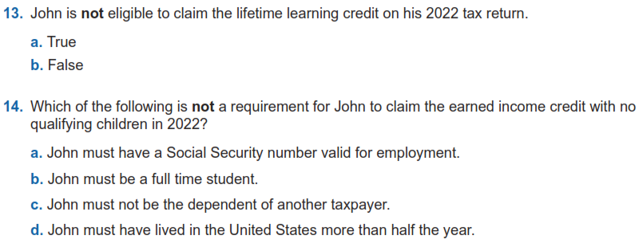
Adv. Scenario 6 Interview Notes
J-5
I-2, I-5
Scenario and initial test questions Pub 6744 pg. 73

Slide 32
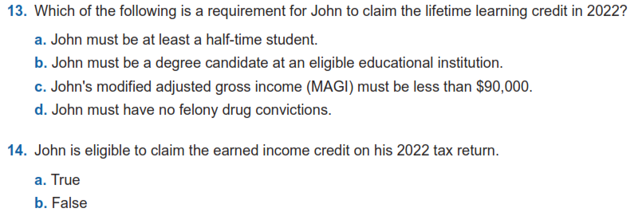
Adv. Scenario 6 Retest Questions
J-5
I-2, I-5
Retest Pub 6744 Pg 107

Slide 33
Out of Scope

Slide 34
What is Out of Scope?
This means we as a VITA program cannot complete the return
Scope refers to VITA eligible tax law topics applied to a volunteer prepared return, does not refer to income levels
There are suggested income guidelines which we will discuss in January
Even if you have the knowledge about how to complete an out-of-scope return, you should not do it
IRS liability protection does not extend to out-of-scope returns
Pages 6-20 in Publication 4012 is our guide

Slide 35
Volunteer Protection Act
Public Law 105-19, Volunteer Protection Act of 1997 (VPA)
Protects volunteers from liability for negligent acts they perform within scope of their responsibilities in the organization for whom they volunteer
Law not written for IRS but for the public
IRS coverage extends to volunteers as long as returns are prepared in scope

Slide 36
Out of Scope Main Points
Rental income
Income for a Minister
Farm Income
Digital Currency
Self-employment income if any of the following apply:
Over $25,000 of expenses
Inventory
Depreciation
Business use of home
Business Loss is reported

Slide 37
Out of Scope Main Points (cont)
Non-cash charitable contributions greater than $500
Taxpayer who is insolvent and filing for bankruptcy
Active Military pay
Distribution from various accounts that indicate the following in Box 7 of 1099-R
5, 6, 8, 9, A, E, J, K, N, P, R, T, U, W
We will cover this in more detail in January

Slide 38
Next Steps

Slide 39
Practice Lab
Practice Lab is the place to try out the system regardless of how much training you attend
You will need the Practice Lab for Scenarios 7-9
Taxslayer appears to be updated to be acceptable for Certification
Very important to practice using the system on your own before trying to complete a live return starting in February
Resource references for Scenarios 7-9 will be sent out

Slide 40
Login links
Taxslayer “Springboard” – access to Practice Lab and eventually live Taxslayer
Search on: Taxslayer Springboard
https://vita.taxslayerpro.com/
IRS Link-and-Learn for certification
Search on: Link and Learn Home
https://www.linklearncertification.com/d/

Slide 41
Taking the Test When We’re Done
If you run into problems accessing the Practice Lab or Certification Site, let us know
Make sure to complete:
Volunteer Standards of Conduct
Intake/Interview and Quality Review
Advanced Certification (after we complete the training)
Once all three tests are completed and passed, print off and sign Form 13615
You MUST use the form generated by the software
Return Form 13615 to Meredith either in person or via email meredith.hershner@uweci.org
Certification target date is January 6th, 2023

Slide 42
Training Timetable for New Volunteers
Sessions 1 and 2 of Certification Training (in person)
December 10th at United Way (Sat 9 AM – 3:30 PM)
ZOOM Session 3 of Certification Training (Scenarios 7-9)
December 12th (Mon 5:30 – 8:30)
Session 3 of Certification Training (in person)
December 17th at United Way (Sat 9 AM – Noon)
Home-Brew scenarios and detail process discussions (ZOOM – Saturdays – all volunteers)
January 7th
January 14th
January 28th
If you miss one of the sessions, returning Volunteer training is on Thurs evenings Dec 8 and 15

Slide 43
Other Updates (Meredith)
Site Locations and Schedules
Signing up
Shirts
Other Updates

Slide 44
Questions?
Thank you! See you next Saturday or Monday

