Slide 1
Tax Preparer Training – Session 3
Tax Year 2022 Dec. 12,15,and 17, 2022

Slide 2
Again, We’re Glad You’re Here
We hope things are making sense as we outline the program and go through the certification process
Any issues, let us know and we will do our best to address them

Slide 3
Agenda
Tax Training Reminder
Available Resources for Tax Returns
Certification Scenarios 7-9
Next Steps
(we’ll take one 15 minute break somewhere if needed)

Slide 4
Tax Training Reminder

Slide 5
Training Timetable
Session 3 Certification Training (Scenarios 7-9)
Oriented to New Volunteers
ZOOM - December 12th (Mon, 5:30-8:30)
In Person - December 17th at United Way (Sat, 9 – Noon)
Oriented to Returning Volunteers
ZOOM - December 15th (Thurs, 5:30-8:30)
Additional scenarios and detail process discussions (ZOOM – Saturdays – for all volunteers)
January 7th
January 14th
January 28th

Slide 6
Volunteer Testing For TY 2022
IRS site: https://www.linklearncertification.com/d/
Create or confirm your account as a tax volunteer for VITA
Contact Meredith or me if you have issues
Tests – all certification tests have “Pass” threshold of 80%
For Tax Preparers
Volunteer Standards of Conduct
Intake/Interview and Quality Review
Advanced Certification
For Site Coordinators
Volunteer Standards of Conduct
Intake/Interview and Quality Review
Advanced Certification
Site Coordinator Test

Slide 7
Available Tax Resources

Slide 8
Key Resources for doing Taxes
Pub 4012 – VITA/TCE Volunteer Resource Guide
https://www.irs.gov/pub/irs-pdf/p4012.pdf
Pub 4491 – VITA/TCE Training Guide
https://www.irs.gov/pub/irs-pdf/p4491.pdf
Pub 17 – Your Federal Income Tax – Tax Guide
Additional coverage of tax law and how to prepare taxes
https://www.irs.gov/pub/irs-pdf/p17.pdf

Slide 9
About those Resources
Pub 4012 will be your primary resource
It is grouped by sections, and the index does a reasonable job of providing a more detailed search
It illustrates the most common entries for Taxslayer
It has the definitive list of what is in or out of scope
Pub 4491 is big, and is only on-line
Provides examples and more in-depth discussion of topics
Lists the relevant changes for forms and tax laws for TY 2022
Pub 17 is NOT tied to VITA or Taxslayer
It’s the IRS general taxpayer guide for most topics related to Form 1040 and the associated schedules
The language is more bureaucratic, but can provide specifics if you are still unsure after looking at Pub 4012 and 4491

Slide 10
Tax Certification Tests

Slide 11
Scenario 7
Robert and Emily Lincoln

Slide 12
Adv. Scenario 7 Interview Notes
Scenario and initial test questions Form 6744 pg. 74

Slide 13
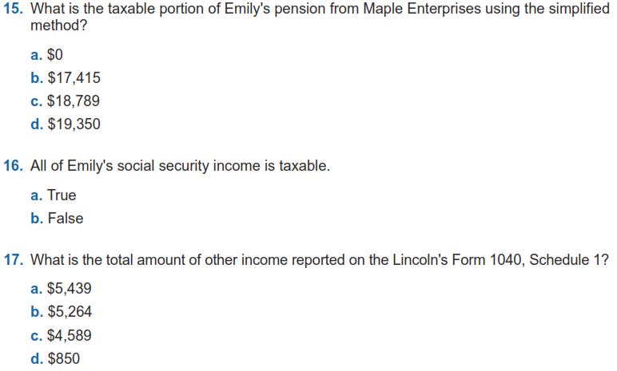
Adv. Scenario 7: Questions
D-39/40, Instruction 1 on D-40
D-50, 1040 Ln 6B, Soc Sec Worksheet (end of return)
D-56, topics 1,2,5; also Sched 1 list
Notes:
This article clarifies information provided on page 10 of IRS Publication 5307, Tax Reform Basics for Individuals and Families for the repeal of deduction for alimony payments under the Tax Cuts & Jobs Act of 2017.
Alimony or separation payments paid to a spouse or former spouse under a divorce or separation agreement, such as a divorce decree, a separate maintenance decree, or a written separation agreement, may be alimony for federal tax purposes. Alimony or separation payments are deductible if the taxpayer is the payer spouse. Receiving spouses must include the alimony or separation payments in their income.
Beginning Jan. 1, 2019, alimony or separate maintenance payments are not deductible from the income of the payer spouse, or includable in the income of the receiving spouse, if made under a divorce or separation agreement executed after Dec. 31, 2018.
This also applies to a divorce or separation agreement executed on or before Dec. 31, 2018, and modified after December 31, 2018, as long as the modification:
changes the terms of the alimony or separate maintenance payments; and
states that the alimony or separate maintenance payments are not deductible by the payer spouse or includable in the income of the receiving spouse.
On the other hand, generally alimony or separate maintenance payments are deductible from the income of the payer spouse and includable in the income of the receiving spouse, if made under a divorce or separation agreement executed on or before Dec. 31, 2018, even if the agreement was modified after December 31, 2018, so long as the modification is not one described in the preceding paragraph.

Slide 14
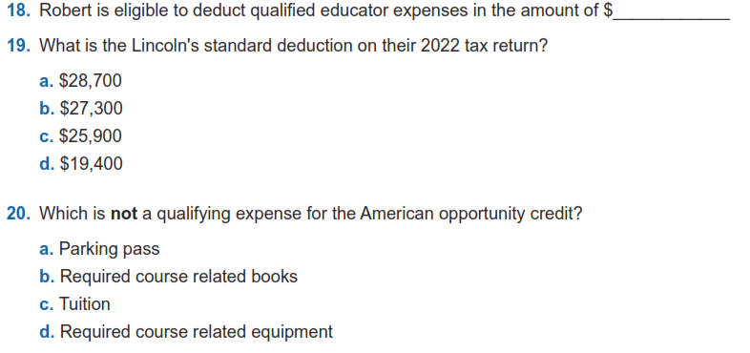
Adv. Scenario 7: Questions (con’t)
300
E-4
F-2 ( NOT F-1)
J-1, 6, 8
Notes:
This article clarifies information provided on page 10 of IRS Publication 5307, Tax Reform Basics for Individuals and Families for the repeal of deduction for alimony payments under the Tax Cuts & Jobs Act of 2017.
Alimony or separation payments paid to a spouse or former spouse under a divorce or separation agreement, such as a divorce decree, a separate maintenance decree, or a written separation agreement, may be alimony for federal tax purposes. Alimony or separation payments are deductible if the taxpayer is the payer spouse. Receiving spouses must include the alimony or separation payments in their income.
Beginning Jan. 1, 2019, alimony or separate maintenance payments are not deductible from the income of the payer spouse, or includable in the income of the receiving spouse, if made under a divorce or separation agreement executed after Dec. 31, 2018.
This also applies to a divorce or separation agreement executed on or before Dec. 31, 2018, and modified after December 31, 2018, as long as the modification:
changes the terms of the alimony or separate maintenance payments; and
states that the alimony or separate maintenance payments are not deductible by the payer spouse or includable in the income of the receiving spouse.
On the other hand, generally alimony or separate maintenance payments are deductible from the income of the payer spouse and includable in the income of the receiving spouse, if made under a divorce or separation agreement executed on or before Dec. 31, 2018, even if the agreement was modified after December 31, 2018, so long as the modification is not one described in the preceding paragraph.

Slide 15
Adv. Scenario 7: Questions (con’t)
G-2
G-5
J-6/7
7,035
W-2, 1099-R, 1099-SSA, 1040 Ln 25D
Notes:
This article clarifies information provided on page 10 of IRS Publication 5307, Tax Reform Basics for Individuals and Families for the repeal of deduction for alimony payments under the Tax Cuts & Jobs Act of 2017.
Alimony or separation payments paid to a spouse or former spouse under a divorce or separation agreement, such as a divorce decree, a separate maintenance decree, or a written separation agreement, may be alimony for federal tax purposes. Alimony or separation payments are deductible if the taxpayer is the payer spouse. Receiving spouses must include the alimony or separation payments in their income.
Beginning Jan. 1, 2019, alimony or separate maintenance payments are not deductible from the income of the payer spouse, or includable in the income of the receiving spouse, if made under a divorce or separation agreement executed after Dec. 31, 2018.
This also applies to a divorce or separation agreement executed on or before Dec. 31, 2018, and modified after December 31, 2018, as long as the modification:
changes the terms of the alimony or separate maintenance payments; and
states that the alimony or separate maintenance payments are not deductible by the payer spouse or includable in the income of the receiving spouse.
On the other hand, generally alimony or separate maintenance payments are deductible from the income of the payer spouse and includable in the income of the receiving spouse, if made under a divorce or separation agreement executed on or before Dec. 31, 2018, even if the agreement was modified after December 31, 2018, so long as the modification is not one described in the preceding paragraph.

Slide 16
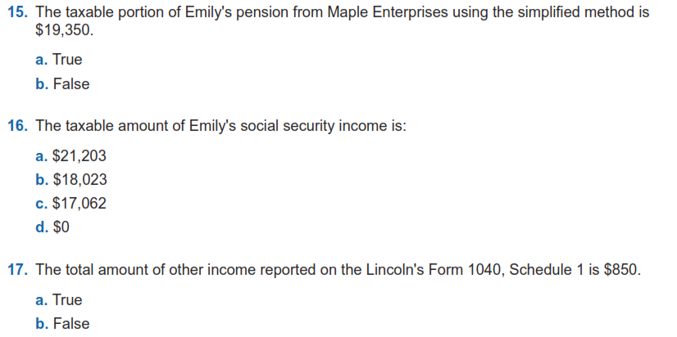
Adv. Scenario 7: Retest Questions
D-39/40
D-50, 1040 Ln 6B, Soc Sec Worksheet (end of return)
D-56, topics 1,2,5; also Sched 1 list
Retest Form 6744 Pg 109
Notes:
This article clarifies information provided on page 10 of IRS Publication 5307, Tax Reform Basics for Individuals and Families for the repeal of deduction for alimony payments under the Tax Cuts & Jobs Act of 2017.
Alimony or separation payments paid to a spouse or former spouse under a divorce or separation agreement, such as a divorce decree, a separate maintenance decree, or a written separation agreement, may be alimony for federal tax purposes. Alimony or separation payments are deductible if the taxpayer is the payer spouse. Receiving spouses must include the alimony or separation payments in their income.
Beginning Jan. 1, 2019, alimony or separate maintenance payments are not deductible from the income of the payer spouse, or includable in the income of the receiving spouse, if made under a divorce or separation agreement executed after Dec. 31, 2018.
This also applies to a divorce or separation agreement executed on or before Dec. 31, 2018, and modified after December 31, 2018, as long as the modification:
changes the terms of the alimony or separate maintenance payments; and
states that the alimony or separate maintenance payments are not deductible by the payer spouse or includable in the income of the receiving spouse.
On the other hand, generally alimony or separate maintenance payments are deductible from the income of the payer spouse and includable in the income of the receiving spouse, if made under a divorce or separation agreement executed on or before Dec. 31, 2018, even if the agreement was modified after December 31, 2018, so long as the modification is not one described in the preceding paragraph.

Slide 17
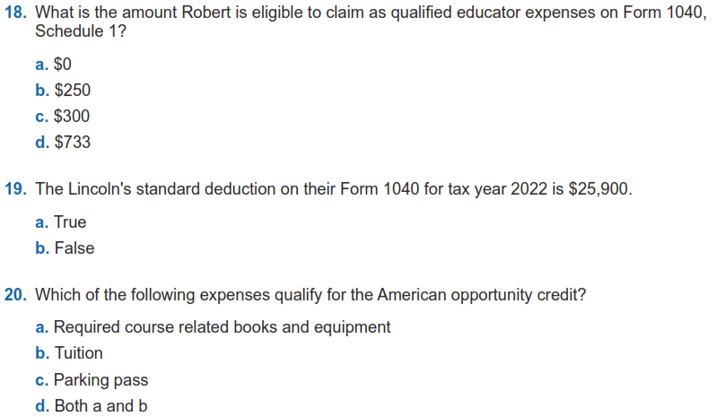
Adv. Scenario 7: Retest Questions (con’t)
E-4
F-2 ( NOT F-1)
J-1, 6, 8
Notes:
This article clarifies information provided on page 10 of IRS Publication 5307, Tax Reform Basics for Individuals and Families for the repeal of deduction for alimony payments under the Tax Cuts & Jobs Act of 2017.
Alimony or separation payments paid to a spouse or former spouse under a divorce or separation agreement, such as a divorce decree, a separate maintenance decree, or a written separation agreement, may be alimony for federal tax purposes. Alimony or separation payments are deductible if the taxpayer is the payer spouse. Receiving spouses must include the alimony or separation payments in their income.
Beginning Jan. 1, 2019, alimony or separate maintenance payments are not deductible from the income of the payer spouse, or includable in the income of the receiving spouse, if made under a divorce or separation agreement executed after Dec. 31, 2018.
This also applies to a divorce or separation agreement executed on or before Dec. 31, 2018, and modified after December 31, 2018, as long as the modification:
changes the terms of the alimony or separate maintenance payments; and
states that the alimony or separate maintenance payments are not deductible by the payer spouse or includable in the income of the receiving spouse.
On the other hand, generally alimony or separate maintenance payments are deductible from the income of the payer spouse and includable in the income of the receiving spouse, if made under a divorce or separation agreement executed on or before Dec. 31, 2018, even if the agreement was modified after December 31, 2018, so long as the modification is not one described in the preceding paragraph.

Slide 18
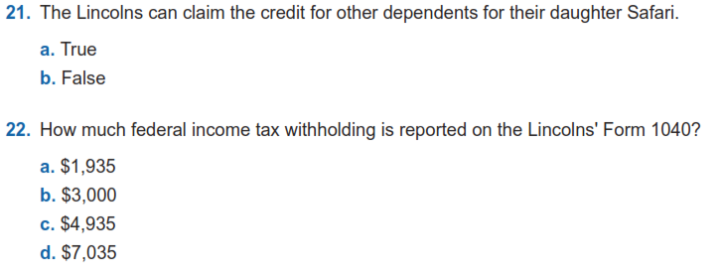
Adv. Scenario 7: Retest Questions (con’t)
G-5
W-2, 1099-R, 1099-SSA, 1040 Ln 25D
Notes:
This article clarifies information provided on page 10 of IRS Publication 5307, Tax Reform Basics for Individuals and Families for the repeal of deduction for alimony payments under the Tax Cuts & Jobs Act of 2017.
Alimony or separation payments paid to a spouse or former spouse under a divorce or separation agreement, such as a divorce decree, a separate maintenance decree, or a written separation agreement, may be alimony for federal tax purposes. Alimony or separation payments are deductible if the taxpayer is the payer spouse. Receiving spouses must include the alimony or separation payments in their income.
Beginning Jan. 1, 2019, alimony or separate maintenance payments are not deductible from the income of the payer spouse, or includable in the income of the receiving spouse, if made under a divorce or separation agreement executed after Dec. 31, 2018.
This also applies to a divorce or separation agreement executed on or before Dec. 31, 2018, and modified after December 31, 2018, as long as the modification:
changes the terms of the alimony or separate maintenance payments; and
states that the alimony or separate maintenance payments are not deductible by the payer spouse or includable in the income of the receiving spouse.
On the other hand, generally alimony or separate maintenance payments are deductible from the income of the payer spouse and includable in the income of the receiving spouse, if made under a divorce or separation agreement executed on or before Dec. 31, 2018, even if the agreement was modified after December 31, 2018, so long as the modification is not one described in the preceding paragraph.

Slide 19
Adv. Scenario 7 Questions
Test
Question 15
Question 16
Question 17
Question 18
Question 19
Question 20
Question 21
Question 22
Retest
Question 15
Question 16
Question 17
Question 18
Question 19
Question 20
Question 21
Question 22
C
B
B
B
A
B
$300
C
B
B
A
D
D
A
$7,035
D

Slide 20
Scenario 8
Joanne Oak

Slide 21
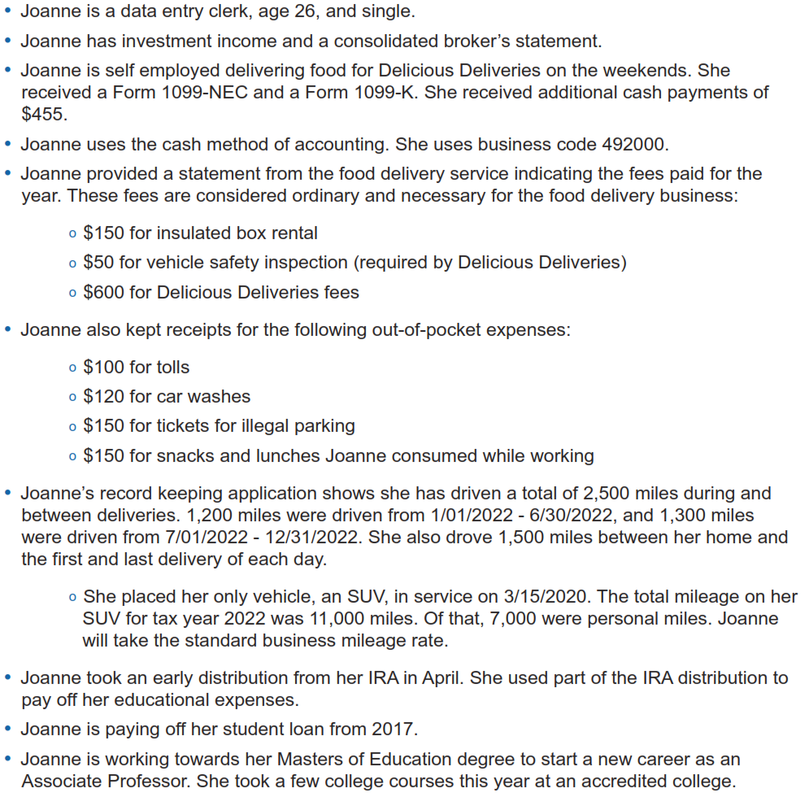
Adv. Scenario 8 Interview Notes
Scenario and initial test questions
Form 6744 pg. 94

Slide 22
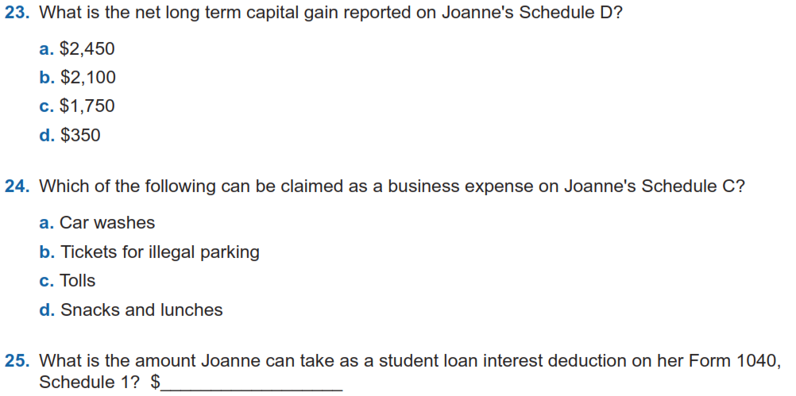
Adv. Scenario 8 Questions
D-26-29, Sched D
D-23/24
2,500
E-11

Slide 23
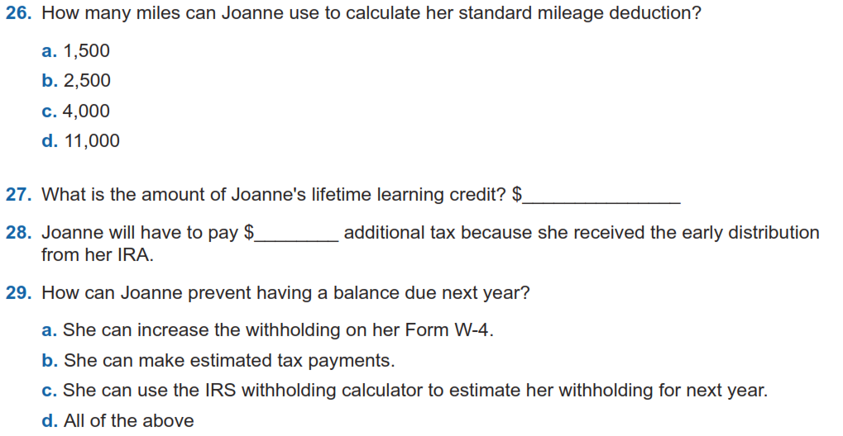
Adv. Scenario 8 Questions (con’t)
D-25
J-5/6 , Form 8863, Sched 3 Prt 1 Ln 3
480
10
H-4, Form 5329, Sched 2 Prt 2 Ln 8
K-21

Slide 24
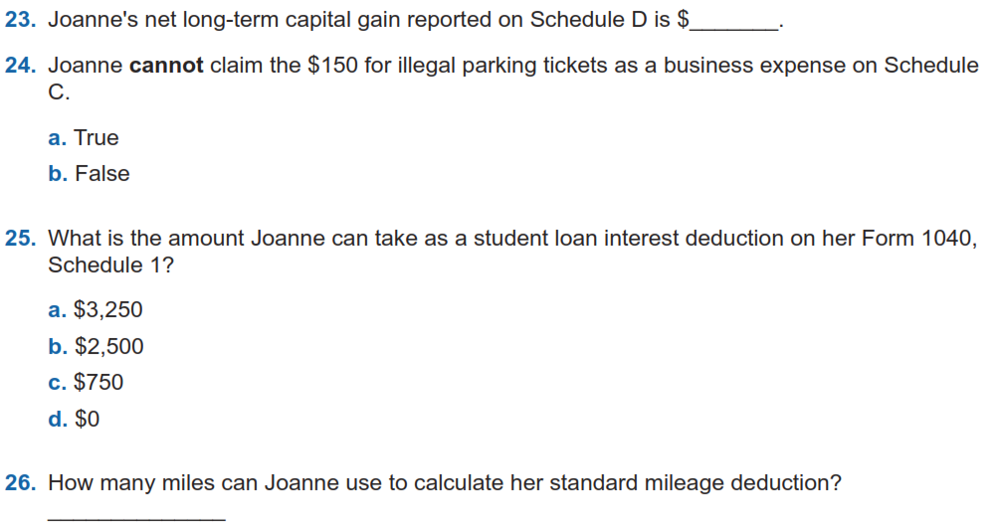
Adv. Scenario 8: Retest Questions
2,450
D-26/29 Sched D
D-24
E-11
2,500
D-25
Retest Form 6744 Pg 111
Notes:
This article clarifies information provided on page 10 of IRS Publication 5307, Tax Reform Basics for Individuals and Families for the repeal of deduction for alimony payments under the Tax Cuts & Jobs Act of 2017.
Alimony or separation payments paid to a spouse or former spouse under a divorce or separation agreement, such as a divorce decree, a separate maintenance decree, or a written separation agreement, may be alimony for federal tax purposes. Alimony or separation payments are deductible if the taxpayer is the payer spouse. Receiving spouses must include the alimony or separation payments in their income.
Beginning Jan. 1, 2019, alimony or separate maintenance payments are not deductible from the income of the payer spouse, or includable in the income of the receiving spouse, if made under a divorce or separation agreement executed after Dec. 31, 2018.
This also applies to a divorce or separation agreement executed on or before Dec. 31, 2018, and modified after December 31, 2018, as long as the modification:
changes the terms of the alimony or separate maintenance payments; and
states that the alimony or separate maintenance payments are not deductible by the payer spouse or includable in the income of the receiving spouse.
On the other hand, generally alimony or separate maintenance payments are deductible from the income of the payer spouse and includable in the income of the receiving spouse, if made under a divorce or separation agreement executed on or before Dec. 31, 2018, even if the agreement was modified after December 31, 2018, so long as the modification is not one described in the preceding paragraph.

Slide 25
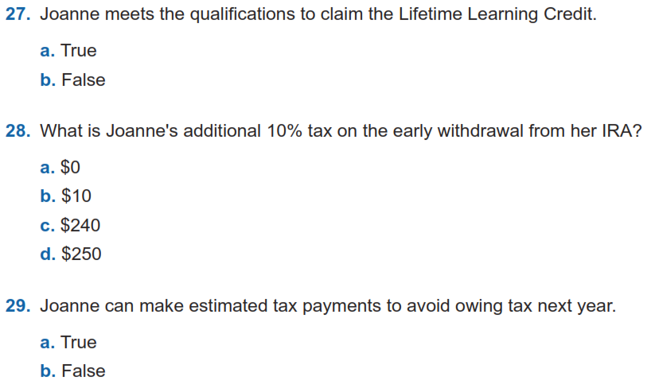
Adv. Scenario 8: Retest Questions (con’t)
J-5/6
H-4, Form 5329, Sched 2 Prt 2 Ln 8
K-21
Notes:
This article clarifies information provided on page 10 of IRS Publication 5307, Tax Reform Basics for Individuals and Families for the repeal of deduction for alimony payments under the Tax Cuts & Jobs Act of 2017.
Alimony or separation payments paid to a spouse or former spouse under a divorce or separation agreement, such as a divorce decree, a separate maintenance decree, or a written separation agreement, may be alimony for federal tax purposes. Alimony or separation payments are deductible if the taxpayer is the payer spouse. Receiving spouses must include the alimony or separation payments in their income.
Beginning Jan. 1, 2019, alimony or separate maintenance payments are not deductible from the income of the payer spouse, or includable in the income of the receiving spouse, if made under a divorce or separation agreement executed after Dec. 31, 2018.
This also applies to a divorce or separation agreement executed on or before Dec. 31, 2018, and modified after December 31, 2018, as long as the modification:
changes the terms of the alimony or separate maintenance payments; and
states that the alimony or separate maintenance payments are not deductible by the payer spouse or includable in the income of the receiving spouse.
On the other hand, generally alimony or separate maintenance payments are deductible from the income of the payer spouse and includable in the income of the receiving spouse, if made under a divorce or separation agreement executed on or before Dec. 31, 2018, even if the agreement was modified after December 31, 2018, so long as the modification is not one described in the preceding paragraph.

Slide 26
Adv. Scenario 8 Questions
Test
Question 23
Question 24
Question 25
Question 26
Question 27
Question 28
Question 29
Retest
Question 23
Question 24
Question 25
Question 26
Question 27
Question 28
Question 29
A
$2,450
C
A
$2,500
B
B
2,500
$480
A
$10
B
D
A

Slide 27
Scenario 9
Thomas Polk

Slide 28
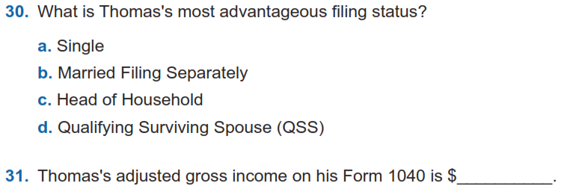
Adv. Scenario 9 Interview Notes
B-10
Form 1040, Line 11
41,104
Scenario and initial test questions Form 6744 pg. 95

Slide 29
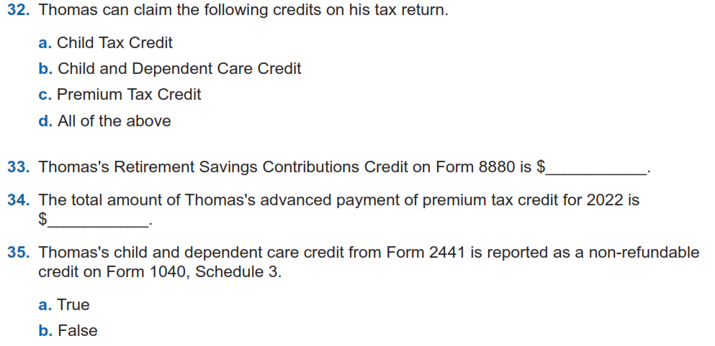
Adv. Scenario 9 Questions (con’t)
G-2
G-10
H-8, Sched 3 Prt 2 Ln 9
G-14/15, Form 8880, Sched 3 Prt 1 Ln 4
100
4,656
Form 8962, 1095-A
Ln 2

Slide 30
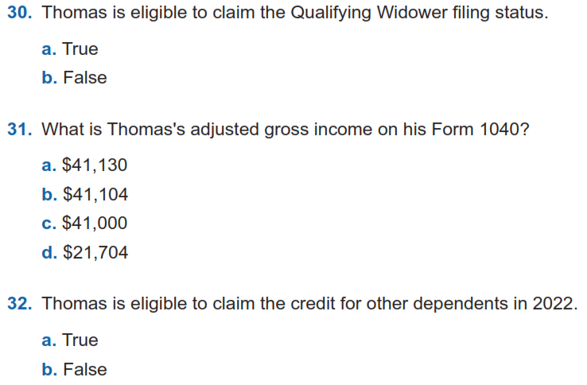
Adv. Scenario 9 Retest Questions
B-10
Form 1040, Line 11
G-4
Retest Form 6744 Pg 112

Slide 31
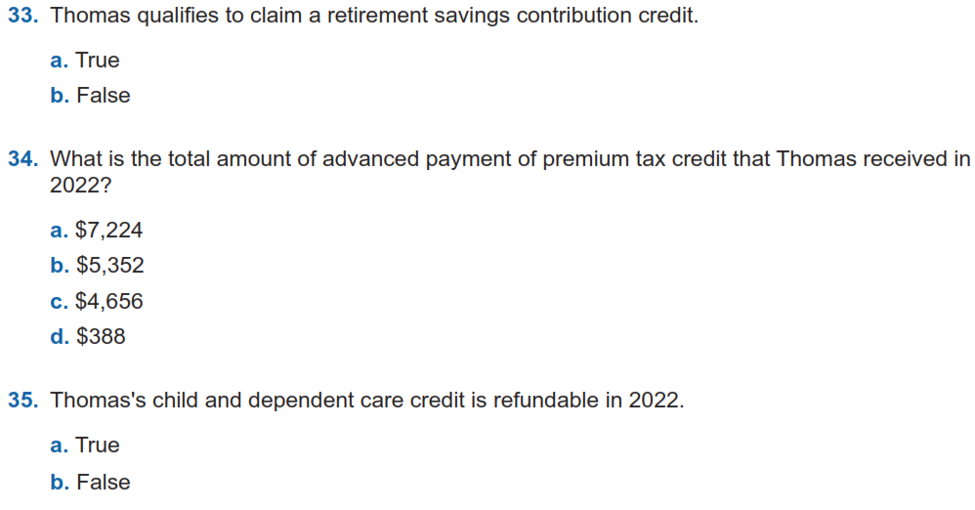
Adv. Scenario 9 Retest Questions (con’t)
G-14/15
Form 8962, 1095-A
Form 2441, Sched 3 Prt 1 Ln 2
Retest Form 6744 Pg 112

Slide 32
Adv. Scenario 9 Questions
Test
Question 30
Question 31
Question 32
Question 33
Question 34
Question 35
Retest
Question 30
Question 31
Question 32
Question 33
Question 34
Question 35
C
B
$41,104
B
D
B
$100
A
$4,656
C
A
B

Slide 33
Concerns with Scenarios?
Are there any of the scenarios you want to revisit?

Slide 34
Next Steps

Slide 35
Practice Lab
Practice Lab is the place to try out the system regardless of how much training you attend
Very important to practice using the system on your own before trying to complete a live return starting in February

Slide 36
Login links
Taxslayer “Springboard” – access to Practice Lab and eventually live Taxslayer
Search on: Taxslayer Springboard
https://vita.taxslayerpro.com/
IRS Link-and-Learn for certification
Search on: Link and Learn Home
https://www.linklearncertification.com/d/

Slide 37
Taking the Test When We’re Done
If you run into problems accessing the Practice Lab or Certification Site, let us know
Make sure to complete:
Volunteer Standards of Conduct
Intake/Interview and Quality Review
Advanced Certification
Starting next week, I will send out the answer key on request
Once all three tests are completed and passed, print off and sign Form 13615
This form MUST come from the Certification program
Return Form 13615 to Meredith either in person or via email meredith.hershner@uweci.org
Certification target date is January 6th, 2023

Slide 38
Other Updates (Meredith)
Site Locations and Schedules
Signing up
Shirts
Other Updates

Slide 39
Questions?
Thank you! See you in January!

Slide 40
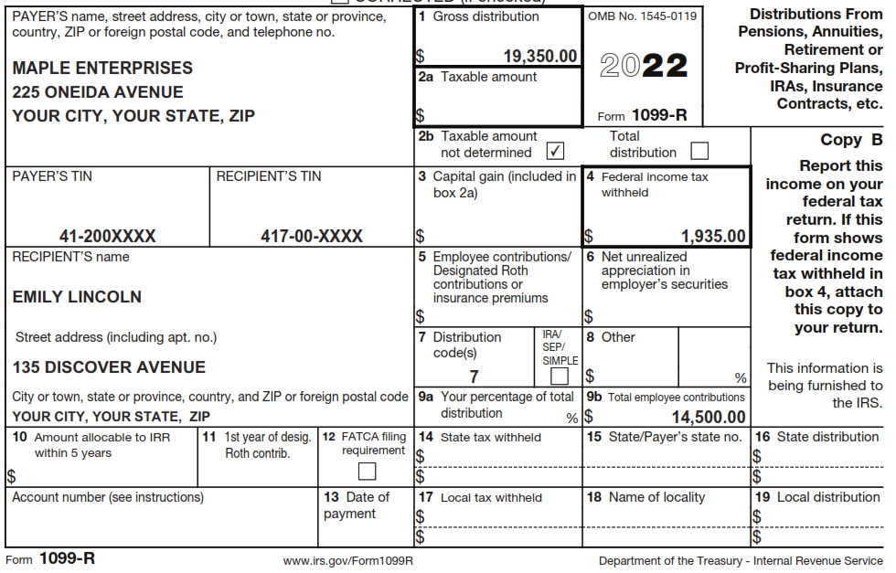
Taxable portion of pension
Plan Cost

Slide 41
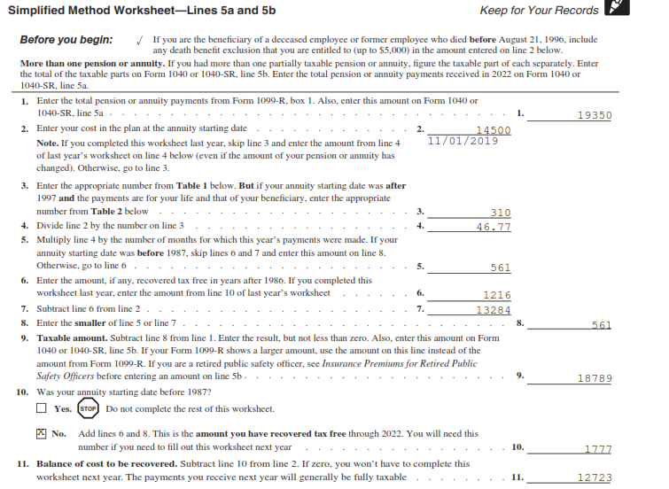
Pension data for next year
This year’s input
Next year’s input

Slide 42
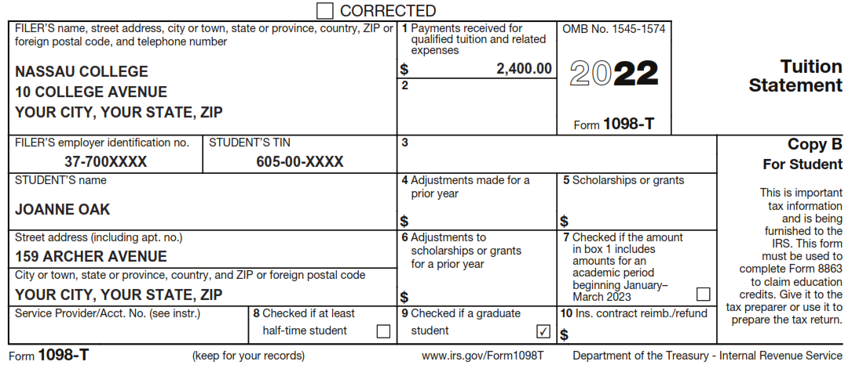
Student Credits
Billed but not paid

Slide 43
Summing up Capital Gains

