Slide 1
Tax Preparer Training – Session 1
Tax Year 2022 Dec. 5, 2022

Slide 2
Introductions

Slide 3
Welcome to VITA
We’re glad you’re willing to help us provide a truly valuable service to the community
We serve clients with a wide variety of backgrounds and situations
Initially, there is a body of information related to ethics and intake procedures that the IRS requires us to be aware of
We will gladly address any questions or concerns you might have with the ethics and intake requirements as we go

Slide 4
Agenda
Tax Training Summary
Volunteer Standards of Conduct
Intake/Interview and Quality Review
Using Available Resources
Client Process for TY 2022
Next Steps
(we’ll take a 15 minute break somewhere)

Slide 5
Tax Training Summary

Slide 6
Training Timetable for New Volunteers
ZOOM Session 2 of Certification Training (Scenarios 1-6)
December 7th (Wed)
Sessions 1 and 2 of Certification Training (in person)
December 10th at United Way (Sat)
ZOOM Session 3 of Certification Training (Scenarios 7-9)
December 12th (Mon)
Session 3 of Certification Training (in person)
December 17th at United Way (Sat)
If you miss one of the sessions, returning Volunteer training is on Thurs evenings Dec 8 and 15
Additional scenarios and detail process discussions (ZOOM – Saturdays – for all volunteers)
January 7th
January 14th
January 28th

Slide 7
Training Publications
Form 6744 – VITA/TCE Volunteer Assistor’s Test/Retest
https://www.irs.gov/pub/irs-pdf/f6744.pdf
Pub 4961 – Volunteer Standards of Conduct
https://www.irs.gov/pub/irs-pdf/p4961.pdf
Pub 5101 – Intake Interview Quality Review
https://www.irs.gov/pub/irs-pdf/p5101.pdf
Pub 4012 – VITA/TCE Volunteer Resource Guide
https://www.irs.gov/pub/irs-pdf/p4012.pdf
Pub 4491 – VITA/TCE Training Guide
https://www.irs.gov/pub/irs-pdf/p4491.pdf
Pub 17 – Your Federial Income Tax – Tax Guide
Additional coverage of tax law and how to prepare taxes
https://www.irs.gov/pub/irs-pdf/p17.pdf

Slide 8
Standards of Conduct and Intake Certification Training
Review of examples
Review key places to find relevant information
Walk through certification questions
This is not a difficult test, and you will not be provided the answers to these questions
If you take the test the first time and do NOT reach the 80% threshold, note which questions you missed but do NOT take the test the 2nd time until you contact me or Meredith.
We will review what you missed and help you get to the correct answer for the 2nd attempt.

Slide 9
Tax Certification Training
We recommend you go through the scenarios beforehand and choose your answers, but do NOT take the certification test until after the training sessions are done
We will review certification scenarios
Identify key places to find relevant information
Poll participating volunteers for their choice on answers
If needed, clarification/discussion about which answers are correct and why

Slide 10
Requirements
All VITA volunteers preparing and doing Quality Review on client returns must
Pass the Volunteer Standards of Conduct (VSC) certification test with a score of 80% or higher.
Pass the Intake/Interview and Quality Review certification test with a score of 80% or higher
Pass the Advanced Course certification test with a score of 80% or higher
Agree to comply with the VSC by signing and dating Form 13615 prior to working at a site.
Electronically generated by certification process

Slide 11
Volunteer Testing For TY 2022
IRS site: https://www.linklearncertification.com/d/
Create an account as a tax volunteer for VITA
You will not be doing Site Coordinator testing
Contact Meredith or me if you have issues
Tests – all certification tests have “Pass” threshold of 80%
For Tax Preparers
Volunteer Standards of Conduct
Intake/Interview and Quality Review
Advanced Certification
For Site Coordinators
Volunteer Standards of Conduct
Intake/Interview and Quality Review
Advanced Certification
Site Coordinator Test

Slide 12
Certification Tests

Slide 13
Volunteer Standards of Conduct
Ethics Training for Volunteers

Slide 14
Volunteer Standards of Conduct
Key points are highlighted in this PowerPoint but for the complete set of information, refer to IRS Publication 4961 which can be found at:
https://www.irs.gov/pub/irs-pdf/p4961.pdf
Read the publication online or download your own copy. The test and retest questions are listed at the end of Pub 4961 as well as Form 6744

Slide 15
Volunteer Standards of Conduct (VSC)
Follow Quality Site Requirements
Do not accept payment, solicit donations, or accept refund payments
Do not solicit business from taxpayers or use knowledge gained to benefit yourself or for personal use
Do not knowingly prepare false returns
Do not engage in activity deemed to have a negative effect on the VITA program
Treat all taxpayers in a professional, courteous, and respectful manner

Slide 16
Failure to Follow the VSC may mean (in increasing severity):
Your removal from VITA program
You are added to IRS Registry barring you from any future VITA participation
Deactivation of that site’s VITA IRS qualification.
Termination of the full United Way VITA program
Referral for possible criminal investigation

Slide 17
VSC Quality Site Requirements
Proper certification
Can be certified to Basic, Advanced, and Military
A return must be assigned to someone certified to for all aspects of the return
United Way VITA has all volunteers get Advanced Certification
For the UW VITA program, anything requiring Military certification is out of scope
Have a defined Intake and Quality Review Process
This includes making sure the taxpayer understands the process
Completing intake form 13614-C and answering questions
Participate in a Quality Review of the completed return

Slide 18
VSC Quality Site Requirements
Volunteers confirm Taxpayer Identity and other key information
Gov’t issued photo identification required for filing taxpayers
SSN or ITIN for everyone listed on the return
Reference materials available (Pub 4012, etc)
Volunteer Agreement form 13615 complete
Timely Filing of Returns
Civil Rights information (posters at sites)
Proper IRS site identification
Proper security for confidentiality

Slide 19
Example 1
You finish a time-consuming return, and the client is very grateful. On her way out, the client stops by and tries to sneak a $20 bill in your pocket, saying, “It would have cost me ten times that with a paid preparer.” Return the money and explain that you cannot accept money for doing taxes, but United Way or a sponsoring charity may appreciate a donation which can be made at the main office or via their website.
Key point: You cannot accept payment from taxpayers.

Slide 20
Examples 2a and 2b
Your primary business includes selling health insurance policies. During the interview, you find out the taxpayer lost access to health insurance in January of the current year. You cannot offer to sell the taxpayer health insurance through your business.
Your daughter asks you to take orders at the VITA site for her school fundraiser
Key point: Even though you may be trying to help, soliciting business from the taxpayer is not allowed.

Slide 21
Example 3
A volunteer preparer told the taxpayer that cash income does not need to be reported. The return was completed without the cash income. The quality reviewer simply missed this omission, and the return was printed, signed, and e-filed. The volunteer preparer has violated this standard.
Key point: Since the quality reviewer did not knowingly allow this return to be e-filed incorrectly, the quality reviewer did not violate this standard. We should not confuse an unethical action with a lack of knowl­edge or a simple mistake.

Slide 22
Resolving Problems
The site coordinator is the first point of contact for resolving any problems.
If a volunteer feels an ethical issue can’t be handled by the site coordinator, email IRS at WI.VolTax@irs.gov and/or contact the local IRS-SPEC Relationship Manager.
Failure to Comply with the Standards of Conduct
If a violation is discovered, appropriate action will be taken, up to removal and barring the volunteer from the VITA program, closing of the site, and discontinuing IRS support to the sponsoring partner.

Slide 23
Volunteer Standards of Conduct Questions
Ethics Training for Volunteers

Slide 24
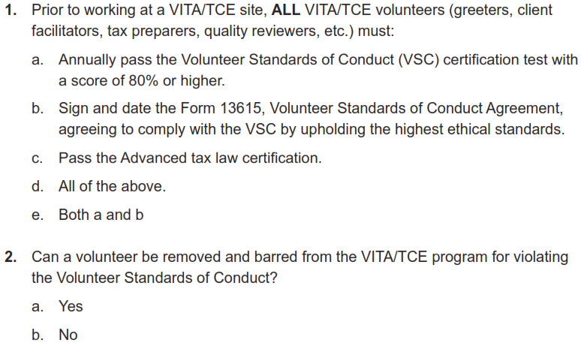
Volunteer Standards of Conduct
The test begins on page 10 in Pub 6744.

Slide 25
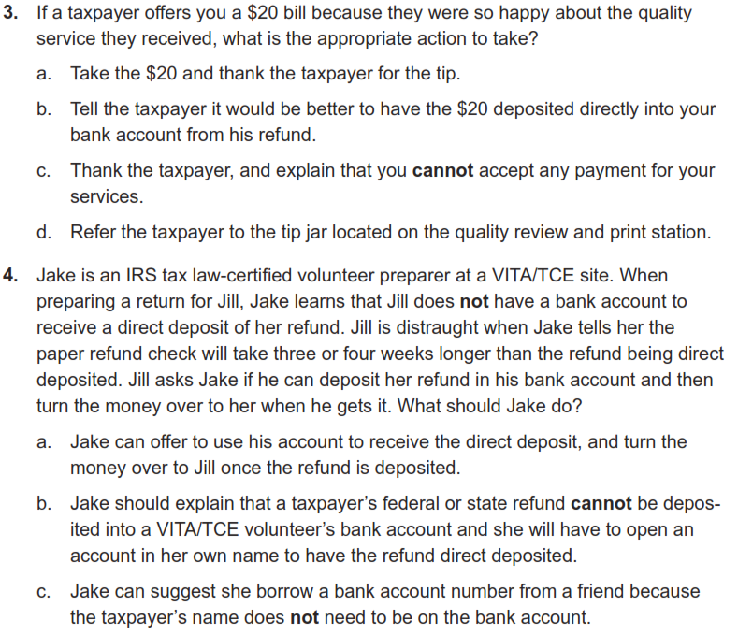
Volunteer Standards of Conduct

Slide 26
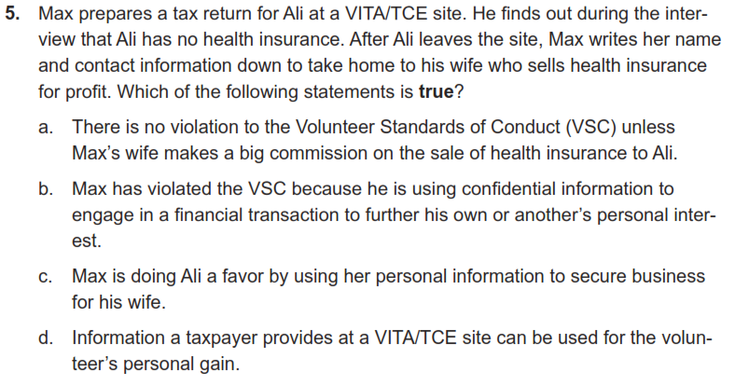
Volunteer Standards of Conduct

Slide 27
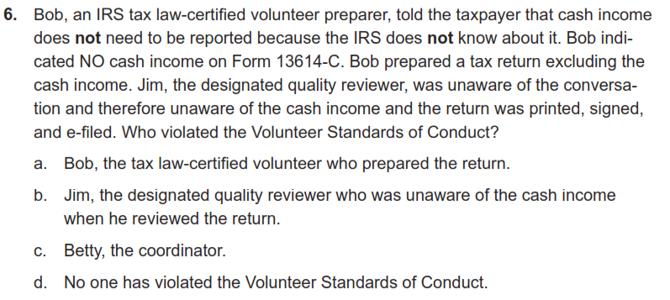
Volunteer Standards of Conduct

Slide 28
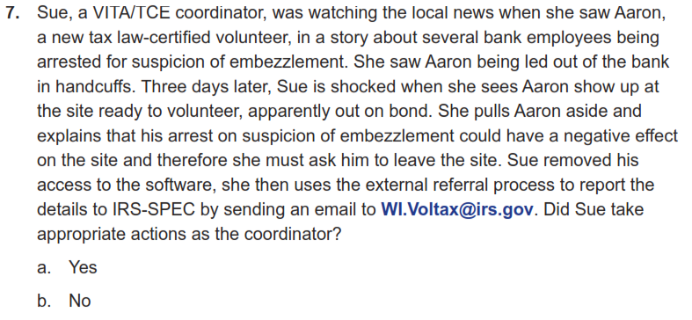
Volunteer Standards of Conduct

Slide 29
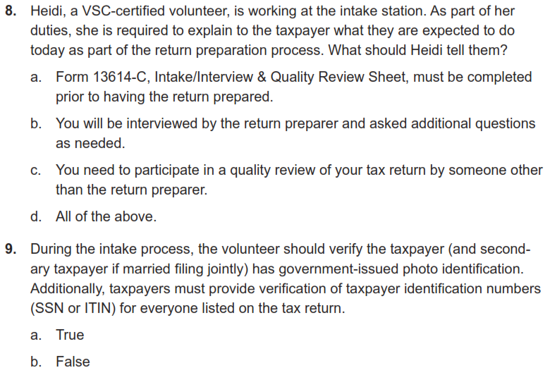
Volunteer Standards of Conduct

Slide 30
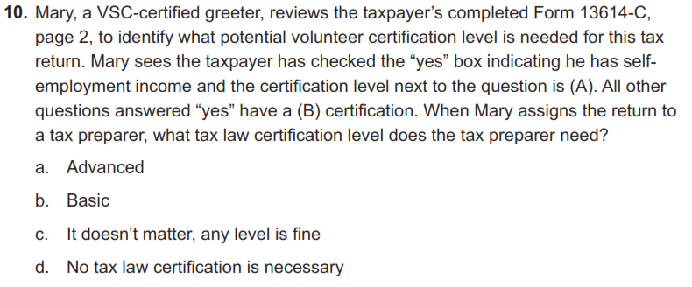
Volunteer Standards of Conduct

Slide 31
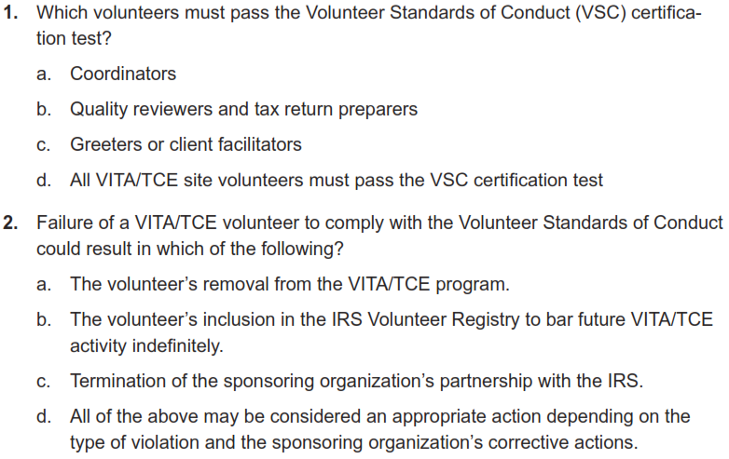
Volunteer Standards of Conduct
Retest begins on page 15 in Pub 6744.

Slide 32
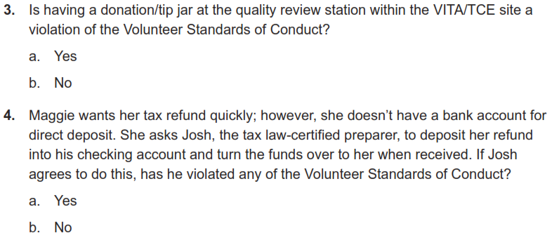
Volunteer Standards of Conduct
Retest

Slide 33
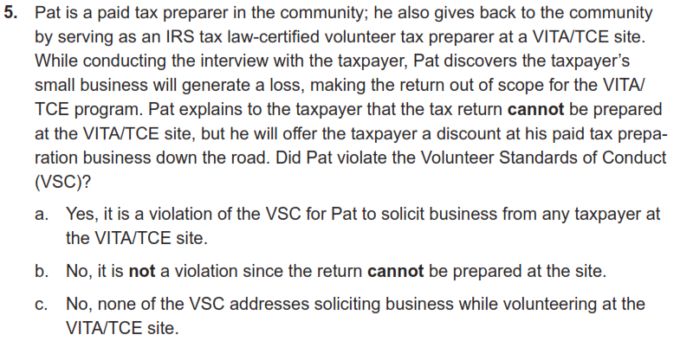
Volunteer Standards of Conduct
Retest

Slide 34
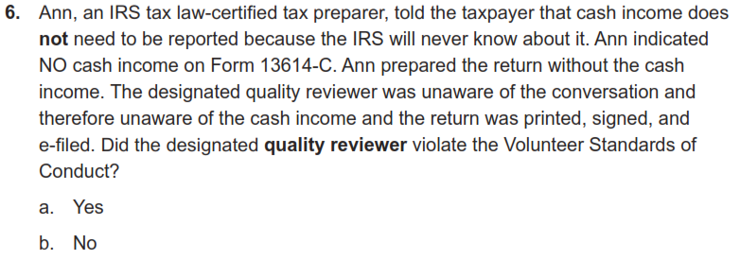
Volunteer Standards of Conduct
Retest

Slide 35
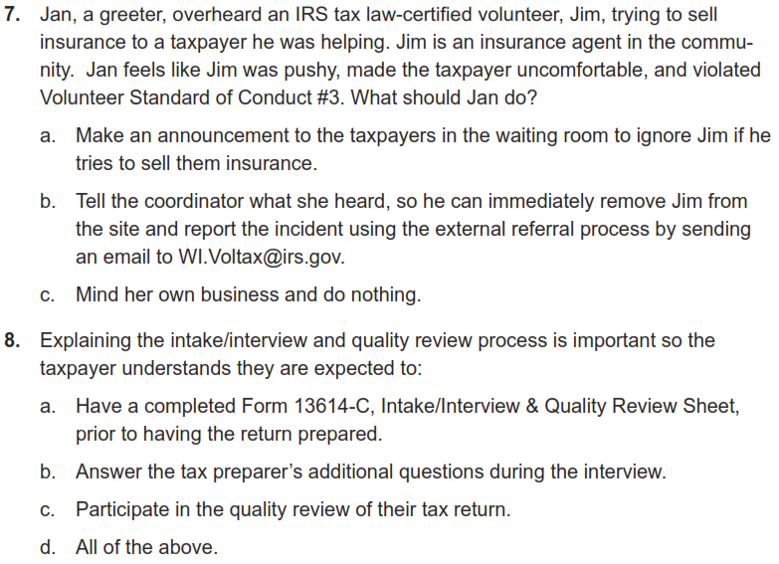
Volunteer Standards of Conduct
Retest

Slide 36
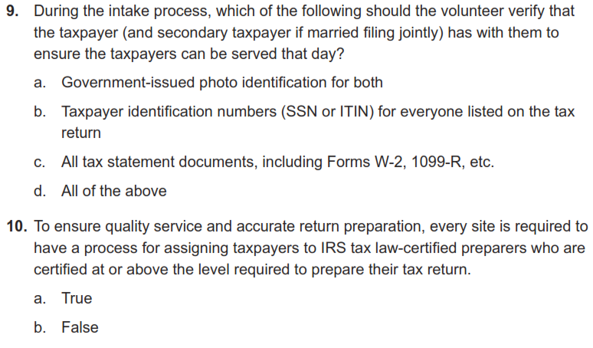
Volunteer Standards of Conduct
Retest

Slide 37
Intake/Interview and Quality Review
(We will go over our actual process in much more detail during the January training)

Slide 38
Rationale
Preparing an accurate return begins with explaining the tax preparation process, completing all questions on form 13614-C, listening to the taxpayer, and asking the right questions
Form 13614-C, Intake/Interview & Quality Review Sheet, is a tool designed to help ensure taxpayers are given the opportunity to provide all needed information before their tax return is prepared
When used properly, this form effectively contributes to accurate tax return preparation

Slide 39
Purpose of Intake Training
The IRS believes there is a definite correlation between proper use of Intake/Interview and Quality Review Process and preparation of an accurate tax return
IRS oversight reviews indicate consistent use of complete intake, interview, and quality review processes results in more accurate returns
Per Quality Site Requirement #2, it is mandatory that Form 13614-C completed for each tax return
Volunteers who refuse to prepare returns without following the Intake/Interview process are in violation of the Volunteer Standards of Conduct

Slide 40
Completing Form 13614-C
Taxpayer completes pages 1 through 3 of the Form 13614-C before meeting with a tax preparer
Page 4 is also completed, but it is a separate form 15080
Form 15080 is the taxpayer consent (Global Carry Forward) to keep their core data available to other VITA sites and for next year
Volunteers may help complete the form with the taxpayer if assistance is required
Tax preparer also interviews the taxpayer using the information provided on Form 13614-C
All questions on Form 13614-C must be answered and unsure answers changed to yes or no
We will have Form 13614-C available in English and Spanish. It is also available to be downloaded from irs.gov in many other languages

Slide 41
Intake Process: Verifying Identity
Interview should begin by requiring a photo ID to verify the identity of the taxpayer and spouse on the tax return
Identity theft continues to grow as a serious problem
Exceptions for requiring photo ID may only be made under extreme circumstances and for taxpayers known to the site after being approved by the site coordinator
More details are in Publication 4299, Privacy, Confidentiality and Civil Rights - A Public Trust

Slide 42
Intake Process: Return and Volunteer Certification Levels
Site must have a process to ensure the return is within scope of the VITA Program and to identify the certification level needed
Site must also have a process to ensure volunteers have the certification needed for the returns they prepare
All VITA volunteers for this program will have Advanced Certification
We will not do Military certification
We will cover this again when we go over out-of-scope areas in January

Slide 43
The Interview Process
Do not proceed to enter data or allow the taxpayer to leave (NIP – Not In Person) until you have completed a thorough interview with the taxpayer because you may find that:
The tax return is outside our certification
The tax return is outside the scope of the VITA Program
The taxpayer does not have all needed information or documentation
Discovering these things before proceeding will save everyone’s time and avoid frustration

Slide 44
The Interview Process
Update or correct the intake form with any changes identified during the interview with the taxpayer
Clarify information while reviewing Form 13614-C during the Interview to gather all needed information
Be alert for conflicting information because sometimes an entry on one part will raise a question on another part of Form 13614-C
Notes for added information, reminders and clarifications are always beneficial
You will have an intake guide-sheet for notes

Slide 45
The Interview Process: Part I Personal Information
Verify that the information in Part I is correct and complete
Ensure that the names match the social security document
Information in Part I impacts tax law determinations
Are they a US Citizen?
Are they a student?
Can anyone else claim them?

Slide 46
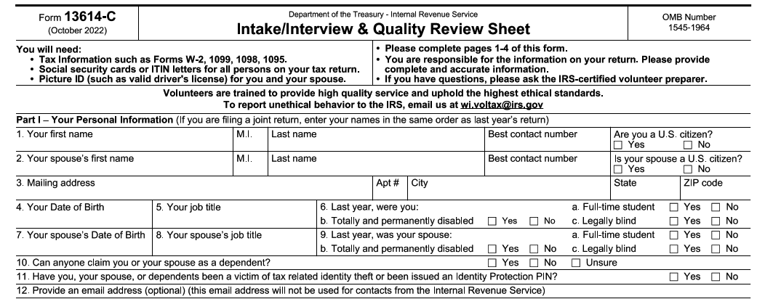
The Interview Process: Part I Personal Information
Major causes of IRS rejects if these are not correct

Slide 47
The Interview Process: Part II Marital Status and Household Information
Information in this section will help you make determinations about:
Filing Status
Dependency Exemptions
Various credits and deductions

Slide 48
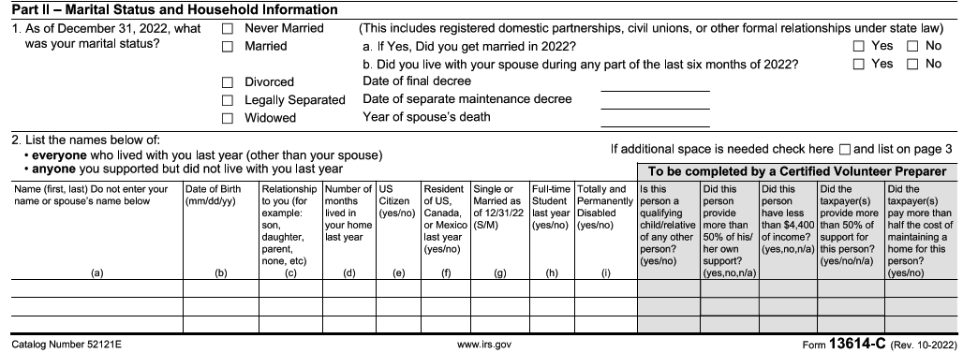
The Interview Process: Part II Marital Status and Household Information

Slide 49
The Interview Process: Part III - Income
Make sure all the questions on Part III of Form 13614-C are complete.
Change any “unsure" answers to “yes” or “no”
Step through all the “yes” income answers and verify any needed documentation is present
Always check if there is other income not covered on the 13614-C
This especially true for taxpayers who are self employed
Have we captured all income including cash payments received for work performed?

Slide 50
The Interview Process: Part III - Income
The only “M” designation for Military on form, and all rental income is out-of-scope in any case
2021 “virtual currency” is now “digital assets” for TY 2022
We will not be dealing with digital assets for VITA
Added 1099-K in list of self-employed income documents

Slide 51
The Interview Process: Part IV- Expenses
Questions in this section help alert you to expenses paid by the taxpayer that may affect their return
The fact that a taxpayer had an expense is not the only consideration for a tax deduction or credit
Your reference materials will help you determine eligibility for deductions and credits and take into consideration the most advantageous position for the taxpayer

Slide 52
The Interview Process: Part IV - Expenses

Slide 53
The Interview Process: Part V-Life Events
The Life Events section asks various questions that relate to the calculation of tax and the processing of the return

Slide 54
The Interview Process: Part V– Life Events
This is still a critical item to verify and see the 1095-A.
No longer here for TY 2022:
Questions on Economic Impact Payments (Stimulus)
Question on Advanced Child Tax Credit

Slide 55
The Interview Process: Additional Info
Taxpayer indicates how will receive their refund as well as other information which may be needed to complete the return
Highly desirable, but optional: Demographic information in this section may be collected and entered in the tax software

Slide 56
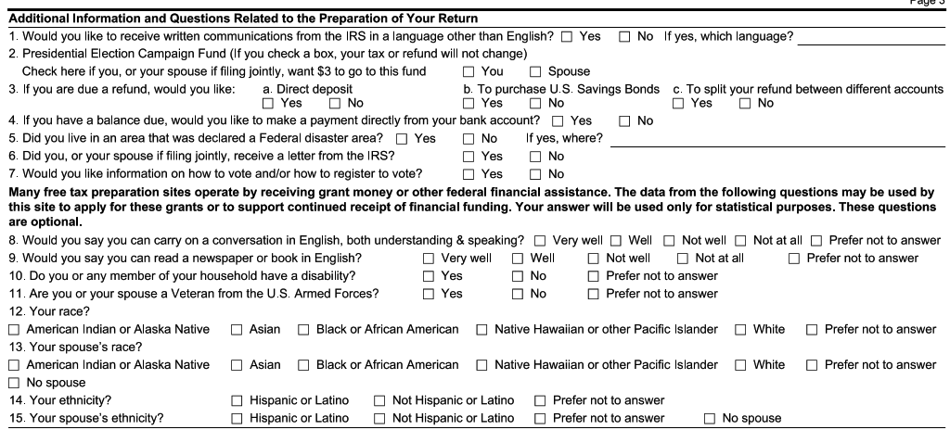
The Interview Process: Additional Info
Questions below the line are very helpful, but optional
NEW: Question on interest in voter registration
Make sure to verify 3 and 4 with the taxpayer, since it determines how their return or payment is processed

Slide 57
The Interview Process: Due Diligence
As a volunteer, you must do your part when preparing or quality reviewing a tax return to ensure the information on the return is correct and complete
Generally, as an IRS certified volunteer, you can rely in good faith on some types of information from a taxpayer without requiring documentation
For example: You do not need to see proof of a taxpayer's cash contribution to a charity if you feel comfortable that this information is not unusual or questionable
If the IRS gets informed, we need to see documentation
Part of due diligence requires asking a taxpayer to clarify information that may appear to be inconsistent or incomplete
If you are not comfortable with the information provided by a taxpayer, you are not obligated to prepare the tax return
Contact the site coordinator

Slide 58
Preparing the Tax Return
After completing the intake and interview process, either
Prepare the return in the Taxslayer
For NIP, complete a VITA folder with all the needed information inside
Consult references and tools to determine filing status, exemptions, income, adjustments, deductions, credits, or payments
Publication 4012 contains tax law information, and guidance on using tools embedded in the IRS-provided software
Publication 17 and Publication 4491
Volunteer Tax Alerts
Once the return is prepared, a Quality Reviewer other than the preparer will go through the taxpayer material and the return

Slide 59
Quality Review Process Introduction
Purpose of a Quality Review to ensure that the taxpayer's tax return is accurate based on the Intake/Interview Sheet, and supporting documents provided by the taxpayer and the interview with the taxpayer
Someone besides the preparer must conduct a Quality Review of every return prepared
Quality Review offers the best opportunity to correct small errors before they can cause big problems
Quality Review takes place after the return is prepared, but before the taxpayer signs the return

Slide 60
Quality Review Process Introduction
There are two acceptable QR methods:
Designated Review - Preferred quality review method employs a designated Quality Reviewer, a volunteer who is solely dedicated to reviewing returns prepared by the other volunteers at the site
Peer Review - Designated Quality Reviewer not available, volunteers review each other’s returns
Note: Self-Review, quality reviewing a return you prepared, is never an acceptable quality review method
Publication 5299 Quality Review Refresher and Publication 5310 Tax Return Quality Review Job Aid available for QR volunteers

Slide 61
Quality Review Process Introduction
The Quality Review Process must include four critical actions:
Engaging the taxpayer in the review process
For the NIP process, this is the responsibility of the QR volunteer giving the tax return back to the client.
Comparing all information provided by the taxpayer on Form 13614-C and supporting documents against the completed tax return entries
If necessary, using official reference materials to verify that tax law determinations are correct

Slide 62
Intake and Quality Review Questions
Ethics Training for Volunteers

Slide 63
Intake/Interview and Quality Review Questions
The test begins on page 19 of Pub 6744, retest on page 21

Slide 64
Intake/Interview and Quality Review Questions

Slide 65
Intake/Interview and Quality Review Questions

Slide 66
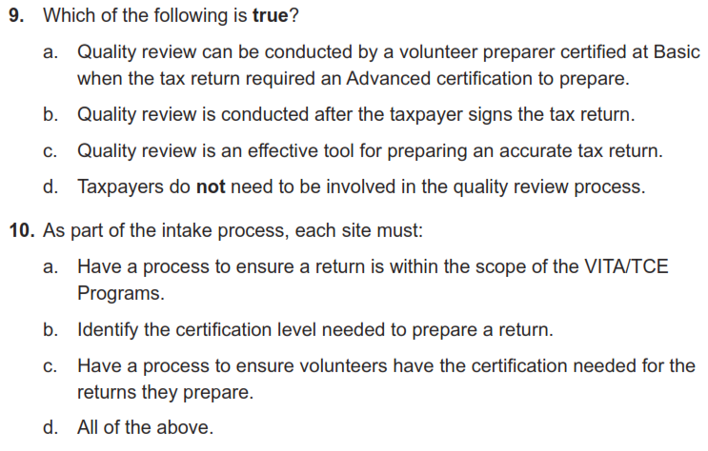
Intake/Interview and Quality Review Questions

Slide 67
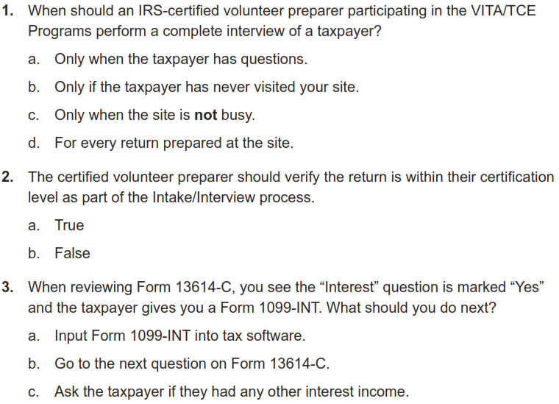
Intake/Interview and Quality Review Questions
Retest on page 21

Slide 68
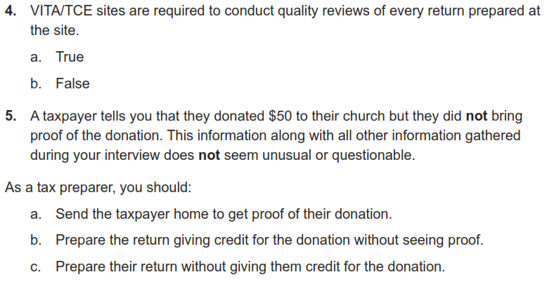
Intake/Interview and Quality Review Questions
Retest

Slide 69
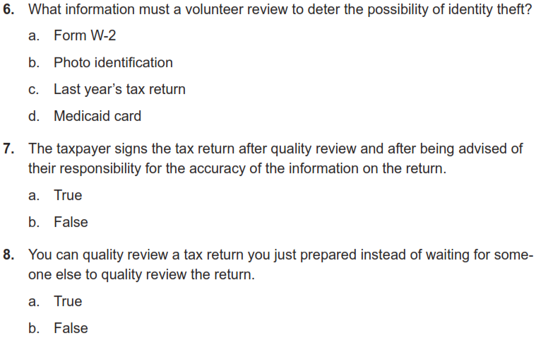
Intake/Interview and Quality Review Questions
Retest

Slide 70
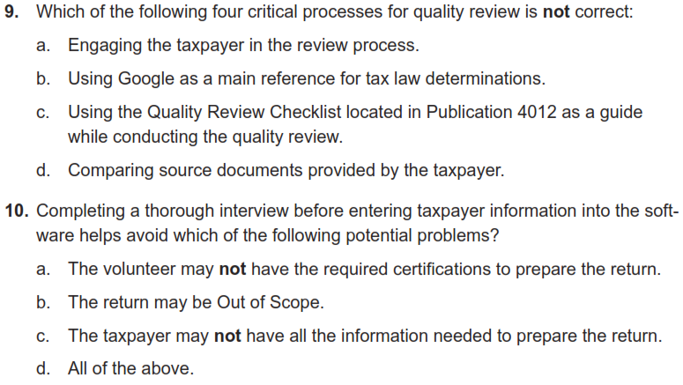
Intake/Interview and Quality Review Questions
Retest

Slide 71
Using Available Resources

Slide 72
Key Resources for doing Taxes
Pub 4012 – VITA/TCE Volunteer Resource Guide
https://www.irs.gov/pub/irs-pdf/p4012.pdf
Pub 4491 – VITA/TCE Training Guide
https://www.irs.gov/pub/irs-pdf/p4491.pdf
Pub 17 – Your Federal Income Tax – Tax Guide
Additional coverage of tax law and how to prepare taxes
https://www.irs.gov/pub/irs-pdf/p17.pdf

Slide 73
About those Resources
Pub 4012 will be your primary resource
It is grouped by sections, and the index does a reasonable job of providing a more detailed search
It illustrates the most common entries for Taxslayer
It has the definitive list of what is in or out of scope
Pub 4491 is big, and is only on-line
Provides examples and more in-depth discussion of topics.
Lists the relevant changes for forms and tax laws for TY 2022
Pub 17 is NOT tied to VITA or Taxslayer
It’s the IRS general taxpayer guide for most topics related to Form 1040 and the associated schedules
The language is more bureaucratic, but can provide specifics if you are still unsure after looking at Pub 4012 and 4491

Slide 74
Client Process for TY 2022

Slide 75
Client Process For TY 2022
We will be doing both intake/dropoff (NIP) and in-person preparation
Appointments will be set up in ALL cases. No open walk-ins.
Site locations and days are still being finalized
UW is working on sites in multiple quadrants of Cedar Rapids and Marion
We hope to have a greeter at most sites to help with logistics as clients arrive
We want to avoid processing returns at home
Client sign-up process will be discussed later
You will be provided the UW VITA URL where links, slide decks and recordings will be published

Slide 76
Next Steps

Slide 77
Practice Lab
Practice Lab is a great place to try out the system regardless of how much training you attend
Practice is important!!
Highly recommend using the system on your own before trying to complete with a real person starting in February
Details to come on site status and shift sign-ups

Slide 78
Login links
Taxslayer “Springboard” – access to Practice Lab and eventually live Taxslayer
Not needed for this week, but will be needed by next Monday 12/12
Search on: Taxslayer Springboard
https://vita.taxslayerpro.com/
IRS Link-and-Learn for certification
Search on: Link and Learn Home
https://www.linklearncertification.com/d/

Slide 79
Taking the Test When We’re Done
If you run into problems accessing the Practice Lab or Certification Site, let us know
Make sure to complete:
Volunteer Standards of Conduct
Intake/Interview and Quality Review
Advanced Certification (after we complete the training)
Once all three tests are completed and passed, print off and sign Form 13615
This form MUST come from the Certification program
Return Form 13615 to Meredith either in person or via email meredith.hershner@uweci.org
Certification target date is January 6th, 2023

Slide 80
VITA Shirts
If you did not get the link to order long-sleeve VITA T-shirts, let us know
These are provided by the program

Slide 81
Questions?
Thank you! See you Wednesday evening

