Slide 1

Tax Preparer Training – Sessions 1&2
Tax Year 2022 Dec. 8, 2022

Slide 2

Welcome to VITA
New or returning, we’re glad you’re willing to help us provide a truly valuable service to the community
We serve clients with a wide variety of backgrounds and situations

Slide 3
Agenda
Tax Training Overview
Volunteer Standards of Conduct
Intake/Interview and Quality Review
Available Resources for Tax Returns
Certification Scenarios 1-6
Client Process for TY 2022
Out-of-Scope Reminder
Next Steps
(we’ll take at least one 15 minute break somewhere)

Slide 4
Tax Training Overview

Slide 5
Training Timetable
Sessions 1 and 2 of Certification Training (in person)
  Oriented to New Volunteers
    In Person - December 10th at United Way (Sat, 9 – 3:30)
Session 3 of Certification Training (Scenarios 7-9)
  Oriented to New Volunteers
    ZOOM - December 12th (Mon, 5:30-8:30)
    In Person - December 17th at United Way (Sat, 9 – Noon)
  Oriented to Returning Volunteers
    ZOOM - December 15th (Thurs, 5:30-8:30)
Additional scenarios and detail process discussions (ZOOM – Saturdays – for all volunteers)
  January 7th
  January 14th
  January 28th

Slide 6
Training Publications
Form 6744 – VITA/TCE Volunteer Assistor’s Test/Retest
  https://www.irs.gov/pub/irs-pdf/f6744.pdf
Pub 4961 – Volunteer Standards of Conduct
  https://www.irs.gov/pub/irs-pdf/p4961.pdf
Pub 5101 – Intake Interview Quality Review
  https://www.irs.gov/pub/irs-pdf/p5101.pdf
Pub 4012 – VITA/TCE Volunteer Resource Guide
  https://www.irs.gov/pub/irs-pdf/p4012.pdf
Pub 4491 – VITA/TCE Training Guide
  https://www.irs.gov/pub/irs-pdf/p4491.pdf
Pub 17 – Your Federal Income Tax – Tax Guide
  Additional coverage of tax law and how to prepare taxes
  https://www.irs.gov/pub/irs-pdf/p17.pdf

Slide 7
Standards of Conduct and Intake Certification Training
Even though most of you have been through this before, there is a body of information related to ethics and intake procedures that the IRS asks us to present
We will review Policies and Examples
These are not difficult tests, so based on previous years’ experiences we don’t think it is necessary to walk through these in training
  If you take the tests the first time and do NOT reach the 80% threshold, note which questions you missed but do NOT take the test the 2nd time until you contact me or Meredith.
  We will review what you missed and help you get to the correct answer for the 2nd attempt.

Slide 8
Tax Certification Training
We hope you go through the scenarios beforehand and choose your answers, but request you do NOT take the tax certification test until after the training sessions are done
We will review certification scenarios
Identify key places to find relevant information
Poll participating volunteers for their choice on answers
If needed, clarification/discussion about which answers are correct and why

Slide 9
Requirements
All VITA volunteers preparing and doing Quality Review on client returns must
  Pass the Volunteer Standards of Conduct (VSC) certification test with a score of 80% or higher.
  Pass the Intake/Interview and Quality Review certification test with a score of 80% or higher
  Pass the Advanced Course certification test with a score of 80% or higher
  Agree to comply with the VSC by signing and dating Form 13615 prior to working at a site.
    Electronically generated by certification process

Slide 10
Volunteer Testing For TY 2022
IRS site: https://www.linklearncertification.com/d/
  Create or confirm your account as a tax volunteer for VITA
  Contact Meredith or me if you have issues
Tests – all certification tests have “Pass” threshold of 80%
  For Tax Preparers
    Volunteer Standards of Conduct
    Intake/Interview and Quality Review
    Advanced Certification
  For Site Coordinators
    Volunteer Standards of Conduct
    Intake/Interview and Quality Review
    Advanced Certification
    Site Coordinator Test

Slide 11
Volunteer Standards of Conduct
Ethics Training for Volunteers

Slide 12
Volunteer Standards of Conduct
Key points are highlighted in this PowerPoint but for the complete set of information, refer to IRS Publication 4961 which can be found at:
https://www.irs.gov/pub/irs-pdf/p4961.pdf
Read the publication online or download your own copy. The test and retest questions are listed at the end of Pub 4961 as well as Form 6744

Slide 13
Volunteer Standards of Conduct (VSC)
Follow Quality Site Requirements
Do not accept payment, solicit donations, or accept refund payments
Do not solicit business from taxpayers or use knowledge gained to benefit yourself or for personal use
Do not knowingly prepare false returns
Do not engage in activity deemed to have a negative effect on the VITA program
Treat all taxpayers in a professional, courteous, and respectful manner

Slide 14
Failure to Follow the VSC may mean
(in increasing severity):
Your removal from VITA program
You are added to IRS Registry barring you from any future VITA participation
Deactivation of that site’s VITA IRS qualification.
Termination of the full United Way VITA program
Referral for possible criminal investigation

Slide 15
VSC Quality Site Requirements
Proper certification
  Can be certified to Basic, Advanced, and Military
  A return must be assigned to someone certified to for all aspects of the return
    United Way VITA has all volunteers get Advanced Certification
    For the UW VITA program, anything requiring Military certification is out of scope
Have a defined Intake and Quality Review Process
  This includes making sure the taxpayer understands the process
    Completing intake form 13614-C and answering questions
    Participate in a Quality Review of the completed return

Slide 16
VSC Quality Site Requirements
Volunteers confirm Taxpayer Identity and other key information
  Gov’t issued photo identification required for filing taxpayers
  SSN or ITIN for everyone listed on the return
Reference materials available (Pub 4012, etc)
Volunteer Agreement form 13615 complete
Timely Filing of Returns
Civil Rights information (posters at sites)
Proper IRS site identification
Proper security for confidentiality

Slide 17
Example 1
You finish a time-consuming return, and the client is very grateful. On her way out, the client stops by and tries to sneak a $20 bill in your pocket, saying, “It would have cost me ten times that with a paid preparer.” Return the money and explain that you cannot accept money for doing taxes, but United Way or a sponsoring charity may appreciate a donation which can be made at the main office or via their website.
Key point: You cannot accept payment from taxpayers.

Slide 18
Examples 2a and 2b
Your primary business includes selling health insurance policies. During the interview, you find out the taxpayer lost access to health insurance in January of the current year. You cannot offer to sell the taxpayer health insurance through your business.
Your daughter asks you to take orders at the VITA site for her school fundraiser
Key point: Even though you may be trying to help, soliciting business from the taxpayer is not allowed.

Slide 19
Example 3
A volunteer preparer told the taxpayer that cash income does not need to be reported. The return was completed without the cash income. The quality reviewer simply missed this omission, and the return was printed, signed, and e-filed. The volunteer preparer has violated this standard.
Key point: Since the quality reviewer did not knowingly allow this return to be e-filed incorrectly, the quality reviewer did not violate this standard. We should not confuse an unethical action with a lack of knowl­edge or a simple mistake.

Slide 20
Resolving Problems
The site coordinator is the first point of contact for resolving any problems.
If a volunteer feels an ethical issue can’t be handled by the site coordinator, email IRS at WI.VolTax@irs.gov and/or contact the local IRS-SPEC Relationship Manager.
Failure to Comply with the Standards of Conduct
  If a violation is discovered, appropriate action will be taken, up to removal and barring the volunteer from the VITA program, closing of the site, and discontinuing IRS support to the sponsoring partner.

Slide 21
Intake/Interview and Quality Review
(We will go over our actual process in much more detail during the January training)

Slide 22
Rationale
Preparing an accurate return begins with explaining the tax preparation process, completing all questions on form 13614-C, listening to the taxpayer, and asking the right questions
Form 13614-C, Intake/Interview & Quality Review Sheet, is a tool designed to help ensure taxpayers are given the opportunity to provide all needed information before their tax return is prepared
When used properly, this form effectively contributes to accurate tax return preparation

Slide 23
Purpose of Intake Training
The IRS believes there is a definite correlation between proper use of Intake/Interview and Quality Review Process and preparation of an accurate tax return
IRS oversight reviews indicate consistent use of complete intake, interview, and quality review processes results in more accurate returns
Per Quality Site Requirement #2, it is mandatory that Form 13614-C completed for each tax return
Volunteers who refuse to prepare returns without following the Intake/Interview process are in violation of the Volunteer Standards of Conduct

Slide 24
Completing Form 13614-C
Taxpayer completes pages 1 through 3 of the Form 13614-C before meeting with a tax preparer
  Page 4 is also completed, but it is a separate form 15080
  Form 15080 is the taxpayer consent (Global Carry Forward) to keep their core data available to other VITA sites and for next year
Volunteers may help complete the form with the taxpayer if assistance is required
Tax preparer also interviews the taxpayer using the information provided on Form 13614-C
All questions on Form 13614-C must be answered and unsure answers changed to yes or no
We will have Form 13614-C available in English and Spanish. It is also available to be downloaded from irs.gov in many other languages

Slide 25
Intake Process: Verifying Identity
Interview should begin by requiring a photo ID to verify the identity of the taxpayer and spouse on the tax return
  Identity theft continues to grow as a serious problem
Exceptions for requiring photo ID may only be made under extreme circumstances and for taxpayers known to the site after being approved by the site coordinator
More details are in Publication 4299, Privacy, Confidentiality and Civil Rights - A Public Trust

Slide 26
Intake Process: Return and Volunteer Certification Levels
Site must have a process to ensure the return is within scope of the VITA Program and to identify the certification level needed
Site must also have a process to ensure volunteers have the certification needed for the returns they prepare
  All VITA volunteers for this program will have Advanced Certification
  We will not do Military certification
  We will cover this again when we go over out-of-scope areas in January

Slide 27
The Interview Process
Do not proceed to enter data or allow the taxpayer to leave (NIP – Not In Person) until you have completed a thorough interview with the taxpayer because you may find that:
  The tax return is outside our certification
  The tax return is outside the scope of the VITA Program
  The taxpayer does not have all needed information or documentation
Discovering these things before proceeding will save everyone’s time and avoid frustration

Slide 28
The Interview Process
Update or correct the intake form with any changes identified during the interview with the taxpayer
Clarify information while reviewing Form 13614-C during the Interview to gather all needed information
Be alert for conflicting information because sometimes an entry on one part will raise a question on another part of Form 13614-C
Notes for added information, reminders and clarifications are always beneficial
  You will have an intake guide-sheet for notes, which we will review in January

Slide 29
The Interview Process: Part I Personal Information
Verify that the information in Part I is correct and complete
Ensure that the names match the social security document
Information in Part I impacts tax law determinations
  Are they a US Citizen?
  Are they a student?
  Can anyone else claim them?
No changes from last year

Slide 30
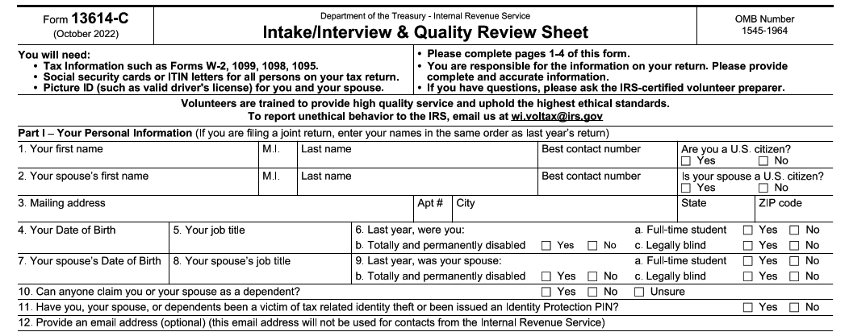
The Interview Process: Part I Personal Information
Major causes of IRS rejects if these are not correct

Slide 31
The Interview Process: Part II Marital Status and Household Information
Information in this section will help you make determinations about:
  Filing Status
  Dependency Exemptions
  Various credits and deductions
No changes from last year (year and $ limit adjustments)

Slide 32
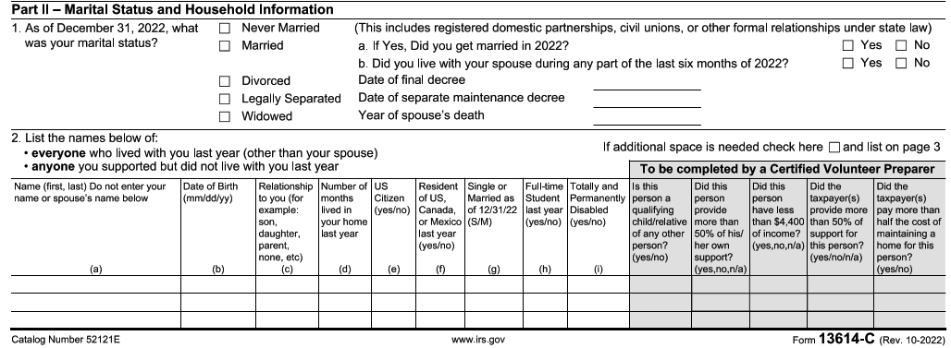
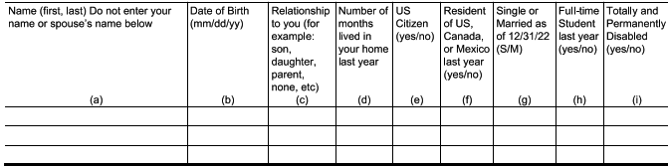
The Interview Process: Part II Marital Status and Household Information

Slide 33
The Interview Process: Part III - Income
Make sure all the questions on Part III of Form 13614-C are complete.
  Change any “unsure" answers to “yes” or “no”
Step through all the “yes” income answers and verify any needed documentation is present
Always check if there is other income not covered on the 13614-C
  This especially true for taxpayers who are self employed
  Have we captured all income including cash payments received for work performed?
Crypto currency is becoming a bigger deal
  Taxslayer asks one question in the personal information section
  This goes directly to the question at the start of Form 1040

Slide 34
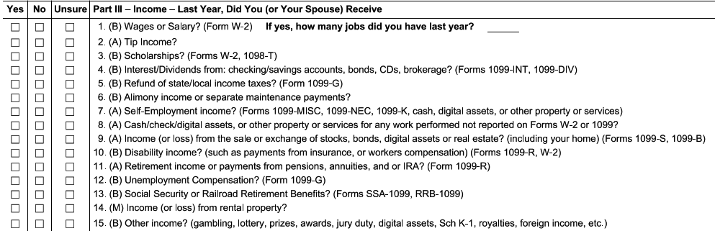
The Interview Process: Part III - Income
The only “M” designation for Military on form, and all rental income is out-of-scope in any case
2021 “virtual currency” is now “digital assets” for TY 2022
  We will discuss dealing with digital assets in January
Added 1099-K in list of self-employed income documents

Slide 35
The Interview Process: Part IV- Expenses
Questions in this section help alert you to expenses paid by the taxpayer that may affect their return
The fact that a taxpayer had an expense in a certain area does not automatically qualify it for a tax deduction or credit
Your reference materials will help you determine eligibility for deductions and credits and take into consideration the most advantageous position for the taxpayer
No changes from last year

Slide 36
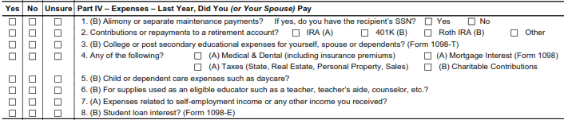
The Interview Process: Part IV - Expenses

Slide 37
The Interview Process: Part V-Life Events
The Life Events section asks various questions that relate to the calculation of tax and the processing of the return
There are some things no longer in this section for TY 2022

Slide 38
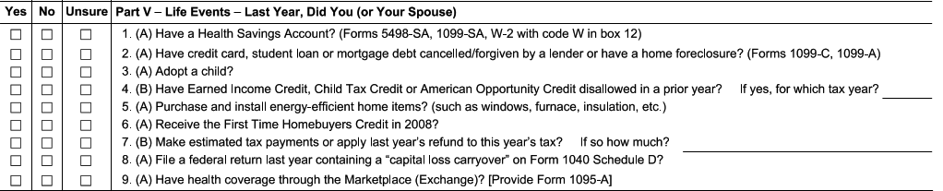
The Interview Process: Part V– Life Events
This is still a critical item to verify and see the 1095-A.
No longer here for TY 2022:
  Question on Economic Impact Payments (Stimulus)
  Question on Advanced Child Tax Credit

Slide 39
The Interview Process: Additional Info
Taxpayer indicates how they will receive their refund as well as other information which may be needed to complete the return
Highly desirable, but optional: Demographic information in this section may be collected and entered in the tax software
One new question in this section

Slide 40
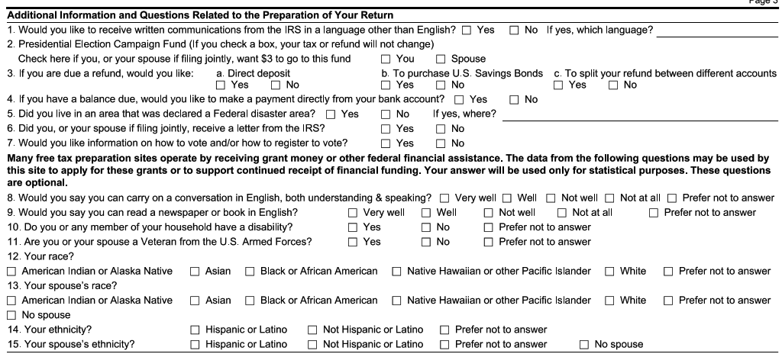
The Interview Process: Additional Info
Questions below the line are very helpful, but optional
NEW: Question on interest in voter registration
Make sure to verify 3 and 4 with the taxpayer, since it determines how their return or payment is processed

Slide 41
The Interview Process: Due Diligence
As a volunteer, you must do your part when preparing or quality reviewing a tax return to ensure the information on the return is correct and complete
Generally, as an IRS certified volunteer, you can rely in good faith on some types of information from a taxpayer without requiring documentation
  For example: You do not need to see proof of a taxpayer's cash contribution to a charity if you feel comfortable that this information is not unusual or questionable
  If the IRS gets informed, we need to see documentation
Part of due diligence requires asking a taxpayer to clarify information that may appear to be inconsistent or incomplete
If you are not comfortable with the information provided by a taxpayer, you are not obligated to prepare the tax return
  Contact the site coordinator

Slide 42
Preparing the Tax Return
After completing the intake and interview process, either
  Prepare the return in the Taxslayer
  For NIP, complete a VITA folder with all the needed information inside
Consult references and tools to determine filing status, exemptions, income, adjustments, deductions, credits, or payments
  Publication 4012 contains tax law information, and guidance on using tools embedded in the IRS-provided software
  Publication 17 and Publication 4491
  Volunteer Tax Alerts
Once the return is prepared, a Quality Reviewer other than the preparer will go through the taxpayer material and the return

Slide 43
Quality Review Process Introduction
Purpose of a Quality Review to ensure that the taxpayer's tax return is accurate based on the Intake/Interview Sheet, and supporting documents provided by the taxpayer and the interview with the taxpayer
Someone besides the preparer must conduct a Quality Review of every return prepared
Quality Review offers the best opportunity to correct small errors before they can cause big problems
Quality Review takes place after the return is prepared, but before the taxpayer signs the return

Slide 44
Quality Review Process Introduction
There are two acceptable QR methods:
  Designated Review - Preferred quality review method employs a designated Quality Reviewer, a volunteer who is solely dedicated to reviewing returns prepared by the other volunteers at the site
  Peer Review - Designated Quality Reviewer not available, volunteers review each other’s returns
Note: Self-Review, quality reviewing a return you prepared, is never an acceptable quality review method
Publication 5299 Quality Review Refresher and Publication 5310 Tax Return Quality Review Job Aid available for QR volunteers

Slide 45
Quality Review Process Introduction
The Quality Review Process must include these critical actions:
  Engaging the taxpayer in the review process
    For the NIP process, this is the responsibility of the QR volunteer giving the tax return back to the client.
  Comparing all information provided by the taxpayer on Form 13614-C and supporting documents against the completed tax return entries
  If necessary, using official reference materials to verify that tax law determinations are correct

Slide 46
Available Tax Resources

Slide 47
Key Resources for doing Taxes
Pub 4012 – VITA/TCE Volunteer Resource Guide
  https://www.irs.gov/pub/irs-pdf/p4012.pdf
Pub 4491 – VITA/TCE Training Guide
  https://www.irs.gov/pub/irs-pdf/p4491.pdf
Pub 17 – Your Federal Income Tax – Tax Guide
  Additional coverage of tax law and how to prepare taxes
  https://www.irs.gov/pub/irs-pdf/p17.pdf

Slide 48
About those Resources
Pub 4012 will be your primary resource
  It is grouped by sections, and the index does a reasonable job of providing a more detailed search
  It illustrates the most common entries for Taxslayer
  It has the definitive list of what is in or out of scope
Pub 4491 is big, and is only on-line
  Provides examples and more in-depth discussion of topics
  Lists the relevant changes for forms and tax laws for TY 2022
Pub 17 is NOT tied to VITA or Taxslayer
  It’s the IRS general taxpayer guide for most topics related to Form 1040 and the associated schedules
  The language is more bureaucratic, but can provide specifics if you are still unsure after looking at Pub 4012 and 4491

Slide 49
Some Changes Affecting Certification
Educator Expenses limit is now $300 (up from $250)
Dependent/Child Care Credit cannot be refundable
Age limits back to 25 to <65 for EIC
No charitable deduction outside of Schedule A
We will go over changes in detail in January

Slide 50
Tax Certification Tests

Slide 51
Scenario 1
Chris Spalding

Slide 52
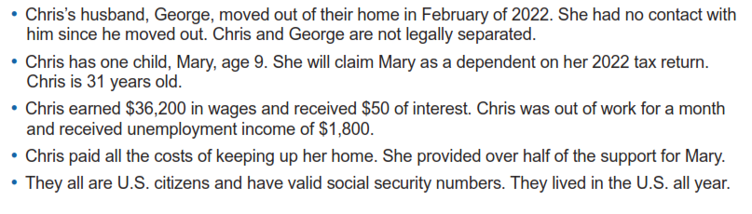
Adv. Scenario 1 Interview Notes
Scenario and initial test questions Form 6744 pg. 68

Slide 53
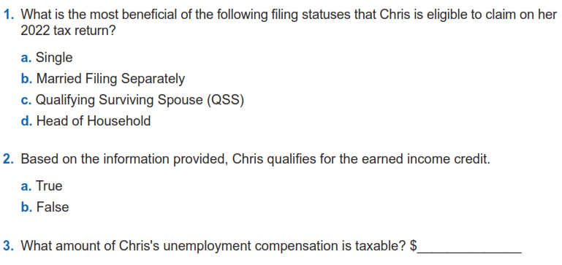
Adv. Scenario 1: Questions
B-10
I-3/4
$1,800
D-1
Notes:
This article clarifies information provided on page 10 of IRS Publication 5307, Tax Reform Basics for Individuals and Families for the repeal of deduction for alimony payments under the Tax Cuts & Jobs Act of 2017.
Alimony or separation payments paid to a spouse or former spouse under a divorce or separation agreement, such as a divorce decree, a separate maintenance decree, or a written separation agreement, may be alimony for federal tax purposes. Alimony or separation payments are deductible if the taxpayer is the payer spouse. Receiving spouses must include the alimony or separation payments in their income.
Beginning Jan. 1, 2019, alimony or separate maintenance payments are not deductible from the income of the payer spouse, or includable in the income of the receiving spouse, if made under a divorce or separation agreement executed after Dec. 31, 2018.
This also applies to a divorce or separation agreement executed on or before Dec. 31, 2018, and modified after December 31, 2018, as long as the modification:
changes the terms of the alimony or separate maintenance payments; and
states that the alimony or separate maintenance payments are not deductible by the payer spouse or includable in the income of the receiving spouse.
On the other hand, generally alimony or separate maintenance payments are deductible from the income of the payer spouse and includable in the income of the receiving spouse, if made under a divorce or separation agreement executed on or before Dec. 31, 2018, even if the agreement was modified after December 31, 2018, so long as the modification is not one described in the preceding paragraph.

Slide 54
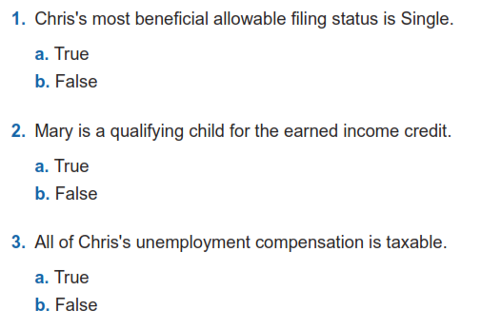
Adv. Scenario 1: Retest Questions
B-10
I-3/4
D-1
Retest Form 6744 Pg 103
Notes:
This article clarifies information provided on page 10 of IRS Publication 5307, Tax Reform Basics for Individuals and Families for the repeal of deduction for alimony payments under the Tax Cuts & Jobs Act of 2017.
Alimony or separation payments paid to a spouse or former spouse under a divorce or separation agreement, such as a divorce decree, a separate maintenance decree, or a written separation agreement, may be alimony for federal tax purposes. Alimony or separation payments are deductible if the taxpayer is the payer spouse. Receiving spouses must include the alimony or separation payments in their income.
Beginning Jan. 1, 2019, alimony or separate maintenance payments are not deductible from the income of the payer spouse, or includable in the income of the receiving spouse, if made under a divorce or separation agreement executed after Dec. 31, 2018.
This also applies to a divorce or separation agreement executed on or before Dec. 31, 2018, and modified after December 31, 2018, as long as the modification:
changes the terms of the alimony or separate maintenance payments; and
states that the alimony or separate maintenance payments are not deductible by the payer spouse or includable in the income of the receiving spouse.
On the other hand, generally alimony or separate maintenance payments are deductible from the income of the payer spouse and includable in the income of the receiving spouse, if made under a divorce or separation agreement executed on or before Dec. 31, 2018, even if the agreement was modified after December 31, 2018, so long as the modification is not one described in the preceding paragraph.

Slide 55
Scenario 2
Adam and Lisa Garcia

Slide 56
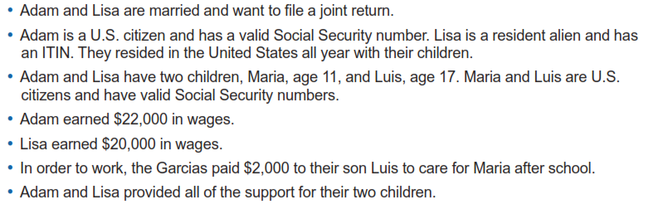
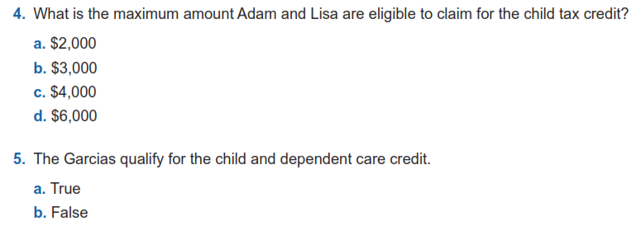
Adv. Scenario 2 Interview Notes
G-2
G-3: Assuming no additional tax credit, need form 8812 calculations
G-10
Scenario and initial test questions Form 6744 pg. 69

Slide 57
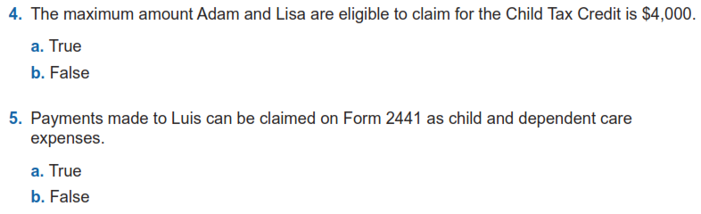
Adv. Scenario 2: Retest Questions
G-2
G-10
Retest Form 6744 Pg 104
Notes:
This article clarifies information provided on page 10 of IRS Publication 5307, Tax Reform Basics for Individuals and Families for the repeal of deduction for alimony payments under the Tax Cuts & Jobs Act of 2017.
Alimony or separation payments paid to a spouse or former spouse under a divorce or separation agreement, such as a divorce decree, a separate maintenance decree, or a written separation agreement, may be alimony for federal tax purposes. Alimony or separation payments are deductible if the taxpayer is the payer spouse. Receiving spouses must include the alimony or separation payments in their income.
Beginning Jan. 1, 2019, alimony or separate maintenance payments are not deductible from the income of the payer spouse, or includable in the income of the receiving spouse, if made under a divorce or separation agreement executed after Dec. 31, 2018.
This also applies to a divorce or separation agreement executed on or before Dec. 31, 2018, and modified after December 31, 2018, as long as the modification:
changes the terms of the alimony or separate maintenance payments; and
states that the alimony or separate maintenance payments are not deductible by the payer spouse or includable in the income of the receiving spouse.
On the other hand, generally alimony or separate maintenance payments are deductible from the income of the payer spouse and includable in the income of the receiving spouse, if made under a divorce or separation agreement executed on or before Dec. 31, 2018, even if the agreement was modified after December 31, 2018, so long as the modification is not one described in the preceding paragraph.

Slide 58
Scenario 3
Jenny Smith

Slide 59
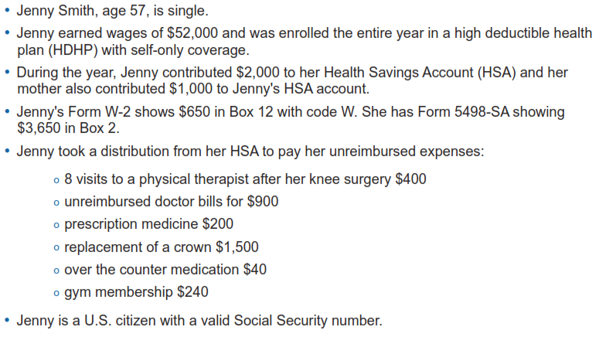
Adv. Scenario 3 Interview Notes
Scenario and initial test questions Form 6744 pg. 70

Slide 60
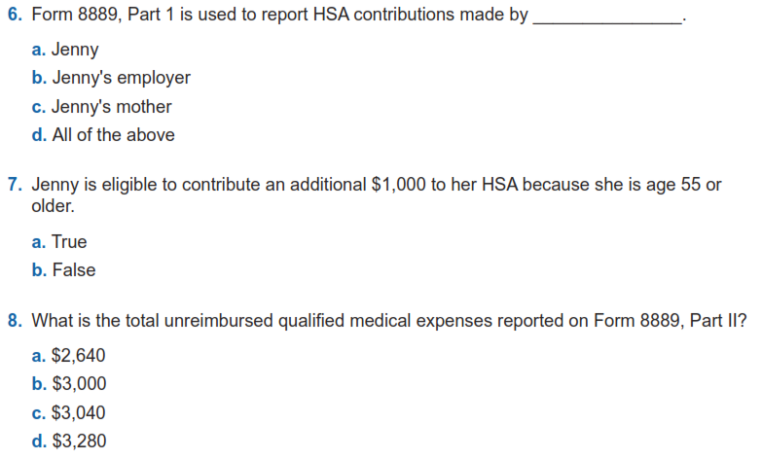
Adv. Scenario 3 Questions
E-7, form 8889

Slide 61
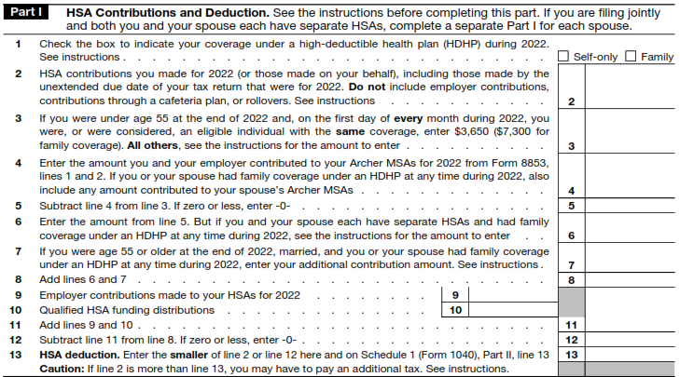
Adv. Scenario 3 Questions
Form 8889

Slide 62
Adv. Scenario 3 Questions
E-7, form 8889
E-7
E-9
Scenario and initial test questions Form 6744 pg. 70

Slide 63
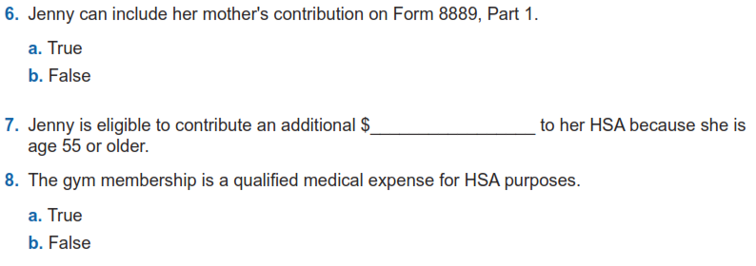
Adv. Scenario 3 Retest Questions
E-7
$1,000
E-7
E-9
Retest Form 6744 Pg 105

Slide 64
Scenario 4
Alice Adams

Slide 65
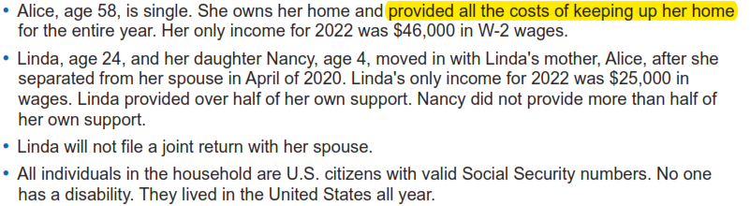
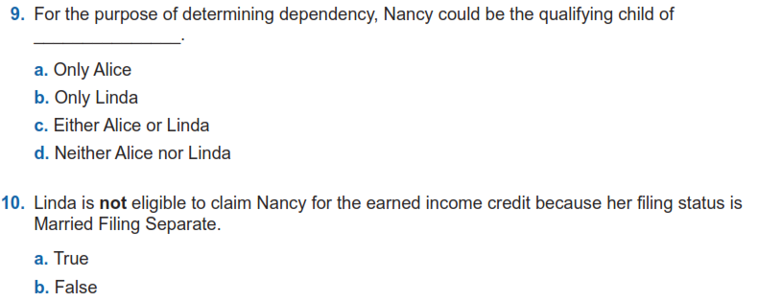
Adv. Scenario 4 Interview Notes
C-1/2 , Example on C-2
Scenario and initial test questions Form 6744 pg. 71
Check B-10 flow for why she is MFS
I-2/3, Footnote 4 on I-2

Slide 66
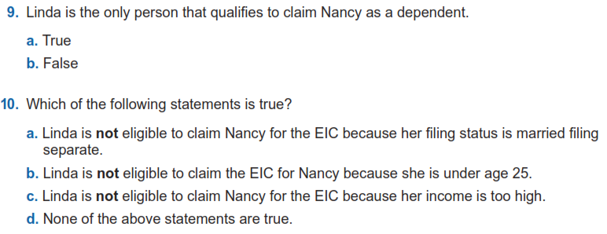
Adv. Scenario 4 Retest Questions
C-1/2 , Example on C-2
Revisit: a) B-10 flow I-2, and I-2 Footnote 4;
b) and c) I-2
Retest Form 6744 Pg 106

Slide 67
Scenario 5
Ellen Black

Slide 68
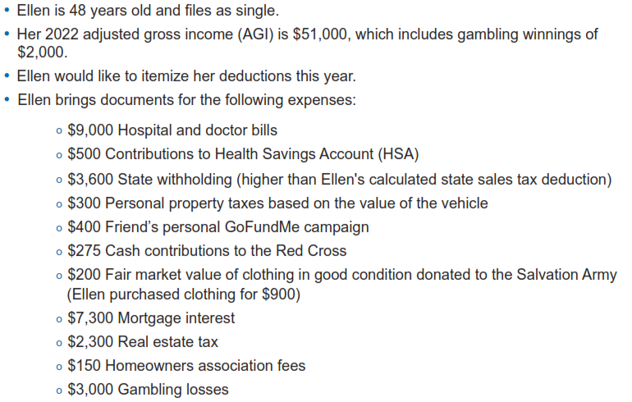
Adv. Scenario 5 Interview Notes
Scenario and initial test questions Form 6744 pg. 72

Slide 69
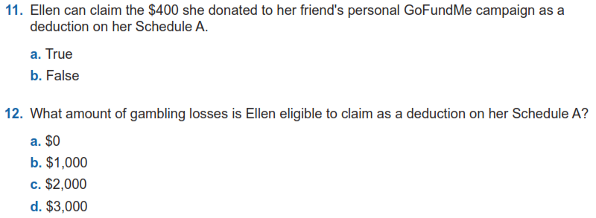
Adv. Scenario 5 Questions
F-4, question 14
F-12

Slide 70
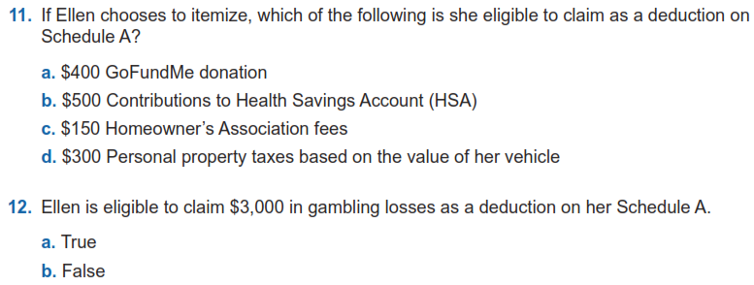
Adv. Scenario 5 Retest Questions
F-4, question 14
Top of E-6, Form 8889
F-11
F-8
F-12
Retest Form 6744 Pg 107

Slide 71
Scenario 6
John Ward

Slide 72
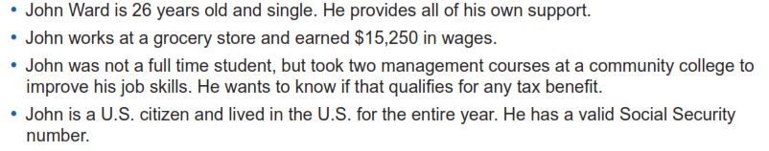
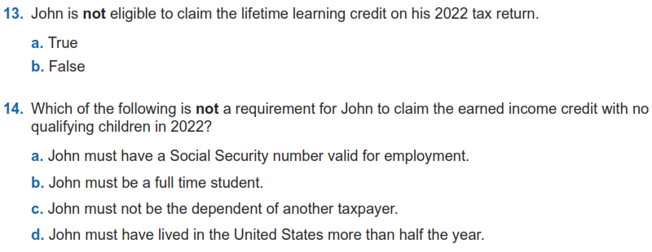
Adv. Scenario 6 Interview Notes
J-5
I-2, I-5
Scenario and initial test questions Form 6744 pg. 73

Slide 73
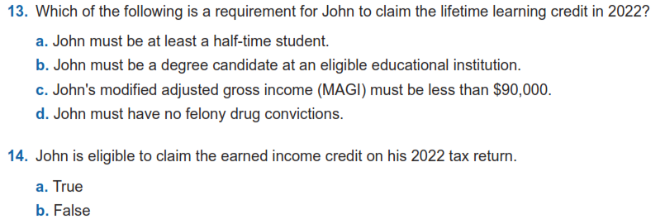
Adv. Scenario 6 Retest Questions
J-5
I-2, I-5
Retest Form 6744 Pg 107

Slide 74
Client Process for TY 2022

Slide 75
Client Process For TY 2022
We will be doing both intake/dropoff (NIP) and in-person preparation
  Appointments will be set up in ALL cases. No open walk-ins.
Site locations and days are still being finalized
  UW is working on sites in multiple quadrants of Cedar Rapids and Marion
We hope to have a greeter at most sites to help with logistics as clients arrive
We want to avoid processing returns at home
Client sign-up process will be discussed later
You will be provided the UW VITA URL where links, slide decks and recordings will be published

Slide 76
Scenario 1
Chris Spalding

Slide 77
Adv. Scenario 1 Interview Notes
Scenario and initial test questions Form 6744 pg. 68

Slide 78
Adv. Scenario 1: Questions
B-10
I-3/4
$1,800
D-1
Notes:
This article clarifies information provided on page 10 of IRS Publication 5307, Tax Reform Basics for Individuals and Families for the repeal of deduction for alimony payments under the Tax Cuts & Jobs Act of 2017.
Alimony or separation payments paid to a spouse or former spouse under a divorce or separation agreement, such as a divorce decree, a separate maintenance decree, or a written separation agreement, may be alimony for federal tax purposes. Alimony or separation payments are deductible if the taxpayer is the payer spouse. Receiving spouses must include the alimony or separation payments in their income.
Beginning Jan. 1, 2019, alimony or separate maintenance payments are not deductible from the income of the payer spouse, or includable in the income of the receiving spouse, if made under a divorce or separation agreement executed after Dec. 31, 2018.
This also applies to a divorce or separation agreement executed on or before Dec. 31, 2018, and modified after December 31, 2018, as long as the modification:
changes the terms of the alimony or separate maintenance payments; and
states that the alimony or separate maintenance payments are not deductible by the payer spouse or includable in the income of the receiving spouse.
On the other hand, generally alimony or separate maintenance payments are deductible from the income of the payer spouse and includable in the income of the receiving spouse, if made under a divorce or separation agreement executed on or before Dec. 31, 2018, even if the agreement was modified after December 31, 2018, so long as the modification is not one described in the preceding paragraph.

Slide 79
Adv. Scenario 1: Retest Questions
B-10
I-3/4
D-1
Retest Form 6744 Pg 103
Notes:
This article clarifies information provided on page 10 of IRS Publication 5307, Tax Reform Basics for Individuals and Families for the repeal of deduction for alimony payments under the Tax Cuts & Jobs Act of 2017.
Alimony or separation payments paid to a spouse or former spouse under a divorce or separation agreement, such as a divorce decree, a separate maintenance decree, or a written separation agreement, may be alimony for federal tax purposes. Alimony or separation payments are deductible if the taxpayer is the payer spouse. Receiving spouses must include the alimony or separation payments in their income.
Beginning Jan. 1, 2019, alimony or separate maintenance payments are not deductible from the income of the payer spouse, or includable in the income of the receiving spouse, if made under a divorce or separation agreement executed after Dec. 31, 2018.
This also applies to a divorce or separation agreement executed on or before Dec. 31, 2018, and modified after December 31, 2018, as long as the modification:
changes the terms of the alimony or separate maintenance payments; and
states that the alimony or separate maintenance payments are not deductible by the payer spouse or includable in the income of the receiving spouse.
On the other hand, generally alimony or separate maintenance payments are deductible from the income of the payer spouse and includable in the income of the receiving spouse, if made under a divorce or separation agreement executed on or before Dec. 31, 2018, even if the agreement was modified after December 31, 2018, so long as the modification is not one described in the preceding paragraph.

Slide 80
Scenario 2
Adam and Lisa Garcia

Slide 81
Adv. Scenario 2 Interview Notes
G-2
G-3: Assuming no additional tax credit, need form 8812 calculations
G-10
Scenario and initial test questions Form 6744 pg. 69

Slide 82
Adv. Scenario 2: Retest Questions
G-2
G-10
Retest Form 6744 Pg 104
Notes:
This article clarifies information provided on page 10 of IRS Publication 5307, Tax Reform Basics for Individuals and Families for the repeal of deduction for alimony payments under the Tax Cuts & Jobs Act of 2017.
Alimony or separation payments paid to a spouse or former spouse under a divorce or separation agreement, such as a divorce decree, a separate maintenance decree, or a written separation agreement, may be alimony for federal tax purposes. Alimony or separation payments are deductible if the taxpayer is the payer spouse. Receiving spouses must include the alimony or separation payments in their income.
Beginning Jan. 1, 2019, alimony or separate maintenance payments are not deductible from the income of the payer spouse, or includable in the income of the receiving spouse, if made under a divorce or separation agreement executed after Dec. 31, 2018.
This also applies to a divorce or separation agreement executed on or before Dec. 31, 2018, and modified after December 31, 2018, as long as the modification:
changes the terms of the alimony or separate maintenance payments; and
states that the alimony or separate maintenance payments are not deductible by the payer spouse or includable in the income of the receiving spouse.
On the other hand, generally alimony or separate maintenance payments are deductible from the income of the payer spouse and includable in the income of the receiving spouse, if made under a divorce or separation agreement executed on or before Dec. 31, 2018, even if the agreement was modified after December 31, 2018, so long as the modification is not one described in the preceding paragraph.

Slide 83
Scenario 3
Jenny Smith

Slide 84
Adv. Scenario 3 Interview Notes
Scenario and initial test questions Form 6744 pg. 70

Slide 85
Adv. Scenario 3 Questions
E-7, form 8889

Slide 86
Adv. Scenario 3 Questions
Form 8889

Slide 87
Adv. Scenario 3 Questions
E-7, form 8889
E-7
E-9
Scenario and initial test questions Form 6744 pg. 70

Slide 88
Adv. Scenario 3 Retest Questions
E-7
$1,000
E-7
E-9
Retest Form 6744 Pg 105

Slide 89
Scenario 4
Alice Adams

Slide 90
Adv. Scenario 4 Interview Notes
C-1/2 , Example on C-2
Scenario and initial test questions Form 6744 pg. 71
Check B-10 flow for why she is MFS
I-2/3, Footnote 4 on I-2

Slide 91
Adv. Scenario 4 Retest Questions
C-1/2 , Example on C-2
Revisit: a) B-10 flow I-2, and I-2 Footnote 4;
b) and c) I-2
Retest Form 6744 Pg 106

Slide 92
Scenario 5
Ellen Black

Slide 93
Adv. Scenario 5 Interview Notes
Scenario and initial test questions Form 6744 pg. 72

Slide 94
Adv. Scenario 5 Questions
F-4, question 14
F-12

Slide 95
Adv. Scenario 5 Retest Questions
F-4, question 14
Top of E-6, Form 8889
F-11
F-8
F-12
Retest Form 6744 Pg 107

Slide 96
Scenario 6
John Ward

Slide 97
Adv. Scenario 6 Interview Notes
J-5
I-2, I-5
Scenario and initial test questions Form 6744 pg. 73

Slide 98
Adv. Scenario 6 Retest Questions
J-5
I-2, I-5
Retest Form 6744 Pg 107

Slide 99
Out of Scope Reminders

Slide 100
What is Out of Scope?
This means we as a VITA program cannot complete the return
Scope refers to VITA eligible tax law topics applied to a volunteer prepared return, does not refer to income levels
  There are suggested income guidelines which we will discuss in January
Even if you have the knowledge about how to complete an out-of-scope return, you should not do it
IRS liability protection does not extend to out-of-scope returns
Pages 6-20 in Publication 4012 is our guide

Slide 101
Volunteer Protection Act
Public Law 105-19, Volunteer Protection Act of 1997 (VPA)
  Protects volunteers from liability for negligent acts they perform within scope of their responsibilities in the organization for whom they volunteer
Law not written for IRS but for the public
IRS coverage extends to volunteers as long as returns are prepared in scope

Slide 102
Out of Scope Main Points
Rental income
Income for a Minister
Farm Income
Direct Transactions with Digital Assets
Self-employment income if any of the following apply:
  Over $25,000 of expenses
  Inventory
  Depreciation
  Business use of home
  Business Loss is reported

Slide 103
Out of Scope Main Points (cont)
Non-cash charitable contributions greater than $500
Taxpayer who is insolvent and filing for bankruptcy
Active Military pay
Distribution from various accounts that indicate the following in Box 7 of 1099-R
  5, 6, 8, 9, A, E, J, K, N, P, R, T, U, W
We will cover this and more in detail in January

Slide 104
Next Steps

Slide 105
Practice Lab
Practice Lab is the place to try out the system regardless of how much training you attend
You will need the Practice Lab for Scenarios 7-9
  Taxslayer appears to be updated to be acceptable for Certification
  Please wait until we finish training on those next week
Very important to practice using the system on your own before trying to complete a live return starting in February
Resource references for Scenarios 7-9 will be sent out shortly

Slide 106
Login links
Taxslayer “Springboard” – access to Practice Lab and eventually live Taxslayer
  Not needed for this week, but will be needed by next Monday 12/12
  Search on: Taxslayer Springboard
https://vita.taxslayerpro.com/
IRS Link-and-Learn for certification
  Search on: Link and Learn Home
https://www.linklearncertification.com/d/

Slide 107
Taking the Test When We’re Done
If you run into problems accessing the Practice Lab or Certification Site, let us know
Make sure to complete:
  Volunteer Standards of Conduct
  Intake/Interview and Quality Review
  Advanced Certification (after we complete the training)
Once all three tests are completed and passed, print off and sign Form 13615
  This form MUST come from the Certification program
Return Form 13615 to Meredith either in person or via email meredith.hershner@uweci.org
Certification target date is January 6th, 2023

Slide 108
Other Updates (Meredith)
Site Locations and Schedules
  Signing up
Shirts
Other Updates

Slide 109
Questions?
Thank you! See you next Thursday evening

