Slide 1
Advanced Course Certification
Tax Year 2022

Slide 2
VITA Season Information

Slide 3
Season Timeline
Start 1/30
End 4/7
10 week season

Slide 4
Kinds of Shifts/Appointments
All client shifts have appointments, no walk-ins
Kinds of potential shifts
Intake – meet with client to take in tax information from clients; taxes prepared at another time/location; taxes return to location to be reviewed with client, signed, and filed
In-person – meet with client to prepare their taxes; someone else reviews taxes; taxes are filed in this appointment
Preparation – work with a group of volunteers to prepare intake taxes; prepared by one person, reviewed by another; no clients present

Slide 5
Sites

Slide 6
Confirmed Sites
Hiawatha Public Library – 150 W Willman St, Hiawatha, IA 52233
Intake appointments
Horizons – 819 5th St. SE Cedar Rapids, IA 52401
Both intake and in-person appointments
Ladd Library – 3750 Williams Blvd. SW Cedar Rapids, IA 52404
Intake appointments
Jones County Volunteer Center – 105 Broadway Pl #1, Anamosa, IA 52205
Both intake and in-person appointments
St. Andrew’s – 4420 Center Point Rd NE, Cedar Rapids, IA 52402
Intake appointments
United Way of East Central Iowa – 317 7th Ave SE, Suite 401 Cedar Rapids, IA 52401
Preparation only, no client appointments

Slide 7
In Process Sites
Marion Public Library - 1101 6th Avenue, Marion, IA 52302
Intake appointments
St. Mark’s United Methodist Church – 4700 Johnson Ave NW, Cedar Rapids, IA 52405
Both intake and in-person appointments, and intake preparation

Slide 8
Shift Schedules

Slide 9
Site Schedules
Will be shared in mid-December via email
Use signup genius to sign up for shifts
Sign up for shifts and locations that work with your schedule
If a shift is full that you are interested in, please let me know and we will figure it out
Please let me know if you are willing to be a site coordinator/shift leader!
If you have any questions about schedules, let me know

Slide 10
Shifts
If you sign up for a shift it is yours for the season
Example: if you sign up at Horizons on Mondays from 1-4, that is your shift each Monday from 1/30 to 4/7
If you have vacation or life happens, we will adjust
If you know a week you will be gone, please let me know

Slide 11
Other Information

Slide 12
Picking Up VITA Materials
What: Form 6744 (test booklet) & Pub 4012 (VITA Resource Guide)
Where: 317 7th Ave SE, Suite 401 Cedar Rapids, IA 52401
When: M-F 7:30AM-5:00PM
How: Take elevator to the fourth floor and just outside the door on the left
Instructions on picking up materials are included there

Slide 13
Taking the Test
Instructions to get your certifications to me will be sent out
Return Form 13615 to Meredith either in person or via email meredith.hershner@uweci.org
Certification is due January 6th, 2023

Slide 14
January Scenario Training
Training Dates
January 7th
January 14th
January 28th
Practice scenarios and get a feel for using the system
Important especially for those that are working face-to-face with clients

Slide 15
Practice Lab
Practice Lab is a great place to try out the system if you are unable to attend a January training
Practice is important!!
Highly recommend using the system on your own before trying to complete with a real person starting the week of 1/30

Slide 16
VITA T-shirts
Email sent out a few weeks ago
If you are new, you might not have received this email
Another email coming Wednesday with the link for t-shirts
I always order extras in various sizes to accommodate volunteers

Slide 17
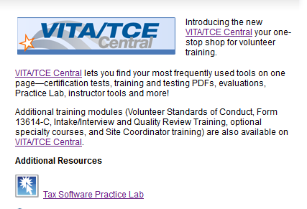
Sign in Instructions
Computer
Select the preparer account
Use the password label on your computer keyboard (most likely VITA2020)
Use google chrome for best results
Practice Lab
If you have not logged in yet, you will need to create an account – even if you have already taken your certification tests (link and learn and the practice lab are different portals, but you can use the same username and password)
Practice Lab Instructions
Go to https://apps.irs.gov/app/vita/
Select the practice lab
Enter password TRAINPROWEB
Either create a new account or
login with your information

Slide 18
Sign in Instructions
Link and Learn Instructions
The certification tests can be found at: https://apps.irs.gov/app/vita/
Or google, Link and Learn. Choose the address that has vita in the link name.
You will arrive at the Link & Learn Taxes main page.
Click on the VITA/TCE Central link.

Slide 19
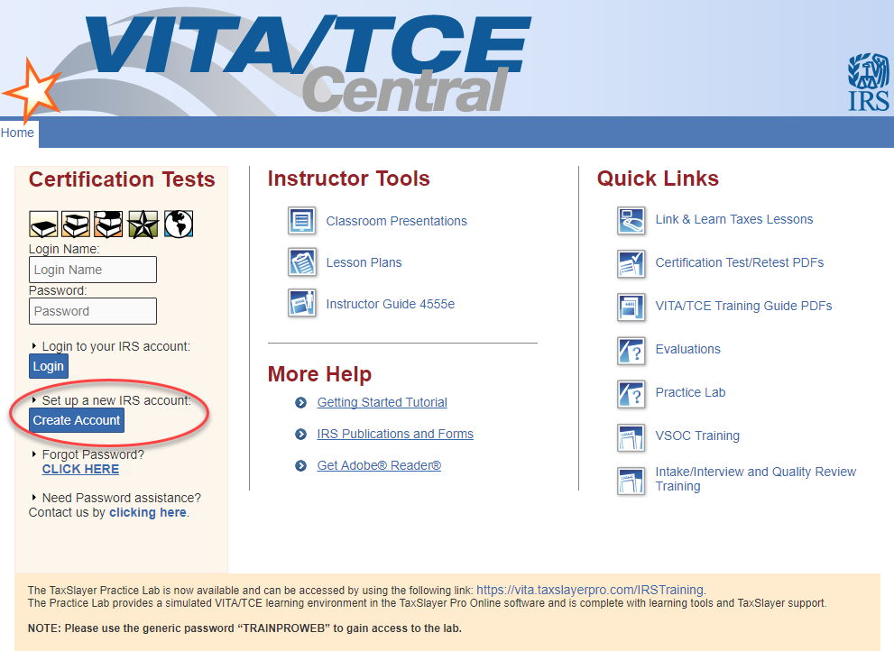
Sign in Instructions
If you are a new user, or a returning user who forgot the login information, create an account.

Slide 20
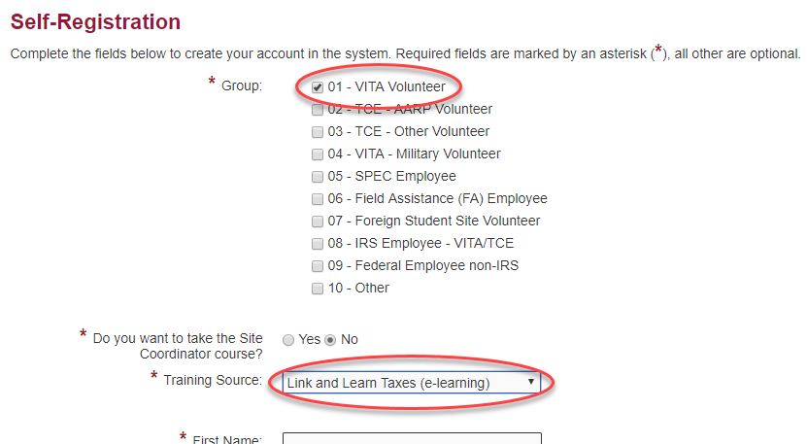
Sign in Instructions
Choose VITA Volunteer as the group.
Choose Link and Learn Taxes (e-learning) as the training source.
At the bottom, there is reference to a PTIN number. Those fields can be left blank.

Slide 21
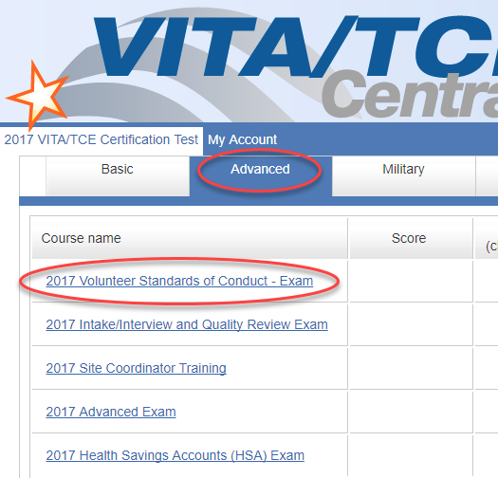
Sign in Instructions
Once the account is created, log in. Select the Advanced tab and click on the certification you wish to complete.
On the next pop-up window, click Launch in the top right corner to begin the test.

Slide 22
Questions?
Thank you! See you later this week.

