Slide 1
January 28, 2023 Training Session
Tax Year 2022

Slide 2
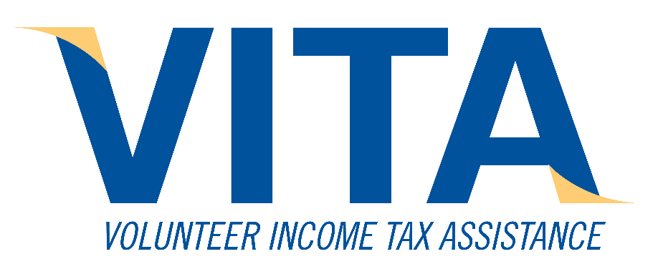
Agenda
Updates from United Way staff
Updates on IA Tax Changes
New for 2022 TY
New for upcoming 2023 TY
What didn’t change with recent legislation
Misc New Info
Resource Support
Low Income Exempt
Overview of making IA Adjustments
Part-Year Residents
Review IA Return Scenarios
Final Notes
Next Steps

Slide 3
Updates for Iowa

Slide 4
New for IA TY 2022 – Not Much
Tax bracket and Std Deduction values
QBI – IA will use 75% of Federal calculation
Taxslayer handles all of that
(Maybe you’ll do a spouse allocation for QBI)
Up to $1000 income exclusion for Premium or Retention Bonus funded by IA DHS for
Most peace officers
Correctional Officer/Medical staff
Teachers at accredited schools
Childcare workers
It is not clear how we would identify that bonus aside from asking the client
Charitable Mileage up to 50¢ starting July 1
IA 529 account limit up to $3,522/beneficiary

Slide 5
New for IA TY 2023 – A Lot
These changes are from Iowa Department of Revenue sources based on SF2417 (passed in 2018) and HF2317 (passed in spring 2022)
We have no idea:
How the IDR bureaucracy will end up actually interpreting and implementing these in the Expanded Instructions
What the new tax form(s) will look like
How it will be handled in Taxslayer
In other words, IA training a year from now will be really “interesting”

Slide 6
New for IA TY 2023 – cont
Why be interested in these changes now?
It doesn’t affect completing TY 2022 taxes
Clients do ask us about what they might do different for the next tax year
We are not tax advisors, but its awkward to say we don’t know anything about what’s coming
The honest answer is, we can’t know exactly how this all will affect a client’s taxes in 2023
That being said, it’s still worthwhile to go over the changes (even if we can’t predict the effect)

Slide 7
New for IA TY 2023 – cont
Retirement Income Not Taxed
Age 55 or older on Dec 31, 2023, or Disabled
Applied individually to spouses
IDR is still drafting what income qualifies
Married-Filing-Separate-Combined Return gone
100% QBI Federal amount carried to IA return
Student Loan Debt paid by an employer can be used to reduce taxable income
If the student also deducts Student Loan Interest, the Student Loan Debt amount must be reduced by that interest amount

Slide 8
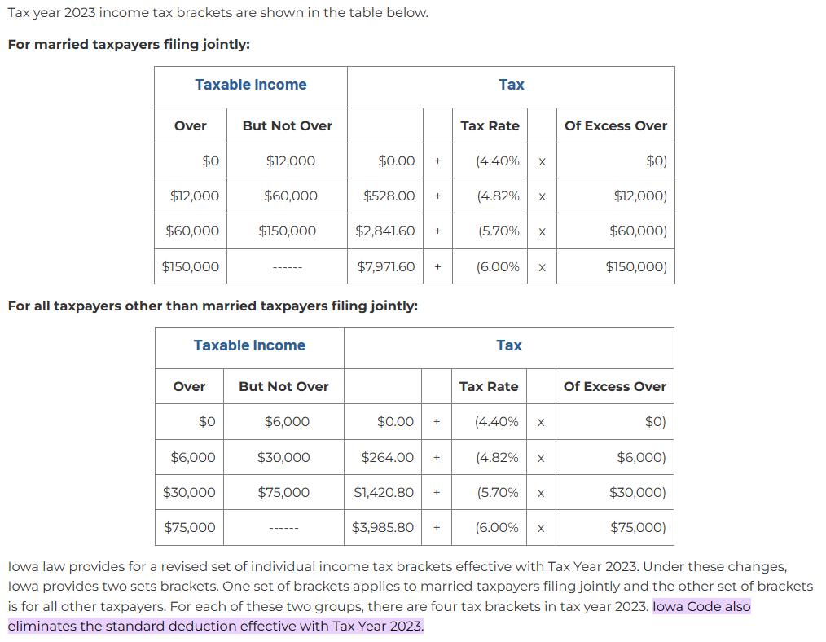
New for IA TY 2023 – cont

Slide 9
New for IA TY 2023 – cont
Iowa Tax Starting Point and Std Deductions
This implies that the Federal Std Deduction or any Federal itemizing is already done before IA is started
No details given on what IA adjustments are included or how this will be implemented
Will there even be an IA Sched A?
We will be done with spouse allocations, but not with IA adjustments

Slide 10
New for IA TY 2023 – cont
Federal Tax Deductibility Gone (Not Quite Yet)
TY 2022 (or earlier) Fed tax received as a refund or paid in 2023 will still be included when we process TY 2023
What we will NOT deduct for the 2023 TY is Federal withholding and estimated payments applied to the 2023 Fed taxes
We’ll have one more season after this one of truly needing to see previous years’ returns

Slide 11
New for IA TY 2023 – cont
Federal Tax Deductibility Gone – 2023 Example
Sahlberg Scenario | 2022 TY Taxes | 2023 TY Same Data | 2024 TY Same Data
Current TY withholding | $2200 | $2200 | $2200
Current TY Estimated Taxes | $1600 | $1600 | $1600
Prior Tax year additional Tax | $ 500 | $ 500 | $ 500
Total for IA Fed Adjustment | $4300 | $ 500 | $ 0
Using the Sahlberg scenario as an illustration
Rules for 2022 TY mean all three categories are included for the IA adjustment on line 31
Using the same data points
As we’ve interpreted the changes for 2023, only the additional tax paid in 2023 for 2022 taxes would be used to adjust IA taxable income for TY 2023
The withholding and estimated taxes paid during 2023 would NOT be allowed
No adjustments would happen starting with the 2024 TY

Slide 12
New for IA TY 2023 – cont
Health Insurance Premium Deduction
Only for taxpayers 65 or older with a net income of <$100,000
Will this deduction matter if this group doesn’t have any income?
Still can’t double-dip; can’t use the same insurance premiums for itemizing on Sched A and also for direct income reduction
It does create situations where you would choose “Yes” to leave Health Insurance Premiums on Sched A
$100,000 cutoff includes these added back
Retirement Income
Std or Itemized Deduction (Assume Fed?)
QBI Deduction
Personal Exemption (still set to $0)

Slide 13
New for IA TY 2023 – cont
Iowa Required Withholding
Up until now, you had two choices for retirement withdrawals
No withholding at all (Fed or IA)
Withholding of both Fed and IA (5% minimum)
Fed withholding with no IA withholding was not an option
Starting in 2023, it appears you will not be required to have any IA withholding, regardless of the Federal choice, if
The income is qualified non-taxable retirement income
The taxpayer qualifies for the non-taxable status
If a client asks, tell them to talk to the financial institution handling their retirement funds to discuss and confirm

Slide 14
Still in effect for IA in TY 2023
Income still not taxed for IA
Military pension (DFAS)
Federal Securities (e.g., Savings Bonds)
RailRoad pension
Social Security
Income still taxed for IA, but not Federal
Selected Municipal/State Bond interest

Slide 15
Other Late Updates

Slide 16
Odds-n-Ends
If we see clients from the Ingredion strike, any union strike pay they received is taxable and should be on a 1099-MISC, Box 3. Per Pub 4012 (D-58 and I-1):
Do NOT enter using the 1099-MISC screen
Enter under “Other Income”
Select “Strike Benefits” and set as “Earned Income”
Under “Self-Employment Tax”, use “Adjustments Non-Farm”
Enter the 1099-MISC Box 3 amount as a negative value
This removes any self-employment taxes
Resolving what I wasn’t sure of 2 weeks ago for IA
IA Educator Expenses limit is still $500
Limit for K-12 Tuition/Textbook credit is still 25% of up to $2000/child
Child Dependent Care tax credit for IA tops out at $45K net income (Had been $90K for TY 2021)

Slide 17
Resource Support

Slide 18
Resources – Sheets and Docs
Sent out
Digital Asset
Limits and amounts for common credits and deductions
IA Adjustments vs. Fed
Vehicle Registration deduction
Gambling
2022 IA School District list - #s and tax surcharges
2021 IA Handbook
Still to come
Simplified Method for 1099-R
Part-Year resident
2022 Addendum for the IA Handbook
Pondering
Low Income Exemption

Slide 19
Low Income Exemption

Slide 20
Low Income Exemption
For 2022, this applies if your income is less than
 | Under age 65 | Either Spouse Age 65 or older
Filing Single | $9,000 | $24,000
All other status’ | $13,500 | $32,000
Income includes totals combined for both spouses, if applicable
Standard Net Income (Line 26) plus
Any Pension Exclusion (Line 21) added back in, plus
Social Security Benefits (Step 4) (not taxed, but included for this calculation)
This is why it is sometimes confusing why one client gets the “Low Income Exemption” and another doesn’t, and they have a similar net income
If a client has this exemption for the current or previous TY, their Fed refund is entered as $0 regardless of what is on their previous Fed 1040

Slide 21
Iowa Adjustments

Slide 22
Basic IA Adjustments
Required – Entry for Fed Refund, and possibly Fed tax paid from prior TY
You must ALWAYS enter something for the Federal Refund field
If the client paid taxes the previous year, you still put $0 for the refund
Removing the refundable credits (Fed 1040 Line 32) may change a cash refund into a payment for input on the current IA return
For both Fed refund and payment, enter a positive value
There is no value brought over from the Federal return
Other common adjustments that are not manually re-allocated
Additional Educator Expenses
Stays with spouse who had the expenses
If left blank, Taxslayer uses the Federal value
Any input replaces ALL Federal values, it does not add to them
If both spouses’ expenses are < $300, no need to do an IA input
School Surtax paid the previous year (no default Federal value)
Allocated by Taxslayer as part of itemized deductions
K-12 Tuition/Textbook credit (no default Federal value)
Should stay with the spouse who has that dependent assigned to them in Step 3 on the IA 1040

Slide 23
Basic IA Adjustments - cont
Other common adjustments applied directly to IA income
Reducing interest income from Federal instruments
From 1099-INT Box 3
Savings Bonds, Treasury notes are the most common
Assume Box 3 is not taxed for IA unless you know otherwise
Adding interest income from Iowa-based bonds that are not taxed at the Federal level
From 1099-INT Box 8
Usually municipal bonds, or bonds related to state schools
This one is hard to know for sure, since most clients do not know the details behind what created the Box 8 entry
Assume no adjustments for Box 8 unless you know otherwise
The IA Exp Instructions Step 2 Line 5 has detailed lists of what falls into both categories
Reducing pension income for IPERS or DFAS Military
IPERS change is the difference between Federal Taxable (Box 2a) and IA taxable (Box 16)
For DFAS Military, you reduce by the full amount in Box 2a

Slide 24
Re-Allocating For MFSCR vs MFJ
Taxslayer allocates two items which cannot be changed
Pension Exclusion
Itemized deductions
Generally, the more equal the spouse’s IA net income, the more they gain from making appropriate allocation changes with MFSCR instead of MFJ
Once you approach a split of 85% or higher, it’s unlikely MFSCR will help
Taxslayer will use default allocations to decide which filing status is best, but that is frequently not the optimum
The only way to know for sure is to try the allocations with MFSCR and see how the refund or amount owed changes
Remember, the $ value you see in the upper right of Taxslayer will NOT update until you exit a state return
You need to synchronize allocations and the filing status
If you make allocations and leave the filing status as MFJ, Taxslayer will ignore what you put in the spouse’s fields
If you do some allocations with MFSCR and then manually switch back to MFJ, Taxslayer will NOT remove any of your allocation entries
You have to go in and back them out

Slide 25
Re-Allocating For MFSCR vs MFJ
Details for reallocating values can be found
In the distributed resource sheet with details on most of the fields
In the IA Expanded Instructions (details on rules for splitting the values)
General sources for re-allocation %’s, and what Federal total it applies to
Previous tax year’s IA net income ratio
Federal Refund received, or Federal tax paid from that TY
If that return is not available, use a 50/50 allocation
Current tax year IA net income ratio after all Health Insurance Premiums removed
Health Insurance Premiums that are NOT specific to an IRS form
Ratio between spouses of current tax year income that has NO Federal withholding
Fed Current tax year estimated tax payments
Spouse allocation has no impact on IA estimated payments
Current tax year IA net income ratio
Most other allocation changes

Slide 26
Part-Year Residents

Slide 27
Identify Iowa vs Non-Iowa Income
W-2’s are straightforward
Taxslayer will pull those in
Interest/Dividends
If it was a local bank or credit union branch, assign it to that state
National financial institutions, split by time in each state
Adjust the date if you know the account was not open a full year
Capital Gain
What state did they live in when a sale took place?
IRA/Retirement accounts
What state did they live in when they took the money out?
Pensions or any other monthly payments (e.g., alimony)
Divide by the time period in each state
If the payments started during that tax year, adjust using that date
Unemployment
Which state’s agency issued the 1099-G?
Gambling
Was the payer an IA source, or were they living in IA when they won?
IA wants to tax it either way
Other Income
Where did they live when they received it?

Slide 28
Identify Iowa Reductions
Deductible portion of Self Employment tax
Allocate by the percentage of IA self employment income
Health Insurance Premiums
For Medicare, allocate based on the time in each state
For out-of-pocket, it’s the state they were living in when they paid
Paid Alimony
Divide by the time period in each state
If the payments started during that tax year, adjust using that date
IA Retirement/Pension Exclusion
Use the exclusion $s the client qualifies for ($6K or $12K), up to the amount of retirement income assigned to IA
Federal Refund/Additional Payment input
If the client did NOT live in IA the previous year, these are $0
Taxslayer will adjust some credits on the IA 1040 (Child/Dependent Care, etc.)
Make your adjustments using the IA return Taxslayer sections
These are similar to but not identical to the standard IA adjustments
Taxslayer seems to provide helpful notes on the adjustment screens

Slide 29
Input for the other State(s)
Make sure the client is aware we have no training on other states
We’ll give it our best effort, but will keep it as basic as possible
In the Taxslayer state section, choose to add another state and pick the appropriate one
Remember to get that state set up in the main eFile section of Taxslayer
Consult with your site coordinator and other volunteers if you get stuck
Make sure that state gets printed for the client
Remember Taxslayer only has one date field for auto-debit, which it applies to Federal and all states
If a client has moved out of and into IA, use the latest date they arrived for the IA input.
Moved out of IA on Feb 1, moved back Aug 31
IA date inputs 8/31 for arrival, and blank or 12/31 for date left
IA 126 does not use the dates for recalculating the taxes
You will use them for allocation, but IA 126 does not

Slide 30
Iowa Scenarios

Slide 31
Training Scenario Iowa 1
Gloria Langford

Slide 32
Gloria Langford
Parent (Grandparent) as a dependent
The parent does not have to live with the taxpayer
Understand exactly where all the parent’s support is coming from, and who is paying for what (Pub 4012 Section C, especially C-4/5)
Other Dependent vs. Child Tax Credit clarification
I had stated in an earlier session that these are mutually exclusive
That is true for each dependent, but some dependent(s) can be “Other Dependent”, and different ones qualify for the Child Tax Credit
IPERS retirement contributions
IPERS is NOT a voluntary retirement program
That means contributions do not qualify the taxpayer for any retirement contribution credit
That is why it shows up in Box 14 on the W-2
The retirement credit is calculated on form 8880, so we want to use the option in Box 14 that retirement does NOT carry to Form 8880
Note that printed 1040 1099-R just has “Other” displayed
Selecting “Other (not listed)” will achieve the same thing
IPERS contributions still reduce the taxable income on the W-2

Slide 33
Gloria Langford
Reducing/Excluding Early Withdrawal penalty on a 1099-R (Code 1 Box 7)
The most common qualified reasons our clients will have for an exclusion are higher education and medical expenses
They have to be unreimbursed expenses
Medical expenses are the only one (I believe) that has a threshold
You can only exclude expenses that exceed 7.5% of your AGI
Does not require you to itemize
Easiest way to get the number for this category
Get the return input all done EXCEPT for the Form 5329
Generate the return’s pdf and see if there is any deductible amount showing on Sched A Line 4
If Line 4 is 0, they don’t get any exclusion
If line 4 is >0, use that as the $ value for Form 5329
There are a few cases where you can get an exclusion without using Form 5329, but it is extremely unlikely we’ll see those
Federal Refund/Taxes Paid
ALWAYS check the refundable credits to adjust these values
The majority of our clients will have this adjustment needed

Slide 34
Gloria Langford
Health Savings Account
It’s easy to forget that HSA withdrawals count as reimbursement for medical expenses for itemizing or insurance premiums
You can use HSA for medical or LTC premiums
Always use the HSA to reduce the medical costs first, so the insurance premiums can go to the first page of the IA return
The client’s list of medical expenses seldom has the HSA funds already subtracted
K-12 Expenses for Tuition/Textbook Credit
Aside from tuition and required books/supplies, there are a couple key things to look at for qualifying expenses
Has to be a school organized or sponsored activity
Has to be something they can’t use for day-to-day wear or activity
Home schooling expenses do not qualify
$2000 is the max per dependent, not the max total qualifying expenses
Educator Expenses
Expenses are tied to each spouse

Slide 35
Training Scenario Iowa 2
Gunther and Mary Anne Sahlberg

Slide 36
Gunther and Mary Anne Sahlberg
IPERS Pension
This is the other side of the IPERS coin
The IA taxable value in Box 16 is usually not the same as the Federal in Box 2a, and it’s easy to miss
Use the difference between the two values
Taxslayer will pull Box 2a into the IA 1040, so you have to make the adjustment in the Subtractions from Income screen in the IA section
Even though you are reducing income, you enter a positive value
Note: for Military pensions (DFAS), use the same field only you reduce ALL the taxable income
Mortgage Insurance
There are mortgage insurance premiums in Box 5 of their 1098
That is no longer a deductible expense
Vehicle Registration
Pickup trucks are now moving into the window for the 60% rule with older vehicles
A 2010 truck qualifies for a deduction, but is more than 11 yrs old

Slide 37
Gunther and Mary Anne Sahlberg
Qualified Charitable Distribution (QCD)
Requirements:
There must be some documentation explicitly stating the contribution is a QCD
Could be from the issuing financial institution or the receiving qualified charity (501(3)(C))
The taxpayer must be 70 ½ or older
The contribution must have gone from the issuing financial institution DIRECTLY to the charity
When entering the 1099-R, reduce the taxable amount by the QCD amount
This is a rare instance where your input does not match the form
On the Taxslayer main retirement menu, there is a Non-Taxable Distribution option
Just check the QCD checkbox (there is no field for the amount)
Taxslayer will put a small QCD note at the bottom of the 1040
Regardless of what the client has written down, this is NOT included in itemized charity contributions for Sched A

Slide 38
Gunther and Mary Anne Sahlberg
Estimated Taxes
If the client pays estimated Fed taxes in January of the filing year (not TY), it still counts for Federal but NOT for IA
Any input in the Jan 15th Federal entry will NOT carry to the IA return
If the client truly made a Jan payment, it must go in that field
You may want to make an electronic Taxslayer note for that payment, because it should be included for TY 2023
If the client comes back, those notes carry forward
If the client makes a payment in December, for example, you have two choices:
Enter it in the Jan 15th field, and manually adjust the IA value
This is what I requested for the scenario
Just add that December value to one of the other fields
Taxslayer just adds the field inputs into a total.
It does not have to match the actual timing of IRS payments made
It’s acceptable if the client just tells you the total estimated payments they made in TY 2022
Note: The IA estimated tax input has a Dec payment option

Slide 39
Gunther and Mary Anne Sahlberg
MFSCR vs MFJ
The net IA incomes balance changed drastically between 2021 and 2022
Filing MFSCR for 2021 was a benefit for them
Mary Anne retires, and the net income balance shifts to Gunther
Now, even with all the proper reallocations, Mary Anne’s income goes negative
Dependents and MFSCR
As soon as one spouse’s IA income goes negative, or one spouse doesn’t have enough tax to make use of their credits, IA MFJ is always better
Taxslayer defaults all dependents to the taxpayer, so they get all the dependent credits on Line 43
You can shift dependents to the spouse in the IA Basic Data section
This moves credits from the taxpayer to the spouse on Line 43, and can affect the total refund or payment
This is an easy change to make, and you can shift back and forth with no other changes needed
You may have to move any K-12 Tuition/Textbook credit

Slide 40
Training Scenario Iowa 3
Tiana Baker

Slide 41
Tiana Baker Income Allocation
Savings Bond
She cashed a savings bond while in IA, so that Box 3 income is excluded on the 1099-INT input screen
She cashed it in IA, and the CU is a branch in IA, so we’ll assign that $30 income to IA
W-2s
Taxslayer automatically pulls those to the correct state
1099-G
She won this in IA from an IA casino, so it is $1000 IA income
1099-C
She had the debt forgiven while living in IA from an IA CU branch, so it is IA income
Alimony
Equal monthly payments, so $1500 goes to IA (10 months) and $300 (2 months) to IL

Slide 42
Tiana Baker Adjustments
Health Insurance Premiums
Assume the dental insurance was constant all year
(In a perfect interview, that would be a question to ask)
$1000 goes to IA (10 months)
IL does not have that adjustment, so the other $200 is not used
Federal Refund
Assume she didn’t file an IA tax return for 2021
(again, in a perfect interview that would be confirmed)
Federal taxes had no effect on 2021 IA return, so ignore them for 2022
Enter $0 for the IA Federal Refund input (IA Exp Inst Step 7 Line 27)
Other Notes
Make sure W-2 and other non-IA docs have correct Taxslayer addresses
Itemized expenses are not allocated
We do not make adjustments on credits directly
We did not enter allocations for Child Care expenses
Taxslayer adjusted the Child/Dependent Care credit carried to IA based on the new income ratio
The rule used to adjust the tax is relative to income %, not time

Slide 43
Interviews

Slide 44
Interviews (IP or NIP)
Perfect Interview
This does not exist. We all do the best we can
Too many variables with clients, time, tax situations
Be considerate of the client, but do not be afraid to ask questions
If it affects their taxes, we have an obligation to ask
VITA Intake Sheet
This is not mandatory, but can be extremely helpful
The end goals are to:
Capture or calculate all the important information just once
Filter out what we do not need
Make it understandable to the next person looking at it
You can use the intake sheet, the 13614-C, the photocopy of IDs/SSNs, or a blank piece of paper
The NIP prep or any QR will still double check some things, but it will be much quicker and more efficient if the data is clear and summarized

Slide 45
Final Resources

Slide 46
Iowa
Good school district locators:
https://www.niche.com/k12/schools-near-you/
Search on “niche district locator”
https://www.greatschools.org/school-district-boundaries-map/
Search on “greatschools district locator”
School District Surtax list
https://www.freetaxusa.com/FreeTaxUSA/formdownload?form=ia_school_dist.pdf
Search on “IA school district surtax list 2022”

Slide 47
IRS Access
Options for getting to the IRS:
On-line (ID.me or already existing login)
Phone: General: 800-829-1040 Trans: 800-908-9946
Local Office Appt: 319-375-9166
Option to get a tax transcript mailed without a login
https://sa.www4.irs.gov/irfof-tra/login
ALL new account sign-ups for the IRS site are handled through the ID.me third-party company

Slide 48
Next Steps

Slide 49
Ready?
Make sure you are signed up for site times
Verify you have a valid logon for live Taxslayer
Download any supporting resources you want

Slide 50
Questions?
Thank you! See you at the sites!

