Slide 1
January 7, 2023 Training Session
Tax Year 2022

Slide 2
Agenda
Review Tax changes
Forms
Regulations
Review Out-of-Scope
Planned Resource Sheets
Discuss Scenarios Baker, Langford, Sahlberg
Next Steps

Slide 3
Changes for TY 2022

Slide 4
Pub 4491 has detailed information
Important Changes pages vii - xiii
Temporary Provisions (section 2)
For changes to Income Levels and Credit Limits, refer to the reference document sent out earlier

Slide 5
Tax Forms

Slide 6
13614-C changes to questions
Part III – Income; Changed “Virtual Currency” to “Digital Assets”, added 1099-K to list of self-employment form examples
Part V – Life Events; no longer has questions on EIP or ACTC
New question on voter assistance and registration in Additional Info section

Slide 7
Voter Assistance/Registration
Three questions in the Additional Information Section we want to confirm:
3 and 4: Refund/Balance Due information
7: Help with voting
If the answer to #7 is “No”, nothing further is needed
If the answer to #7 is “Yes”, then we have to point them in the right direction
Tax preparers/interviewers will NOT be helping them with early or absentee voting, registration, or transportation
United Way will provide an information sheet for us to give the client pointing them to voting resources
At some sites, we will also have a greeter with additional UW training to support clients who answer “Yes”
We’ll go over this in more detail on the 14th

Slide 8
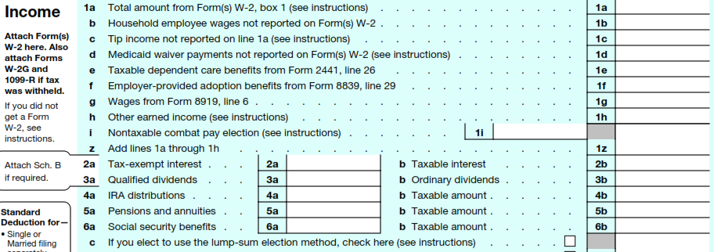
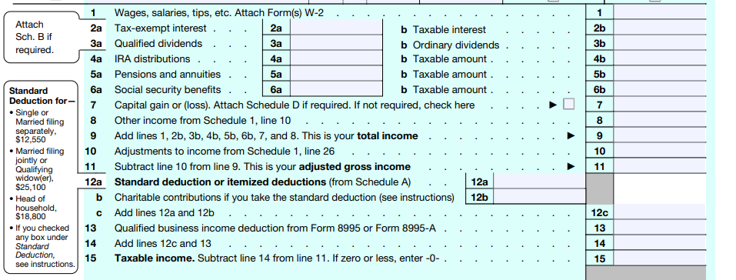
General 1040 changes Pg 1
2022
Expanded Line 1, added Lump Sum for SS
2021
Charitable option gone

Slide 9
General 1040 changes Pg 2
2021
Line 27 EIC age option for foster/homeless children gone
Combat pay moved to pg 1
Option for using an alternative year income gone
Recovery Rebate gone, Line 30 not currently used
Re-worded Line 28
2022

Slide 10
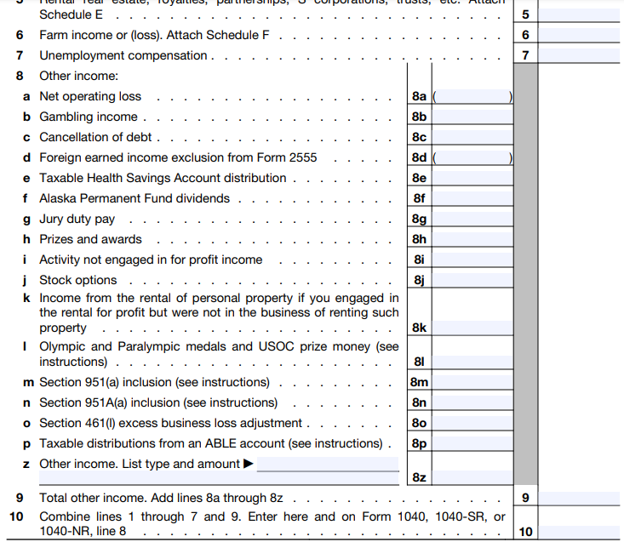
Schedule 1 Part I 2021
Line 8 added five more options for 2022.

Slide 11
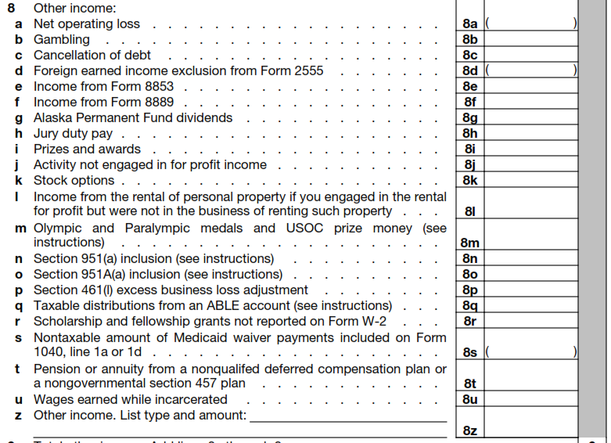
Schedule 1 Part I 2022
Deals with Archer MSA, LTC contracts

Slide 12
Schedule 2 Part II
2021
2022
Checkbox added if Form 5329 is not required

Slide 13
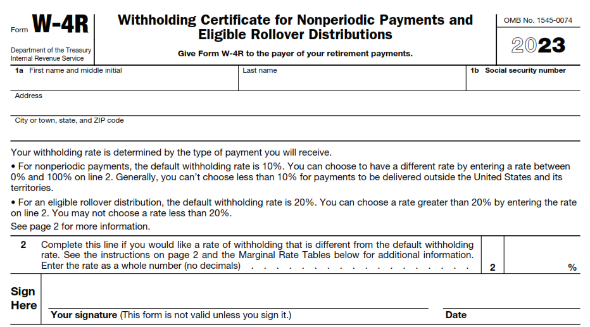
New Forms for 2023
Derived from W-4P, which is now only for periodic payments
Also new is 1099-DA (no images yet) for reporting digital asset exchange transactions (similar to 1099-B)

Slide 14
Tax Regulations

Slide 15
What went away after 2021?
Child Tax Credit
No more advanced payments
Maximum credit/child back to $2,000
No added credit for children under 6
Qualifying child age back to <17 (16 or younger)
Not fully refundable
Earned Income Credit
Age limits back to previous levels: Ages 25 – 64
No extra option for foster/homeless youth
No alternate calculation using 2019 income
Increased credits and opportunities for taxpayers with no qualifying children went away

Slide 16
What went away after 2021? (cont)
Child Dependent Care Tax Credit
No longer refundable
Percentages, phase-out income limits went back
 | 2021 | 2022
Max % applied to expenses | 50% | 35%
Income level to start phase-out | $125K | $15K
Max expenses for 1 dependent | $8K | $3K
Max expenses for > 1 dependent | $16K | $6K
Max employer pre-tax benefit allowed | $10.5K | $5K

Slide 17
What went away after 2021? (cont)
Private Mortgage Insurance not deductible (again)
Charitable contribution adjustment without itemizing no longer there
If they are approved for or received unemployment, a taxpayer is no longer assigned a level of 133% of Federal poverty level income, even if they were above that
No Economic Impact Payments (Recovery Rebate Credits)

Slide 18
Federal Student Loans – Still in effect
Private Loans not covered
Loan payment relief was to end 3/31/2022
Extended
Loans forgiven after 12/31/2020 are tax-free
Lender should not have issued 1099-C (4491 2-5)
Current sunset date is 12/31/2025
Employers can provide up to $5250 tax-free loan assistance
Reduces income on W-2
Current sunset date is 12/31/2025

Slide 19
Mortgage Dept Forgiveness – Still in effect
Must be Taxpayer’s principal residence
Not used as a business or rental property
Taxpayer cannot be bankrupt
Maximum reduction is $750K
MFS limit is $375K
Debt must be forgiven after 12/31/2020
Sunset date is 12/31/2025
Usually see 1099-C, but form 982 is also used.
For foreclosure, form 1099-A may also show up.
Potentially VERY complicated

Slide 20
Residential Energy Credits – one more year
Must be Taxpayer’s primary home, not new build
Has lifetime credit limits back to 2006
$500 overall
$200 for windows
Most items must meet Energy Star Version 6.0
Should be documented, usually by mfg or contractor
Non-refundable credits vary by type of installation
Form 5695
Part 1 out-of-scope (geothermal, wind, solar)
Part 2 covers windows, doors, roof, insulation, etc.
Extended through 2022, supposed to go up for 2023

Slide 21
What was made permanent?
Earned Income Credit
Taxpayer can claim EIC even if qualifying children do not have a SSN
They will be treated as a Taxpayer with no children
Investment Income cutoff up to $10.3K in 2022
Started at $10K in 2021, now indexed for inflation
Allowed for a separated spouse who
Has one or more a qualifying children living with them > ½ year, and
Had a legal separation, or
Lived apart the last 6 months of the year

Slide 22
Other Changes and Extensions
Educator Expenses went from $250 => $300
Qualified expenses include PPE, disinfectant, and other supplies to prevent spreading COVID
Mileage rates changed mid-year
HSA Changes
 | 2022 1/1-6/30 | 2022 7/1-12/31
Business Miles | 58.5¢/mile | 62.5¢/mile
Medical/moving miles | 18¢/mile | 22¢/mile
Charitable miles | 14¢/mile | 14¢/mile
Contribution Limits | 2021 | 2022
Self-only Coverage | $3,600 | $3,650
Family Coverage | $7,200 | $7,300
Add-on if 55+ | $1,000 | $1,000

Slide 23
Out-of-Scope
Primary resource is Pub 4012

Slide 24
Out-of-Scope
Any self-employed taxpayer who:
Had a net loss for 2022
Had inventory
Had depreciation
Had expenses > $35K
Employed and paid others
Business use of home
Hobby or income not-for-profit
Professional gamblers
Bartered for their business
Non-standard Qualified Business Income Deduction
Form 8995-A instead of form 8995

Slide 25
Out-of-Scope
Any rental income
Anything dealing with agriculture, fishing, or forestry
Any clergy
Any Active Military (Military pensions are in-scope)
Any Casualty/Theft losses
Cancellation of debt if it is not
Credit Card
Student Loan
Primary Residence (unless interest shows on 1099-C)
Done while taxpayer is solvent
IRAs – we can only process Standard IRAs (besides Roth)
No SEP or Simple
Penalties for excess contributions
Non-deductible contributions other than Roth
Std IRA Rollovers that are NOT tax-free

Slide 26
Out-of-Scope
1099-R
Taxable amount not determined and the Simplified Method had NOT been used previously.
Box 7 codes 5,6,8,9,A,E,J,K,N,P,R,T,U.W
If it’s not 7, 4, 1, G, or Q, check Pub 4012
1099-INT and 1099-DIV normally in-scope
Anything not in the usual boxes, check Pub 4012
Schedule K-1 only in scope for
Taxable/Tax exempt interest
Regular/Qualified dividends
Capital gains/losses
Royalty (no expenses)

Slide 27
Out-of-Scope
HSA
MSA or Archer
IRA distributions into an HSA
Excess contribution penalty
Energy Credits
Part I of form 5695 (geothermal, solar, or wind based)
Contractor credits (Form 8908)
Charity
Non-Cash contributions > $500
Charity carryover from prior years
Sale of home if used for rental or for business

Slide 28
Out-of-Scope
Any credits for purchasing electric or alternative vehicles (Form 8936)
Adoption expenses
Capital Assets ARE in scope for
Standard purchase/sales stocks and bonds
Capital loss carryovers
Wash sales (adjustment code W)
Anything else, check Pub 4012
Estimating tax penalties (1040 Line 38)
Alternative Minimum Tax
1099-K that is NOT related to self-employment or gambling winnings

Slide 29
Planned Resource Sheets

Slide 30
Planned Resource Sheets
Common Credits and Limits (sheet already out)
Digital Assets (DA) (sheet already out)
Clients will probably be more familiar with the terms Virtual or Crypto Currency
Core guideline:
If the DA activity used $s, would it affect their taxes?
If the answer is “yes”, it will be out-of-scope
Vehicle Registration Fees (out before 28th)
Key point: deduction is based on weight only
We do not include the large E-Vehicle fees
Gambling (mostly already there with Baker)
Hope to send out soon

Slide 31
Training Scenario 1
Tiana Baker

Slide 32
Discussion
Gambling is usually straightforward, but can be messy
Taxslayer only checks wins/losses on the W-2G form
It’s up to the preparer/interviewer to capture the full picture
We usually see W-2Gs from a casino, but several new options could show up
With gambling and other deductions, we still need to capture them fully
They may not apply for Federal, but may qualify for IA itemizing
Any questions or areas to review?

Slide 33
Training Scenario 2
Gloria Langford

Slide 34
Discussion
A parent as a dependent is not uncommon
Support and income details are key during the interview
In this case for early withdrawal, the Sched A is helpful even though she uses the standard deduction.
It calculates the total unreimbursed medical costs over her 7.5% limit
That’s what you have to use when you enter the value for Form 5329
Medical reasons is the only exception we usually run into that has that type of restriction for how much of the funds you can apply for reducing the extra penalty
Any questions or areas to review?

Slide 35
Training Scenario 3
Gunther and Mary Sahlberg

Slide 36
Discussion
Qualified Charitable Distributions need supporting documentation
Be skeptical if a client just says “oh, it was QCD”
NOT indicated on 1099-R
Documents or letters from the issuing financial institution or from the receiving charity almost always make it clear it was a QCD
Capital loss is straightforward if you have the right number to start with
For this it is REALLY helpful, almost necessary, to have last year’s 1040 package
One of the last pages in the VITA package is the Capital Loss Carryover Worksheet with the next year’s starting number. In this case, it’s $668
Any questions or areas to review?

Slide 37
Next Steps

Slide 38
Next Training
Added scenarios and detail VITA site process discussions
ZOOM January 14th
I plan to send out two more scenarios
Covering Iowa taxes
ZOOM January 28nd
Figure out what your best choices are for sites and times.
Working with clients starts January 30

Slide 39
Final Questions?
Thank you! See you Jan 14th

