Slide 1
January 14, 2023 Training Session
Tax Year 2022

Slide 2
Agenda
Review Processes:
Intake/Interview
Preparation
QR and Returning Completed Taxes to Clients
Missing Documents
eFile, completion screens
Amended and Prior Year Returns
Comments on Iowa Taxes
Review of O’Connor, Adams
Next Steps

Slide 3
Quick Notes for the Presentation
Shorthand
“IP” is In-Person
“NIP” is Not-in-Person
“Intake” is an NIP process
“Interview” applies to both IP and NIP
We are not going over prior year or amended returns
More on that later
When in doubt about the process consult the Site Coordinator and other volunteers
Missed new Out-of-Scope item last week
Name-Image-Likeness (NIL) income for athletes is Out-of-Scope
Should show up on 1099-NEC
Reminder to sign up for sites and shifts

Slide 4
Intake/Interview
Applies to both IP and NIP

Slide 5
Starting Out
Verify Photo ID, Taxpayer and Spouse (if a joint return)
Gov’t Issued Document
Do this even if there is a greeter
Verify SSNs or ITINs, including dependents
For NIP, get copies of Photo and Tax IDs
Make sure the client understands the process, especially for NIP

Slide 6
Starting Out – 13614-C
Go through the 13614-C
Verify all birthdays
Resolve illegible entries
Verify dependent status
Resolve unanswered or “Unsure” questions.
Verify choices for refund or payments AND DATE
Make sure Voting question is answered
If you are not busy, it is OK for the incoming client to fill out the 13614-C at your table.
You may need to directly help the client with the 13614-C (especially if there is no greeter)

Slide 7
Starting out – misc.
Do they prefer text or call for contacting them?
Note this on the 13614-C, usually writing and circling “T” or “Text” above the phone #, or “L” for landline or “No Text”
If no phone # can be provided, consult the Site Coordinator on what contact info to capture
Explain about signing Carry-Forward (F15080)
Accepting this means their data is available to ANY VITA site (Through Nov 2024 if they ask)
Does not affect doing their current taxes if they don’t sign
Note signature is on F15080, not 13614-C

Slide 8
Options for SSN/ITIN
If they do not have a Social Security or ITIN card with them, the following are acceptable:
SSA-1099
Letter from Social Security Office or IRS with name and full SSN or ITIN on it.
We have accepted the SSN/ITIN from the previous year’s return, especially for spouse or dependents
Verify with the client the earlier return was not rejected or had issues.
If you use something besides the original cards, it’s helpful to note for QR or NIP what you used
Verify the name for primary taxpayer

Slide 9
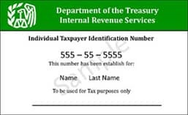
ITIN Card

Slide 10
Do you have all the documents?
Based on the 13614-C, do you have everything?
If information is provided to the IRS by a 3rd party (financial institution, employer, etc.) there should be a document.
If something is missing, follow the process outlined later in this presentation
Other documents are helpful, if not required.
Receipts from Colleges
Car registration
Property Tax
For documents we don’t need, kindly thank them for being thorough, but return them.

Slide 11
Capture/Summarize other data
Use the Intake Form for capturing data, especially if there is no other documentation
The more information in one place for the NIP preparers/QR and IP QR people, the better.
Take notes on Intake Form, 13614-C, photocopies
Examples
Bank information
Debit cards do NOT have bank account information
Deposit slips are NOT reliable for bank routing #
Cash income
Self-employed expenses
Out-of-Pocket Medical expenses and premiums
Charity
College or other school expenses

Slide 12
Out-of-Scope
If at any time you come across something that appears to be Out-of-Scope
Double-check in Pub 4012
Consult with the Site Coordinator
If it is OoS, explain and apologize to the client
Return all their documents
Any photocopies or notes we made can be returned to the client or set aside for shredding
We do not recommend other places to go for tax preparation
Keep the 13614-C, but clearly note on it that this was an Out-of-Scope situation

Slide 13
Tax Preparation

Slide 14
In-Person Preparation
Input the data in Taxslayer
Resolve anything that comes up that was missed in the initial interview
When done, the client is usually curious to know what the refund is or what they owe.
Remind them QR still needs to review it
Set the Taxslayer status flag to “Ready for Review”
Do NOT flag “Complete”

Slide 15
In-Person Prep (con’t)
Prepare their VITA/TCE envelope
Write their name, phone #, and text/notext choice
Make sure the tax year and site name are on the envelope
Put in all their relevant documents, the 13614-C, and your notes
Give them the envelope and let them know where to wait for an available QR person.
If there’s a greeter, let the greeter know.
Preparer’s initials are not needed on envelope
Colored label envelopes usually for NIP sites
Will have labels at IP sites for missing docs

Slide 16
Not-In-Person Preparation
Explain and have the client sign F14446
This is our permission to keep their documents
Prepare their VITA/TCE envelope
Write their name, phone #, and text/notext choice
Make sure the tax year and site name are on the envelope
Put all their relevant documents, signed forms, and your notes inside
Initial/Date the log label for Intake
Put the promise date (2 weeks) on the log label

Slide 17
Not-In-Person Prep (con’t)
Give the client a return-reminder half-sheet
Write the date and client’s name
Enter the date two weeks out when they can return
They can come anytime 2 weeks out or later
Make sure the site days and hours are on the sheet
Put the VITA envelope in the assigned location to go to the preparation site.

Slide 18
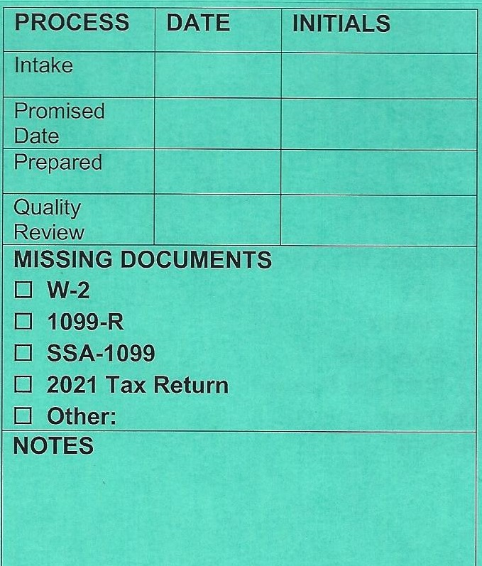
VITA Envelope
319-555-5555
TEXT
CLIENT NAME
2022
SITE NAME

Slide 19
Not-In-Person Preparation Site
Site Coordinator will indicate priority for envelopes to be processed
Remove all documents from the envelope
Review 13614-C, documents, and all intake notes
Enter the data in Taxslayer
Add any new notes useful for QR

Slide 20
NIP Tax Preparation Site (con’t)
Set the Taxslayer status flag to “Ready for Review”
Do NOT check “Complete”
Put everything back in the envelope
Date and initial the log label as the preparer
Put the envelope in the designated location for QR

Slide 21
Not-In-Person Issues
Issues can happen in preparation or QR
Examples are if you discover:
Missing documents not caught at the interview
The return is out-of-scope
Needed information is not in the notes
Try to resolve questions among the preparer, QR, and Site Coordinator
If that isn’t possible, contact the client
If you don’t get in contact quickly, set the envelope aside with a clear note as to what the issue is.

Slide 22
NIP Issues – Missing Document
Envelope stays at the NIP Preparation site
Clearly identify the issue on the envelope
When you do get in touch with the client, they have the same options as if this was discovered during the intake (covered later)
The physical documents can be brought to the intake site or to the preparation site
If brought to the intake site
Site Coordinators communicate for awareness
The docs will be transferred to the preparation site

Slide 23
NIP Issues – Notes not Complete
Envelope stays at the NIP Preparation site
If the client is not immediately available, note the issue on the envelope and set aside
When you do get in touch with the client, have them provide the missing information and update the notes
Complete the return and finish the process

Slide 24
NIP Issues - Out-of-Scope
Put everything back in the envelope and clearly mark it as to what the problem is
Have the envelope returned to the intake site
At the Intake Site:
Contact the client; let them know the situation and that they need to come back and pick up their documents (no appointment)
Make sure the 13614-C is marked as Out-of-Scope
When they come to pick it up:
Remove the 13614-C and F14446 (Consent form)
Return the envelope with the other documents
The F14446 can be shredded

Slide 25
Quality Review

Slide 26
In-Person QR
Pull up the return in Taxslayer
QR the return
Verify data with the client as appropriate
If there are issues, discuss with the preparer
Correct if appropriate
Print the return (VITA print setup)
Mark the return as “Approved” and “Complete” in Taxslayer
Pull out the e-file forms and any vouchers
Do NOT transmit

Slide 27
Not-In-Person QR
Pull up the return in Taxslayer
QR the return
If there are issues, discuss with the preparer
If the client needs to be involved, try to contact them
Correct if appropriate
Print the return (VITA print setup)
Pull out the e-file forms and any vouchers
Staple the return

Slide 28
Not-In-Person QR (con’t)
Mark the return as “Approved” and “Complete” in Taxslayer
Do NOT transmit
Put all documents, forms, and the printed return into the envelope
Date and Initial the log label for QR
Put the envelope in the appropriate place to go back to the intake site

Slide 29
Giving the Client their Return
Applies to both IP QR and NIP Intake site

Slide 30
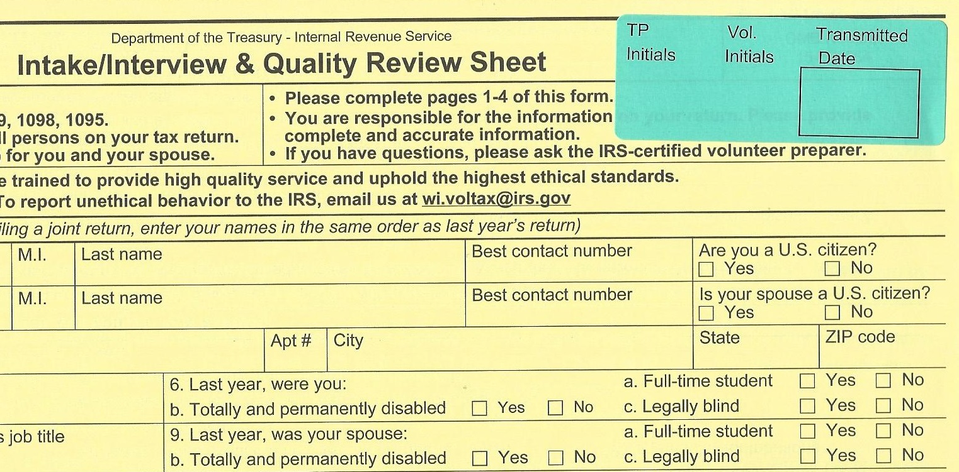
Giving the Client their Return
Go through the return with the client
Verify bank refund/payment options and account information (especially DATE if using auto-debit)
Remind them again this is their return
If anything will be e-filed:
WITNESS the client signing Fed 8879 and/or IA 8453
Those forms are being kept by the client
You and the client initial the sticker in the upper right corner of the 13614-C to indicate those forms were signed
That is the confirmation for e-filing

Slide 31
Giving the Client their Return (con’t)
If any return or voucher will be mailed in:
Make sure they have the correct address
Fed addresses can vary
Iowa address is usually written on the document
Show them where to sign
Make sure they know the deadlines
E-filing but using a voucher:
Explain the tax return goes in now, they can send the voucher later
Mailing return with a voucher:
Best to mail both at the same time

Slide 32
Giving the Client their Return (con’t)
Staple the return, if that’s not already done
Put all their documents, the tax return/voucher, and any signed e-file forms in the VITA envelope
All our notes and photocopies can either be put in the envelope or set aside for shredding
Other signed forms (14446) should be shredded
Remind the client to bring the return with them when they have taxes done next year
Put the 13614-C in the designated location for later e-file transmission

Slide 33
Missing Documents

Slide 34
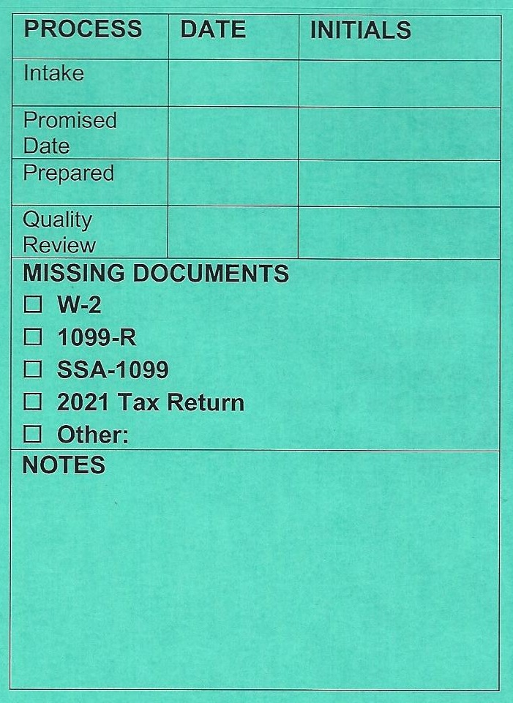
Missing Documents
The most common missing documents are identified
It could be more than 1
Add any others in the “Other” field or in Notes
Cross out, date, and initial when the document is brought in

Slide 35
Missing Documents – Intake or IP
Try to identify all missing information
There may be multiple documents
Capture all missing docs on the envelope label
Hilite or circle them to remind the client
Complete the interview and/or intake for all other information
Make sure the client understands what is missing and their options. They can:
Bring the documents back to the current site, no new appointment needed
Email the documents (explain that is not secure)
We have a VITA United Way gmail account

Slide 36
Missing Documents - IP
Prepare the VITA envelope as normal, with a label added if not already there
Discuss the choices below with the client, Site Coordinator and possibly QR:
It may be impossible to proceed further until the client provides the documents
It may be possible to prepare and QR the tax return to a temporary holding point without the missing documents
With either option, the rest of the process that follows applies

Slide 37
Missing Documents – IP No Prep
Put all the client documents, all photo copies, and all notes into the envelope
The envelope stays with the client
Keep the 13614-C with a clear note what is missing
The 13614-C is stored in a designated location
Make sure the missing items are clearly indicated on the envelope label
Explain to the client that their return may be done as NIP when they come back instead of IP
Make sure the client knows the site availability, and they don’t need a new appointment

Slide 38
Missing Documents – IP Prepare
Prepare the tax return as far as possible with existing documents
Put everything into the envelope as you would for a standard QR
Make sure the missing items are clearly indicated on the envelope label
Flag as “Ready for Review” in Taxslayer
Add a note in Taxslayer about the issue
Have them wait with the envelope for the next QR person, same as a normal process

Slide 39
Missing Documents – IP QR
Perform QR with the client using the available information and documents
Do NOT
Set the “Approved” or “Complete” flags
Keep the 13614-C with a clear note what is missing and that initial QR was done
The 13614-C is stored in a designated location
Remind the client about the days/hours for the site, and that no new appointment is needed
The client leaves with the envelope

Slide 40
Missing Documents– NIP at Intake
Prepare the VITA envelope as normal
Put all the client documents, all photo copies, all notes and the F14446 into the envelope
The envelope stays with the client
Keep the 13614-C with a clear note what is missing
The 13614-C is stored in a designated location
Make sure the missing items are clearly indicated on the envelope label
Remind the client about the days/hours for the site, and that no new appointment is needed
The clock starts when they return with the documents, no 2-week reminder sheet

Slide 41
Missing Documents Arrive

Slide 42
Missing Documents Arrive - IP
Verify all documents are now there
Update the envelope label
If emailed, the document will need to be printed
Even if emailed, the client will still need to come in for QR
Find the matching 13614-C
Have a preparer enter the additional data
Client may have to wait
The client waits for QR (still need 2 people)
QR finishes the process as normal

Slide 43
Missing Documents Arrive - NIP
Verify all documents are now there
Update the envelope label
If emailed, the documents will need to be printed
Give the client a 2-week reminder sheet (or email)
Did the physical document come to the NIP prep site or an IP site?
Site coordinators communicate to locate appropriate 13614-C
IP site arranges for completion at an NIP site
Physical document came to the NIP intake site?
Site Coordinator arranges getting document to the prep site with the 13614-C
That site matches with appropriate 13614-C
Process continues as normal

Slide 44
Finishing and e-filing

Slide 45
Refund or Amount Owed
Steps are shown across the top
Any refunds or amount owed are shown when you start
Note the IA amount, since it is not displayed later

Slide 46
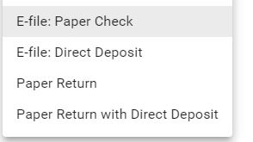
Select Filing Options
For Federal and State, select the filing option

Slide 47
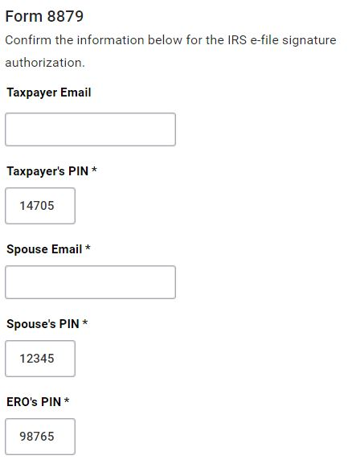
8879 Data – No Input
These should be defaulted by the system, and do not need to be changed

Slide 48
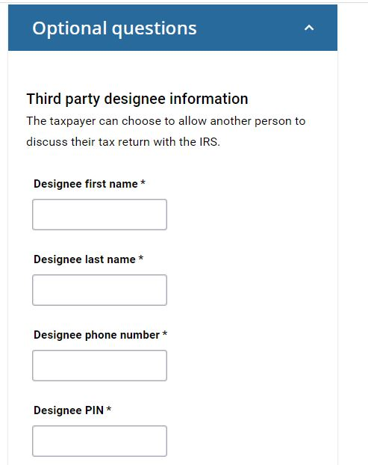
Optional Questions – No Input
We do not deal with this

Slide 49
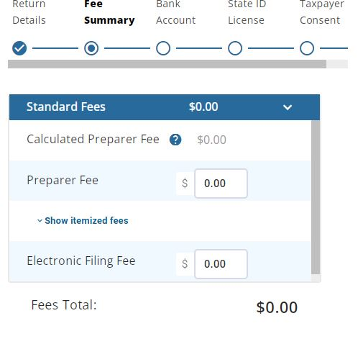
Fees – No Input
We do not have fees

Slide 50
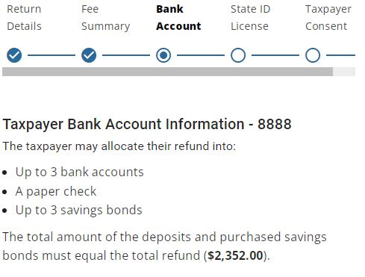
Total for any Bank activity
Only shows Federal total here
Iowa is on earlier screen

Slide 51
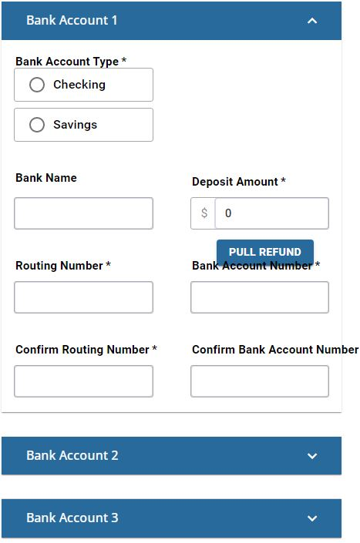
Bank Details
Input up to three bank accounts for refunds or payments
Use the button to pull in the full Fed refund if only 1 bank
Totals must equal full Fed refund
Bank info carries to IA

Slide 52
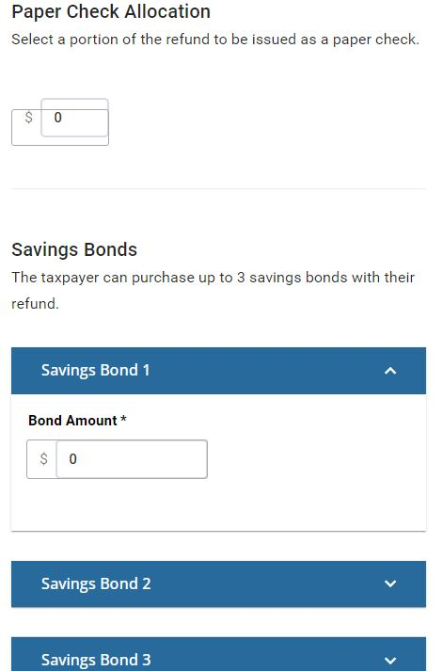
Check/Savings Bond Input
If being paid by check, indicate that here
We very seldom deal with Savings Bonds

Slide 53
Error Messages
If you miss something required , you will get an error

Slide 54
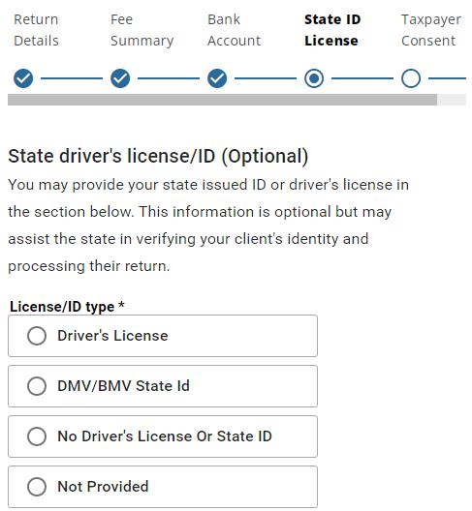
Driver’s License – No Input
We don’t need to input this

Slide 55
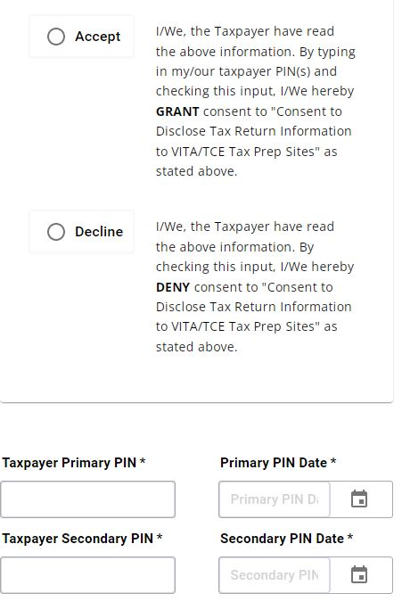
Carry-Forward Authorization
This screen is currently not in the practice lab
We can assume it will be there for the live filing
This is the input from Form 15080 at the back of 13614-C
This does not affect their return
If they signed 15080, then Accept
Use ZIP codes for PIN and today’s date

Slide 56
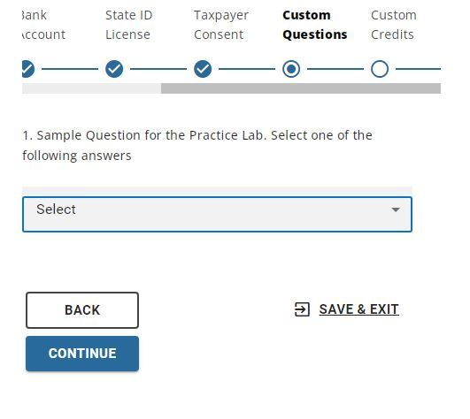
Additional Questions
Questions from end of 13614-C
Notice you can Save/Exit at any point and return later to finish

Slide 57
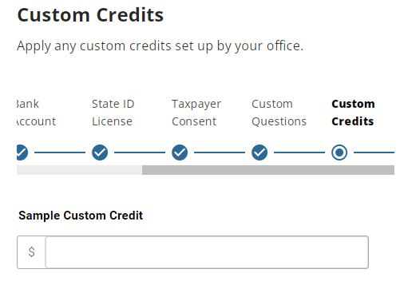
Custom Credits – No Input
No inputs here

Slide 58
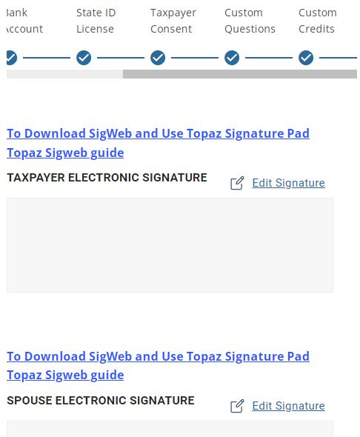
esignatures
We will not be using esignatures

Slide 59
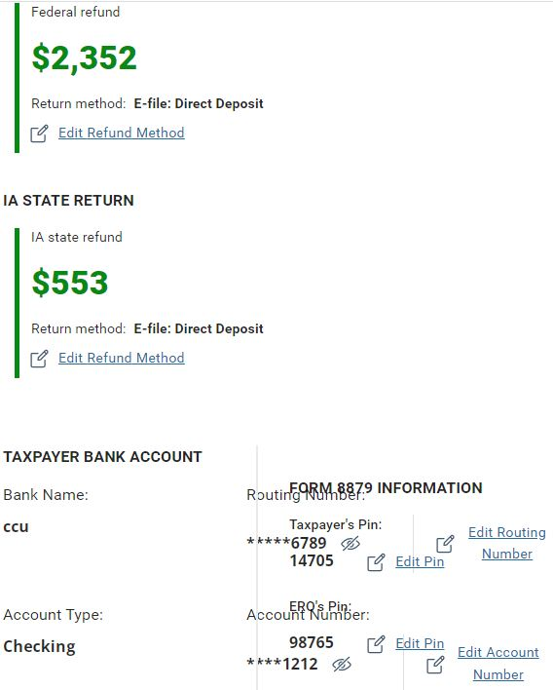
Summary/Verification
The refunds and bank summary are shown here
Your screen layout may affect how it is presented

Slide 60
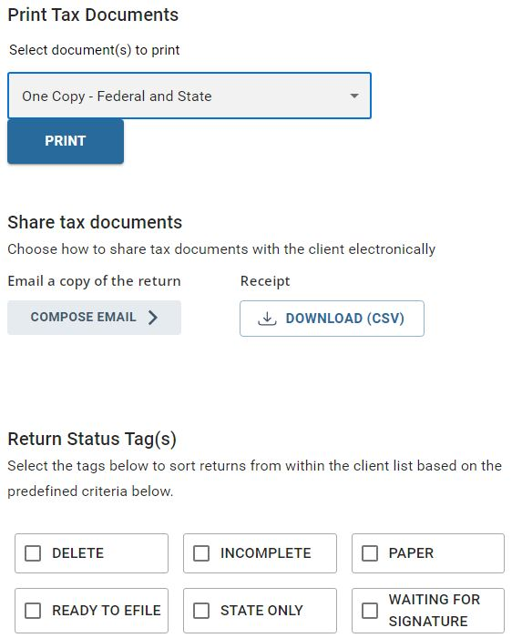
Printing and Tags
Choose the print option (Usually VITA)
Set any tags if needed
(eMail option may not be there for 2022)

Slide 61
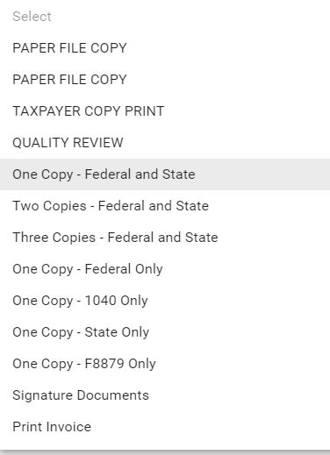
Printing Configuration Options
There should be a VITA configuration available in the live Taxslayer

Slide 62
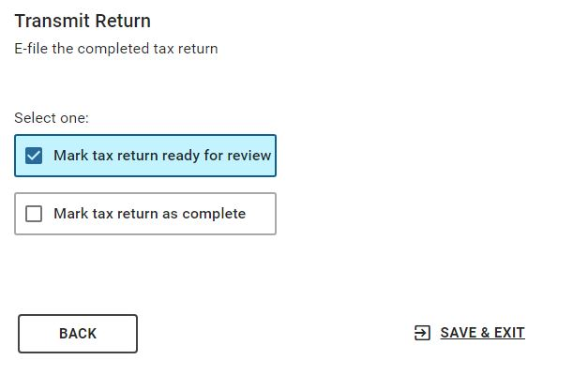
Review and Complete Flags
Setting these two flags at the right time is important to our process
BE CAREFUL of the TRANSMIT Button
It may not be active while “In Review”

Slide 63
Amended and Prior Years

Slide 64
Amended and Requests for Prior Years
In both these cases, our STRONG suggestion is to not have new VITA volunteers tackle them
We are not revisiting 2021 training in these sessions
Have separate, clearly labeled VITA envelopes for each return
Use year-appropriate 13614-C and intake forms
We will try to have those available at each site
If you run low, photo-copies are acceptable
If a NIP client has more than one return to process
Give a 3-week promise date
Rubber-band the envelopes together

Slide 65
Amended and Requests for Prior Years
If an IP client has more than one return to process:
And made an appointment for each return
Proceed as normal for each return
Did NOT make extra appointments
Site Coordinator/Manager decision:
Can we inconvenience other clients to spend the time to deal with all those returns now?
If not, the recommendation is:
Process the current year return as normal
Complete interviews for the other returns, but put those into a NIP flow
The client will return in 2 or 3 weeks to pick up the other amended or prior year returns

Slide 66
Amended and Requests for Prior Years
Amended Returns
Pub 4012 has a pretty good flow and set of instructions in section M
Prior Years
There are some very significant tax items regarding EIP and ACTC for 2021 and 2020 that aren’t here for 2022
Some key points from the 2021 training will be put into a slide deck and made available on the United Way volunteer site where current training is available
I will review the 2021 Intake form and have that available
After this much time has passed, the clients may be less likely to have all the IRS letters for EIP and ACTC
Use the clients best guess for amounts, and explain the IRS will adjust their return based on the IRS records

Slide 67
Reminder for Iowa for 2022

Slide 68
Reminders and Changes for Iowa
What I believe is confirmed
IA charitable miles allowance: 39¢ => 50¢ on July 1
College Savings IA 529 allowable deduction is now $3,522/beneficiary (was $3,474)
Under “Other Adjustments” in Taxslayer IA
IA Qualified Business Income Deduction is now 75% of Federal (50% for 2022, will be 100% for 2023)
Starting in 2020, Iowa conforms to IRS tax changes unless specifically changed by Iowa law
Iowa Standard Deductions | 2021 | 2022
Married Filing Joint | $5240 | $5420
All Others | $2130 | $2210

Slide 69
Reminders and Changes for Iowa
What I believe is new
Income deduction of up to $1K for premium or retention pay for
Peace or corrections officers, teachers, and child care workers
What I’m not sure of
IA Expanded 1040 instructions not out yet for 2022
Did Educator expense limit for Iowa stayed at $500 for each educator?
Tuition/Text book credit is now 25% of what?
Was $1K/dependent in 2020, $2K/dependent in 2021
Taxslayer shows a $500 for the limit for 2021 and 2022
Is IA Child/Dependent Care income limit still $90K?

Slide 70
Training Scenario 4
Shamus O’Connor

Slide 71
Discussion
Differing Addresses
It is not uncommon to have a different address on the driver’s license or other tax documents from what is on the 13614-C
Out clients can move frequently
For the return, use what is on the 13614-C
For returning clients, verify what address gets pulled forward from the previous year
Taxslayer pulls that 13614-C address into the tax documents you input.
Try to remember to edit those to what is actually on the document (especiall W-2 and 1099-R)
Sometimes, the IRS will flag an issue if we file a different address for a document than what the IRS received
Education Credits
Taxslayer asks about a previous year 1098-T with Box 7 checked and an amount in Box 2
I’ve never seen this with our clients, so unless we see something directly contradicting it, assume we will check “No” for that question in the Education Credits input
The Taxslayer checkbox for full-time student has parameters for age and duration of schooling during the year.
A 1098-T can have the 1/2- time student box checked, but not meet the requirement for Taxslayer
If that 1098-T box is NOT checked, than they cannot get the Taxslayer box checked

Slide 72
Discussion
Last Names
I don’t remember if Taxslayer never liked apostrophes.
The Practice Lab doesn’t like O’Connor
Hyphenated names can cause issues with getting returns accepted
It’s not a Taxslayer Issue
The IRS wants that last name to match up exactly to previous returns for that SSN
It you have last year’s return and the client says they had no rejections, then make sure the name matches that
Usually, you can go by the SS card
For clients from some cultures, this can still be an issue. We don’t always interpret correctly what they want used for their last name
Otherwise, make the client aware you may adjust the format of their last name to allow it to be accepted
Primary Taxpayer
If there is a spouse or deceased spouse involved, you may have a change on the 13614-C for who the Primary Taxpayer is
It doesn’t affect their filing, but may affect the ability to pull forward an earlier return
If there is a difference for living spouses, verify who they want as the primary taxpayer
If there is a change, pull data forward by earlier primary taxpayer, than edit in “Personal Data”

Slide 73
Training Scenario 5
Samuel and Patricia Adams

Slide 74
Discussion
Railroad Income
Basically an alternate way of inputting SSA-1099 (Blue Form RRB-1099) and 1099-R (Green Form RRB-1099-R)
The RRB-1099-R has no state fields
Taxslayer has you input the RRB-1099 into the Soc Sec screen, and turns the RRB-1099-R into a 1099-R when it generates the 1040
SSA-1099 RRB-1099
Box 5 => Box 3 and Box 5
Box 6 => Box 10
Description => Box 11 (Medicare)
Boxes 7-9 are for lump sum distributions from prior years
1099-R RRB-1099-R
Box 9b => Box 3
Box 1 => Box 4 and Box 7
Box 4 => Box 9
Simplified Method
It’s nice to have field 10 from the previous year’s Simplified Method worksheet, but not required
As long as you have their birthdays, the month/year the pension started, and Box 3 on the RRB-1099-R, you can figure the amount recovered to-date
This is assuming the pension payout hasn’t changed since it began, and the IRS doesn’t change the look-up values in Table 2 on the worksheet
There is a URL for a calculator I’ll put into the resource sheet I create

Slide 75
Discussion
Self-Employment
It’s nice to have expenses properly categorized, but as long as it’s a qualified expense, it will get summed up no matter what field you use on the “General Expenses” screen
I don’t remember if we had a discussion last year on tolls and parking
It’s a bit unusual for someone to get both a 1099-K and 1099-NEC from the same source, but I wanted to have both inputs. For whatever reason, Taxslayer treats the two inputs very differently
The 1099-NEC gets entered into it’s own form and Taxslayer automatically feeds that into Schedule C
The 1099-K link on the Income screen just points you to the Schedule C to input it directly there in the income field
For mileage: I’ll suggest that if the client doesn’t have it divided between the two ½s of the year, we divide it equally among the months that they were actively driving
Estimated Taxes
There is no formal IRS form listing these, so use what the client tells you for amounts and dates
If things are skewed (appears to be late payments, or all in the 4th quarter), we might remind them again it is their return, but there is a very slight chance the IRS may ask them about it

Slide 76
Next Steps

Slide 77
Next Training
Covering Iowa taxes and latest updates
ZOOM January 28th
Hoping for 3 scenarios
PLEASE go in and make sure you are signed up for the sites and times that you can support.
What Meredith can open for appointments is completely dependent on those sign-ups
This info is also needed to try and balance intake vs. available prep and QR resources

Slide 78
Questions?
Thank you! See you on Jan 28th

