Slide 2
Thank you for everything you do!
Company name:
Lifetime Giving:
Company Logo:

Slide 3
MISSION:
UWECI unites the caring powers of communities to invest in solutions that improve people’s lives.
SERVICE AREA:
Five counties: Linn, Cedar, Benton, Jones and Iowa
UNITE TO INSPIRE FOCUS AREAS:
Economic Mobility, Childhood Success, Access to Healthcare, Safety Net Services
UPDATED FUNDING CYCLE FY24-FY26:
Supporting 31 Partner Agencies and 49 Programs

Slide 5
Childcare
Housing/Workforce
Childhood Success
Economic Mobility
Access to
Healthcare
Safety Net Services

Slide 6
Building Economic Mobility
Iowa ranked #9 in country for having oldest housing
40% of renters spend more than 30% of their income on housing
22% of households in Iowa are ALICE
To work collaboratively with our community to address the need for more affordable housing units
Working to create a pathway for those under or un-employed to continue to progress their career
Impact 26 homes / 2,500 individuals
Support individuals entering the workforce
Impact 3,000 individuals with employment opportunities
$3.4 million back into the community through VITA

Slide 7
Fostering Childhood Success
Partnering to reach:
Single parents earning a median income spend 41.6% of their income on childcare
Linn County Graduation rate = 87%
Gather a group to align towards solutions for quality and affordable childcare
Reduce stigma of childcare role and create solutions to support at-risk or crisis youth
Quality and affordable childcare
Impact 2,000 children in our community with childhood success resources
Utilize youth providers for youth in high need communities
Impact 13,000 children for quality after school and summer programs

Slide 8
Improving Access to Healthcare
Iowa households below the ALICE threshold were likely to miss, delay, or skip their child’s preventative check up
3,408 hospital stays per 100,000 enrolled in Medicare could be prevented from outpatient treatment
Support individuals with disparities in health outcomes to have equitable access to care and resources
Enhance our 55+ volunteer transportation programs in rural areas
Impact 9,800 individuals
Women United supporters will continue to advocate to reduce barriers
Impact 2,835 women through Women United

Slide 9
Supporting Safety Net Services
270+ individuals served by local emergency shelters, transitional housing facilities
7% (or 21,000 individuals) of UWECI’s five-county area is food insecure
Understand and implement strategies for individuals to have access to resources in crisis
Collaborate with the National Alliance to End Homelessness for Linn County recommendations
Educate and promote 211
Impact 482 individuals in shelters
813,000 meals / 9,000,000 pounds of food distributed

Slide 10
What Inspires You?
Volunteer
Support non-profit capacity building
Education around community issues
Feeling of fulfillment
Volunteer Now, Volunteer Centers, BOLD
Invest
By investing your dollars, UWECI can
Identify community issues
Participate in solutions via community coalitions/groups/committees
Support non-profits/organizations with those solutions through grant making
Advocate
Educate/Inform self and others
Evoke Change
BOLD, Civic Circle,21 Day Equity Challenge, Women United,
Emerging Leaders United

Slide 11
Questions?

Slide 12
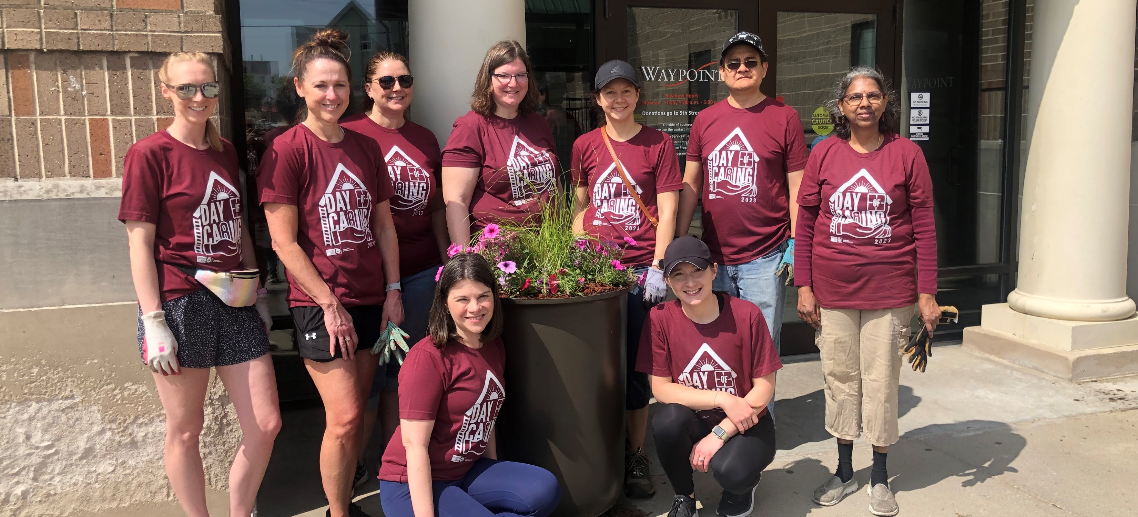
Thank You!!!

