Slide 1
Tax Preparer Training – New Volunteers
Session 1
Tax Year 2023 (Prepared in 2024) Dec. 4, 2023

Slide 2
Welcome and Introductions

Slide 3
Welcome to VITA
We’re glad you’re willing to help us provide a truly valuable service to the community
We serve clients with a wide variety of backgrounds and situations
Initially, there is a body of information related to ethics and intake procedures that the IRS requires us to be aware of
We will gladly address any questions or concerns you might have with the ethics and intake requirements as we go
There will be a lot of information presented over the next two months, but do not be intimidated
Site coordinators and fellow volunteers will always be available and willing to help
You are not expected to know it all

Slide 4
Introductions
Mark Bornemann
Training
9th Season as a VITA volunteer
Previous life as a Process Engineer at Collins Aeronautics
Meredith Hershner
Senior Manager, Community Resource and Volunteer Engagement - UWECI
VITA Coordinator
Patti Jakoubek
VITA Relationship Specialist

Slide 5
Agenda
Tax Training Overview
Volunteer Standards of Conduct
Review and certification questions
Intake/Interview and Quality Review
Review and certification questions
Client Process for TY 2023
Next Steps
Final Questions
(we’ll take a 15 minute break somewhere)

Slide 6
Tax Training Overview

Slide 7
Training Timetable for New Volunteers
ZOOM Session 2 of Certification Training (Scenarios 1-6)
December 6th (Wed)
Sessions 1 and 2 of Certification Training (in person)
December 9th at United Way (Sat)
ZOOM Session 3 of Certification Training (Scenarios 7-9)
December 11th (Mon)
Session 3 of Certification Training (in person)
December 16th at United Way (Sat)
If you miss one of the sessions, returning Volunteer training is on Thurs evenings Dec 7 and 14
Additional scenarios and detail process discussions (ZOOM – Saturdays – for all volunteers)
January 13, 2024
January 20, 2024
January 27, 2024
We will tentatively start the filing season on Jan 29, 2024

Slide 8
Training Publications
Form 6744 – VITA/TCE Volunteer Assistor’s Test/Retest
https://www.irs.gov/pub/irs-pdf/f6744.pdf
Pub 4012 – VITA/TCE Volunteer Resource Guide
https://www.irs.gov/pub/irs-pdf/p4012.pdf
Pub 4961 – Volunteer Standards of Conduct
https://www.irs.gov/pub/irs-pdf/p4961.pdf
Pub 5101 – Intake Interview Quality Review
https://www.irs.gov/pub/irs-pdf/p5101.pdf
Pub 5166 – VITA/TCE Volunteer Qual Site Requirements
https://www.irs.gov/pub/irs-pdf/p5166.pdf
Pub 4491 – VITA/TCE Training Guide
https://www.irs.gov/pub/irs-pdf/p4491.pdf
Pub 17 – Your Federal Income Tax – Tax Guide
Additional coverage of tax law and how to prepare taxes
https://www.irs.gov/pub/irs-pdf/p17.pdf

Slide 9
About those Resources
Pub 4012 will be your primary resource
It is grouped by sections, and the index does a reasonable job of providing a more detailed search
It illustrates the most common entries for Taxslayer
It has the definitive list of what is in or out of scope
Pub 4491 is big, and is only on-line
Provides examples and more in-depth discussion of topics.
Lists the relevant changes for forms and tax laws for TY 2023
Pub 17 is NOT tied to VITA or Taxslayer
It’s the IRS general taxpayer guide for most topics related to Form 1040 and the associated schedules
The language is more bureaucratic, but can provide specifics if you are still unsure after looking at Pub 4012 and 4491
Taxslayer is the software VITA uses for filing taxes

Slide 10
Standards of Conduct and Intake Certification Training
Review of examples
Walk through certification questions
We will poll your response on a few of them
This is not a difficult test, and you will not be provided the answers to these questions
If you take the test the first time and do NOT reach the passing threshold, note which questions you missed but do NOT take the test the 2nd time until you contact me or Meredith.
We will review what you missed and help you get to the correct answer for the 2nd attempt.
Typically, the retest questions are the ones used for the 2nd attempt.

Slide 11
Requirements
All VITA volunteers preparing and doing Quality Review on client returns must
Pass the Volunteer Standards of Conduct (VSC) certification test.
Pass the Intake/Interview and Quality Review certification test.
Pass the Advanced Course certification test.
Agree to comply with the VSC by signing and dating Form 13615 prior to working at a site.
Electronically generated by certification process
Forward it on to Meredith

Slide 12
Tax Certification Training
The UWECI VITA program has all volunteers meet Advanced Certification
We recommend you go through the scenarios beforehand and choose your answers, but do NOT take the certification tests until after the training sessions are done
We will review certification scenarios
Identify key places to find relevant information
Poll participating volunteers for their choice on answers
If appropriate, clarification/discussion about which answers are correct and why

Slide 13
Volunteer Testing For TY 2023
IRS site: https://www.linklearncertification.com/d/
Create an account as a tax volunteer for VITA
You will not be doing Site Coordinator testing
Contact Meredith or me if you have issues
Tests – all certification tests have “Pass” thresholds of 80%, and you get two attempts.
Volunteer Standards of Conduct
Intake/Interview and Quality Review
Advanced Certification

Slide 14
Certification Tests

Slide 15
Volunteer Standards of Conduct
Ethics Training for Volunteers

Slide 16
Volunteer Standards of Conduct
Key points are highlighted in this PowerPoint but for the complete set of information, refer to IRS Publication 4961 which can be found at:
https://www.irs.gov/pub/irs-pdf/p4961.pdf
Read the publication online or download your own copy.

Slide 17
Volunteer Standards of Conduct (VSC)
Follow Quality Site Requirements
Do not accept payment, solicit donations, or accept refund payments
Do not solicit business from taxpayers or use knowledge gained to benefit yourself or for personal use
Do not knowingly prepare false returns
Do not engage in activity deemed to have a negative effect on the VITA program
Treat all taxpayers in a professional, courteous, and respectful manner

Slide 18
Failure to Follow the VSC may mean (in increasing severity):
Your removal from VITA program
You are added to IRS Registry barring you from any future VITA participation
Deactivation of that site’s VITA IRS qualification.
Termination of the full United Way VITA program
Referral for possible criminal investigation

Slide 19
VSC #1: Quality Site Requirements
Proper certification
Volunteer name/address should match Gov’t ID
Can be certified to Basic, Advanced, and/or Military
A return must be assigned to someone certified to for all aspects of the return
United Way VITA has all volunteers get Advanced Certification
For the UW VITA program, anything requiring Military certification is out of scope
Have a defined Intake and Quality Review Process
This includes making sure the taxpayer understands the process
Completing intake form 13614-C and answering questions
Participate in a Quality Review of the completed return

Slide 20
VSC #1: Quality Site Requirements
Volunteers confirm Taxpayer Identity and other key information
Gov’t issued photo identification required for taxpayer clients
All spouses/joint filers, but not dependents
SSN or ITIN for everyone listed on the return
Reference materials available (Pub 4012, etc)
Volunteer Agreement form 13615 complete
Timely Filing of Returns
Civil Rights information (posters at sites)
Proper IRS site identification
Proper security for confidentiality

Slide 21
Example for VSC #2: No Payment
You finish a time-consuming return, and the client is very grateful. On her way out, the client stops by and tries to sneak a $20 bill in your pocket, saying, “It would have cost me ten times that with a paid preparer.” Return the money and explain that you cannot accept money for doing taxes, but United Way or a sponsoring charity may appreciate a donation which can be made at the main office or via their website.
Key point: You cannot accept payment from taxpayers, this includes not having tip jars.

Slide 22
Examples for VSC #3: No Soliciting
Your primary business includes selling health insurance policies. You find out the taxpayer recently lost access to health insurance. You cannot offer to sell the taxpayer health insurance through your business.
You have a friend working as a paid tax preparer. A client is out-of-scope for VITA. You cannot refer them to your friend.
Your daughter asks you to take orders at the VITA site for her school fundraiser. That still counts as soliciting personal business.
Key point: Even though you may be trying to help, soliciting business from the taxpayer is not allowed.

Slide 23
Example for VSC #4: False Return
A volunteer preparer told the taxpayer that cash income does not need to be reported. The return was completed without the cash income. The quality reviewer simply missed this omission, and the return was printed, signed, and e-filed. The volunteer preparer has violated this standard.
Key point: Since the quality reviewer did not knowingly allow this return to be e-filed incorrectly, the quality reviewer did not violate this standard. We should not confuse an unethical action with a lack of knowl­edge or a simple mistake.
Also, remember the taxpayer will be paying the penalty if a fraudulent return is reviewed by the IRS.

Slide 24
Discussion for VSC #5
Negative effect on VITA-
This primarily leans toward criminal activity or seriously alleged criminal activity.
Pub 4961 and the test has an example where a volunteer was publicly arrested.
They may not be convicted, but the allegation casts a shadow over the program

Slide 25
Discussion for #6
Being courteous and respectful –
We do not pass judgement on any client’s situation.
The example in Pub 4961 is a taxpayer who is unhappy with how their tax return ended up.
That is the focus of the guideline, but this can apply to any volatile or controversial subject.
Our response is that VITA is here get the best legal tax filing for each unique client, with no views or input on any political or social topics.
If a client becomes unmanageable for any reason, we can refuse to provide service.
In an extreme case, the site coordinator will work with the site’s guidelines to remove those clients.
At no time should a volunteer put themselves at physical risk in dealing with clients.

Slide 26
Resolving Problems
The site coordinator is the first point of contact for resolving any problems you aren’t comfortable with.
If a volunteer feels an issue can’t be handled by the site coordinator, email IRS at WI.VolTax@irs.gov and/or contact the local IRS-SPEC Relationship Manager.
Failure to Comply with the Standards of Conduct
If a violation is discovered, appropriate action will be taken, up to removal and barring the volunteer from the VITA program, closing of the site, and discontinuing IRS support to the sponsoring partner.

Slide 27
Volunteer Standards of Conduct Questions
Ethics Training for Volunteers

Slide 28
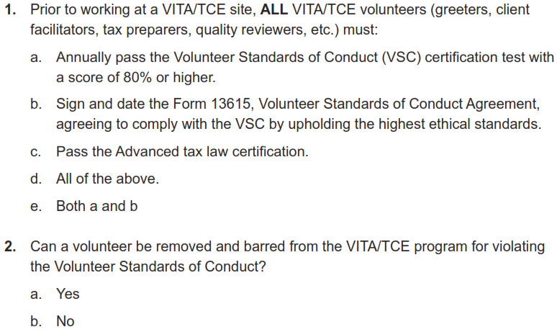
Volunteer Standards of Conduct
The test begins on page 14 in Pub 6744, the retest on page 17.

Slide 29
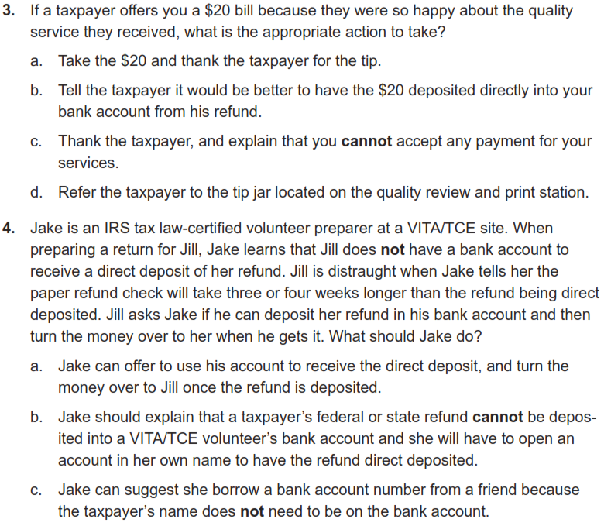
Volunteer Standards of Conduct

Slide 30
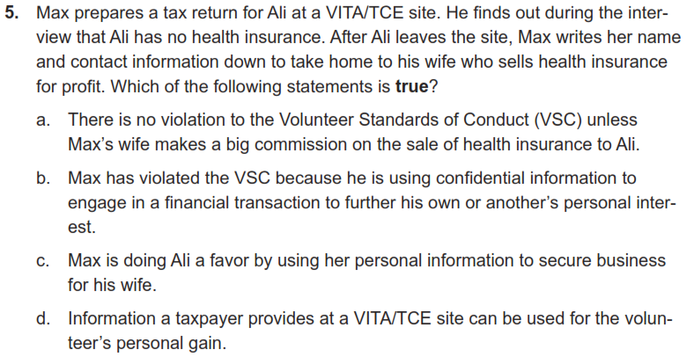
Volunteer Standards of Conduct

Slide 31
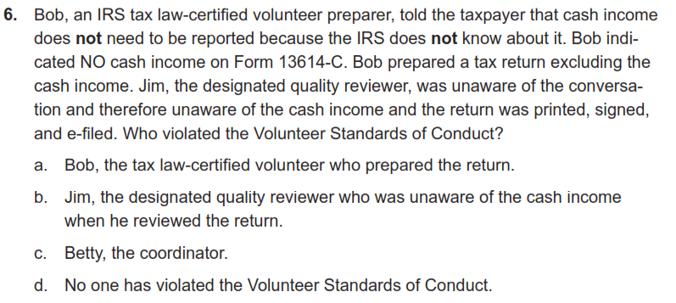
Volunteer Standards of Conduct

Slide 32
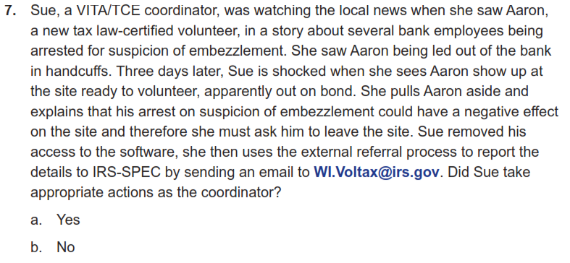
Volunteer Standards of Conduct

Slide 33
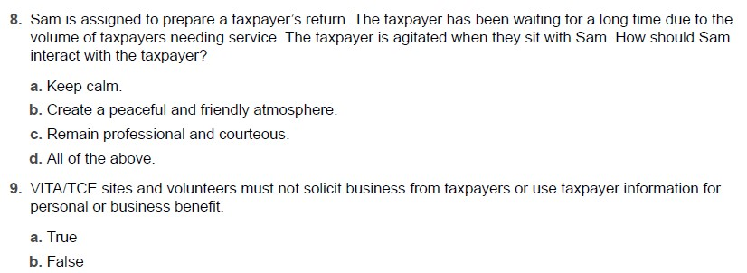
Volunteer Standards of Conduct

Slide 34
Volunteer Standards of Conduct

Slide 35
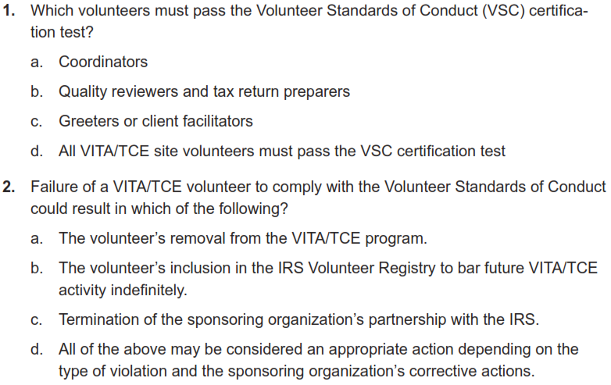
Volunteer Standards of Conduct
Retest begins on page 17 in Pub 6744.

Slide 36
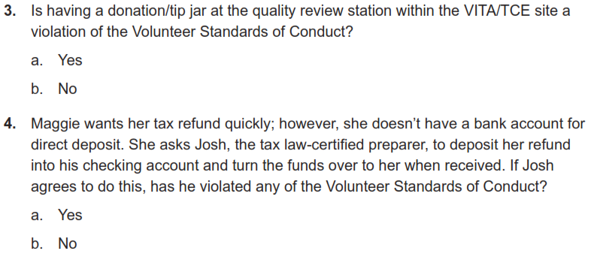
Volunteer Standards of Conduct
Retest

Slide 37
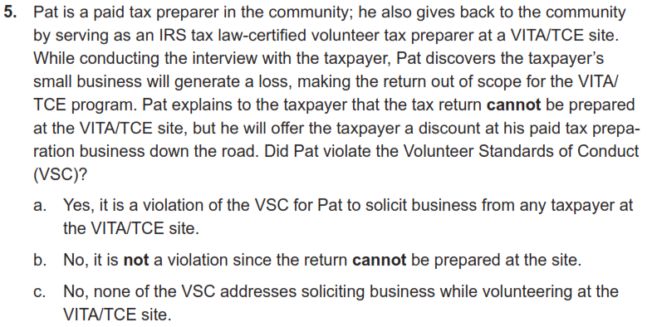
Volunteer Standards of Conduct
Retest

Slide 38
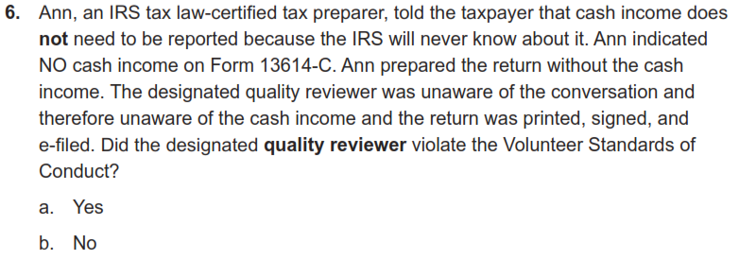
Volunteer Standards of Conduct
Retest

Slide 39
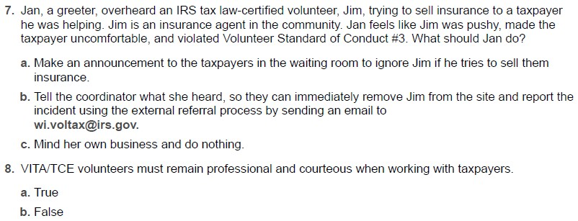
Volunteer Standards of Conduct
Retest

Slide 40
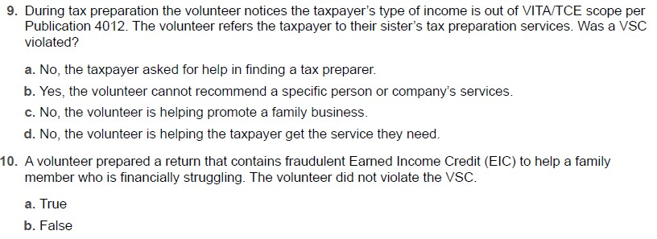
Volunteer Standards of Conduct
Retest

Slide 41
Intake/Interview and Quality Review
(We will go over our actual site processes in much more detail during the January training)

Slide 42
Rationale
Preparing an accurate return begins with explaining the tax preparation process, completing all questions on form 13614-C, listening to the taxpayer, and asking the right questions
Form 13614-C, Intake/Interview & Quality Review Sheet, is a tool designed to help ensure taxpayers are given the opportunity to provide all needed information before their tax return is prepared
When used properly, this form effectively contributes to accurate tax return preparation

Slide 43
Purpose of Intake Training
The IRS believes there is a definite correlation between proper use of Intake/Interview and Quality Review Process and preparation of an accurate tax return
IRS oversight reviews indicate consistent use of complete intake, interview, and quality review processes results in more accurate returns
Per Quality Site Requirements, it is mandatory that Form 13614-C completed for each tax return
Volunteers who refuse to prepare returns without following the Intake/Interview process are in violation of the Volunteer Standards of Conduct
The primary source for this is Pub 5101

Slide 44
Completing Form 13614-C
Taxpayer completes pages 1 through 3 of the Form 13614-C before meeting with a tax preparer
Page 4 is also completed, but it is a separate form 15080
Form 15080 is the taxpayer consent (Global Carry Forward) to keep their core data available to other VITA sites and for next year
Volunteers may help complete the form with the taxpayer if assistance is required
Tax preparer also interviews the taxpayer using the information provided on Form 13614-C
All questions on Form 13614-C Parts I to V must be answered and unsure answers changed to yes or no
We will have Form 13614-C available in English and Spanish. It is also available to be downloaded from irs.gov in many other languages
There is also a 13614-NR form for interviewing non-resident aliens
We have never needed that form, but the test mentions it

Slide 45
Intake Process: Verifying Identity
Interview should begin by requiring a photo ID to verify the identity of the taxpayer and any joint filer on the tax return
Identity theft continues to grow as a serious problem
Exceptions for requiring photo ID may only be made under special circumstances, primarily for taxpayers known to the site after being approved by the site coordinator
More details are in Publication 4299, Privacy, Confidentiality and Civil Rights - A Public Trust

Slide 46
Intake Process: Return and Volunteer Certification Levels
Site must have a process to ensure the return is within scope of the VITA Program and to identify the certification level needed
Site must also have a process to ensure volunteers have the certification needed for the returns they prepare
All VITA volunteers for this program will have Advanced Certification
We will not do Military or International certification
We will cover this again when we go over out-of-scope areas in January

Slide 47
The Interview Process
UWECI VITA employs two primary flows:
In person: the interview and actual tax preparation occur while the client is present
Not in Person (NIP):
The initial interview is done with the client present
All documents are passed to preparers who complete and QR the taxes
The client comes back to review and sign the return before we submit it
Do not proceed to enter data or allow the taxpayer to leave (NIP) until you have completed a thorough interview with the taxpayer because you may find that:
The tax return is outside our certification
The tax return is outside the scope of the VITA Program
The taxpayer does not have all needed information or documentation
Discovering these things before proceeding will save everyone’s time and avoid frustration

Slide 48
The Interview Process
Update or correct the intake form with any changes identified during the interview with the taxpayer
Clarify information while reviewing Form 13614-C during the Interview to gather all needed information
Be alert for conflicting information because sometimes an entry on one part will raise a question on another part of Form 13614-C
Notes for added information, reminders and clarifications are always beneficial
You will have an intake guide-sheet for notes

Slide 49
The Interview Process: Part I Personal Information
Verify that the information in Part I is correct and complete
Ensure that the names match the social security document
Information in Part I impacts tax law determinations
Are they a US Citizen?
Are they a student?
Can anyone else claim them?

Slide 50
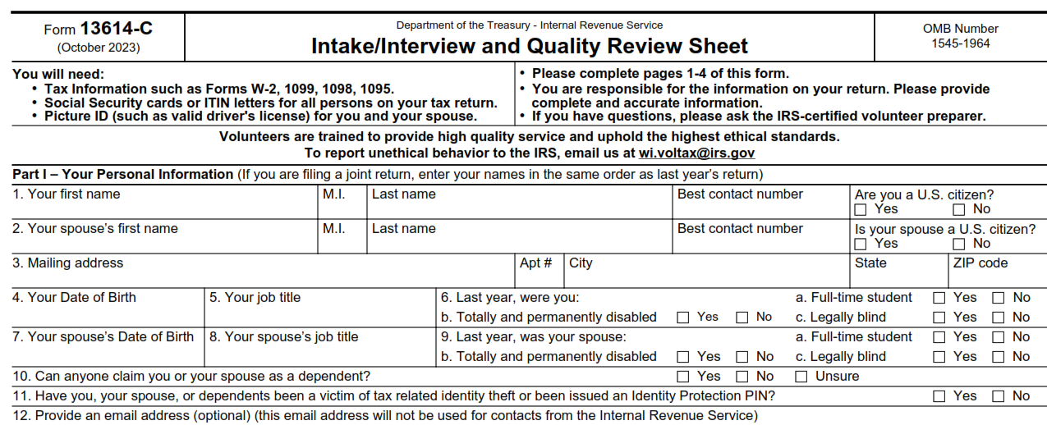
The Interview Process: Part I Personal Information
Major causes of IRS rejects if these are not correct

Slide 51
The Interview Process: Part II Marital Status and Household Information
Information in this section will help you make determinations about:
Filing Status
Dependency Qualification and Exemptions
Various credits and deductions

Slide 52
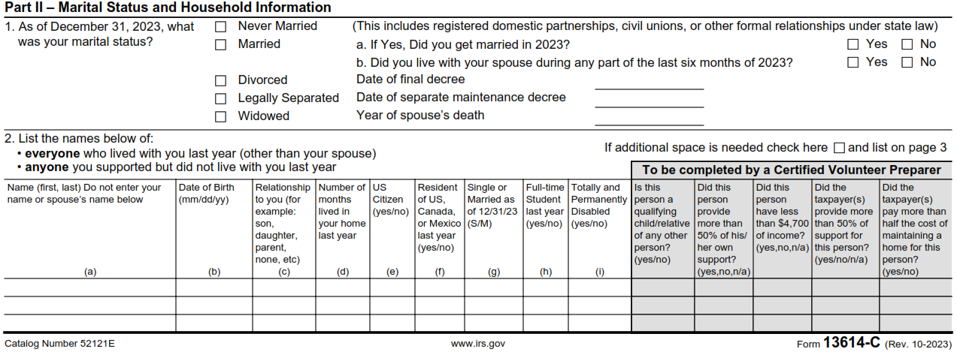
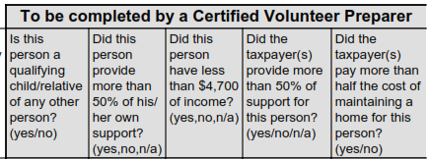
The Interview Process: Part II Marital Status and Household Information
Note the relevant date fields (“Long time ago” is OK) and living-with-spouse question.

Slide 53
The Interview Process: Part III - Income
Make sure all the questions on Part III of Form 13614-C are complete.
Change any “unsure" answers to “yes” or “no”
Step through all the “yes” income answers and verify any needed documentation is present
Always check if there is other income not covered on the 13614-C
This especially true for taxpayers who are self employed
Have we captured all income including cash payments received for work performed?

Slide 54
The Interview Process: Part III - Income
Rental income is the only “M” designation for Military on form, and all rental income is out-of-scope in any case
Note the certification designation for Tip Income in #2 (for later reference)

Slide 55
The Interview Process: Part IV- Expenses
Questions in this section help alert you to expenses paid by the taxpayer that may affect their return
The fact that a taxpayer had an expense is not the only consideration for a tax deduction or credit
Your reference materials will help you determine eligibility for deductions and credits and take into consideration the most advantageous position for the taxpayer
Taxslayer also automates some of this

Slide 56
The Interview Process: Part IV - Expenses
Be aware that these items under #4 may be much less important this year with the changes to Iowa tax law.
We’ll cover this in more detail in January

Slide 57
The Interview Process: Part V-Life Events
The Life Events section asks various questions that relate to the calculation of tax and the processing of the return

Slide 58
The Interview Process: Part V– Life Events
This is a critical item to verify and see the 1095-A.
This is sometimes answered incorrectly by the client, and always needs to be specifically verified.
It can go by several terms, including ACA and Obamacare.
The previous year’s return can also help resolve this.

Slide 59
The Interview Process: Additional Info
The taxpayer indicates how to receive their refund as well as other information which may be needed to complete the return
Highly desirable, but optional: Demographic information in this section may be collected and entered in the tax software

Slide 60
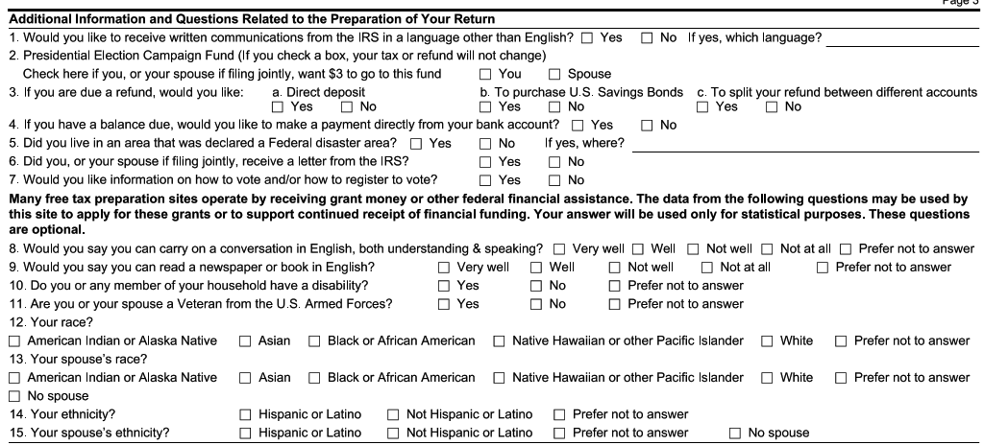
The Interview Process: Additional Info
Questions below the red line are helpful, but optional
We will refer the client to a source for this information.
Make sure to verify 3 and 4 with the taxpayer, since it determines how their return or payment is processed

Slide 61
The Interview Process: Due Diligence
As a volunteer, you must do your part when preparing or quality reviewing a tax return to ensure the information on the return is correct and complete
Generally, as an IRS certified volunteer, you can rely in good faith on some types of information from a taxpayer without requiring documentation
For example: You do not need to see proof of a taxpayer's cash contribution to a charity if you feel comfortable that this information is not unusual or questionable
If the IRS receives a form, we usually need to verify information
Part of due diligence requires asking a taxpayer to clarify information that may appear to be inconsistent or incomplete
If you are not comfortable with the information provided by a taxpayer, you are not obligated to prepare the tax return
Contact the site coordinator

Slide 62
Preparing the Tax Return
After completing the intake and interview process, either
For In-Person, start preparing the return in Taxslayer
For NIP, complete a VITA folder with all the needed information inside
Consult references and tools to determine filing status, exemptions, income, adjustments, deductions, credits, or payments
Publication 4012 contains tax law information, and guidance on using tools embedded in Taxslayer
Publication 17 and Publication 4491
Volunteer Tax Alerts
Once the return is prepared, a Quality Reviewer other than the preparer will go through the taxpayer material and the return

Slide 63
Quality Review Process Introduction
Purpose of a Quality Review to ensure that the taxpayer's tax return is accurate based on the Intake/Interview Sheet, and supporting documents provided by the taxpayer and the interview with the taxpayer
Someone besides the preparer must conduct a Quality Review of every return prepared
Quality Review offers the best opportunity to correct small errors before they can cause big problems
Quality Review takes place after the return is prepared, but before the taxpayer signs the return
We submit taxes after the taxpayer has reviewed and signed them

Slide 64
Quality Review Process Introduction
There are two acceptable QR methods:
Designated Review - Preferred quality review method employs a designated Quality Reviewer, a volunteer who is solely dedicated (at that shift and site) to reviewing returns prepared by the other volunteers at the site
Peer Review - Designated Quality Reviewer not available, so volunteers review each other’s prepared returns
Note: Self-Review, quality reviewing a return you prepared yourself, is never an acceptable quality review method
Other related publications:
Pub 5299 Quality Review Refresher
Pub 5310 Tax Return Quality Review Job Aid available for QR volunteers
Pub 5838 VITA/TCE Intake/Interview and QR Handbook

Slide 65
Quality Review Process Introduction
The Quality Review Process must include key critical actions:
Engaging the taxpayer in the review process
For the NIP process, this activity is the responsibility of the volunteer giving the tax return back to the client.
Comparing all information provided by the taxpayer on Form 13614-C and supporting documents against the completed tax return entries
As appropriate, using official reference materials to verify that tax law determinations are correct
Reminding the client that they are responsible for the return
We assist with creating it, but they will be held accountable by the IRS

Slide 66
Intake and Quality Review Questions
Ethics Training for Volunteers

Slide 67
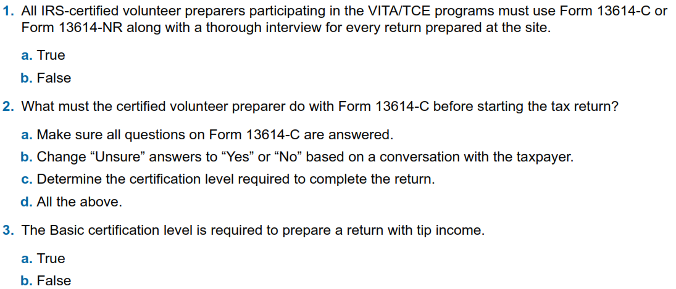
Intake/Interview and Quality Review Questions
The test begins on page 21 of Pub 6744, retest on page 23
unreported tip income.

Slide 68
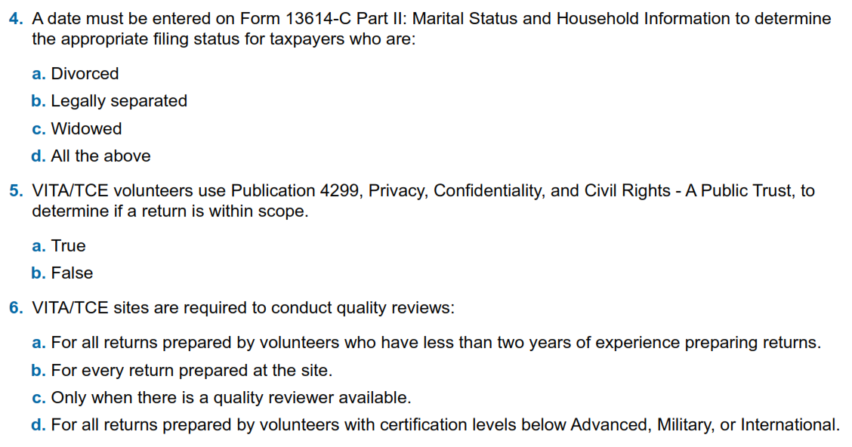
Intake/Interview and Quality Review Questions

Slide 69
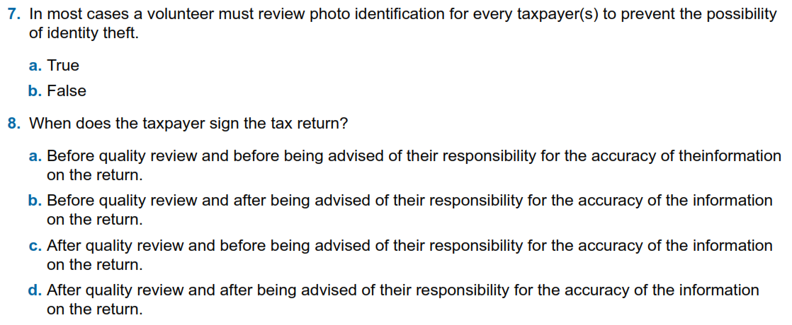
Intake/Interview and Quality Review Questions

Slide 70
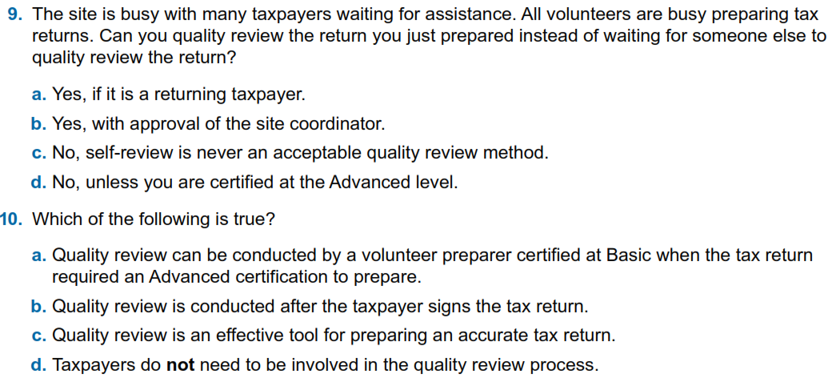
Intake/Interview and Quality Review Questions

Slide 71
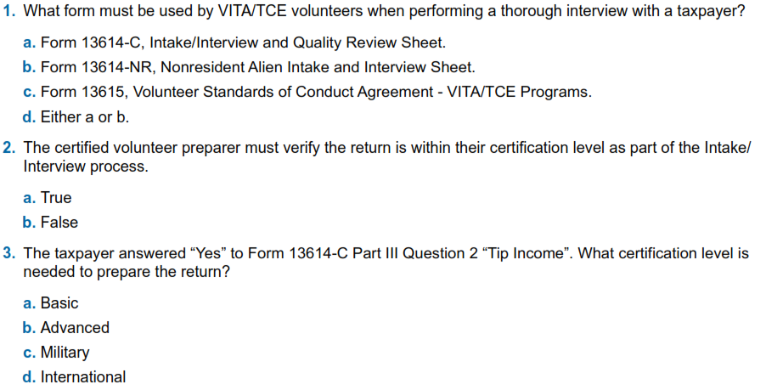
Intake/Interview and Quality Review Questions
Retest on page 23
a return with unreported tip income?

Slide 72
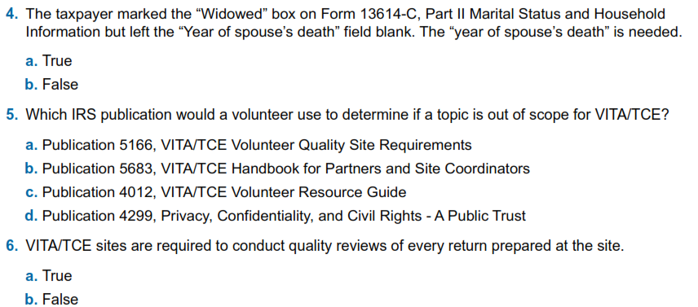
Intake/Interview and Quality Review Questions
Retest

Slide 73
Intake/Interview and Quality Review Questions
Retest

Slide 74
Intake/Interview and Quality Review Questions
Retest

Slide 75
Client Process for TY 2023

Slide 76
Client Process For TY 2023
We will be doing both intake/dropoff (NIP) and in-person preparation
Appointments will be set up in ALL cases. No open walk-ins.
We will try to have greeters available when possible to help with logistics as clients arrive
We want to avoid processing returns outside of VITA facilities
Meredith will review the client sign-up process
You will be provided the UW VITA URL links where slide decks and recordings will be published
Site locations and days are still being finalized
Sites will vary in which intake/process mode they operate under
Meredith will provide updates on the status for sites

Slide 77
Next Steps

Slide 78
Practice Lab
Practice Lab is a great place to try out the system regardless of how much training you attend
Practice is important!!
Highly recommend using the system on your own before trying to complete with a real person starting in February
Details to come later on site status and shift sign-ups

Slide 79
Login links
Taxslayer “Springboard” – access to Practice Lab and live Taxslayer
Not needed for this week, but will be needed for training on Monday 12/11 and Saturday 12/16
Search on: Taxslayer Springboard
https://vita.taxslayerpro.com/
IRS Link-and-Learn for certification
Search on: Link and Learn Home
https://www.linklearncertification.com/d/

Slide 80
Taking the Test When We’re Done
If you run into problems accessing the Practice Lab or Certification Site, let us know
Make sure to complete (after relevant training):
Volunteer Standards of Conduct
Intake/Interview and Quality Review
Advanced Certification
Once all three tests are completed and passed, print off and sign Form 13615
This form MUST come from the Certification program
Return Form 13615 to Meredith either in person or via email meredith.hershner@uweci.org
Certification target date is January 10th, 2024

Slide 81
VITA Shirts
You should be receiving a link to reserve long-sleeve VITA T-shirts
These are provided by the program

Slide 82
Questions?
Thank you! See you Wednesday evening
If you think of something: mark.bornemann@uweci.org

