Slide 1
Tax Preparer Training – Returning Volunteers
Session 1
Tax Year 2023 (Prepared in 2024) Dec. 7, 2023

Slide 2
Welcome and Introductions

Slide 3
Welcome back to VITA
Welcome back to what will be another rewarding tax season!
Mark Bornemann
9th Season as a VITA volunteer
Previous life as a Process Engineer at Collins Aerospace
Meredith Hershner
Senior Manager, Community Resource and Volunteer Engagement - UWECI
VITA Coordinator
Patti Jakoubek
VITA Relationship Specialist

Slide 4
Agenda
Tax Training Overview
Volunteer Standards of Conduct
Quick update and discussion
Intake/Interview and Quality Review
Quick update and discussion
Advanced Certification Scenarios 1-6
Out-of-Scope Reminder
Client Process Reminder
Next Steps and Updates from Meredith
Final Questions
(we’ll take a 15 minute break somewhere)

Slide 5
Tax Training Overview

Slide 6
Training Timetable for All Volunteers
New User Certification Training (in person Session 1)
December 9th at United Way (Sat)
ZOOM Session 3 of Certification Training New Users (Scenarios 7-9)
December 11th (Mon)
New User Certification Training (in person Session 2)
December 16th at United Way (Sat)
Returning User Certification ZOOM Session 2 (Scenarios 7-9)
December 14th (Thurs) 5:30 PM
Additional scenarios and detail process discussions (ZOOM – Saturdays – for all volunteers)
January 13, 2024
January 20, 2024
January 27, 2024
We will tentatively start the filing season on Jan 29, 2024

Slide 7
Training Publications
Form 6744 – VITA/TCE Volunteer Assistor’s Test/Retest
https://www.irs.gov/pub/irs-pdf/f6744.pdf
Pub 4012 – VITA/TCE Volunteer Resource Guide
https://www.irs.gov/pub/irs-pdf/p4012.pdf
Pub 4961 – Volunteer Standards of Conduct
https://www.irs.gov/pub/irs-pdf/p4961.pdf
Pub 5101 – Intake Interview Quality Review
https://www.irs.gov/pub/irs-pdf/p5101.pdf
Pub 5166 – VITA/TCE Volunteer Qual Site Requirements
https://www.irs.gov/pub/irs-pdf/p5166.pdf
Pub 4491 – VITA/TCE Training Guide
https://www.irs.gov/pub/irs-pdf/p4491.pdf
Pub 17 – Your Federal Income Tax – Tax Guide
Additional coverage of tax law and how to prepare taxes
https://www.irs.gov/pub/irs-pdf/p17.pdf

Slide 8
About those Resources
Pub 4012 will be your primary resource
It illustrates the most common entries for Taxslayer
It has the definitive list of what is in or out of scope
Pub 4491 is big, and is only on-line
Provides examples and more in-depth discussion of topics.
Lists the relevant changes for forms and tax laws for TY 2023
Pub 17 is NOT tied to VITA or Taxslayer
It’s the IRS general taxpayer guide for most topics related to Form 1040 and the associated schedules
The language is more bureaucratic, but can provide specifics if you are still unsure after looking at Pub 4012 and 4491

Slide 9
Standards of Conduct and Intake, Interview QR Certification Training
We will refresh your memory on the IRS policies.
We will not be reviewing all the questions.
You’ve all done this before
There have been a few changes to the tests, which we’ll go over.
If you take the test the first time and do NOT reach the passing threshold, note which questions you missed but we’ll suggest to talk to Meredith, me, or a site manager before the 2nd try.
We certainly do not want anyone to miss the 2nd attempt.

Slide 10
Advanced Tax Certification Training
We will review the scenarios
Identify key places for relevant information
Poll participants for their choice on answers
Discuss/Review the answers if necessary
Again, if you take the test the first time and do NOT reach the passing threshold, note which questions you missed and talk to someone before the 2nd attempt

Slide 11
Volunteer Testing For TY 2023
IRS site: https://www.linklearncertification.com/d/
Create an account as a tax volunteer for VITA
Contact Meredith or me if you have issues
Tests – all certification tests have “Pass” threshold of 80%, and you get two attempts.
Volunteer Standards of Conduct
Intake/Interview and Quality Review
Site Coordinator
Required if you will be acting in that role
We will not be going over that test in training
Advanced Certification

Slide 12
Requirements
All VITA volunteers preparing and doing Quality Review on client returns must
Pass the Volunteer Standards of Conduct (VSC) certification test.
Pass the Intake/Interview and Quality Review certification test.
Pass the Advanced Course certification test.
(Our VITA approach, not an IRS requirement)
Agree to comply with the VSC by signing and dating Form 13615 prior to working at a site.
Electronically generated by certification process
Forward it on to Meredith

Slide 13
Certification Tests

Slide 14
Volunteer Standards of Conduct
Ethics Training for Volunteers

Slide 15
Volunteer Standards of Conduct
The main IRS publication for this area is 4961 which can be found at:
https://www.irs.gov/pub/irs-pdf/p4961.pdf

Slide 16
Volunteer Standards of Conduct (VSC)
Follow Quality Site Requirements
Do not accept payment, solicit donations, or accept refund payments
Do not solicit business from taxpayers or use knowledge gained to benefit yourself or for personal use
Do not knowingly prepare false returns
Do not engage in activity deemed to have a negative effect on the VITA program
Treat all taxpayers in a professional, courteous, and respectful manner

Slide 17
Failure to Follow the VSC may mean (in increasing severity):
Your removal from VITA program
You are added to IRS Registry barring you from any future VITA participation
Deactivation of that site’s VITA IRS qualification.
Termination of the full United Way VITA program
Referral for possible criminal investigation

Slide 18
VSC #1: Quality Site Requirements
Proper certification
Volunteer name/address should match Gov’t ID
Have a defined Intake and Quality Review Process
Every client must have a complete 13614-C
We must go through the tax return with every client before they sign and make clear it is THEIR return
Volunteers confirm Taxpayer Identity and other key information
Gov’t issued photo identification required for taxpayer clients
All spouses/joint filers, but not dependents
SSN or ITIN for everyone listed on the return
Reference materials available (Pub 4012, etc)

Slide 19
VSC #1: Quality Site Requirements (con’t)
Volunteer Agreement form 13615 complete
Created by the certification software and sent to Meredith
Timely Filing of Returns
Civil Rights information (posters at sites)
Proper IRS site identification
Proper security for confidentiality
This includes physical documents/returns as well as electronic access

Slide 20
Other VSC Key Points:
VSC #2 No Payments: You cannot accept cash payment from taxpayers, including no tip jars.
VSC #3 No Soliciting: Even though you may be trying to help, soliciting business in any form from the taxpayer is not allowed.
VSC #4 Fraudulent Return: We should not confuse an unethical action with a lack of knowl­edge or a simple mistake. Remember the taxpayer pays the penalty if a fraudulent return is reviewed by the IRS.
VSC #5 Reflecting badly on VITA: This focuses mainly on criminal or seriously alleged criminal acts.

Slide 21
Discussion for VSC #6
Being professional, courteous and respectful –
VITA’s purpose is always to get the best legal tax filing for each unique client, with no consideration for any political or social topics.
VITA volunteers have always been exemplary in staying calm and respectful.
We get overwhelming positive response from grateful clients
However, the rare “bad apple” client does exist.

Slide 22
Discussion for VSC #6 (con’t)
Being professional, courteous and respectful –
The Pub 4961 example has a taxpayer who is unhappy with how their tax return ended up.
That is the primary focus of the guideline, but it can apply to any volatile or controversial area.
If a client becomes unmanageable for any reason, we can refuse to provide service.
In an extreme case, the site coordinator will work with the site’s guidelines to remove those clients.

Slide 23
Resolving Problems
The site coordinator is the first point of contact for resolving any problems you aren’t comfortable with.
If a volunteer feels an issue can’t be handled by the site coordinator, email IRS at WI.VolTax@irs.gov and/or contact the local IRS-SPEC Relationship Manager.

Slide 24
Volunteer Protection Act
Public Law 105-19, Volunteer Protection Act of 1997 (VPA)
Protects volunteers from liability for negligent acts they perform within scope of their responsibilities in the organization for whom they volunteer
Law not written for IRS but for the public
IRS coverage extends to volunteers as long as returns are prepared in scope
Any questions or concerns on this?

Slide 25
Notes for Volunteer Standards of Conduct Test
Ethics Training for Volunteers

Slide 26
Volunteer Standards of Conduct
There are some changes, so pay attention even though you’ve been through this before
Questions 8, 9, and 10 are new for both the test and retest
The previous questions that related to involving the client in the review process, verifying client ID, and verifying certification level are gone
New questions cover staying calm/professional, not soliciting business, and doing a fraudulent return
Be alert for “reverse” phrasing of questions
A situation is presented where someone did something they shouldn’t have
For example, instead of asking “Did they violate a VSC? TRUE/FALSE” the question will be posed as “They did not violate a VSC – TRUE/FALSE”

Slide 27
Intake/Interview and Quality Review
(We will go over our actual site processes in much more detail during the January training)

Slide 28
Rationale
Preparing an accurate return begins with explaining the tax preparation process, completing all questions on form 13614-C, listening to the taxpayer, and asking the right questions
Form 13614-C, Intake/Interview & Quality Review Sheet, is a tool designed to help ensure taxpayers are given the opportunity to provide all needed information before their tax return is prepared
When used properly, this form effectively contributes to accurate tax return preparation

Slide 29
Purpose of Intake Training
The IRS believes there is a definite correlation between proper use of Intake/Interview and Quality Review Process and preparation of an accurate tax return
IRS oversight reviews indicate consistent use of complete intake, interview, and quality review processes results in more accurate returns
Per Quality Site Requirements, it is mandatory that Form 13614-C completed for each tax return
Volunteers who refuse to prepare returns without following the Intake/Interview process are in violation of the Volunteer Standards of Conduct
The primary source for this section is Pub 5101

Slide 30
Completing Form 13614-C
Taxpayer completes pages 1 through 3 of the Form 13614-C before meeting with a tax preparer
Page 4 is also completed, but it is a separate form 15080
Form 15080 is the taxpayer consent (Global Carry Forward) to keep their core data available to other VITA sites and for next year
Volunteers may help complete the form with the taxpayer if assistance is required
Tax preparer also interviews the taxpayer using the information provided on Form 13614-C

Slide 31
Completing Form 13614-C (con’t)
All questions on Form 13614-C Parts I to V must be answered and unsure answers changed to yes or no
We will have Form 13614-C available in English and Spanish. It is also available to be downloaded from irs.gov in many other languages
There are no changes to 13614-C for TY 2023, aside from year and $ threshold updates
There is also a 13614-NR form for interviewing non-resident aliens
We have never used that form, but the test mentions it
The IRS information indicates they are equivalent forms

Slide 32
Intake Process: Verifying Identity
Interview should begin by requiring a photo ID to verify the identity of the taxpayer and any joint filer on the tax return
Identity theft continues to grow as a serious problem
Exceptions for requiring photo ID may only be made under special circumstances, primarily for taxpayers known to the site after being approved by the site coordinator
More details are in Publication 4299, Privacy, Confidentiality and Civil Rights - A Public Trust

Slide 33
Intake Process: Return and Volunteer Certification Levels
Site must have a process to ensure the return is within scope of the VITA Program and to identify the certification level needed
Site must also have a process to ensure volunteers have the certification needed for the returns they prepare
All VITA volunteers for this program will have Advanced Certification
We will not do Military or International certification
We will cover this again when we go over out-of-scope areas in January

Slide 34
The Interview Process
UWECI VITA will still employ two primary flows:
In person: do everything while the client is present
Not in Person (NIP):
The initial interview is done with the client present
All documents are passed to preparers who complete and QR the taxes
The client comes back to review and sign the return before we submit it
Do not proceed to enter data or allow the taxpayer to leave (NIP) until you have completed a thorough interview with the taxpayer because you may find:
The tax return is outside our certification or scope of VITA
The taxpayer does not have all needed information or documentation
Discovering these things before proceeding will save everyone’s time and avoid frustration

Slide 35
The Interview Process (con’t)
Update or correct the intake form with any changes identified during the interview with the taxpayer
Clarify information while reviewing Form 13614-C during the Interview to gather all needed information
Be alert for conflicting information; sometimes an entry on one part will raise a question on another part of Form 13614-C
Notes for added information, reminders and clarifications are always beneficial
You will have the intake guide-sheet for notes which we’ll review in January

Slide 36
The Interview Process: Part I Personal Information
Verify that the information in Part I is correct and complete
Ensure that the names match the social security document
Information in Part I impacts tax law determinations
Are they a US Citizen?
Are they a student?
Can anyone else claim them?

Slide 37
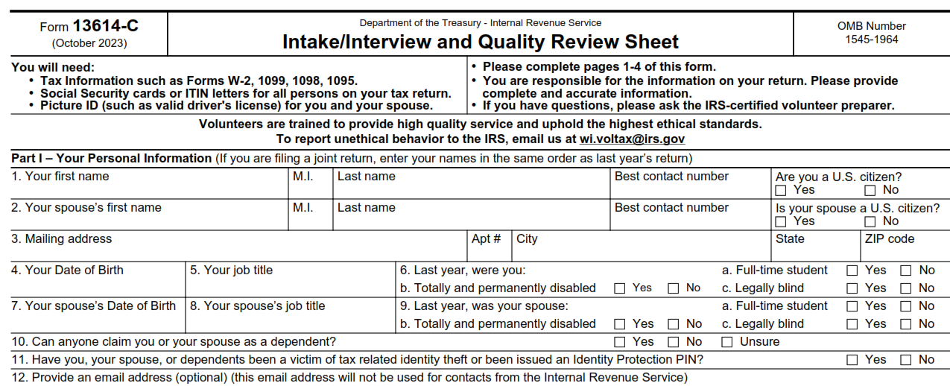
The Interview Process: Part I Personal Information
Major causes of IRS rejects if these are not correct

Slide 38
The Interview Process: Part II Marital Status and Household Information
Information in this section will help you make determinations about:
Filing Status
Dependency Qualification and Exemptions
Various credits and deductions

Slide 39
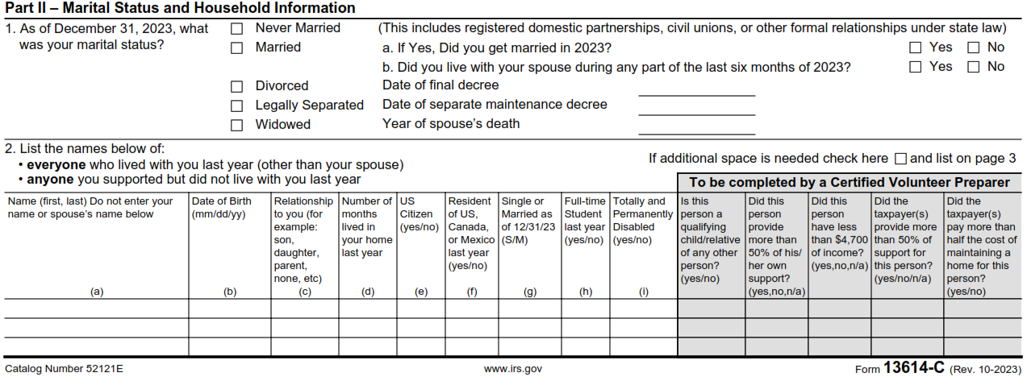
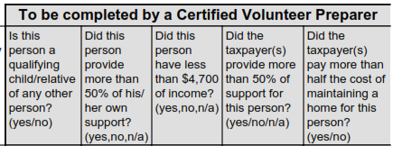
The Interview Process: Part II Marital Status and Household Information
We frequently forget to double-check these

Slide 40
The Interview Process: Part III - Income
Make sure all the questions on Part III of Form 13614-C are complete.
Change any “unsure" answers to “yes” or “no”
Step through all the “yes” income answers and verify any needed documentation is present
Always check if there is other income not covered on the 13614-C
This especially true for taxpayers who are self employed
Have we captured all income including cash payments received for work performed?
We’ll touch on digital assets (crypto-currency) in January

Slide 41
The Interview Process: Part III - Income
Rental income is the only “M” designation for Military on form, and all rental income is out-of-scope in any case
Note the certification level designation for Tip Income in #2 (for later reference in new certification questions)

Slide 42
The Interview Process: Part IV- Expenses
Questions in this section help alert you to expenses paid by the taxpayer that may affect their return
The fact that a taxpayer had an expense is not the only consideration for a tax deduction or credit
Your reference materials will help you determine eligibility for deductions and credits and take into consideration the most advantageous position for the taxpayer
Taxslayer does automate some of this

Slide 43
The Interview Process: Part IV - Expenses
Be aware that these items under #4 may be much less important this year with the changes to Iowa tax law.
We’ll cover this in more detail in January

Slide 44
The Interview Process: Part V-Life Events
The Life Events section asks various questions that relate to the calculation of tax and the processing of the return

Slide 45
The Interview Process: Part V– Life Events
This is a critical item to verify and see the 1095-A.
This is sometimes answered incorrectly by the client, and always needs to be specifically verified.
It can go by several terms, including ACA and Obamacare.
The previous year’s return can also help resolve this.

Slide 46
The Interview Process: Additional Info
The taxpayer indicates how to receive their refund as well as other information which may be needed to complete the return
Highly desirable, but optional: Demographic information in this section may be collected and entered in the tax software

Slide 47
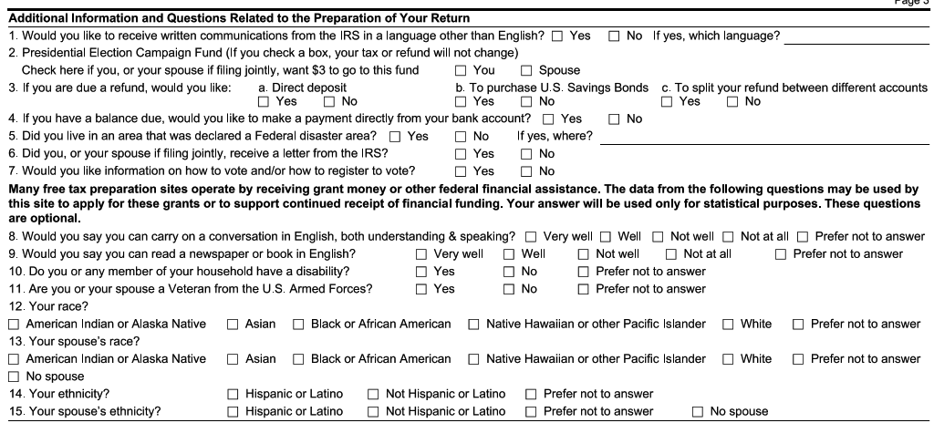
The Interview Process: Additional Info
Questions below the red line are helpful, but optional
We will refer the client to a source for this information.
Make sure to verify 3 and 4 with the taxpayer, since it determines how their return or payment is processed

Slide 48
The Interview Process: Due Diligence
As a volunteer, you must do your part when preparing or quality reviewing a tax return to ensure the information on the return is correct and complete
Generally, as an IRS certified volunteer, you can rely in good faith on some types of information from a taxpayer without requiring documentation
For example: You do not need to see proof of a taxpayer's cash contribution to a charity if you feel comfortable that this information is not unusual or questionable
If the IRS receives a form, we usually need to verify information
Part of due diligence requires asking a taxpayer to clarify information that may appear to be inconsistent or incomplete
If you are not comfortable with the information provided by a taxpayer, you are not obligated to prepare the tax return
Contact the site coordinator

Slide 49
Preparing the Tax Return
After completing the intake and interview process, either
For In-Person, start preparing the return in Taxslayer
For NIP, complete a VITA folder with all the needed information inside
Consult references and tools to determine filing status, exemptions, income, adjustments, deductions, credits, or payments
Publication 4012 contains tax law information, and guidance on using tools embedded in Taxslayer
Publication 17 and Publication 4491
Volunteer Tax Alerts
Once the return is prepared, a Quality Reviewer other than the preparer will go through the taxpayer material and the return

Slide 50
Quality Review Process
Purpose of a Quality Review to ensure that the taxpayer's tax return is accurate based on the Intake/Interview Sheet, and supporting documents provided by the taxpayer and the interview with the taxpayer
Someone besides the preparer must conduct a Quality Review of every return prepared
Quality Review offers the best opportunity to correct small errors before they can cause big problems
Quality Review takes place after the return is prepared, but before the taxpayer signs the return
We submit taxes after the taxpayer has reviewed and signed them

Slide 51
Quality Review Process (con’t)
There are two acceptable QR methods:
Designated Review - Preferred quality review method employs a designated Quality Reviewer, a volunteer who is solely dedicated (at that shift and site) to reviewing returns prepared by the other volunteers at the site
Peer Review - Designated Quality Reviewer not available, so volunteers review each other’s prepared returns
Note: Self-Review, quality reviewing a return you prepared yourself, is never an acceptable quality review method
Other related publications:
Pub 5299 Quality Review Refresher
Pub 5310 Tax Return Quality Review Job Aid available for QR volunteers
Pub 5838 VITA/TCE Intake/Interview and QR Handbook

Slide 52
Quality Review Process (con’t)
The Quality Review Process must include key critical actions:
Engaging the taxpayer in the review process
For the NIP process, this activity is the responsibility of the volunteer giving the tax return back to the client.
Comparing all information provided by the taxpayer on Form 13614-C and supporting documents against the completed tax return entries
As appropriate, using official reference materials to verify that tax law determinations are correct
Reminding the client that they are responsible for the return
We assist with creating it, but they will be held accountable by the IRS

Slide 53
Intake and Quality Review Test Notes
Ethics Training for Volunteers

Slide 54
Intake/Interview and Quality Review
There are changes here as well, including tweaks to the questions after Pub 6744 was published
Questions 3, 4, and 5 are new for both the test and retest
Questions on interest income, requirement for QR, and reasonable client verbal information are gone
New questions cover tip income, dates related to marital status, and which Pub controls out-of-scope
Retest Question 1 is also significantly revised
The previous question asked generally about performing a client interview
The new question asks about which form you have to use for the client interview

Slide 55
Intake/Interview and Quality Review
They shuffled some of the other questions
Still there, but a different number in the sequence
Question 3 for both test and retest have a wording change from Pub 6744. (new text in blue)
unreported tip income.
a return with unreported tip income?
Any doubts or concerns with the VSC and Intake/Interview questions?

Slide 56
Advanced Certification Scenarios
(Not requiring Taxslayer)

Slide 57
Scenario 1
Lydia Roadway

Slide 58
Adv. Scenario 1 Interview Notes
Scenario and initial test questions Pub 6744 pg. 69

Slide 59
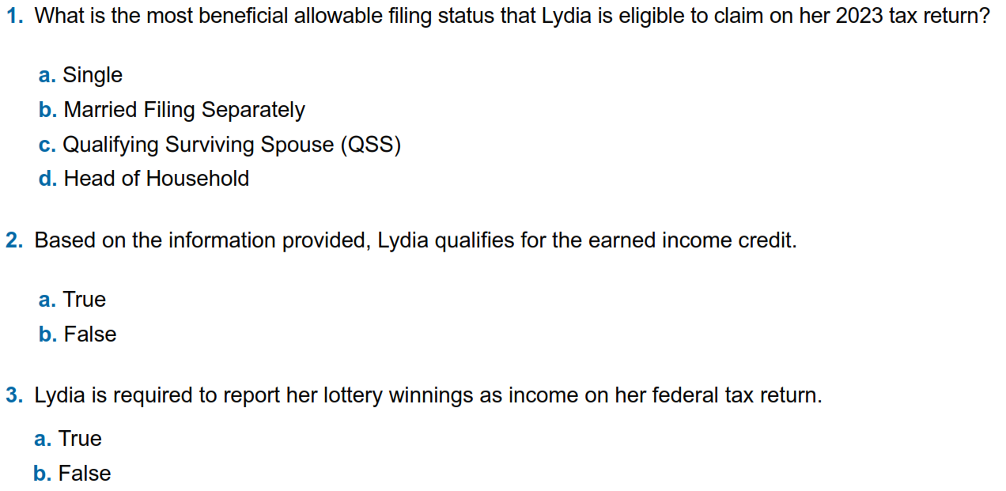
Adv. Scenario 1: Questions
B-12
I-4 (note 4), I-5/6
C-3/5 Qualifying Child
D-3 Lottery classified as gambling
Notes:
This article clarifies information provided on page 10 of IRS Publication 5307, Tax Reform Basics for Individuals and Families for the repeal of deduction for alimony payments under the Tax Cuts & Jobs Act of 2017.
Alimony or separation payments paid to a spouse or former spouse under a divorce or separation agreement, such as a divorce decree, a separate maintenance decree, or a written separation agreement, may be alimony for federal tax purposes. Alimony or separation payments are deductible if the taxpayer is the payer spouse. Receiving spouses must include the alimony or separation payments in their income.
Beginning Jan. 1, 2019, alimony or separate maintenance payments are not deductible from the income of the payer spouse, or includable in the income of the receiving spouse, if made under a divorce or separation agreement executed after Dec. 31, 2018.
This also applies to a divorce or separation agreement executed on or before Dec. 31, 2018, and modified after December 31, 2018, as long as the modification:
changes the terms of the alimony or separate maintenance payments; and
states that the alimony or separate maintenance payments are not deductible by the payer spouse or includable in the income of the receiving spouse.
On the other hand, generally alimony or separate maintenance payments are deductible from the income of the payer spouse and includable in the income of the receiving spouse, if made under a divorce or separation agreement executed on or before Dec. 31, 2018, even if the agreement was modified after December 31, 2018, so long as the modification is not one described in the preceding paragraph.

Slide 60
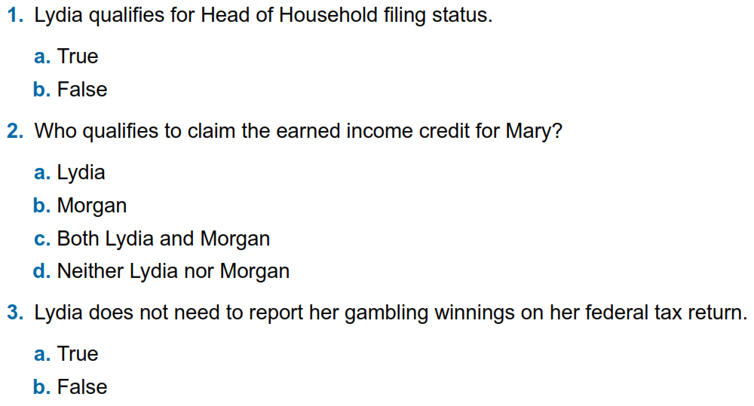
Adv. Scenario 1: Retest Questions
B-12
I-4 (note 4), I-5/6
C-3/5 Qualifying Child
D-3 Lottery classified as gambling
Retest Pub 6744 Pg 104
Notes:
This article clarifies information provided on page 10 of IRS Publication 5307, Tax Reform Basics for Individuals and Families for the repeal of deduction for alimony payments under the Tax Cuts & Jobs Act of 2017.
Alimony or separation payments paid to a spouse or former spouse under a divorce or separation agreement, such as a divorce decree, a separate maintenance decree, or a written separation agreement, may be alimony for federal tax purposes. Alimony or separation payments are deductible if the taxpayer is the payer spouse. Receiving spouses must include the alimony or separation payments in their income.
Beginning Jan. 1, 2019, alimony or separate maintenance payments are not deductible from the income of the payer spouse, or includable in the income of the receiving spouse, if made under a divorce or separation agreement executed after Dec. 31, 2018.
This also applies to a divorce or separation agreement executed on or before Dec. 31, 2018, and modified after December 31, 2018, as long as the modification:
changes the terms of the alimony or separate maintenance payments; and
states that the alimony or separate maintenance payments are not deductible by the payer spouse or includable in the income of the receiving spouse.
On the other hand, generally alimony or separate maintenance payments are deductible from the income of the payer spouse and includable in the income of the receiving spouse, if made under a divorce or separation agreement executed on or before Dec. 31, 2018, even if the agreement was modified after December 31, 2018, so long as the modification is not one described in the preceding paragraph.

Slide 61
Adv. Scenario 1: Questions
B-12
I-4 (note 4), I-5/6
C-3/5 Qualifying Child
D-3 Lottery classified as gambling
Notes:
This article clarifies information provided on page 10 of IRS Publication 5307, Tax Reform Basics for Individuals and Families for the repeal of deduction for alimony payments under the Tax Cuts & Jobs Act of 2017.
Alimony or separation payments paid to a spouse or former spouse under a divorce or separation agreement, such as a divorce decree, a separate maintenance decree, or a written separation agreement, may be alimony for federal tax purposes. Alimony or separation payments are deductible if the taxpayer is the payer spouse. Receiving spouses must include the alimony or separation payments in their income.
Beginning Jan. 1, 2019, alimony or separate maintenance payments are not deductible from the income of the payer spouse, or includable in the income of the receiving spouse, if made under a divorce or separation agreement executed after Dec. 31, 2018.
This also applies to a divorce or separation agreement executed on or before Dec. 31, 2018, and modified after December 31, 2018, as long as the modification:
changes the terms of the alimony or separate maintenance payments; and
states that the alimony or separate maintenance payments are not deductible by the payer spouse or includable in the income of the receiving spouse.
On the other hand, generally alimony or separate maintenance payments are deductible from the income of the payer spouse and includable in the income of the receiving spouse, if made under a divorce or separation agreement executed on or before Dec. 31, 2018, even if the agreement was modified after December 31, 2018, so long as the modification is not one described in the preceding paragraph.

Slide 62
Adv. Scenario 1: Retest Questions
B-12
I-4 (note 4), I-5/6
C-3/5 Qualifying Child
D-3 Lottery classified as gambling
Retest Pub 6744 Pg 104
Notes:
This article clarifies information provided on page 10 of IRS Publication 5307, Tax Reform Basics for Individuals and Families for the repeal of deduction for alimony payments under the Tax Cuts & Jobs Act of 2017.
Alimony or separation payments paid to a spouse or former spouse under a divorce or separation agreement, such as a divorce decree, a separate maintenance decree, or a written separation agreement, may be alimony for federal tax purposes. Alimony or separation payments are deductible if the taxpayer is the payer spouse. Receiving spouses must include the alimony or separation payments in their income.
Beginning Jan. 1, 2019, alimony or separate maintenance payments are not deductible from the income of the payer spouse, or includable in the income of the receiving spouse, if made under a divorce or separation agreement executed after Dec. 31, 2018.
This also applies to a divorce or separation agreement executed on or before Dec. 31, 2018, and modified after December 31, 2018, as long as the modification:
changes the terms of the alimony or separate maintenance payments; and
states that the alimony or separate maintenance payments are not deductible by the payer spouse or includable in the income of the receiving spouse.
On the other hand, generally alimony or separate maintenance payments are deductible from the income of the payer spouse and includable in the income of the receiving spouse, if made under a divorce or separation agreement executed on or before Dec. 31, 2018, even if the agreement was modified after December 31, 2018, so long as the modification is not one described in the preceding paragraph.

Slide 63
Scenario 2
Scott and Barbara Gyms

Slide 64
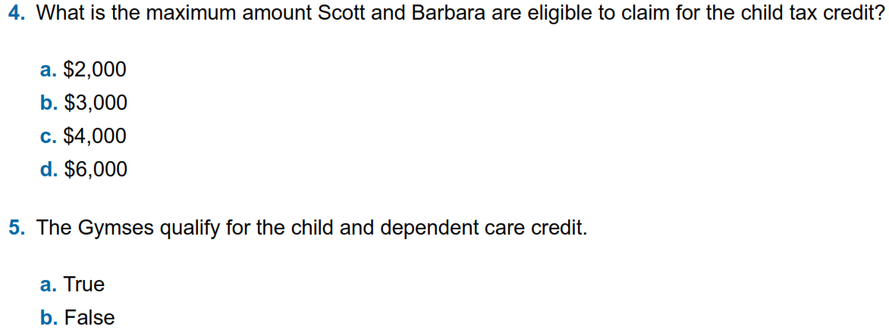
Adv. Scenario 2 Interview Notes
G-4
We assume this is straightforward for the test, but Taxslayer will calculate Form 8812
G-13 Question 4
Scenario and initial test questions Pub 6744 pg. 70

Slide 65
Adv. Scenario 2: Retest Questions
G-4
Again, Taxslayer will calculate Form 8812
G-13 Question 4
Retest Pub 6744 Pg 105
Notes:
This article clarifies information provided on page 10 of IRS Publication 5307, Tax Reform Basics for Individuals and Families for the repeal of deduction for alimony payments under the Tax Cuts & Jobs Act of 2017.
Alimony or separation payments paid to a spouse or former spouse under a divorce or separation agreement, such as a divorce decree, a separate maintenance decree, or a written separation agreement, may be alimony for federal tax purposes. Alimony or separation payments are deductible if the taxpayer is the payer spouse. Receiving spouses must include the alimony or separation payments in their income.
Beginning Jan. 1, 2019, alimony or separate maintenance payments are not deductible from the income of the payer spouse, or includable in the income of the receiving spouse, if made under a divorce or separation agreement executed after Dec. 31, 2018.
This also applies to a divorce or separation agreement executed on or before Dec. 31, 2018, and modified after December 31, 2018, as long as the modification:
changes the terms of the alimony or separate maintenance payments; and
states that the alimony or separate maintenance payments are not deductible by the payer spouse or includable in the income of the receiving spouse.
On the other hand, generally alimony or separate maintenance payments are deductible from the income of the payer spouse and includable in the income of the receiving spouse, if made under a divorce or separation agreement executed on or before Dec. 31, 2018, even if the agreement was modified after December 31, 2018, so long as the modification is not one described in the preceding paragraph.

Slide 66
Adv. Scenario 2 Interview Notes
G-4
G-13 Question 4
Scenario and initial test questions Pub 6744 pg. 70

Slide 67
Adv. Scenario 2: Retest Questions
G-4
G-13 Question 4
Retest Pub 6744 Pg 105
Notes:
This article clarifies information provided on page 10 of IRS Publication 5307, Tax Reform Basics for Individuals and Families for the repeal of deduction for alimony payments under the Tax Cuts & Jobs Act of 2017.
Alimony or separation payments paid to a spouse or former spouse under a divorce or separation agreement, such as a divorce decree, a separate maintenance decree, or a written separation agreement, may be alimony for federal tax purposes. Alimony or separation payments are deductible if the taxpayer is the payer spouse. Receiving spouses must include the alimony or separation payments in their income.
Beginning Jan. 1, 2019, alimony or separate maintenance payments are not deductible from the income of the payer spouse, or includable in the income of the receiving spouse, if made under a divorce or separation agreement executed after Dec. 31, 2018.
This also applies to a divorce or separation agreement executed on or before Dec. 31, 2018, and modified after December 31, 2018, as long as the modification:
changes the terms of the alimony or separate maintenance payments; and
states that the alimony or separate maintenance payments are not deductible by the payer spouse or includable in the income of the receiving spouse.
On the other hand, generally alimony or separate maintenance payments are deductible from the income of the payer spouse and includable in the income of the receiving spouse, if made under a divorce or separation agreement executed on or before Dec. 31, 2018, even if the agreement was modified after December 31, 2018, so long as the modification is not one described in the preceding paragraph.

Slide 68
Scenario 3
Rose Jones

Slide 69
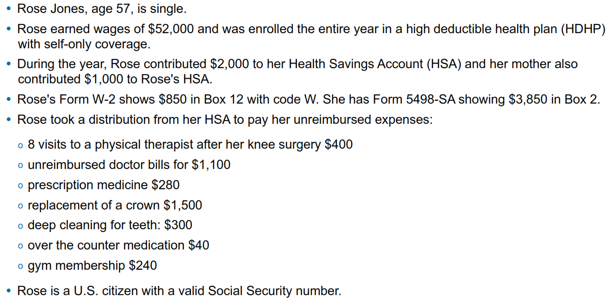
Adv. Scenario 3 Interview Notes
Scenario and initial test questions Pub 6744 pg. 71

Slide 70
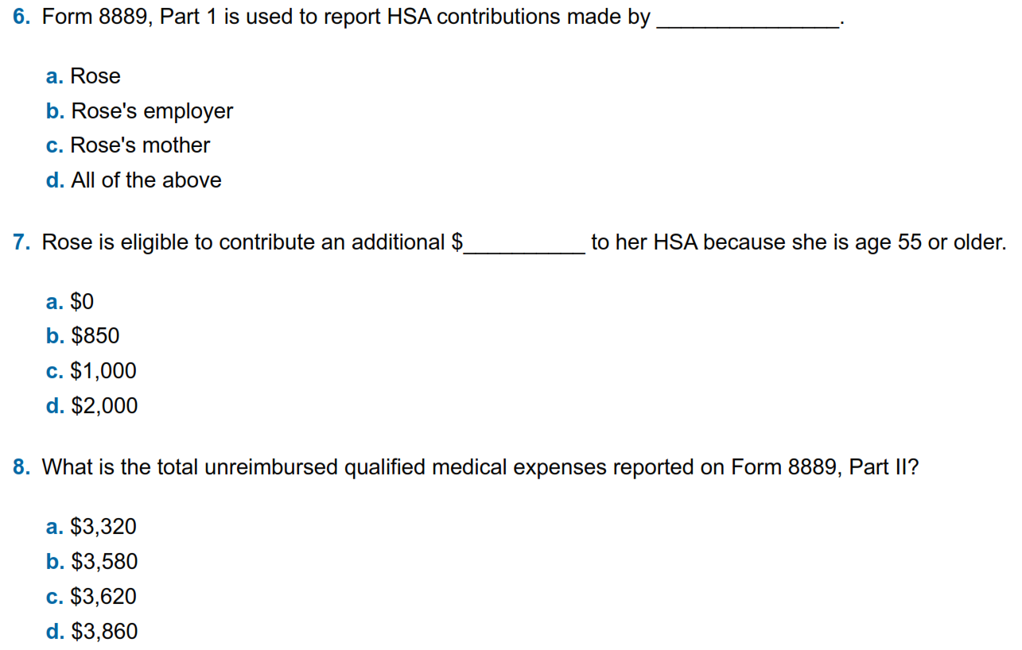
Adv. Scenario 3 Questions
E-12 Sect 3, form 8889
E-12 top
E-14 Top
Scenario and initial test questions Pub 6744 pg. 70

Slide 71
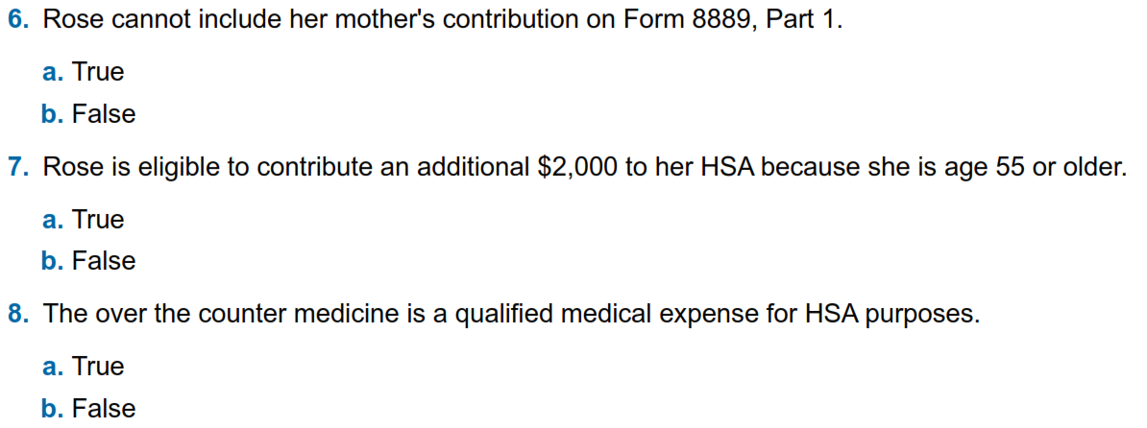
Adv. Scenario 3 Retest Questions
E-12 Sect 3
E-12 top
E-14 Top
Retest Pub 6744 Pg 106

Slide 72
Adv. Scenario 3 Questions
E-12 Sect 3, form 8889
E-12 top
E-14 Top
Scenario and initial test questions Pub 6744 pg. 70

Slide 73
Adv. Scenario 3 Retest Questions
E-12 Sect 3
E-12 top
E-14 Top
Retest Pub 6744 Pg 106

Slide 74
Scenario 4
Carmen Gomez

Slide 75
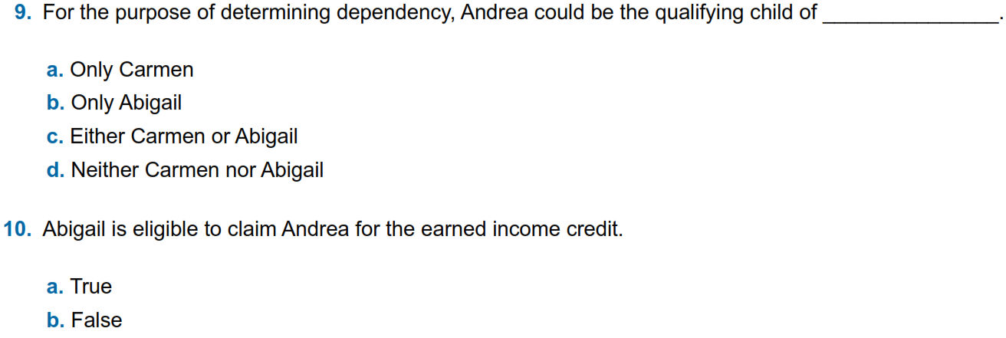
Adv. Scenario 4 Interview Notes
Does not say if separation is legal. (Does that matter in this case?) We’ll assume spouse is not trying to claim Andrea
C-4, see the example (also for Q10)
I-4 – check exception and footnote 4, Part B up top
Scenario and initial test questions Pub 6744 pg. 72

Slide 76
Adv. Scenario 4 Retest Questions
C-4, see the example
B-10 flow – Note she does NOT provide ½ of home upkeep so can’t be head-of-household, also see I-4 footnote 4
I-4 Part B/C – compare ages for child vs no child
I-4 Part D – compare income for child vs no child
Retest Pub 6744 Pg 107

Slide 77
Adv. Scenario 4 Interview Notes
Does not say if separation is legal. (Does that matter in this case?) We’ll assume spouse is not trying to claim Andrea
C-4, see the example (also for Q10)
I-4 – check exception and footnote 4, Part B up top
C-4 Example and I-4; Can be an EIC qualifying child without being a dependent
Scenario and initial test questions Pub 6744 pg. 72

Slide 78
Adv. Scenario 4 Retest Questions
C-4, see the example
B-10 flow – Note she does NOT provide ½ of home upkeep so can’t be head-of-household, also see I-4 footnote 4
I-4 Part B/C – compare ages for child vs no child
I-4 Part D – compare income for child vs no child
Retest Pub 6744 Pg 107

Slide 79
Scenario 5
Helen White

Slide 80
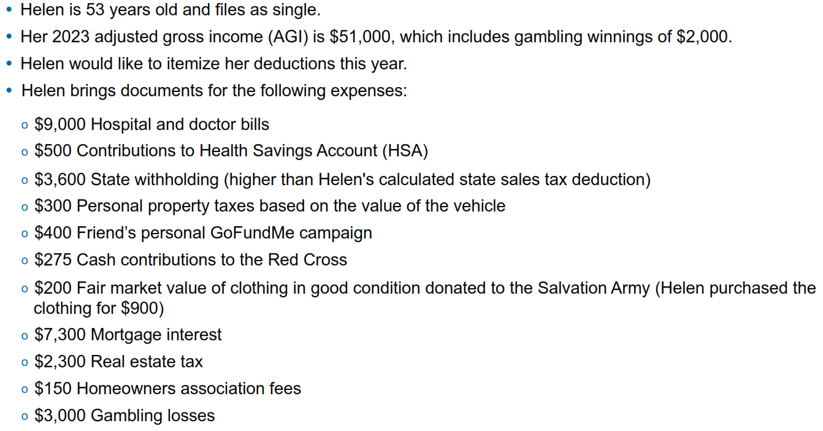
Adv. Scenario 5 Interview Notes
Scenario and initial test questions Pub 6744 pg. 73

Slide 81
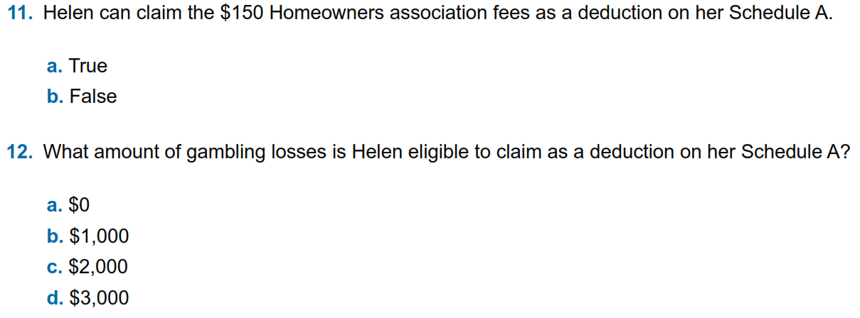
Adv. Scenario 5 Questions
F-14, bottom of page
F-15 – Section 1
F-5 - Section 1
D-65 – Section 2

Slide 82
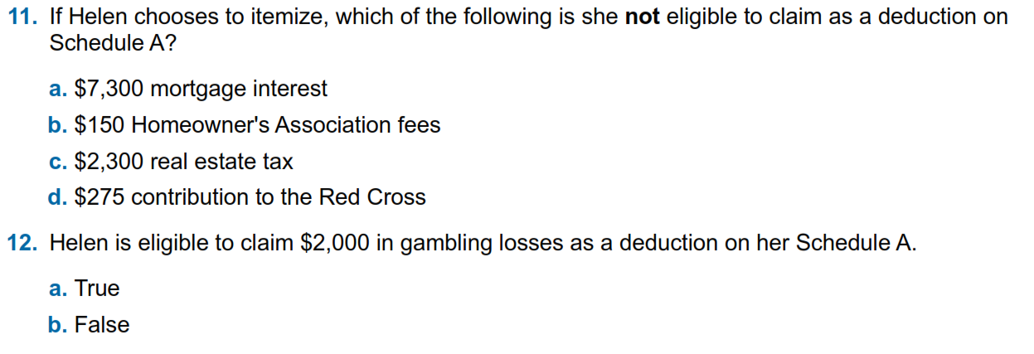
Adv. Scenario 5 Retest Questions
F-14, bottom of page
F-15 – Section 1
F-5 - Section 1
D-65 – Section 2
Retest Pub 6744 Pg 108

Slide 83
Adv. Scenario 5 Questions
F-14, bottom of page
F-15 – Section 1
F-5 - Section 1
D-65 – Section 2

Slide 84
Adv. Scenario 5 Retest Questions
F-14, bottom of page
F-15 – Section 1
F-5 - Section 1
D-65 – Section 2
Retest Pub 6744 Pg 108

Slide 85
Scenario 6
Mike Cooper

Slide 86
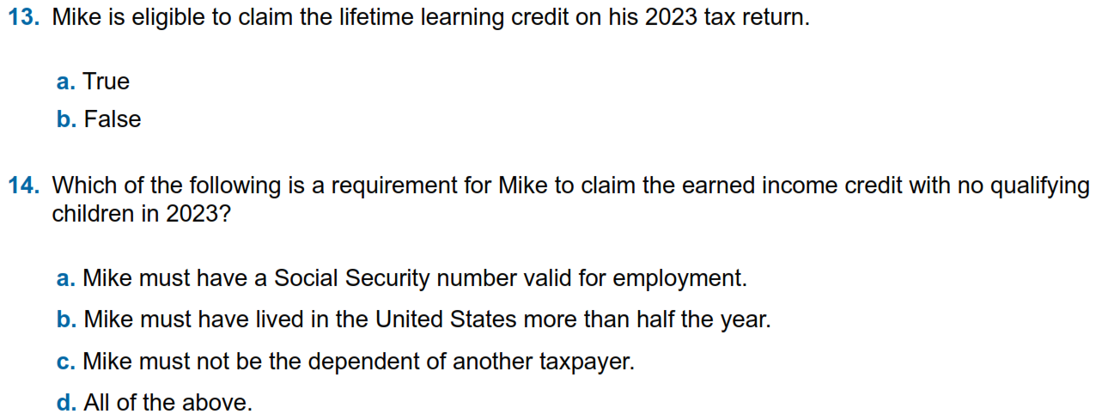
Adv. Scenario 6 Interview Notes
J-7
I-4, Part A and Part C
Scenario and initial test questions Pub 6744 pg. 74

Slide 87
Adv. Scenario 6 Retest Questions
J-5
I-4, Part A, C, and D
Retest Pub 6744 Pg 109

Slide 88
Adv. Scenario 6 Interview Notes
J-7
I-4, Part A and Part C
Scenario and initial test questions Pub 6744 pg. 74

Slide 89
Adv. Scenario 6 Retest Questions
J-5
Note it’s a phase-out, not a pure cut-off
I-4, Part A, C, and D
Retest Pub 6744 Pg 109

Slide 90
Out of Scope

Slide 91
What is Out of Scope?
This means we as a VITA program cannot complete the return
Scope refers to VITA eligible tax law topics applied to a volunteer-prepared return, it does not refer to income levels
There are suggested income guidelines which we will discuss in January
Even if you have the knowledge about how to complete an out-of-scope return, you should not do it
IRS liability protection does not extend to out-of-scope returns
Pages vi – xxi at the front of Publication 4012 are our guide
We will cover this in much more detail in January

Slide 92
Client Process for TY 2023

Slide 93
Client Process For TY 2023
We will be doing both intake/dropoff (NIP) and in-person preparation
Appointments will be set up in ALL cases. No open walk-ins.
We will try to have greeters available when possible to help with logistics as clients arrive
We want to avoid processing returns outside of VITA facilities
Meredith will go over the client sign-up process when that is set
You will be provided the UW VITA URL links where slide decks and recordings will be published
Site locations and days are still being finalized
Sites will vary in which intake/process mode they operate under
Meredith will provide updates on the status for sites

Slide 94
Next Steps

Slide 95
Login links
Taxslayer “Springboard” – access to Practice Lab and live Taxslayer
Not needed for this week, but will be needed for training next Thursday, 12/14
Search on: Taxslayer Springboard
https://vita.taxslayerpro.com/
IRS Link-and-Learn for certification
Search on: Link and Learn Home
https://www.linklearncertification.com/d/

Slide 96
Taking the Test When We’re Done
If you run into problems accessing the Practice Lab or Certification Site, let us know
Make sure to complete (after relevant training):
Volunteer Standards of Conduct
Intake/Interview and Quality Review
Advanced Certification
Once all three tests are completed and passed, print off and sign Form 13615
This form MUST come from the Certification program
Return Form 13615 to Meredith either in person or via email meredith.hershner@uweci.org
Certification target date is January 10th, 2024

Slide 97
VITA Shirts
You should be receiving a message about the latest long-sleeve VITA T-shirts
These are provided by the program
Other updates from Meredith

Slide 98
Questions?
Thanks for joining! See you next Thursday evening

Slide 99
