Slide 1

Tax Preparer Training – Returning Volunteers
Session 2
Tax Year 2023 (Prepared in 2024) Dec. 14, 2023

Slide 2

Again, We’re Glad You’re Returning for another Season
Any issues as we go through the certification process, let us know and we will do our best to address them

Slide 3
Agenda
Tax Training Reminder
Certification Scenarios 7-9
  Review Interview and Questions
Next Steps
(we’ll take one 15 minute break somewhere if needed)

Slide 4
Tax Training Reminder

Slide 5
Training Timetable
Session 3 Certification Training (Scenarios 7-9)
  Oriented to New Volunteers
    In Person - December 16th at United Way (Sat, 9 – Noon)
  Oriented to Returning Volunteers
    ZOOM - December 14th (Thurs, 5:30-8:30)
Additional scenarios and detail process discussions (ZOOM – Saturdays – for all volunteers)
  January 13th
  January 20th
  January 27th
After the first of the year, you should be receiving frequent emails with information regarding the January session

Slide 6
Volunteer Testing For TY 2022
IRS site: https://linklearntaxescertification.com/
  Tweaked – different from last year
  Create or confirm your account as a tax volunteer for VITA
    May need to reset password
  Contact Meredith or me if you have issues
Tests – all certification tests have “Pass” threshold of 80%
  For Tax Preparers
    Volunteer Standards of Conduct
    Intake/Interview and Quality Review
    Advanced Certification
  For Site Coordinators
    Volunteer Standards of Conduct
    Intake/Interview and Quality Review
    Advanced Certification
    Site Coordinator Test

Slide 7
Tax Certification Tests

Slide 8
Scenario 7
Matthew and Rebecca Monroe

Slide 9
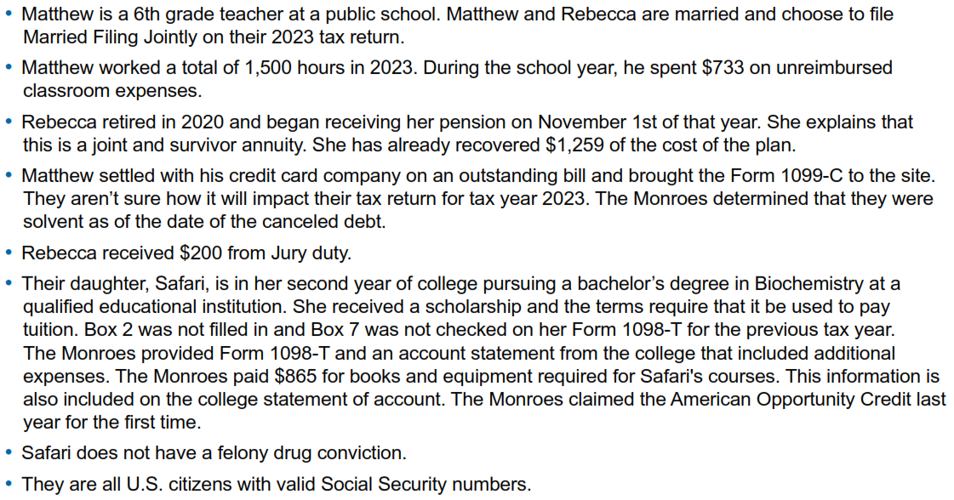


Adv. Scenario 7 Interview Notes
Scenario Form 6744 pg. 75, initial test questions pg. 83

Slide 10
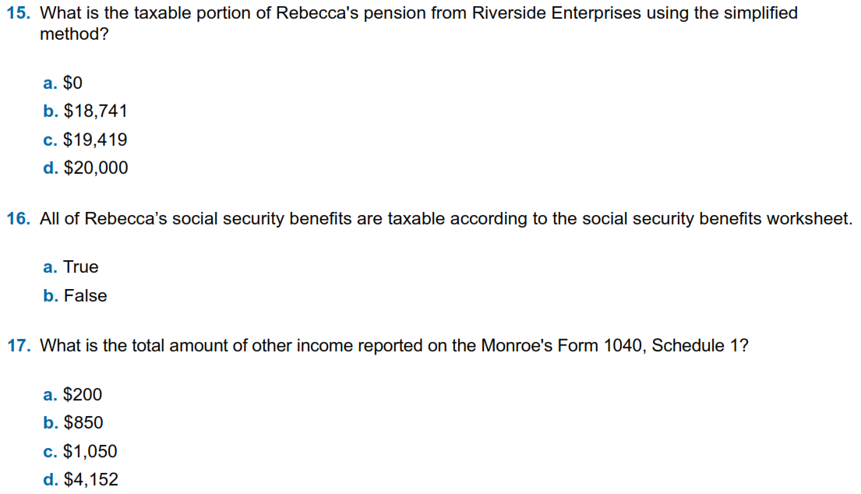
Adv. Scenario 7: Questions
D-45/46, Instruction 1 on D-45
1040 Line 6B, Soc Sec Worksheet (toward the end of the return)
Sched 1 Part 1, Line 10
Notes:
This article clarifies information provided on page 10 of IRS Publication 5307, Tax Reform Basics for Individuals and Families for the repeal of deduction for alimony payments under the Tax Cuts & Jobs Act of 2017.
Alimony or separation payments paid to a spouse or former spouse under a divorce or separation agreement, such as a divorce decree, a separate maintenance decree, or a written separation agreement, may be alimony for federal tax purposes. Alimony or separation payments are deductible if the taxpayer is the payer spouse. Receiving spouses must include the alimony or separation payments in their income.
Beginning Jan. 1, 2019, alimony or separate maintenance payments are not deductible from the income of the payer spouse, or includable in the income of the receiving spouse, if made under a divorce or separation agreement executed after Dec. 31, 2018.
This also applies to a divorce or separation agreement executed on or before Dec. 31, 2018, and modified after December 31, 2018, as long as the modification:
changes the terms of the alimony or separate maintenance payments; and
states that the alimony or separate maintenance payments are not deductible by the payer spouse or includable in the income of the receiving spouse.
On the other hand, generally alimony or separate maintenance payments are deductible from the income of the payer spouse and includable in the income of the receiving spouse, if made under a divorce or separation agreement executed on or before Dec. 31, 2018, even if the agreement was modified after December 31, 2018, so long as the modification is not one described in the preceding paragraph.

Slide 11
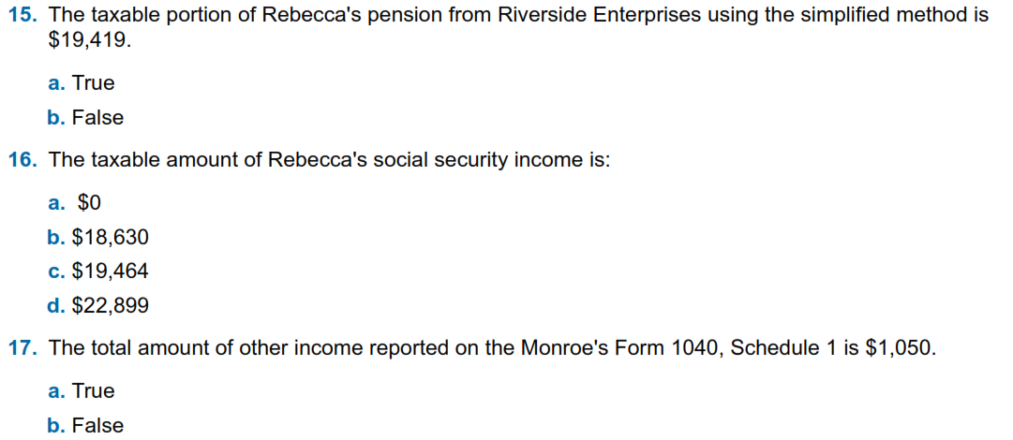
Adv. Scenario 7: Retest Questions
D-45/46, Instruction 1 on D-45
1040 Line 6B, Soc Sec Worksheet (toward the end of return)
Sched 1 Part 1, Line 10
Retest Form 6744 Pg 110
Notes:
This article clarifies information provided on page 10 of IRS Publication 5307, Tax Reform Basics for Individuals and Families for the repeal of deduction for alimony payments under the Tax Cuts & Jobs Act of 2017.
Alimony or separation payments paid to a spouse or former spouse under a divorce or separation agreement, such as a divorce decree, a separate maintenance decree, or a written separation agreement, may be alimony for federal tax purposes. Alimony or separation payments are deductible if the taxpayer is the payer spouse. Receiving spouses must include the alimony or separation payments in their income.
Beginning Jan. 1, 2019, alimony or separate maintenance payments are not deductible from the income of the payer spouse, or includable in the income of the receiving spouse, if made under a divorce or separation agreement executed after Dec. 31, 2018.
This also applies to a divorce or separation agreement executed on or before Dec. 31, 2018, and modified after December 31, 2018, as long as the modification:
changes the terms of the alimony or separate maintenance payments; and
states that the alimony or separate maintenance payments are not deductible by the payer spouse or includable in the income of the receiving spouse.
On the other hand, generally alimony or separate maintenance payments are deductible from the income of the payer spouse and includable in the income of the receiving spouse, if made under a divorce or separation agreement executed on or before Dec. 31, 2018, even if the agreement was modified after December 31, 2018, so long as the modification is not one described in the preceding paragraph.

Slide 12
Adv. Scenario 7: Questions
D-45/46, Instruction 1 on D-45
1040 Line 6B, Soc Sec Worksheet (toward the end of return)
Sched 1 Part 1, Line 10
Notes:
This article clarifies information provided on page 10 of IRS Publication 5307, Tax Reform Basics for Individuals and Families for the repeal of deduction for alimony payments under the Tax Cuts & Jobs Act of 2017.
Alimony or separation payments paid to a spouse or former spouse under a divorce or separation agreement, such as a divorce decree, a separate maintenance decree, or a written separation agreement, may be alimony for federal tax purposes. Alimony or separation payments are deductible if the taxpayer is the payer spouse. Receiving spouses must include the alimony or separation payments in their income.
Beginning Jan. 1, 2019, alimony or separate maintenance payments are not deductible from the income of the payer spouse, or includable in the income of the receiving spouse, if made under a divorce or separation agreement executed after Dec. 31, 2018.
This also applies to a divorce or separation agreement executed on or before Dec. 31, 2018, and modified after December 31, 2018, as long as the modification:
changes the terms of the alimony or separate maintenance payments; and
states that the alimony or separate maintenance payments are not deductible by the payer spouse or includable in the income of the receiving spouse.
On the other hand, generally alimony or separate maintenance payments are deductible from the income of the payer spouse and includable in the income of the receiving spouse, if made under a divorce or separation agreement executed on or before Dec. 31, 2018, even if the agreement was modified after December 31, 2018, so long as the modification is not one described in the preceding paragraph.

Slide 13
Adv. Scenario 7: Retest Questions
D-45/46, Instruction 1 on D-45
1040 Line 6B, Soc Sec Worksheet (toward the end of return)
Sched 1 Part 1, Line 10
Retest Form 6744 Pg 110
Notes:
This article clarifies information provided on page 10 of IRS Publication 5307, Tax Reform Basics for Individuals and Families for the repeal of deduction for alimony payments under the Tax Cuts & Jobs Act of 2017.
Alimony or separation payments paid to a spouse or former spouse under a divorce or separation agreement, such as a divorce decree, a separate maintenance decree, or a written separation agreement, may be alimony for federal tax purposes. Alimony or separation payments are deductible if the taxpayer is the payer spouse. Receiving spouses must include the alimony or separation payments in their income.
Beginning Jan. 1, 2019, alimony or separate maintenance payments are not deductible from the income of the payer spouse, or includable in the income of the receiving spouse, if made under a divorce or separation agreement executed after Dec. 31, 2018.
This also applies to a divorce or separation agreement executed on or before Dec. 31, 2018, and modified after December 31, 2018, as long as the modification:
changes the terms of the alimony or separate maintenance payments; and
states that the alimony or separate maintenance payments are not deductible by the payer spouse or includable in the income of the receiving spouse.
On the other hand, generally alimony or separate maintenance payments are deductible from the income of the payer spouse and includable in the income of the receiving spouse, if made under a divorce or separation agreement executed on or before Dec. 31, 2018, even if the agreement was modified after December 31, 2018, so long as the modification is not one described in the preceding paragraph.

Slide 14

Adv. Scenario 7 Interview Notes
Scenario Form 6744 pg. 75, initial test questions pg. 83

Slide 15
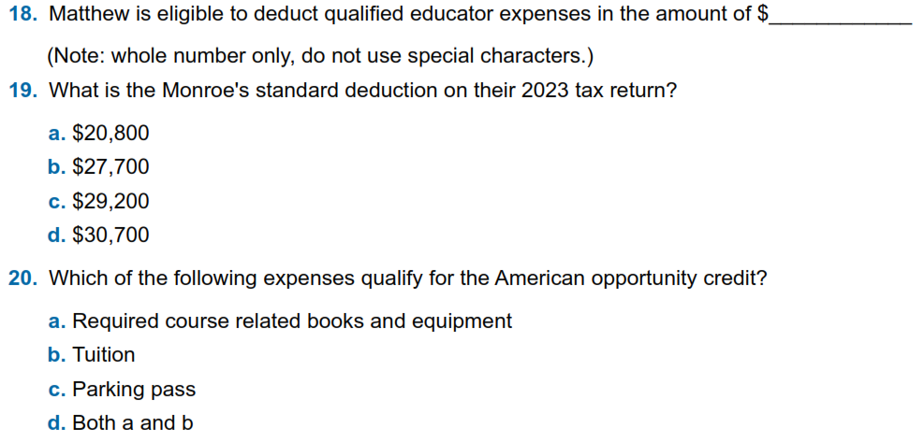
Adv. Scenario 7: Questions (con’t)
E-8
F-4 ( NOT F-3)
Also on F1040 Line 12
J-3 (also J-6 and J-8)
Notes:
This article clarifies information provided on page 10 of IRS Publication 5307, Tax Reform Basics for Individuals and Families for the repeal of deduction for alimony payments under the Tax Cuts & Jobs Act of 2017.
Alimony or separation payments paid to a spouse or former spouse under a divorce or separation agreement, such as a divorce decree, a separate maintenance decree, or a written separation agreement, may be alimony for federal tax purposes. Alimony or separation payments are deductible if the taxpayer is the payer spouse. Receiving spouses must include the alimony or separation payments in their income.
Beginning Jan. 1, 2019, alimony or separate maintenance payments are not deductible from the income of the payer spouse, or includable in the income of the receiving spouse, if made under a divorce or separation agreement executed after Dec. 31, 2018.
This also applies to a divorce or separation agreement executed on or before Dec. 31, 2018, and modified after December 31, 2018, as long as the modification:
changes the terms of the alimony or separate maintenance payments; and
states that the alimony or separate maintenance payments are not deductible by the payer spouse or includable in the income of the receiving spouse.
On the other hand, generally alimony or separate maintenance payments are deductible from the income of the payer spouse and includable in the income of the receiving spouse, if made under a divorce or separation agreement executed on or before Dec. 31, 2018, even if the agreement was modified after December 31, 2018, so long as the modification is not one described in the preceding paragraph.

Slide 16
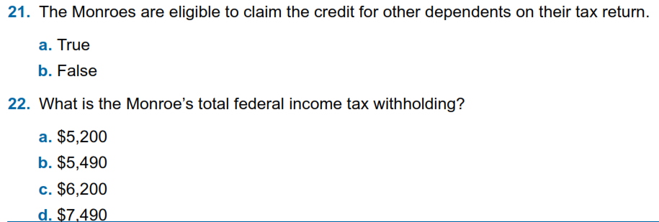
Adv. Scenario 7: Questions (con’t)
G-4, G-7
W-2, 1099-R, SSA-1099, 1040 Ln 25D
Notes:
This article clarifies information provided on page 10 of IRS Publication 5307, Tax Reform Basics for Individuals and Families for the repeal of deduction for alimony payments under the Tax Cuts & Jobs Act of 2017.
Alimony or separation payments paid to a spouse or former spouse under a divorce or separation agreement, such as a divorce decree, a separate maintenance decree, or a written separation agreement, may be alimony for federal tax purposes. Alimony or separation payments are deductible if the taxpayer is the payer spouse. Receiving spouses must include the alimony or separation payments in their income.
Beginning Jan. 1, 2019, alimony or separate maintenance payments are not deductible from the income of the payer spouse, or includable in the income of the receiving spouse, if made under a divorce or separation agreement executed after Dec. 31, 2018.
This also applies to a divorce or separation agreement executed on or before Dec. 31, 2018, and modified after December 31, 2018, as long as the modification:
changes the terms of the alimony or separate maintenance payments; and
states that the alimony or separate maintenance payments are not deductible by the payer spouse or includable in the income of the receiving spouse.
On the other hand, generally alimony or separate maintenance payments are deductible from the income of the payer spouse and includable in the income of the receiving spouse, if made under a divorce or separation agreement executed on or before Dec. 31, 2018, even if the agreement was modified after December 31, 2018, so long as the modification is not one described in the preceding paragraph.

Slide 17
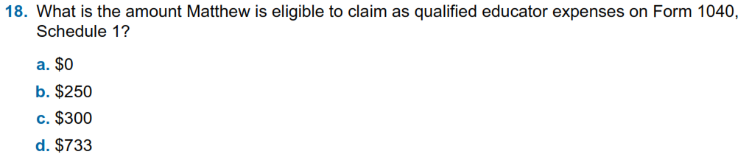
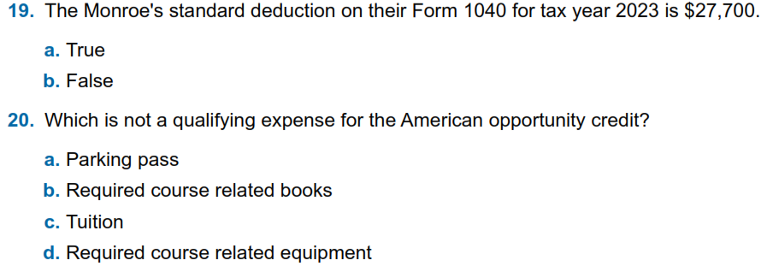
Adv. Scenario 7: Retest Questions (con’t)
E-8
F-4 ( NOT F-3)
Also on F1040 Line 12
J-3 (also J-6 and J-8)
Notes:
This article clarifies information provided on page 10 of IRS Publication 5307, Tax Reform Basics for Individuals and Families for the repeal of deduction for alimony payments under the Tax Cuts & Jobs Act of 2017.
Alimony or separation payments paid to a spouse or former spouse under a divorce or separation agreement, such as a divorce decree, a separate maintenance decree, or a written separation agreement, may be alimony for federal tax purposes. Alimony or separation payments are deductible if the taxpayer is the payer spouse. Receiving spouses must include the alimony or separation payments in their income.
Beginning Jan. 1, 2019, alimony or separate maintenance payments are not deductible from the income of the payer spouse, or includable in the income of the receiving spouse, if made under a divorce or separation agreement executed after Dec. 31, 2018.
This also applies to a divorce or separation agreement executed on or before Dec. 31, 2018, and modified after December 31, 2018, as long as the modification:
changes the terms of the alimony or separate maintenance payments; and
states that the alimony or separate maintenance payments are not deductible by the payer spouse or includable in the income of the receiving spouse.
On the other hand, generally alimony or separate maintenance payments are deductible from the income of the payer spouse and includable in the income of the receiving spouse, if made under a divorce or separation agreement executed on or before Dec. 31, 2018, even if the agreement was modified after December 31, 2018, so long as the modification is not one described in the preceding paragraph.

Slide 18
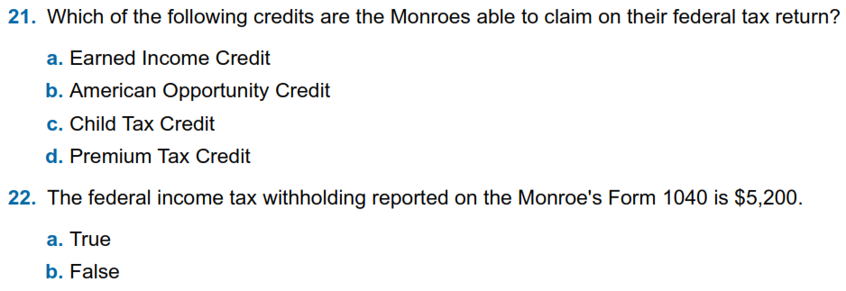
Adv. Scenario 7: Retest Questions (con’t)
I-4, I-5
J-7
G-4
H-10, 13614-C Part V Q9
W-2, 1099-R, SSA-1099, 1040 Ln 25D
Notes:
This article clarifies information provided on page 10 of IRS Publication 5307, Tax Reform Basics for Individuals and Families for the repeal of deduction for alimony payments under the Tax Cuts & Jobs Act of 2017.
Alimony or separation payments paid to a spouse or former spouse under a divorce or separation agreement, such as a divorce decree, a separate maintenance decree, or a written separation agreement, may be alimony for federal tax purposes. Alimony or separation payments are deductible if the taxpayer is the payer spouse. Receiving spouses must include the alimony or separation payments in their income.
Beginning Jan. 1, 2019, alimony or separate maintenance payments are not deductible from the income of the payer spouse, or includable in the income of the receiving spouse, if made under a divorce or separation agreement executed after Dec. 31, 2018.
This also applies to a divorce or separation agreement executed on or before Dec. 31, 2018, and modified after December 31, 2018, as long as the modification:
changes the terms of the alimony or separate maintenance payments; and
states that the alimony or separate maintenance payments are not deductible by the payer spouse or includable in the income of the receiving spouse.
On the other hand, generally alimony or separate maintenance payments are deductible from the income of the payer spouse and includable in the income of the receiving spouse, if made under a divorce or separation agreement executed on or before Dec. 31, 2018, even if the agreement was modified after December 31, 2018, so long as the modification is not one described in the preceding paragraph.

Slide 19
Adv. Scenario 7: Questions (con’t)
300
E-8
F-4 ( NOT F-3)
Also on F1040 Line 12
J-3 (also J-6 and J-8)
Notes:
This article clarifies information provided on page 10 of IRS Publication 5307, Tax Reform Basics for Individuals and Families for the repeal of deduction for alimony payments under the Tax Cuts & Jobs Act of 2017.
Alimony or separation payments paid to a spouse or former spouse under a divorce or separation agreement, such as a divorce decree, a separate maintenance decree, or a written separation agreement, may be alimony for federal tax purposes. Alimony or separation payments are deductible if the taxpayer is the payer spouse. Receiving spouses must include the alimony or separation payments in their income.
Beginning Jan. 1, 2019, alimony or separate maintenance payments are not deductible from the income of the payer spouse, or includable in the income of the receiving spouse, if made under a divorce or separation agreement executed after Dec. 31, 2018.
This also applies to a divorce or separation agreement executed on or before Dec. 31, 2018, and modified after December 31, 2018, as long as the modification:
changes the terms of the alimony or separate maintenance payments; and
states that the alimony or separate maintenance payments are not deductible by the payer spouse or includable in the income of the receiving spouse.
On the other hand, generally alimony or separate maintenance payments are deductible from the income of the payer spouse and includable in the income of the receiving spouse, if made under a divorce or separation agreement executed on or before Dec. 31, 2018, even if the agreement was modified after December 31, 2018, so long as the modification is not one described in the preceding paragraph.

Slide 20
Adv. Scenario 7: Questions (con’t)
G-4, G-7
W-2, 1099-R, SSA-1099, 1040 Ln 25D
Notes:
This article clarifies information provided on page 10 of IRS Publication 5307, Tax Reform Basics for Individuals and Families for the repeal of deduction for alimony payments under the Tax Cuts & Jobs Act of 2017.
Alimony or separation payments paid to a spouse or former spouse under a divorce or separation agreement, such as a divorce decree, a separate maintenance decree, or a written separation agreement, may be alimony for federal tax purposes. Alimony or separation payments are deductible if the taxpayer is the payer spouse. Receiving spouses must include the alimony or separation payments in their income.
Beginning Jan. 1, 2019, alimony or separate maintenance payments are not deductible from the income of the payer spouse, or includable in the income of the receiving spouse, if made under a divorce or separation agreement executed after Dec. 31, 2018.
This also applies to a divorce or separation agreement executed on or before Dec. 31, 2018, and modified after December 31, 2018, as long as the modification:
changes the terms of the alimony or separate maintenance payments; and
states that the alimony or separate maintenance payments are not deductible by the payer spouse or includable in the income of the receiving spouse.
On the other hand, generally alimony or separate maintenance payments are deductible from the income of the payer spouse and includable in the income of the receiving spouse, if made under a divorce or separation agreement executed on or before Dec. 31, 2018, even if the agreement was modified after December 31, 2018, so long as the modification is not one described in the preceding paragraph.

Slide 21
Adv. Scenario 7: Retest Questions (con’t)
E-8
F-4 ( NOT F-3)
Also on F1040 Line 12
J-3 (also J-6 and J-8)
Notes:
This article clarifies information provided on page 10 of IRS Publication 5307, Tax Reform Basics for Individuals and Families for the repeal of deduction for alimony payments under the Tax Cuts & Jobs Act of 2017.
Alimony or separation payments paid to a spouse or former spouse under a divorce or separation agreement, such as a divorce decree, a separate maintenance decree, or a written separation agreement, may be alimony for federal tax purposes. Alimony or separation payments are deductible if the taxpayer is the payer spouse. Receiving spouses must include the alimony or separation payments in their income.
Beginning Jan. 1, 2019, alimony or separate maintenance payments are not deductible from the income of the payer spouse, or includable in the income of the receiving spouse, if made under a divorce or separation agreement executed after Dec. 31, 2018.
This also applies to a divorce or separation agreement executed on or before Dec. 31, 2018, and modified after December 31, 2018, as long as the modification:
changes the terms of the alimony or separate maintenance payments; and
states that the alimony or separate maintenance payments are not deductible by the payer spouse or includable in the income of the receiving spouse.
On the other hand, generally alimony or separate maintenance payments are deductible from the income of the payer spouse and includable in the income of the receiving spouse, if made under a divorce or separation agreement executed on or before Dec. 31, 2018, even if the agreement was modified after December 31, 2018, so long as the modification is not one described in the preceding paragraph.

Slide 22
Adv. Scenario 7: Retest Questions (con’t)
I-4, I-5
J-7
G-4
H-10, 13614-C Part V Q9
W-2, 1099-R, SSA-1099, 1040 Ln 25D
Notes:
This article clarifies information provided on page 10 of IRS Publication 5307, Tax Reform Basics for Individuals and Families for the repeal of deduction for alimony payments under the Tax Cuts & Jobs Act of 2017.
Alimony or separation payments paid to a spouse or former spouse under a divorce or separation agreement, such as a divorce decree, a separate maintenance decree, or a written separation agreement, may be alimony for federal tax purposes. Alimony or separation payments are deductible if the taxpayer is the payer spouse. Receiving spouses must include the alimony or separation payments in their income.
Beginning Jan. 1, 2019, alimony or separate maintenance payments are not deductible from the income of the payer spouse, or includable in the income of the receiving spouse, if made under a divorce or separation agreement executed after Dec. 31, 2018.
This also applies to a divorce or separation agreement executed on or before Dec. 31, 2018, and modified after December 31, 2018, as long as the modification:
changes the terms of the alimony or separate maintenance payments; and
states that the alimony or separate maintenance payments are not deductible by the payer spouse or includable in the income of the receiving spouse.
On the other hand, generally alimony or separate maintenance payments are deductible from the income of the payer spouse and includable in the income of the receiving spouse, if made under a divorce or separation agreement executed on or before Dec. 31, 2018, even if the agreement was modified after December 31, 2018, so long as the modification is not one described in the preceding paragraph.

Slide 23
Scenario 8
Julia Oakley

Slide 24
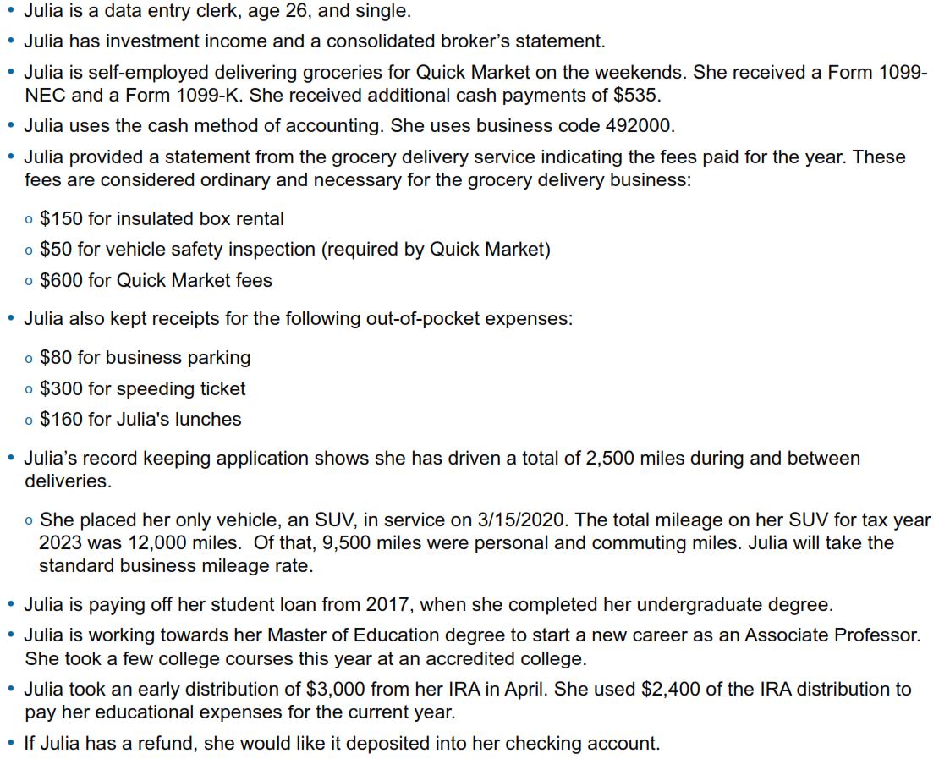








Adv. Scenario 8 Interview Notes
Scenario Form 6744 Pg 84, initial test questions pg. 95

Slide 25
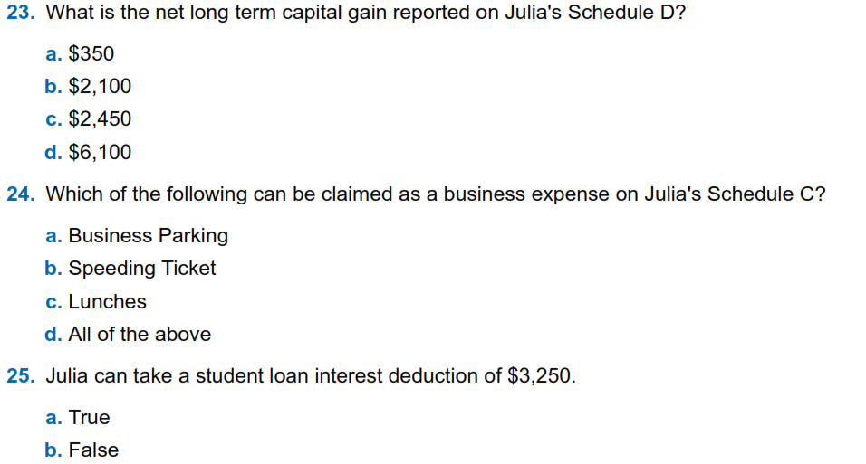


Adv. Scenario 8 Questions
Form 8949 and Sched D (D-32 to D-34)
D-28, bottom of page, also
Schedule C Instructions
Schedule 1 Part II Line 21, E-17

Slide 26
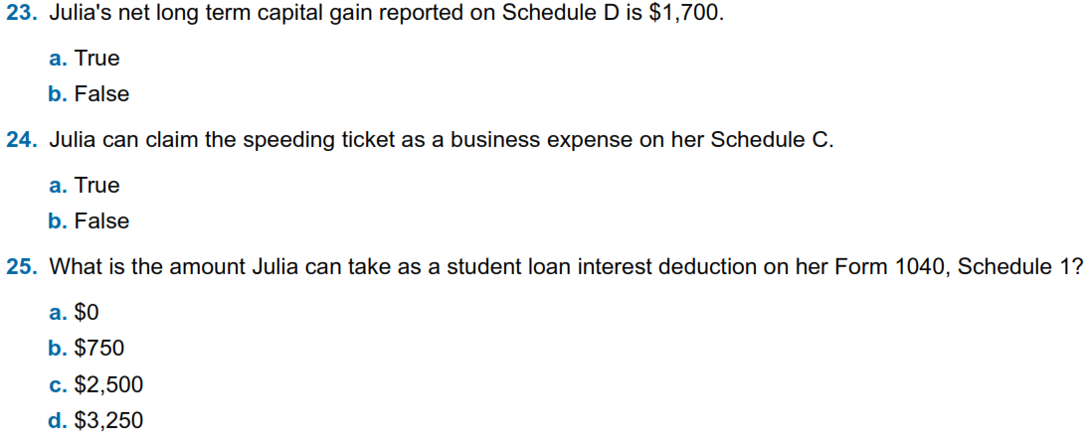
Adv. Scenario 8: Retest Questions
Form 8949 and Sched D (D-32 to D-34)
D-28, bottom of page, also
Schedule C Instructions
Schedule 1 Part II Line 21, E-17
Retest Form 6744 Pg 112
Notes:
This article clarifies information provided on page 10 of IRS Publication 5307, Tax Reform Basics for Individuals and Families for the repeal of deduction for alimony payments under the Tax Cuts & Jobs Act of 2017.
Alimony or separation payments paid to a spouse or former spouse under a divorce or separation agreement, such as a divorce decree, a separate maintenance decree, or a written separation agreement, may be alimony for federal tax purposes. Alimony or separation payments are deductible if the taxpayer is the payer spouse. Receiving spouses must include the alimony or separation payments in their income.
Beginning Jan. 1, 2019, alimony or separate maintenance payments are not deductible from the income of the payer spouse, or includable in the income of the receiving spouse, if made under a divorce or separation agreement executed after Dec. 31, 2018.
This also applies to a divorce or separation agreement executed on or before Dec. 31, 2018, and modified after December 31, 2018, as long as the modification:
changes the terms of the alimony or separate maintenance payments; and
states that the alimony or separate maintenance payments are not deductible by the payer spouse or includable in the income of the receiving spouse.
On the other hand, generally alimony or separate maintenance payments are deductible from the income of the payer spouse and includable in the income of the receiving spouse, if made under a divorce or separation agreement executed on or before Dec. 31, 2018, even if the agreement was modified after December 31, 2018, so long as the modification is not one described in the preceding paragraph.

Slide 27
Adv. Scenario 8 Questions
Form 8949 and Sched D (D-32 to D-34)
D-28, bottom of page, also
Schedule C Instructions
Schedule 1 Part II Line 21, E-17

Slide 28
Adv. Scenario 8: Retest Questions
Form 8949 and Sched D (D-32 to D-34)
D-28, bottom of page, also
Schedule C Instructions
Schedule 1 Part II Line 21, E-17
Retest Form 6744 Pg 112
Notes:
This article clarifies information provided on page 10 of IRS Publication 5307, Tax Reform Basics for Individuals and Families for the repeal of deduction for alimony payments under the Tax Cuts & Jobs Act of 2017.
Alimony or separation payments paid to a spouse or former spouse under a divorce or separation agreement, such as a divorce decree, a separate maintenance decree, or a written separation agreement, may be alimony for federal tax purposes. Alimony or separation payments are deductible if the taxpayer is the payer spouse. Receiving spouses must include the alimony or separation payments in their income.
Beginning Jan. 1, 2019, alimony or separate maintenance payments are not deductible from the income of the payer spouse, or includable in the income of the receiving spouse, if made under a divorce or separation agreement executed after Dec. 31, 2018.
This also applies to a divorce or separation agreement executed on or before Dec. 31, 2018, and modified after December 31, 2018, as long as the modification:
changes the terms of the alimony or separate maintenance payments; and
states that the alimony or separate maintenance payments are not deductible by the payer spouse or includable in the income of the receiving spouse.
On the other hand, generally alimony or separate maintenance payments are deductible from the income of the payer spouse and includable in the income of the receiving spouse, if made under a divorce or separation agreement executed on or before Dec. 31, 2018, even if the agreement was modified after December 31, 2018, so long as the modification is not one described in the preceding paragraph.

Slide 29
Adv. Scenario 8 Interview Notes
Scenario Form 6744 Pg 84, initial test questions pg. 95

Slide 30
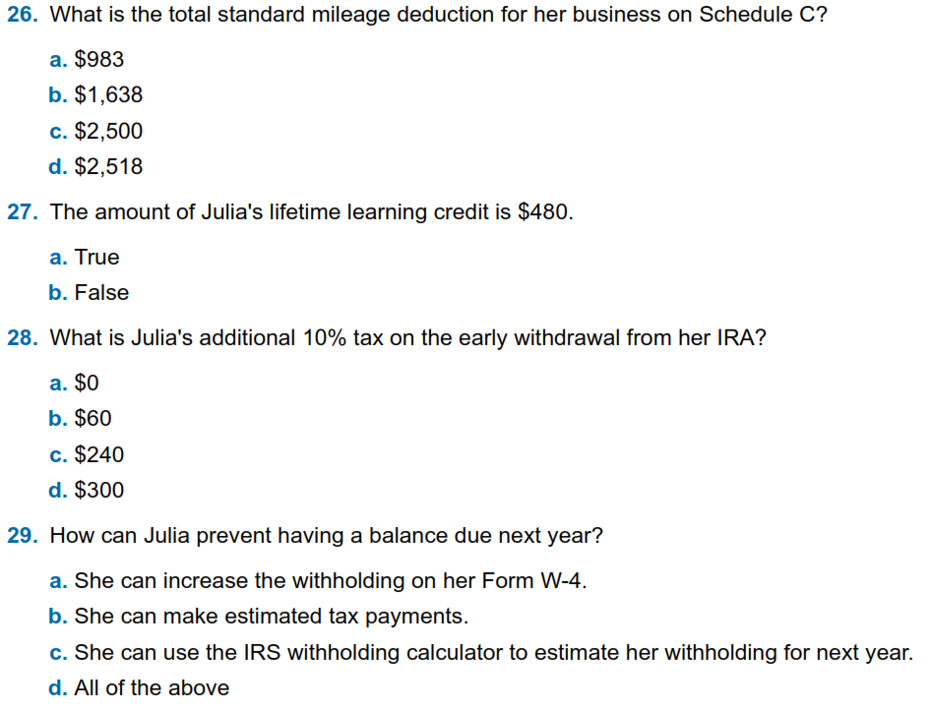
Adv. Scenario 8 Questions (con’t)
Schedule C Part II Line 9 (D-30/31)
Form 8863 Part II Line 19, Sched 3 Part I Line 3 (J-7 to J-13)
Form 5329 Part I, Sched 2 Ln 8 (D-50,H-3/6/7)
K-27

Slide 31
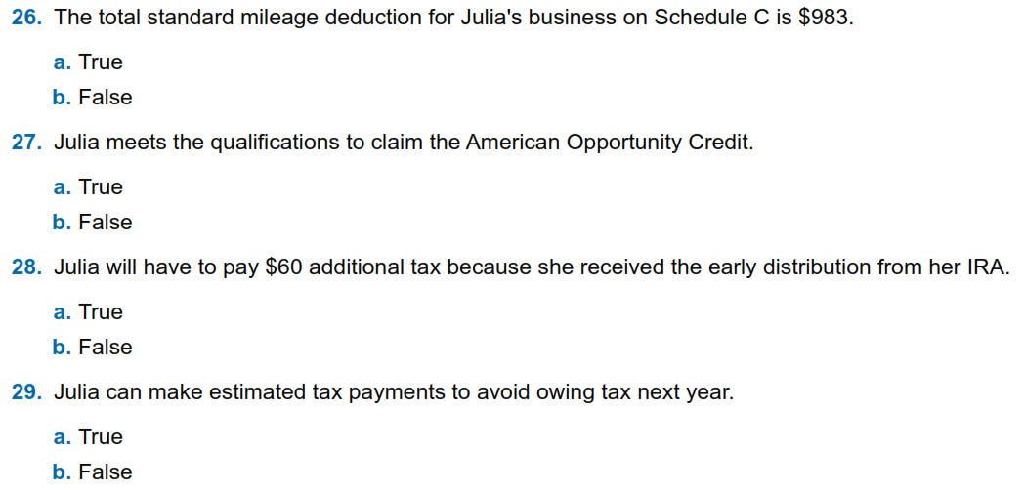
Adv. Scenario 8: Retest Questions (con’t)
Schedule C Part II Line 9 (D-30/31)
J-7
Form 5329 Part I, Sched 2 Ln 8 (D-50,H-3/6/7)
K-27
Notes:
This article clarifies information provided on page 10 of IRS Publication 5307, Tax Reform Basics for Individuals and Families for the repeal of deduction for alimony payments under the Tax Cuts & Jobs Act of 2017.
Alimony or separation payments paid to a spouse or former spouse under a divorce or separation agreement, such as a divorce decree, a separate maintenance decree, or a written separation agreement, may be alimony for federal tax purposes. Alimony or separation payments are deductible if the taxpayer is the payer spouse. Receiving spouses must include the alimony or separation payments in their income.
Beginning Jan. 1, 2019, alimony or separate maintenance payments are not deductible from the income of the payer spouse, or includable in the income of the receiving spouse, if made under a divorce or separation agreement executed after Dec. 31, 2018.
This also applies to a divorce or separation agreement executed on or before Dec. 31, 2018, and modified after December 31, 2018, as long as the modification:
changes the terms of the alimony or separate maintenance payments; and
states that the alimony or separate maintenance payments are not deductible by the payer spouse or includable in the income of the receiving spouse.
On the other hand, generally alimony or separate maintenance payments are deductible from the income of the payer spouse and includable in the income of the receiving spouse, if made under a divorce or separation agreement executed on or before Dec. 31, 2018, even if the agreement was modified after December 31, 2018, so long as the modification is not one described in the preceding paragraph.

Slide 32

Adv. Scenario 8 Questions (con’t)
Schedule C Part II Line 9 (D-30/31)
Form 8863 Part II Line 19, Sched 3 Part I Line 3 (J-7 to J-13)
Form 5329 Part I, Sched 2 Ln 8 (D-50,H-3/6/7)
Only for IRAs
K-27

Slide 33
Adv. Scenario 8: Retest Questions (con’t)
Schedule C Part II Line 9 (D-30/31)
J-7
Form 5329 Part I, Sched 2 Ln 8 (D-50,H-3/6/7)
K-27
Notes:
This article clarifies information provided on page 10 of IRS Publication 5307, Tax Reform Basics for Individuals and Families for the repeal of deduction for alimony payments under the Tax Cuts & Jobs Act of 2017.
Alimony or separation payments paid to a spouse or former spouse under a divorce or separation agreement, such as a divorce decree, a separate maintenance decree, or a written separation agreement, may be alimony for federal tax purposes. Alimony or separation payments are deductible if the taxpayer is the payer spouse. Receiving spouses must include the alimony or separation payments in their income.
Beginning Jan. 1, 2019, alimony or separate maintenance payments are not deductible from the income of the payer spouse, or includable in the income of the receiving spouse, if made under a divorce or separation agreement executed after Dec. 31, 2018.
This also applies to a divorce or separation agreement executed on or before Dec. 31, 2018, and modified after December 31, 2018, as long as the modification:
changes the terms of the alimony or separate maintenance payments; and
states that the alimony or separate maintenance payments are not deductible by the payer spouse or includable in the income of the receiving spouse.
On the other hand, generally alimony or separate maintenance payments are deductible from the income of the payer spouse and includable in the income of the receiving spouse, if made under a divorce or separation agreement executed on or before Dec. 31, 2018, even if the agreement was modified after December 31, 2018, so long as the modification is not one described in the preceding paragraph.

Slide 34
Scenario 9
David MacLee

Slide 35
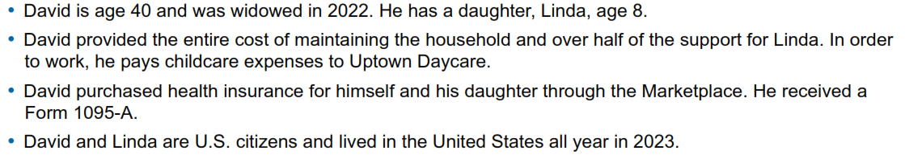
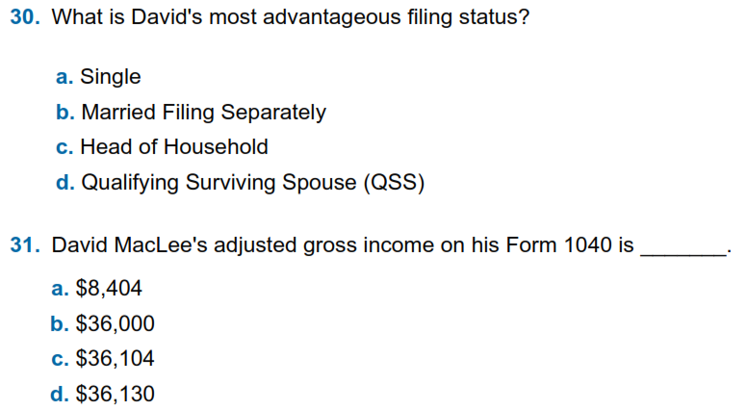

Adv. Scenario 9 Interview Notes
Scenario Form 6744 pg. 96 initial test questions pg. 103
B-12
Form 1040, Line 11

Slide 36
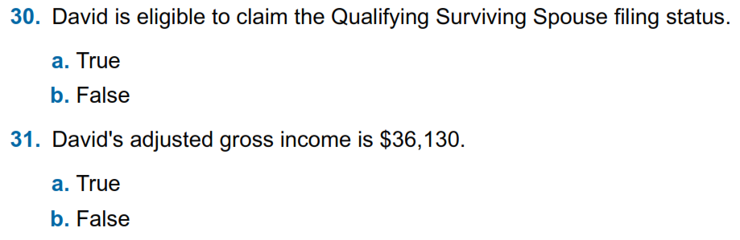
Adv. Scenario 9 Retest Questions
B-12
Form 1040, Line 11
Retest Form 6744 Pg 114

Slide 37
Adv. Scenario 9 Interview Notes
Scenario Form 6744 pg. 96 initial test questions pg. 103
B-12
36,104
Form 1040, Line 11

Slide 38
Adv. Scenario 9 Retest Questions
B-12
Form 1040, Line 11

Slide 39
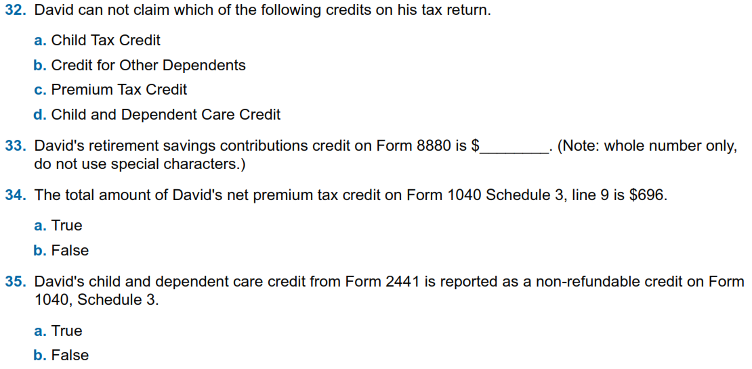
Adv. Scenario 9 Questions (con’t)
G-4
G-6, G-7
Form 8962, Sched 3 Line 9
G-12 through G-16
Form 8880, Sched 3 Part I Line 4
Form 8962, Sched 3 Line 9 (H-10 to H-13)
Form 2441, Sched 3 Line 2 (G-12 to G-16)

Slide 40
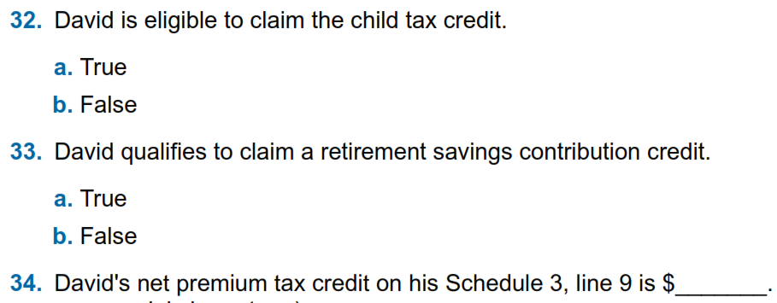
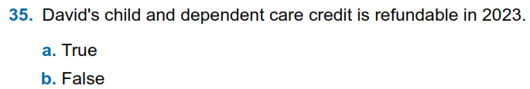
Adv. Scenario 9 Retest Questions
G-4
Form 8880, Sched 3 Part I Line 4
Form 8962, Sched 3 Line 9
Form 2441, Sched 3 Line 2 (G-12 to G-16)
Retest Form 6744 Pg 114

Slide 41
Adv. Scenario 9 Questions (con’t)
G-4
G-6, G-7
Form 8962, Sched 3 Line 9
G-12 through G-16
100
Form 8880, Sched 3 Part I Line 4
Form 8962, Sched 3 Line 9 (H-10 to H-13)
Form 2441, Sched 3 Line 2 (G-12 to G-16)

Slide 42
Adv. Scenario 9 Retest Questions
G-4
Form 8880, Sched 3 Part I Line 4
Form 8962, Sched 3 Line 9
696
Form 2441, Sched 3 Line 2 (G-12 to G-16)
Retest Form 6744 Pg 114

Slide 43
Concerns with Scenarios?
Are there any of the scenarios you want to revisit?

Slide 44
Next Steps

Slide 45
Practice Lab
Practice Lab is the place to try out the system regardless of how much training you attend
Very important to practice using the system on your own before trying to complete a live return starting in late January

Slide 46
Login links
Taxslayer “Springboard” – access to Practice Lab and eventually live Taxslayer
  Search on: Taxslayer Springboard
https://vita.taxslayerpro.com/
IRS Link-and-Learn for certification
https://linklearntaxescertification.com/
  I can’t get Google search to directly locate this site
  Search under: IRS Apps VITA
  The top result should be the IRS summary page for VITA/TCE Central
  Right upper portion of the text has a link to “VITA/TCE Central”
  That will get you to the above certification login

Slide 47
Taking the Test When We’re Done
If you run into problems accessing the Practice Lab or Certification Site, let us know
Make sure to complete:
  Volunteer Standards of Conduct
  Intake/Interview and Quality Review
  Advanced Certification
  (Optional Site Coordinator)
Once all tests are completed and passed, electrically sign and print off Form 13615
  This form MUST come from the Certification program
Return Form 13615 to Meredith either in person or via email meredith.hershner@uweci.org
Certification target date is January 10th, 2024
Starting next week, I can send out certification answers upon request

Slide 48
VITA Season Updates
(Meredith)

Slide 49
Questions?
Thank you! You will year from us, and we’ll see you in January!

Slide 50
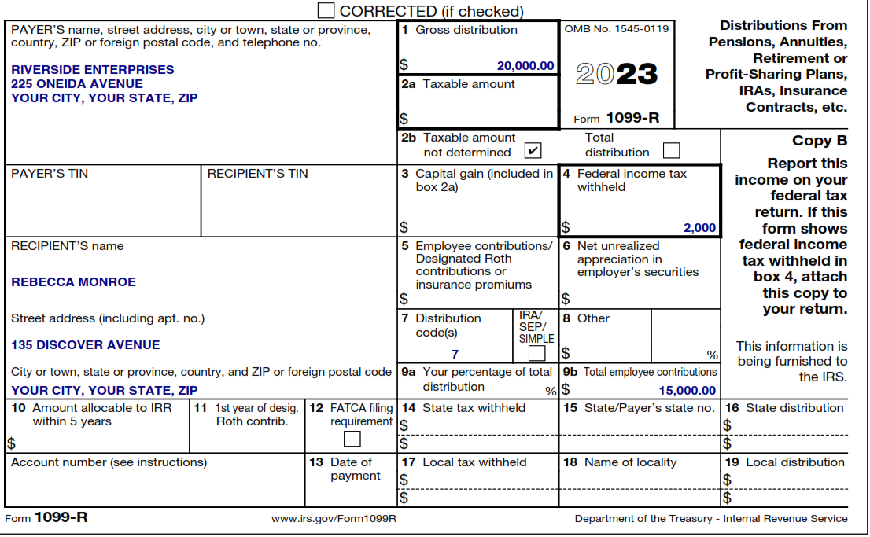
Taxable portion of pension
Plan Cost

Slide 51
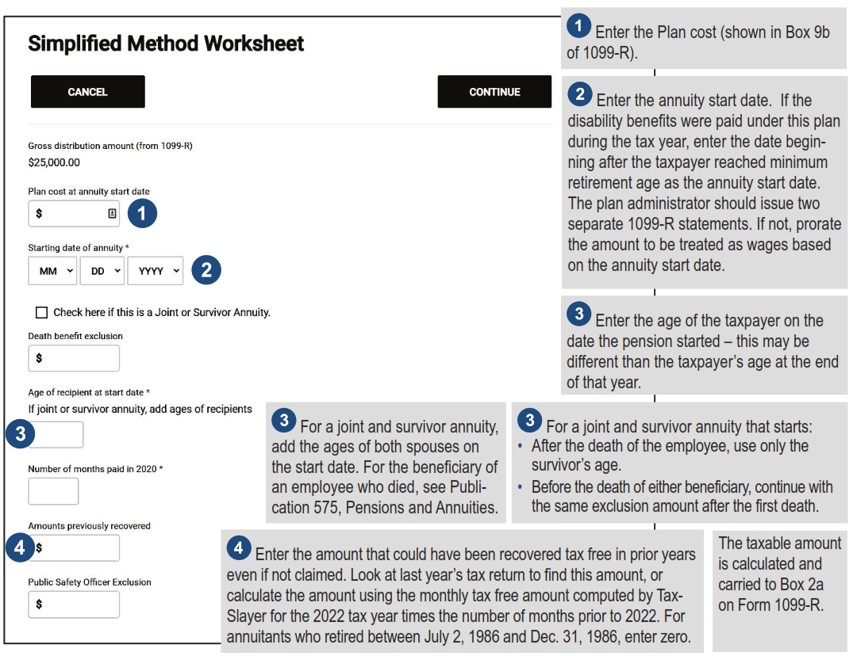




Simplified Method Input
2023

Slide 52
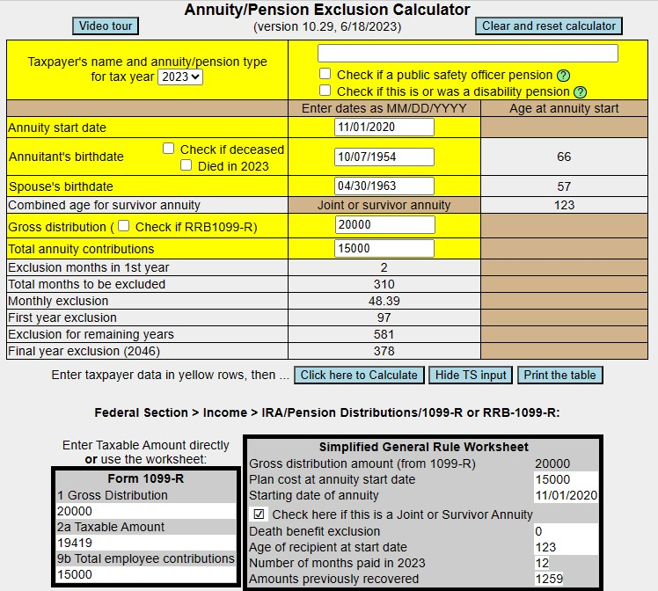
Pension Recovered Cost
(Please still input this into Taxslayer)
Note the age inputs
This is the entry for the Simplified Worksheet (D-47 #4)

Slide 53
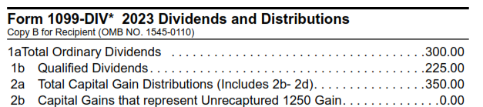
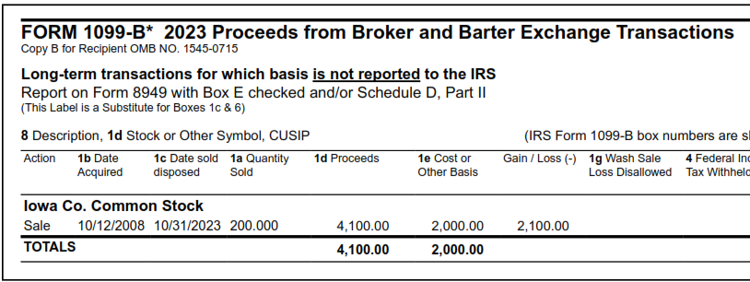
Summing up Capital Gains

Slide 54
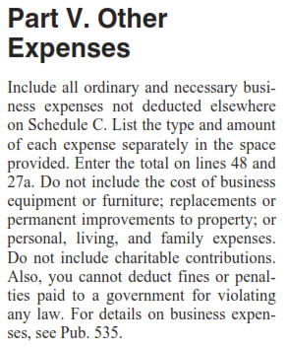
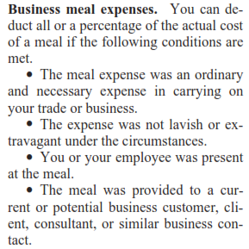



Adv. Scenario 8 Questions – Q24
Schedule C Instructions (2022)
Line 24b

Slide 55
Adv. Scenario 7 Questions
Test
  Question 15
  Question 16
  Question 17
  Question 18
  Question 19
  Question 20
  Question 21
  Question 22
Retest
  Question 15
  Question 16
  Question 17
  Question 18
  Question 19
  Question 20
  Question 21
  Question 22
$19,419
TRUE
FALSE
$19,464
$1,050
TRUE
$300
$300
$29,200
FALSE
D a and b
A
TRUE
B
$7,490
FALSE

Slide 56
Adv. Scenario 8 Questions
Test
  Question 23
  Question 24
  Question 25
  Question 26
  Question 27
  Question 28
  Question 29
Retest
  Question 23
  Question 24
  Question 25
  Question 26
  Question 27
  Question 28
  Question 29
$2,450
FALSE
A
FALSE
FALSE
$2,500
$1,638
FALSE
TRUE
FALSE
$60
TRUE
D – All Above
TRUE

Slide 57
Adv. Scenario 9 Questions
Test
  Question 30
  Question 31
  Question 32
  Question 33
  Question 34
  Question 35
Retest
  Question 30
  Question 31
  Question 32
  Question 33
  Question 34
  Question 35
QSS
TRUE
$36,104
FALSE
B
TRUE
$100
TRUE
TRUE
$696
TRUE
FALSE

