Slide 1
January 13, 2024 Training Session
Tax Year 2023

Slide 2
Agenda
Review Federal Tax changes
Forms
Regulations
Summary of Iowa Tax Changes
Regulations
Forms
Review Out-of-Scope
Federal
Iowa
Supplemental Intake Forms
Planned Resource Sheets
Discuss Scenarios Sahlberg, Langford, Adams
Next Steps

Slide 3
Federal Changes for TY 2023

Slide 4
Pub 4491 has detailed information
Important Changes pages ix - xiii
Temporary Provisions (section 2)
Still a few bugs outstanding for Taxslayer
For changes to Income Levels and Credit Limits, refer to the resource document

Slide 5
Federal Tax Forms

Slide 6
Feast to Famine – Almost No Fed Form Changes
Self-Employed Health Insurance Deduction
In Scope, but not common with our clients
Was a worksheet in Pub 535, now it’s own form 7206
1040-X Amended Returns
Easier to do direct deposit and input bank information for refunds
1099-DA planned for reporting of Digital Asset activity, but deferred till 2026
To be used instead of 1099-B, 1099-MISC, 1099-K

Slide 7
Federal Tax Regulations

Slide 8
Expansion of Early Withdrawal Penalty Exceptions
Distributions from IRA or 401K prior to age 59½
Listed on Pg H-7 of Pub 4012
Went from 12 Exceptions to 21
New exceptions to note
Terminally ill individuals
Distributions that are correcting excess contributions to an IRA
As long as withdrawn before the relevant tax due date
Expanded exceptions for Public Safety Employees
Adds exception for PSEs with 25+ years of service
Includes select state/local corrections officers and firefighters

Slide 9
Early Withdrawal Penalty Exceptions - cont
Existing exception to note from 2020 SECURE Act:
Up to $5,000 penalty-free withdrawal to support birth or adoption of a child
Exception is a spouse’s existing child
Need to provide SSN/TIN of the child
Use either IRA or 401K (if allowed by employer)
Can be done by each parent
Must be done within 1 year after the event
Can be repaid within 3 years, if still participating in that retirement plan
The Form 5329 Instructions has more details on all the exceptions

Slide 10
Residential Energy Credits - What’s the same?
Must be Taxpayer’s primary home, not new build
Most items must meet Energy Star Version 6.0
Should be documented, usually by mfg or contractor
Non-refundable credits vary by type of installation
Form 5695
Part 1 out-of-scope (geothermal, wind, solar)
Part 2 covers windows, doors, roof, insulation, etc.

Slide 11
Residential Energy Credits – What’s New?
Was a lifetime limit of $500 total ($200 windows)
Now annual limits, with no lifetime limit
$1200 total for most items, with specific limits on
Doors - $500 total ($250/door)
Windows - $600 total
$2000 total for heat pumps, biomass heat source
Extended through 2032

Slide 12
Required Minimum Distributions
Applies to total of all Qualified Retirement Accounts
Primarily 401K and Standard IRA
NOT Roth accounts (unless designated as part of a 401K)
Required % to withdraw increases each year
Legislation recently changed the starting age
Age skip for 2023
Note there will be no 1st-year RMD in 2023
People born in 1951 will have until April1 of 2025 to meet the first-year 2024 RMD requirements
Their 2nd year RMD is still due by Dec. 31 of 2025
When were you born? | RMD Start Age
Before 6/30/1949 | 70½
7/1/1949 through 1950 | 72
1951 through 1959 | 73
1960 or later | 75

Slide 13
Required Minimum Distributions - cont
Any qualified plan withdrawal during a year (even anytime the first year) counts toward the RMD
Waiting until the following April 1 that first year is an option, not a requirement
This differs from age constraints for QCD (70½)
You can combine RMD requirements from multiple IRAs into one or more withdrawals from any of them
You cannot combine payments from
More than one person (such as a spouse)
Multiple 401Ks

Slide 14
Federal Student Loan Tax Forgiveness
Still in effect (American Rescue Act – 2021)
PSLF (Public Service Loan Forgiveness) only
Private Loans not covered
Loans forgiven after 12/31/2020 are tax-free
Lender should not issue a 1099-C (Pub 4491 2-1)
Employers can provide up to $5250 tax-free loan assistance
Reduces income on W-2
Current sunset date is 12/31/2025

Slide 15
Mortgage Dept Forgiveness – Still in effect
Must be Taxpayer’s principal residence
Not used as a business or rental property
Taxpayer cannot be bankrupt
Maximum reduction is $750K
MFS limit is $375K
Debt must be forgiven after 12/31/2020
Usually see 1099-C, but form 982 is also used.
For foreclosure, form 1099-A may also show up.
Potentially VERY complicated
Current sunset date is 12/31/2025

Slide 16
Federal Sunset 12/31/2025 Tax Cut and Jobs Act 2017

Slide 17
TCJA 2017 – What May Go Away 12/31/25?
Standard deductions will be reduced by roughly 50%
Tax rates go up: top rate goes up to 39.6%
Child Tax Credit maximum goes back to $1K/child
No more credits for other dependents
State and Local Tax (SALT) ceiling of $10K is gone
Mortgage Interest Deduction qualification
Raised back up from first $750K of debt to first $1M of debt
Back to first $100K of a home equity loan for any reason
Many Miscellaneous Deductions come back
Legal fees, unreimbursed employee expenses, etc.
Must exceed 2% of AGI
Personal exemptions come back to $2K per taxpayer and qualified dependent (with some inflation adjustment)
Does phase out for higher incomes
AMT becomes more of a factor

Slide 18
Iowa Changes for TY 2023

Slide 19
Iowa Tax Regulations

Slide 20
Major Shift for Iowa
Starting point will be the Federal Taxable Income
No separate Iowa itemized deductions
All retirement income is then backed out
No need to separate out military or railroad retirement
Other adjustments will be similar to prior years
Health Insurance premiums, with restrictions
Federal refunds/payments from previous tax years
Does NOT include Federal Withholding for 2023
This is the last year for including this
K-12 Tuition/Tax Credit
Portion of EIC, CTC still carried from Federal 1040
School/EMS surtax

Slide 21
Dealing with Students First ESA
Any activity should not directly affect Iowa taxes unless funds are spent on unauthorized expenses
The Iowa Department of Education (IDE) has stated that some of the IA qualified expenses are considered taxable at the Federal level
Details on which ones are sketchy
A request has been placed with our VITA IRS contact for clarification
Which expenses will be taxed?
Where do we enter them in the Federal tax process?
Stay tuned…..

Slide 22
Iowa Tax Forms

Slide 23
Major Changes for Iowa
Schedule A and Schedule B no longer exist
IA 1040 completely different
IA 1040 form includes a new IA Schedule 1
Still have some supporting forms for specific areas, such as
IA 126 Part-Year Resident
IA 130 Out-of-State Tax Credit

Slide 24
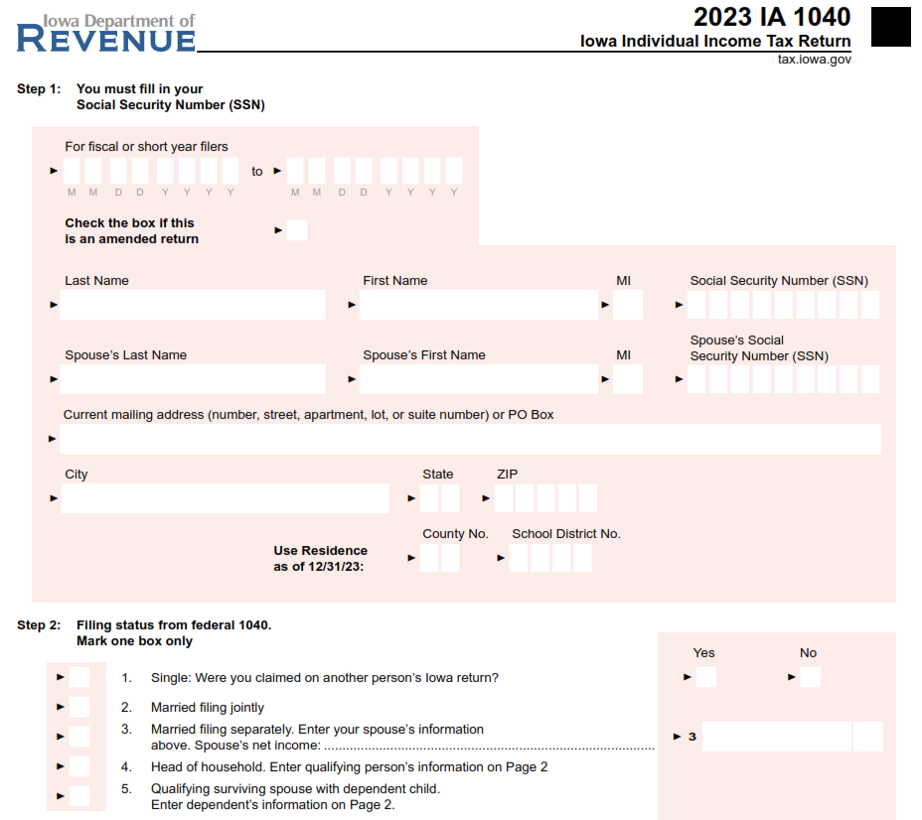
Iowa 1040 pg 1
Basic taxpayer info is similar
Taxslayer will carry over Federal filing status

Slide 25
Iowa 1040 pg 1 - cont
Iowa did not used to let you enter cents. Now they want it, except for entries coming from the Federal form.
Right now, Taxslayer is still rounding all inputs
The $40 personal credit plus extra credits for age/blind and dependents is the same

Slide 26
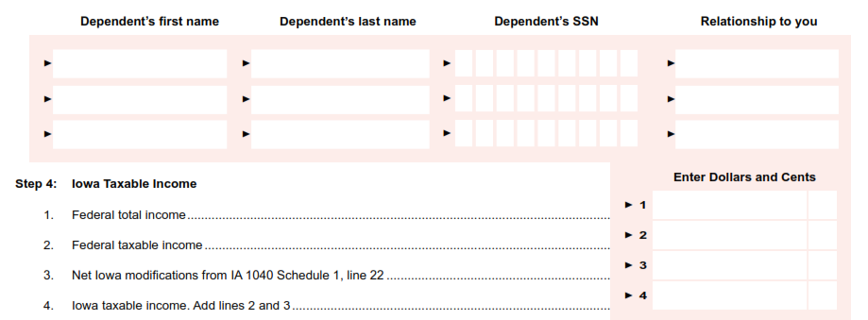
Iowa 1040 pg 2
Taxslayer will carry dependent information from the Federal 1040
Iowa wants to see all dependents, even if you are letting someone else claim them
Federal Total/Taxable income brought in directly from the Federal 1040
Total income is primarily used for allocating taxes for part-year residents
All Iowa adjustments show up from IA Schedule 1 on line 3
You end up with the starting Iowa Taxable income on line 4

Slide 27
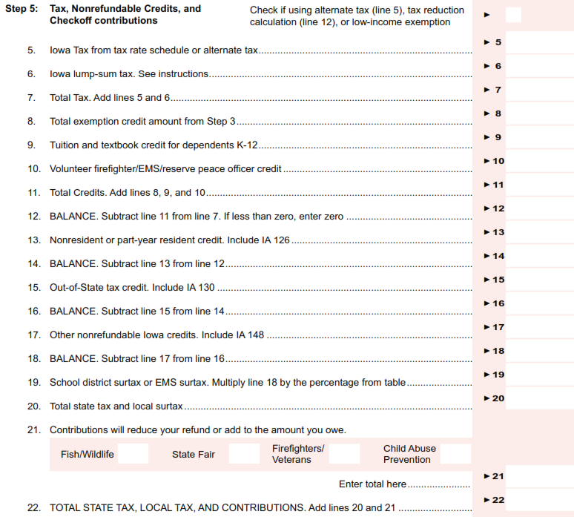
Iowa 1040 pg 2 - cont
Almost identical to Pg 2 of previous IA 1040
Out of Scope

Slide 28
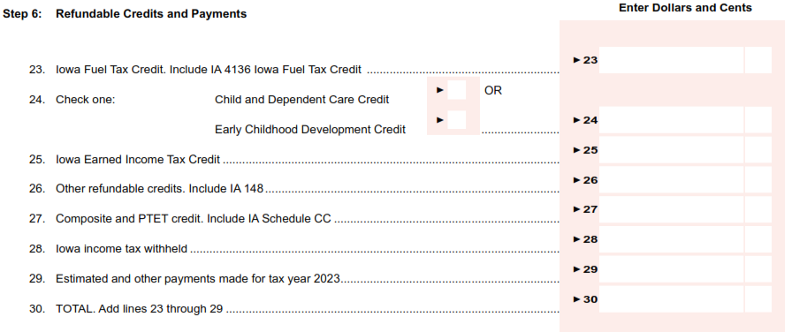
Iowa 1040 pg 3
Out of Scope
Out of Scope
Out of Scope
No major changes
Added composite and pass-through-entity-tax credits, but they are not in scope.

Slide 29
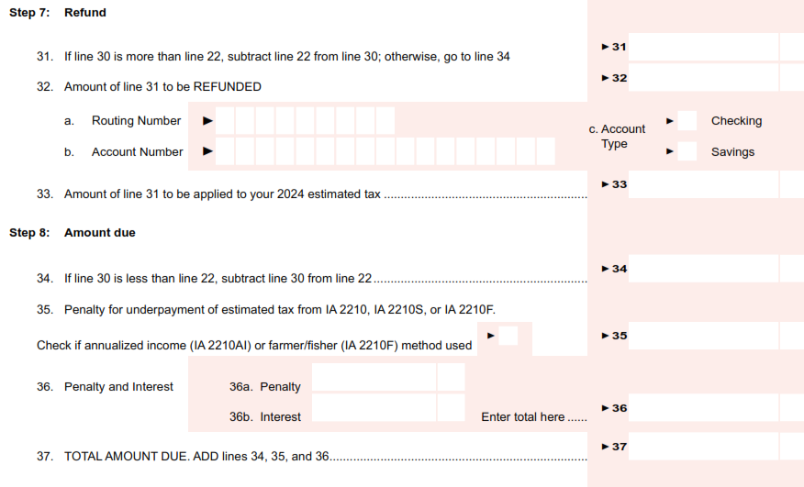
Iowa 1040 pg 3 - cont
Same information as prior years

Slide 30
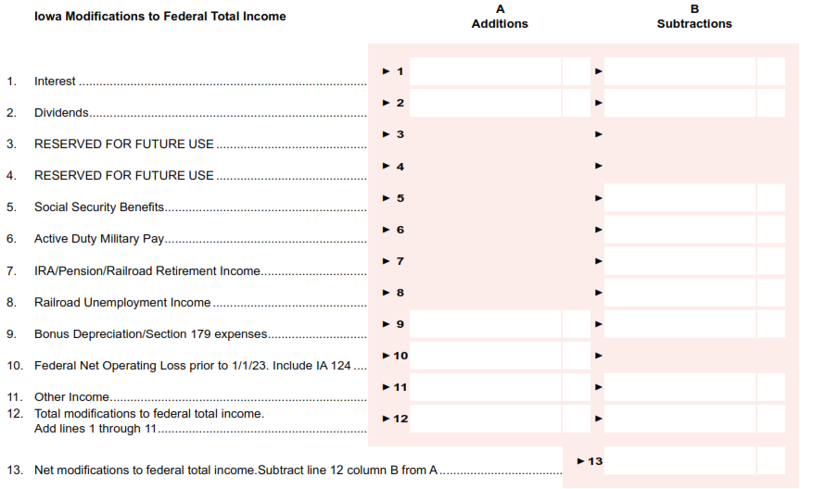
Iowa 1040 Schedule 1 – Federal Total Income
Taxslayer controls Lines 1 and 2 from the Federal section.
These are all the taxable portions of retirement funds on the Federal 1040. Taxslayer should bring them over.
Out of Scope
This comes from a large drop-down in Taxslayer

Slide 31
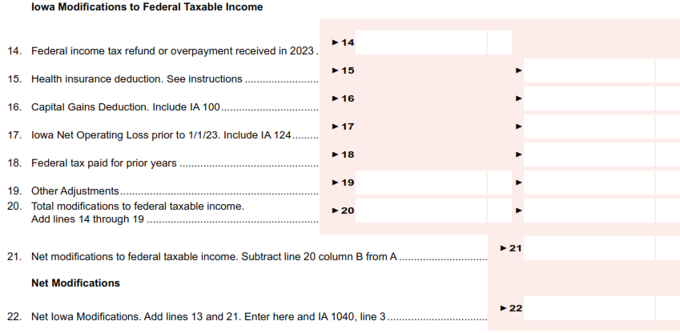
Iowa 1040 Schedule 1 – Federal Taxable Income
This comes from a large drop-down in Taxslayer
The total from the two sections goes up to the main IA 1040
Many of these are moved here from page 1 of the earlier IA 1040

Slide 32
Federal Out-of-Scope
Primary resource is Pub 4012

Slide 33
Out-of-Scope
Any self-employed taxpayer who:
Had a net loss for 2023
Had inventory
Had depreciation
Had expenses > $35K
Employed and paid others
Business use of home
Hobby or income not-for-profit
Professional gamblers
Bartered for their business
Non-standard Qualified Business Income Deduction
Form 8995-A instead of form 8995

Slide 34
Out-of-Scope
Any rental income
Anything dealing with agriculture, fishing, or forestry
Any clergy
Any Active Military pay (Military pensions are in-scope)
Any Casualty/Theft losses
Cancellation of debt only in scope for
Credit Card
Student Loan
Primary Residence (with no interest shown on 1099-C)
Done while taxpayer is solvent
IRAs – we can only do Standard IRAs and basic Roth, not
SEP or Simple
Penalties for excess contributions or late RMD
Non-deductible contributions other than Roth
Std IRA Rollovers that are NOT tax-free

Slide 35
Out-of-Scope
1099-R
Box 7 codes
Out of Scope: 5,6,8,9,A,E,J,K,N,P,R,T,U.W
If it’s not 7, 4, 1, G, or Q, check Pub 4012
Can be a combination of codes
Taxable amount not determined and the Simplified Method had NOT been used previously.
1099-INT and 1099-DIV generally in-scope
Anything not in the usual boxes, check Pub 4012
Schedule K-1 only in scope for
Taxable/Tax exempt interest
Regular/Qualified dividends
Capital gains/losses
Royalty (no expenses)

Slide 36
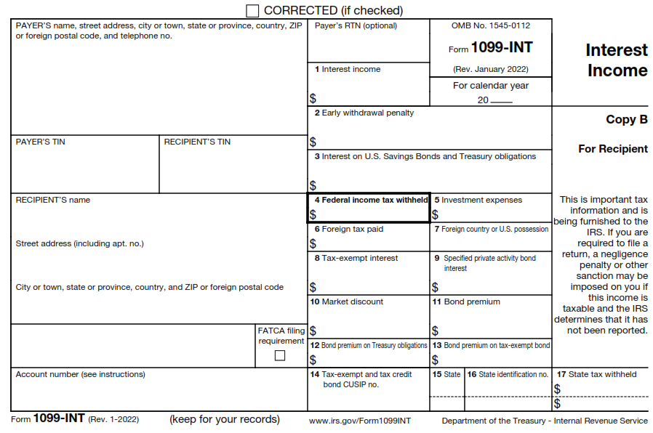
Out-of-Scope
Check Pub 4012 for more details

Slide 37
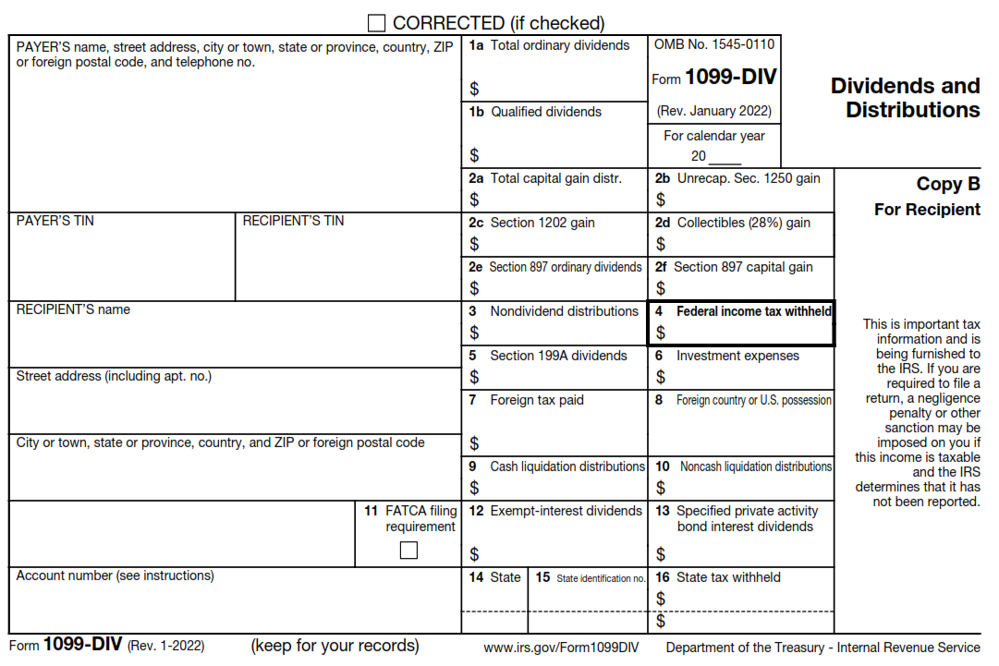
Out-of-Scope
For Section 2, only 2a is in-scope

Slide 38
Out-of-Scope
Related to HSA
MSA or Archer
IRA distributions into an HSA
Excess contribution penalty
Some Energy Credits
Part I of form 5695 (geothermal, solar, or wind based)
Contractor credits (Form 8908)
Charity
Non-Cash contributions > $500
Charity carryover from prior years
Sale of home if used for rental or for business

Slide 39
Iowa Related Out-of-Scope
Iowa Handbook based on IRS Regulations

Slide 40
Out-of-Scope
Form IA 100 – Capital Gains Deduction
This is not from standard stock transactions
Iowa Net Operating Loss
Form IA 148 – Other non-refundable credits
Fuel Tax Credit

Slide 41
Supplemental Intake Forms

Slide 42
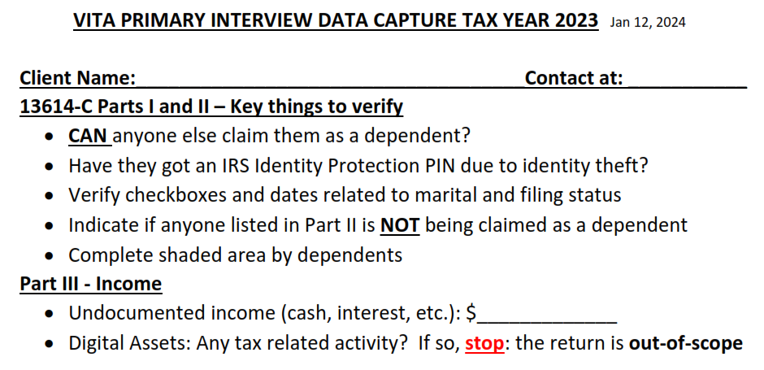
Primary Interview Data Capture - 1
Indicate Text (“T”, preferred) or call (“C”) Also on any doc envelope
Mainly reminder to review and capture key information
Check the resource sheet if needed

Slide 43
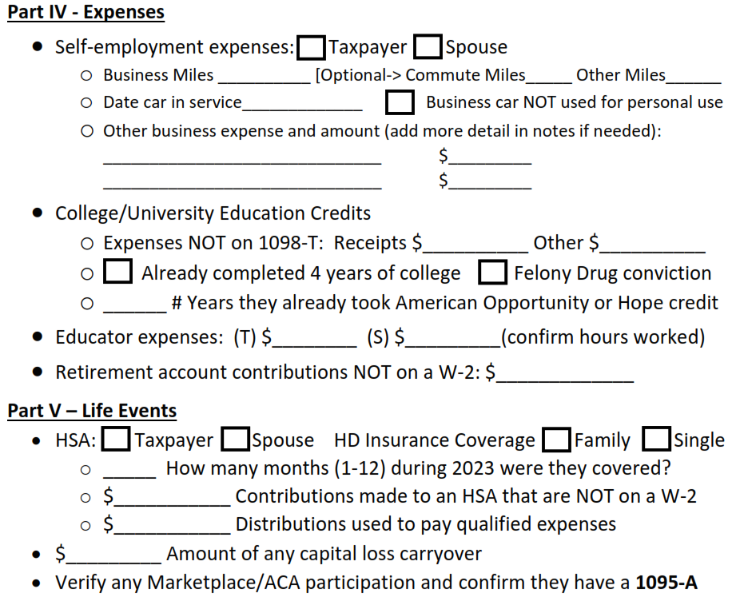
Primary Interview Data Capture - 2
Spouse’s may have separate businesses.
If both, spouse’s expenses must be kept separate
Each spouse may have their own HSA. Cannot be joint.
Need to see the worksheet on their 2022 return

Slide 44
Primary Interview Data Capture - 3
Use reliable source for #s
Remember to verify
REQUIRED if they choose direct payment
Primary source for Iowa intake is the IA Expanded Instructions
We need to see their 2022 return for those credits
Brand new in 2023 – still some open questions
These are things that were NOT paid for with ESA funds. Up to $500 per qualifying dependent (25% of max $2K expenses).

Slide 45
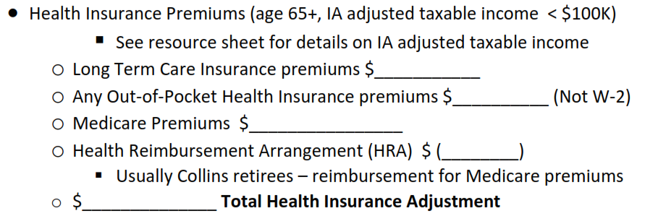
Primary Interview Data Capture - 4
Negative #, subtract
Health Insurance includes Dental and Vision
If taxpayer and spouse, ONLY use premiums for anyone age 65+.
However, $100K income limit applies to the return regardless of any spouse or filing status.
Cannot use for both Schedule A and here
IA Taxable income for this deduction:
Taxable Income (Ln 4 IA 1040)
+ Pension/retirement (Ln 7 Sched 1)
+ Lesser of Fed Deduction (Std or Itemized) vs. Fed AGI
+ Fed QBI deduction
+ Social Security (Step 4 IA Instr)

Slide 46
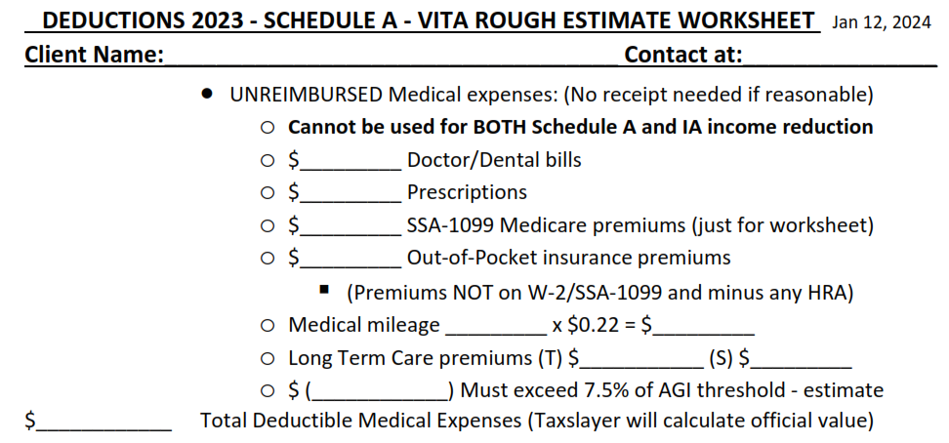
Itemized Interview Data Capture - 1
Indicate Text (“T”, preferred) or call (“C”)
Taxslayer will add these in the actual return
Could turn this negative
Negative #, subtract

Slide 47
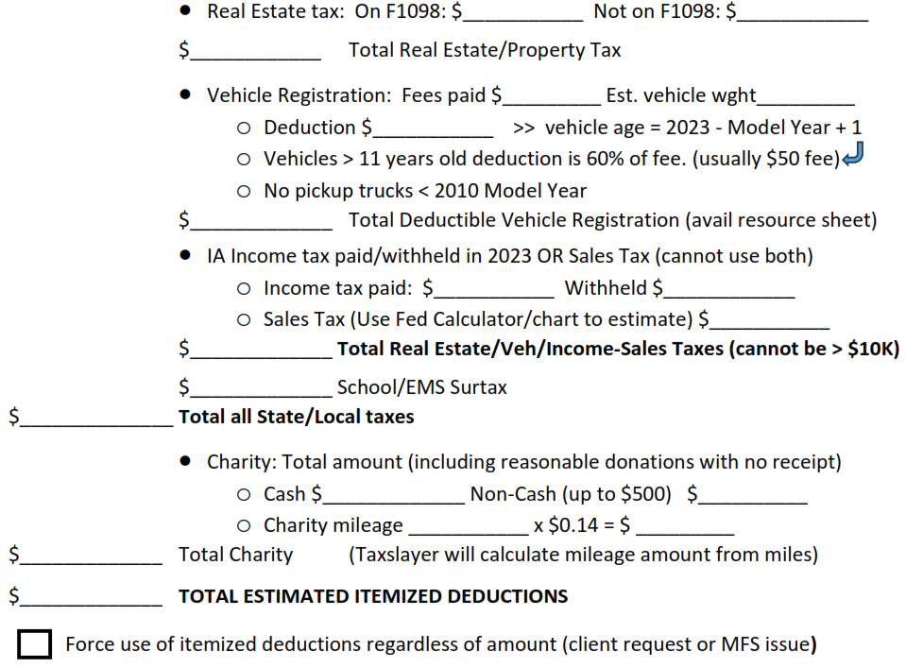
Itemized Interview Data Capture - 2
See resource sheet if questions
Retirees with no IA income tax may benefit from Sales Tax
amount paid last year – IA 2022 1040 line 54
We have slight leeway with the Non-Cash $s
Very rare, but we need to know about it

Slide 48
Planned Resource Sheets

Slide 49
Planned Resource Sheets – Done or This Week
Common Credits and Limits (sheet already out)
Digital Assets (DA) (sheet already out)
Clients may probably be more familiar with the terms Virtual or Crypto Currency
Core guideline:
If DA activity was in $s, would it affect their taxes?
If the answer is “yes”, it will be out-of-scope
Iowa Adjustments in Taxslayer, including
Health Insurance Calculation
Low Income Guidelines
Sales Tax
Gambling

Slide 50
Planned Resource Sheets – By the 27th
Vehicle Registration Fees
Key point: deduction is based on weight only
Added fees for E-vehicles
Iowa Part-Year Resident
Simplified Method
Amended Returns (we’ll see)

Slide 51
Example Scenarios

Slide 52
Training Scenario 1
Gunther and Mary Sahlberg

Slide 53
Sahlberg Discussion 1
Qualified Charitable Distributions need supporting documentation
Be skeptical if a client just says “oh, it was QCD”
Verify they were 70½+ on or before the date of the donation
This is different than RMD, which says any distribution during the year you reach the right age counts toward the RMD
Documents or letters from the issuing financial institution or from the receiving charity almost always make it clear it was a QCD
This is about the only time we change a number from a 1099-R before entering it into Taxslayer
All you see on the return is this little note at the bottom of the first page – QCD on line 4b
It is NOT indicated on the 1099-R

Slide 54
Sahlberg Discussion 2
Capital loss is straightforward if you have the right number to start with
For this it is REALLY helpful, almost necessary, to have last year’s 1040 package
One of the last pages in the VITA package is the Capital Loss Carryover Worksheet with the next year’s starting number
Having an Iowa refund:
Underlying rule: Pre-2023 tax year Iowa refunds received in 2023 only affect 2023 Federal taxes if earlier Iowa taxes affected Federal 2022 taxes
Confusing? It boils down to:
If they didn’t itemize on Federal Schedule A in 2022, any Iowa refund is not taxable for Federal returns in 2023
Any questions or areas to review?

Slide 55
Training Scenario 2
Gloria Langford

Slide 56
Langford Discussion 1
A parent as a dependent is not uncommon
Support and income details are key during the interview
In this case for early withdrawal, the Sched A is helpful even though she uses the standard deduction.
It calculates the total unreimbursed medical costs over her 7.5% limit
The difference between that and the actual expense is what you use when you enter the value for Form 5329
Medical reasons is the only exception we usually run into that has that type of restriction for how much of the funds you can apply for reducing the extra penalty

Slide 57
Langford Discussion 2
HSA Coverage
The last-month (12-month) rule is interesting
Pub 4012 Section E and Form 8889 instructions
As long as the client is enrolled in the HSA in December and keeps going through the entire next year, they are considered to have been enrolled the entire previous year
Allows them to contribute a full year’s worth of funds for that previous year
They face tax penalties if they don’t last the entire next year
Identity Theft
A missing dependent PIN will cause an e-file IRS rejection (but not if filed on paper)
Any questions or areas to review?

Slide 58
Training Scenario 3
Christopher and Cindy Adams

Slide 59
Adams Discussion
Education credits can be tricky
Clients frequently aren’t sure how many times they’ve taken a credit and which credit it was
Pay attention if expenses are really “required” for the courses
Solvency is not always easy to answer for debt foregiveness
There is a worksheet in Pub 4012 if there are doubts
Home mortgage solvency is especially hard
EIC issues: Most clients will remember a letter from the IRS, but not always exactly what it was for
Any questions or areas to review?

Slide 60
Next Steps

Slide 61
Next
Training
ZOOM January 20th and January 27th
I plan to send out three more scenarios for each
20th – Hope to cover more Iowa details related Taxslayer input, as well as a few other tax areas (injured spouse, amending, etc)
27th – Detailed discussion of our recommended VITA process
I’ll be releasing more resource sheets as soon as I can

Slide 62
Final Questions?
Thank you! See you Jan 20th

