Slide 1
January 20, 2024 Training Session
Tax Year 2023

Slide 2
Agenda
Finishing/eFiling a Taxslayer return
We will do bank and final input for the next scenarios
No big changes from last year
Students First ESA
Premium Tax Credits
Iowa Inputs for Taxslayer
Notes on a couple Iowa Credits
Review of Swanson, O’Connor, Edwards
Next Steps

Slide 3
Finishing and e-filing
Section K of Pub 4012

Slide 4
Refund or Amount Owed
Steps are shown across the top
Any refunds or amount owed are shown when you start
Note the IA amount, since it is not displayed later

Slide 5
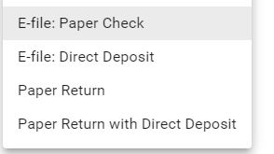
Select Filing Options
For Federal and State, select the filing option
For any returns to be mailed by the client:
Make sure W-2’s and 1099-R’s are included in some manner
For mailed IA returns, remember they need a copy of the Federal return to go along with it

Slide 6
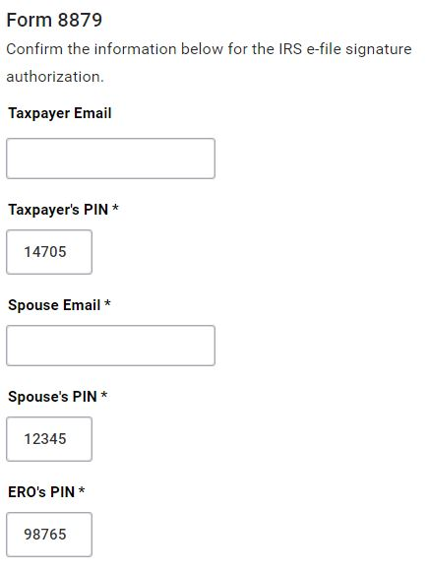
8879 Data – No Input
These should be defaulted by the system, and do not need to be changed

Slide 7
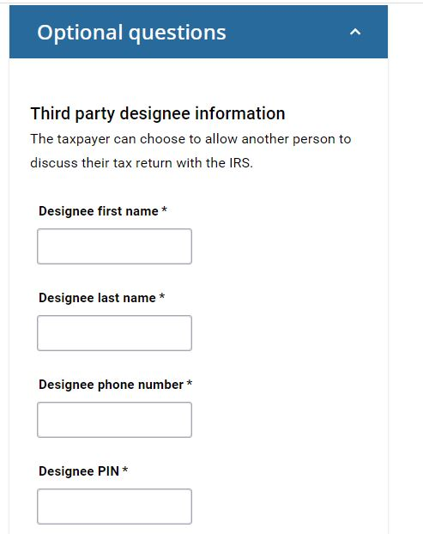
Optional Questions – No Input
We do not deal with this

Slide 8
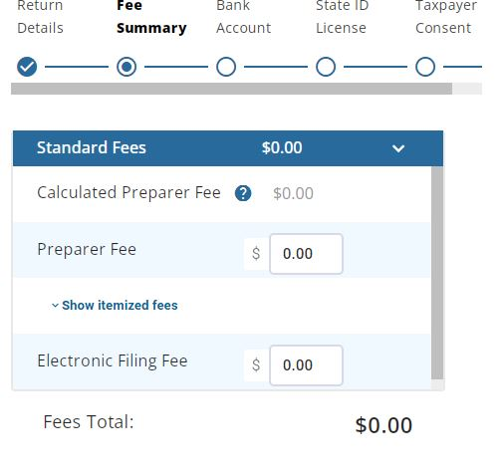
Fees – No Input
We do not have fees

Slide 9
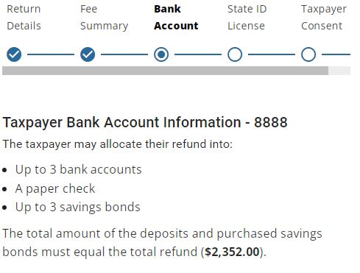
Total for any Bank activity
Only shows Federal total here
Iowa is on earlier screen

Slide 10
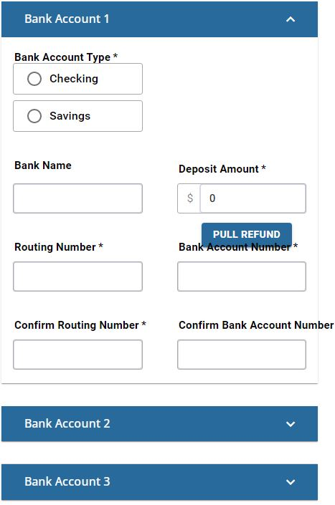
Bank Details
Multiple banks (F8888) not active for Practice Lab at the moment
Input up to three bank accounts for refunds or payments
Use the button to pull in the full Fed refund if only 1 bank
Totals must equal full Fed refund
Bank info carries to IA

Slide 11
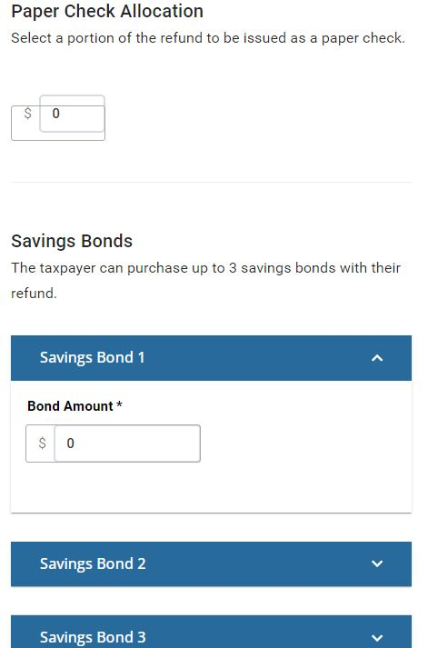
Check/Savings Bond Input
If being paid by check, indicate that here
We very seldom deal with Savings Bonds

Slide 12
Error Messages
If you miss something required , you will get an error

Slide 13
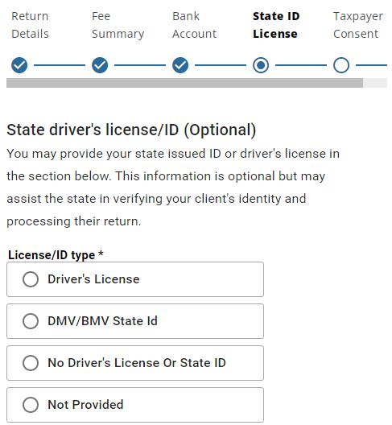
Driver’s License – No Input
We don’t need to input this

Slide 14
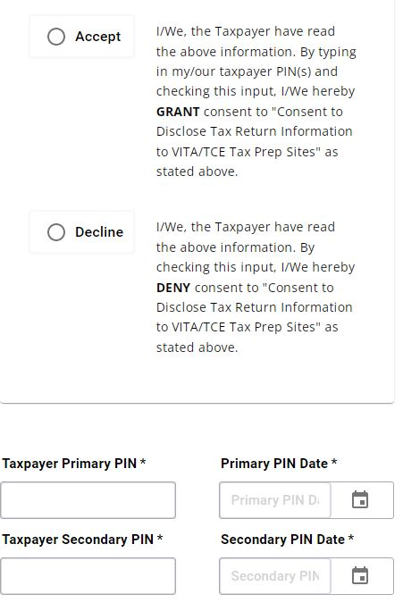
Carry-Forward Authorization
This screen is currently not in the practice lab
We can assume it will be there for the live filing
This is the input from Form 15080 at the back of 13614-C
This does not affect their return
If they signed 15080, then Accept
Use ZIP codes for PIN and today’s date

Slide 15
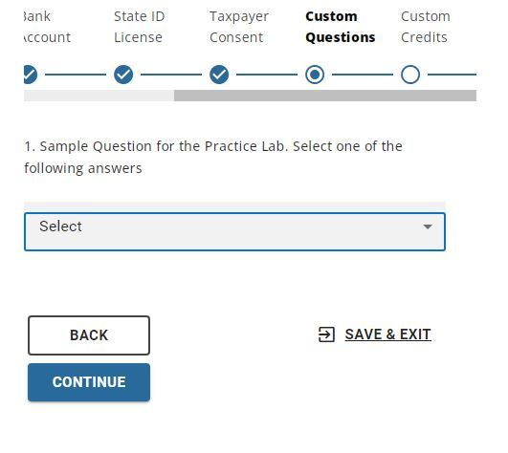
Additional Questions
Questions from end of 13614-C
Notice you can Save/Exit at any point and return later to finish

Slide 16
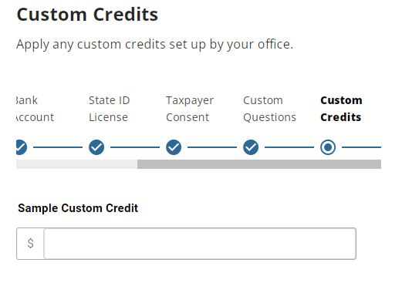
Custom Credits – No Input
No inputs here

Slide 17
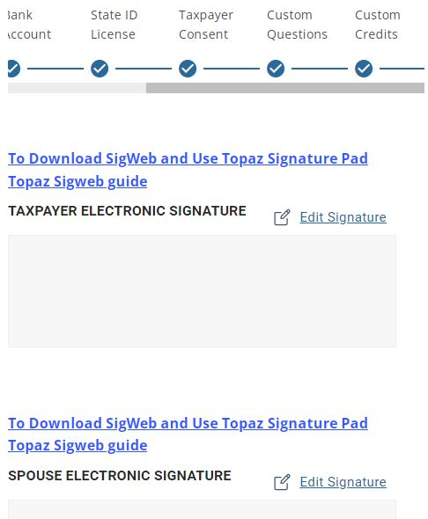
esignatures
We will not be using esignatures

Slide 18
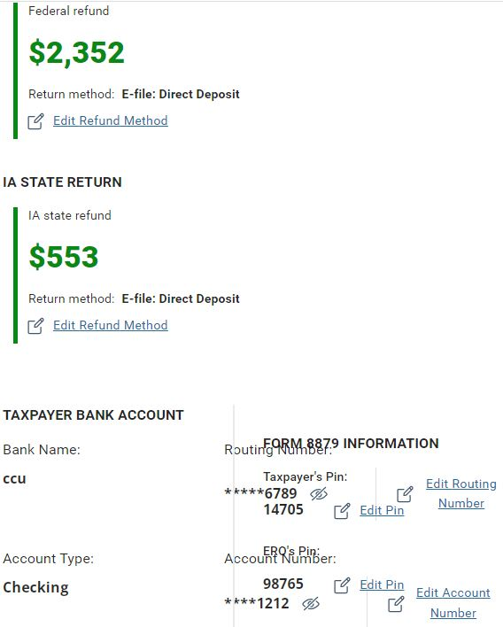
Summary/Verification
The refunds and bank summary are shown here
Your screen layout may affect how it is presented

Slide 19
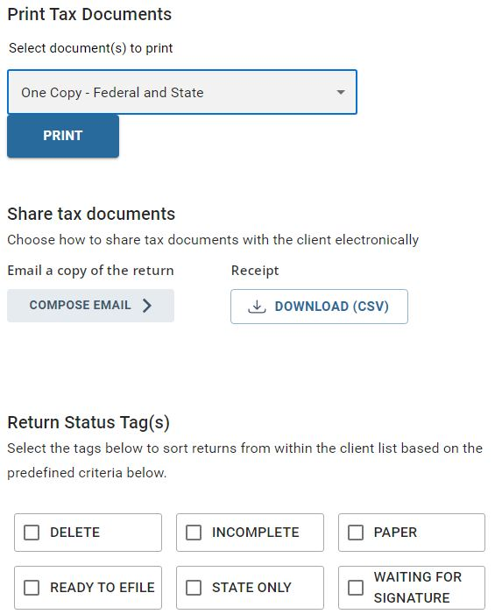
Printing and Tags
Choose the print option (Usually VITA)
Set any tags if needed
eMail option may not be there, but we don’t use it

Slide 20
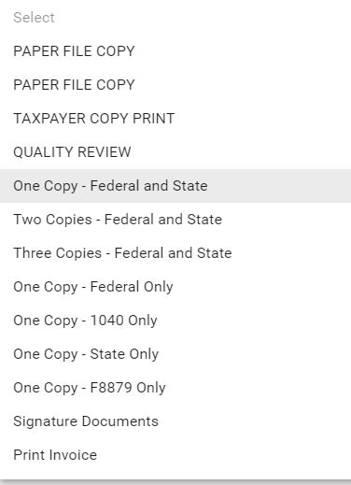
Printing Configuration Options
There should be a VITA configuration available in the live Taxslayer

Slide 21
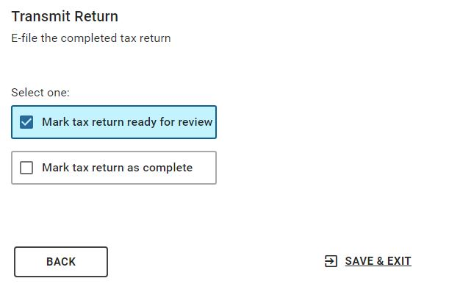
Review and Complete Flags
Setting these two flags at the right time is important to our process
BE CAREFUL of the TRANSMIT Button
It may not be active while “In Review”

Slide 22
Students First ESA

Slide 23
New Program But Little Guidance
Parents with K-12 students attending a private accredited school can have an account set up with $7,635 available for qualified expenses
Income limit is 300% of poverty level this year
Link to IDE list of eligible expenses (also Google Drive)
https://educate.iowa.gov/media/8595/download?inline=
It’s clear activity with these accounts does not impact Iowa taxes (unless spent on ineligible items)
Is there any Federal impact?
I have asked our VITA IRS rep for guidance based on that eligible expense list, and have not received a response yet
Iowa sources have deferred to the IRS

Slide 24
How do we proceed?
Statement from IDE (excerpt on Google Drive) Q24
https://educate.iowa.gov/pk-12/educational-choice/education-savings-account#questions-and-answers
My understanding is that funds transfer directly from the ESA account to the school for tuition/fees, etc.
I believe in most cases, tuition and standard fees would use up all of the $7,635 (½ fall ‘23, ½ spring ‘24)
Until we get specific guidance otherwise, I’m assuming any ESA funds used by our clients are not taxable

Slide 25
Premium Tax Credits
Credits or Repayments for ACA on Form 8962

Slide 26
Handled Differently: Fed vs Iowa
What the client paid themselves for ACA insurance is out-of-pocket Health Insurance
Resources: IRS Pub 502 pg 12 Premium Tax Credit
IA Exp Instr Sched 1 Line 15 “Federal Health Ins Credits”
If they get a credit on Form 8962 in 2023
For any 2023 Federal Schedule A calculation, that reduces their health insurance total
For Iowa
That will be added as income for IA Schedule 1 Line 11 in TY 2024 if it was used for 2023 IA Health Ins Deductions
If they got a credit on their 2022 Form 8962, that goes on their 2023 IA Schedule 1 Line 11 as income if it was used for 2022 IA Health Ins Deductions

Slide 27
Handled Differently: Fed vs Iowa
If they need to repay some Advanced Credit on 2023 Form 8962
For any 2023 Federal Schedule A calculation, that increases their health insurance total
For Iowa, that will add to any qualifying amount they can claim on their 2024 IA Schedule 1 Line 15. (Assuming they did not use Schedule A for 2023, and if they qualify)
If their 2022 Form 8962 shows a repayment, that shows on their 2023 IA Schedule 1 Line 15 (If they qualify)
Going forward
Very few clients itemize on Schedule A
Have to be 65+ to get the Health Insurance Deduction
Not too many clients that age on ACA
So this is the last year we will see too much of this

Slide 28
Iowa in Taxslayer

Slide 29
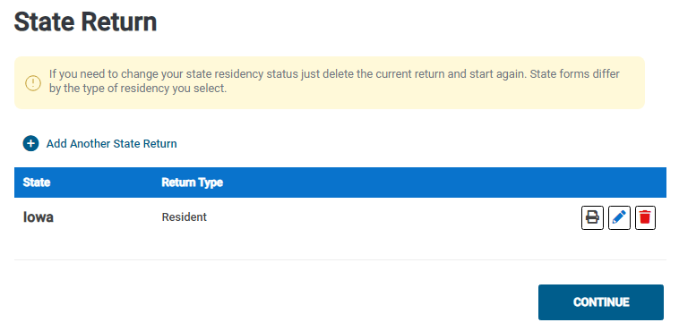
State Selection
Taxslayer should create a base Iowa return for you. Use this button to add additional state returns.
Print just the IA 1040 package
Edit the return

Slide 30
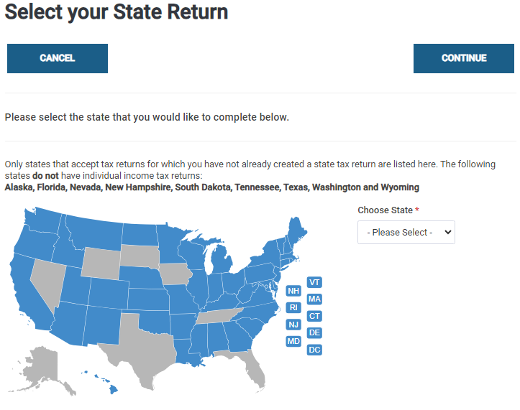
Starting A New State
Click on the map or use the drop-down. (IA is grey because a return already has been started)

Slide 31
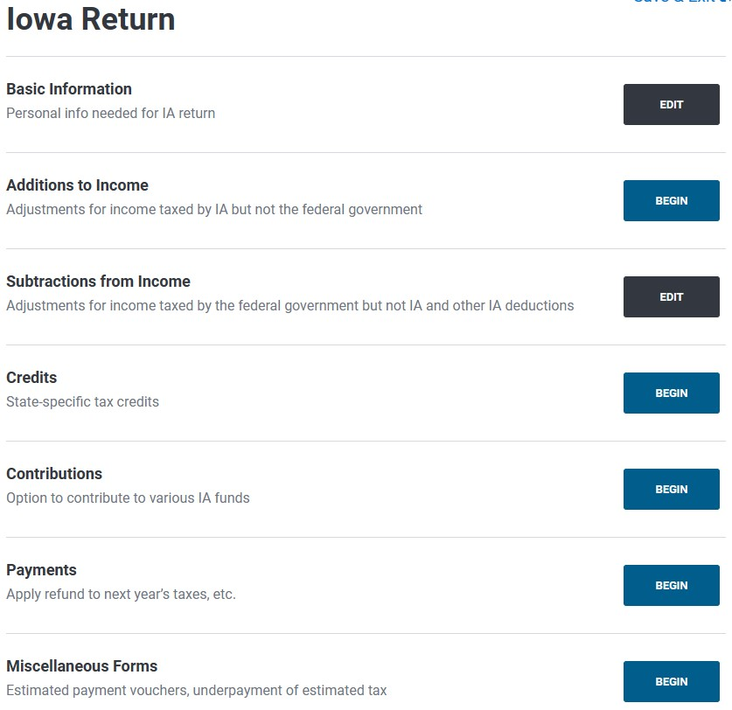
Main Menu

Slide 32
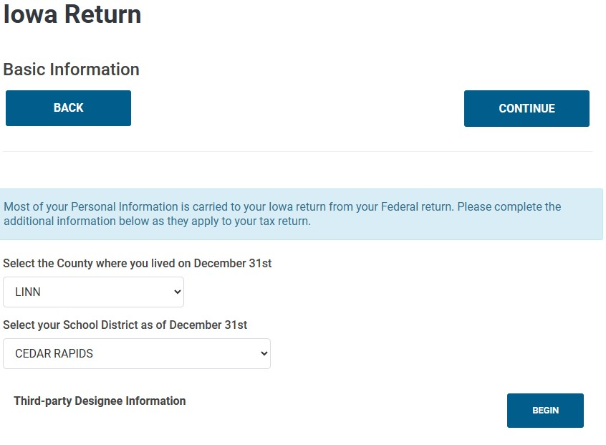
Basic Information – No Spouse
Taxslayer will present this screen when you first start a new return (either No Spouse or Spouse view). It only does it the first time in.
This is new in 2023. A client can specify someone to deal with the IDR on their behalf if they wish.

Slide 33
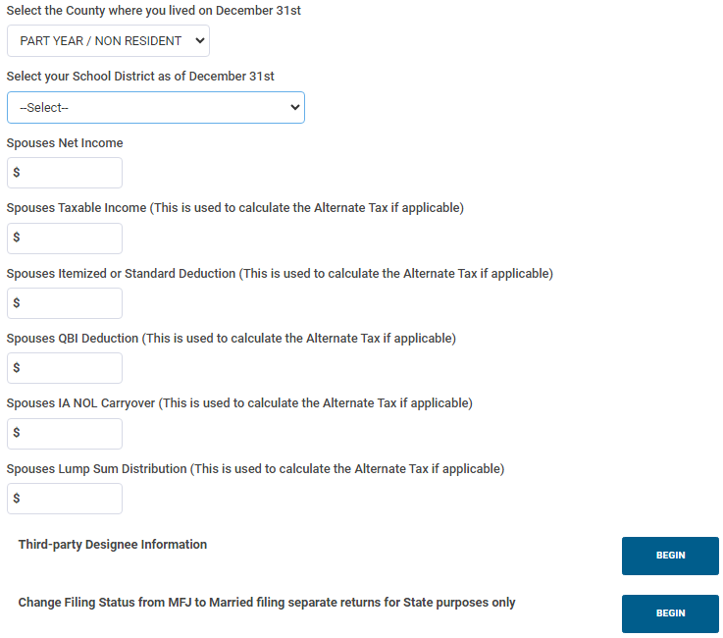
Basic Information – Spouse
You are not forced to input here, but you need to. It’s easy to forget
This is used for calculating Alternative Tax, which we rarely if ever deal with
This is not allowed any more, and a bug report has been submitted.

Slide 34
Adjusting for Iowa Income
The underlying logic is less complicated for IA taxes, but the implementation jumps around
Taxslayer screen arrangement and flow does not always match up with the IA 1040 and the Expanded Instructions
Drop-down lists at this time appear to have issues
A bug report has been submitted
I’ll suggest workarounds for our training, and for the start of the season until things get straightened out

Slide 35
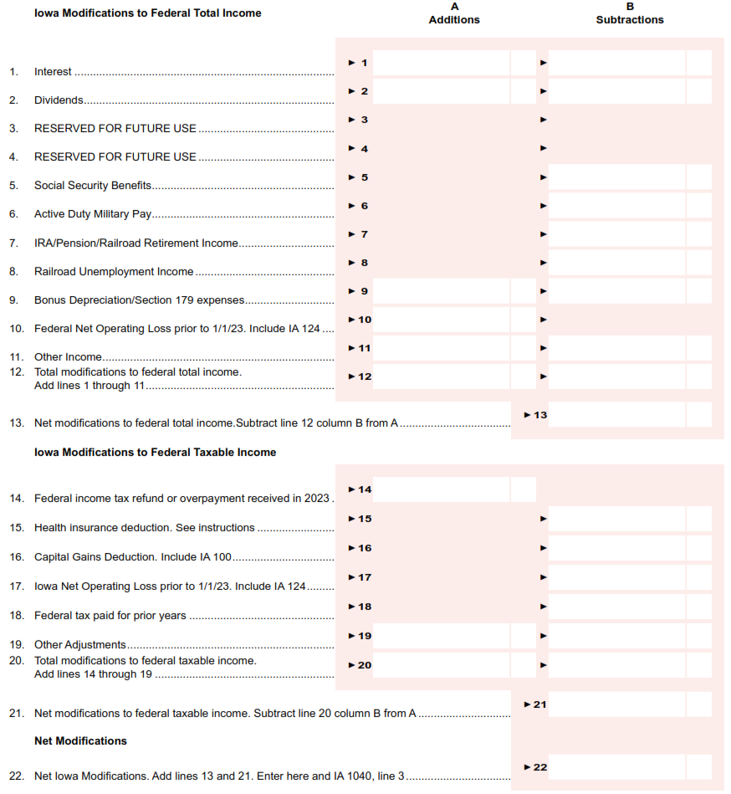
Where it goes on IA Schedule 1
Taxslayer pulls from Federal 1040, 1099-INT and 1099-DIV
Subtractions from Income specific fields
Additions to Income specific fields
Drop-down lists inside Subtraction and Addition sub-screens.
Primarily Lines 11 and 19

Slide 36
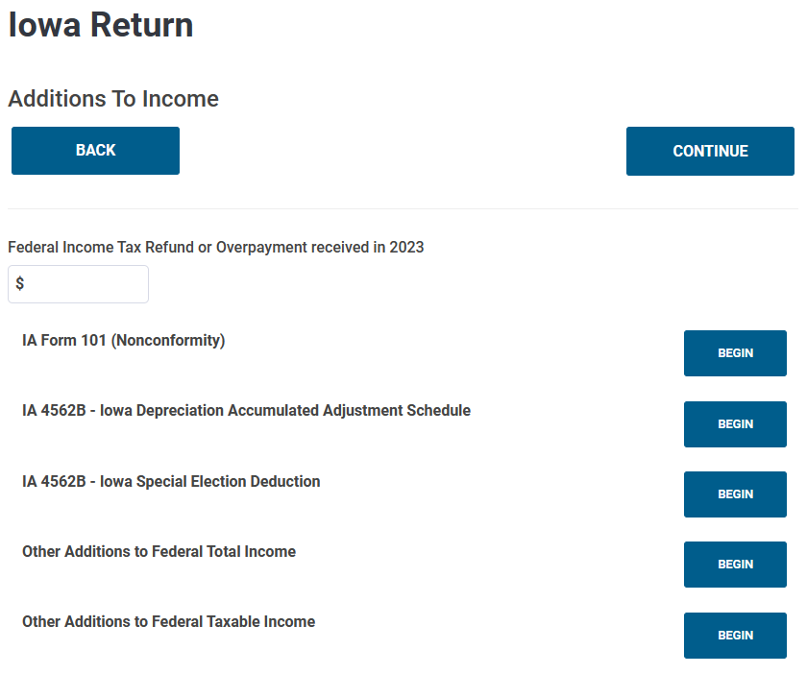
Additions to Income
Line 14 – Mandatory Field
Line 11 – OOS – Listed as option x in IA Exp Instr
Line 9 – OOS – Deal with business and farming

Slide 37
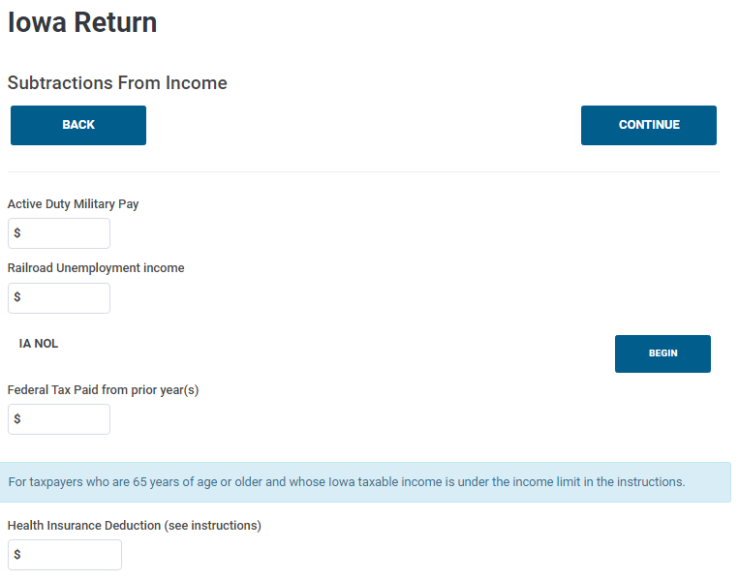
Subtractions from Income - 1
Line 6 – OOS
Line 8 – (I’ve never seen this)
Line 17 Net Operating Loss – OOS
Line 18 – Still need to enter 0 for Fed Refund
Line 15 – Defaulted initially by Taxslayer from Fed inputs (except LTC), but only once

Slide 38
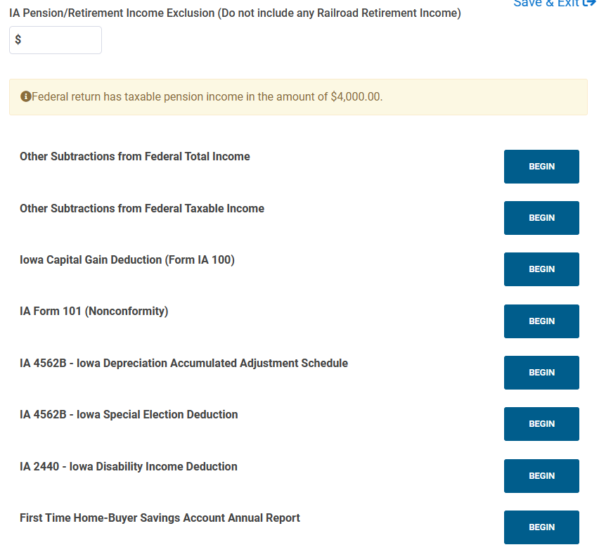
Subtractions from Income - 2
Line 7 – RR Retirement is not usually taxable at Fed level
Helpful Hint
Line 16 – OOS – Business, not stock
Line 11 – OOS – Listed as option x in IA Exp Instr
Line 9 – OOS – Deal with business and farming
Line 19 – listed as option h in IA Exp Instr
Goes with Line 19 j

Slide 39
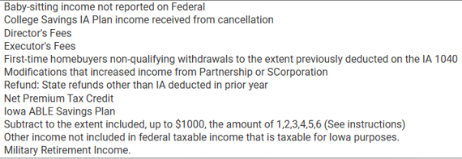
Drop-Down Menu 1 – Line 11 in Exp Instr
a d e f h i k
n o aabbcc
Out-of-Scope: i
Ones we might see: k, refunds from other states, n Net Premium Tax Credit
IA Exp Instr tie it all to Line 11, but Taxslayer lists it only for subtractions
No clarification on how cc Military is different than other entries
Military normal retirement is taxable at the Fed level
Military disability pension is NOT taxable at the Fed level
aa is the Retention Bonus for teachers and daycare
aa is the only one listed her that is a reduction. Others add income.

Slide 40
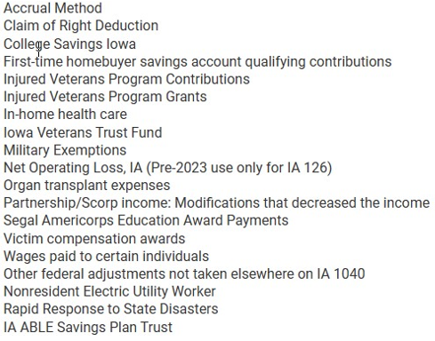
Drop-Down Menu 2 – Line 19 in Exp Instr
a f g j p q r s t
v w x aa bb
gg
hh
ii kk ll nn oo
Should be IA 124. IA 126 is part-yr resident
Not listed for Line 19 in Exp Instr – goes to lines 10 and 17 - OOS
Now the catch-all for other adjustments
Not listed for Line 19 in Exp Instr part of Line 14 - OOS
Out-of-Scope: a, t, w, bb, kk, ll, oo
Ones we might see: g College Savings IA (529), ii IA Able plans, nn ESA
Accrual method used to be the catch-all, now use “other”
IA Exp Instr tie these all to Line 19, but Taxslayer uses it multiple times

Slide 41
Drop-Down List Concerns
In the IA Exp Instr
List 1 are all additions to income for Line 11
The exception is the retention bonus
List 2 are all subtractions from to income for Line 19
Taxslayer only displays List 1 for Subtractions from Federal Total Income
Taxslayer displays List 2 for everything else
However – the inputs for List 1 are treated by the software as if they came from List 2

Slide 42
Drop-Down List Concerns
For both added and subtracted Federal Taxable calculations, inputs under “Other” seem to be ignored
IA Exp Instr lists two items we are interested in for Line 19, but do not show on the drop-downs
Extra Educator Expenses (ee) (up to $200)
Employer contributions toward paying a student loan on a W-2 that were taxed (pp)

Slide 43
Workaround until Resolved
Reminder: Only subtract qualified expenses from the IA taxes that were NOT already reduced at the Federal level
In previous years, we had just used “Accrual Method” (the “a” labeled choice) as the “catch-all”
I’ll suggest we go back to that for now
Use the Federal Taxable (Not Total) Income choices to add or subtract, and choose “Accrual Method”

Slide 44
Adjustments We Frequently See
Extra Educator Expenses (Line 19 ee)
Up to $200 in addition to the Federal limit of $300
The Federal $300 will carry over on its own
Taxed Employer contributions toward paying a student loan on a W-2 (Line 19 pp)
Only the excess over $5,250 was taxed
529 Contributions (Line 19 g)
Taxed at Federal Level
Teacher/Daycare retention bonus (Line 11 aa)
Up to $1000
Net Premium Tax Credits (Form 8962) (Line 11 aa)
This is what they were refunded
This is additional income, not a subtraction

Slide 45
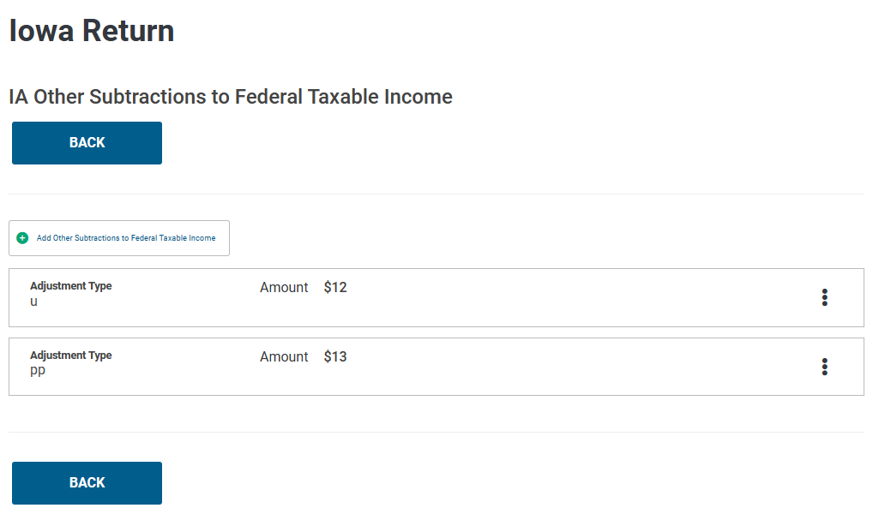
How the Drop-Downs Show Up - Screen
After you “CONTINUE”: You chose from a text drop-down, but the display gives the letter code from the IA Exp Instr

Slide 46
How the Drop-Downs Show Up - Printed
In the IA Exp Instr, it has the following requirement:
Here’s how Taxslayer handles that:
Taxslayer creates one page at the end of the IA 1040 with the adjustment selections for each of the four areas: Total Fed Income Add and Subtract, and Taxable Fed Income Add and Subtract.
For printing, note it’s using the text field, not the letter code from the IA Exp Instr. (Previous years, this page just showed the letter code)

Slide 47
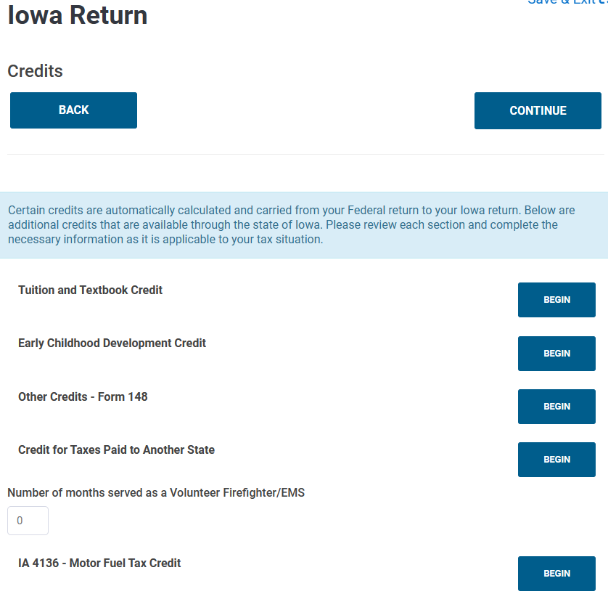
Iowa Credits
25% of up to $2K expenses
(Grades K-12)
25% of up to $1K expenses
(ages 3-5)
OOS
I have not seen this much
OOS

Slide 48
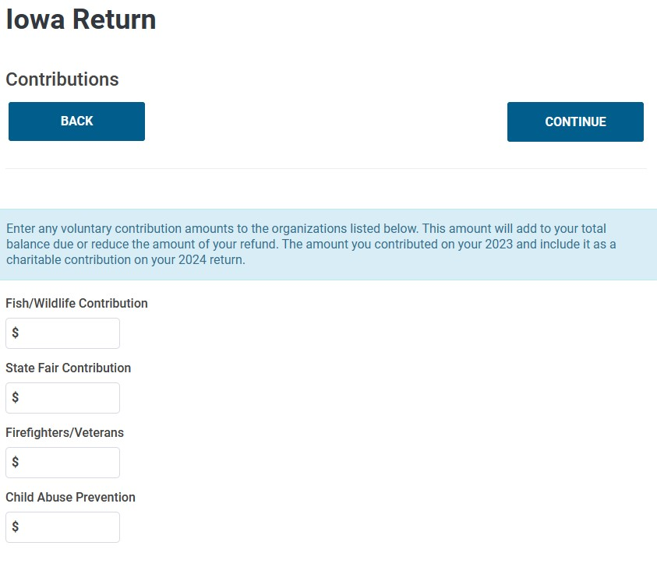
Iowa Unique Contributions

Slide 49
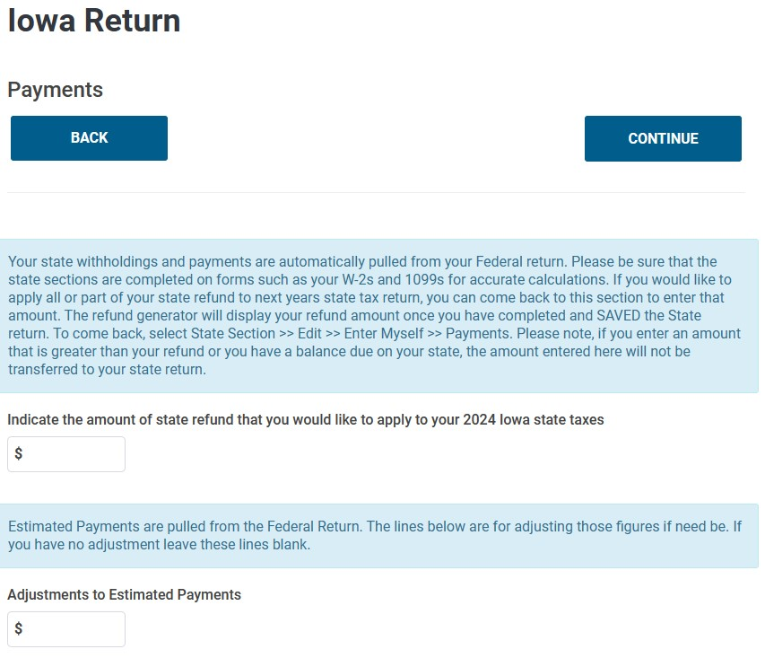
Payment Adjustments
Amounts brought from 2022 and IA estimated payments are input in the Federal section under Payments & Estimates
Fed estimated payments done in January have to be shifted a year

Slide 50
Notes on Iowa Credits

Slide 51
Tuition and Textbook Credit (K-12)
This is frequently overlooked by our clients
How Much?
25% of expenses up to $2K per qualifying dependent
What is covered?
Table is on page 16 (Line 9 Step 5) of the IA Exp Instr
Summary:
Any tuition, fee, textbook, materials or supplies required to participate in school or a school-sponsored activity
Sports, clubs, band, choral, etc
Instrument rental only, not purchasing an instrument
CANNOT be clothing they might wear every day
CANNOT have been already paid for by ESA
If reasonable, they don’t need receipts

Slide 52
Early Childhood Development Credit
This is seldom used
Cannot use both Dependent Care and this credit
Ages 3-5
How Much?
25% of up to $1K in expenses for each qualified dependent
What’s Covered?
List in the IA Exp Instr, pg 49 (Line 24 Step 6)
Preschool services
Development activities outside the home
Books and materials promoting child development
NO religious instruction

Slide 53
Training Scenario 4
James and Stephani Swanson

Slide 54
Discussion
Railroad Pension
Pay attention to which section of the document goes with which input area in Taxslayer, and how fields match up between different documents (vs SSA-1099 and 1099-R)
Getting the starting date for a pension during the interview is critical
Energy Credits
The screen door makes sense if you are replacing the main door, but it is not something you get an energy credit for
Remember to reduce the A/C or furnace amounts by the rebate $
It doesn’t matter how it’s allocated, since it’s combined anyway
IRA Contribution
Since Stephani does have income, she can contribute
There is no longer an age limit
The Retirement Plan question refers to an active plan with a current employer, where the employer is potentially contributing into that plan
Sale of Home
We don’t hear about a lot of home sales, but if a 1099-S shows up we have to include that with their taxes
Make sure everything is in scope

Slide 55
Training Scenario 5
Shamus O’Connor

Slide 56
Discussion
Medicare
It’s unusual for us to see a Medicare payment outside of Social Security, but as the full Social Security age creeps up we may see more
The key point is when you paid the bill, not what time period it covered
Self-Employment
Do any 1099-NEC first, since it will trigger a Schedule C
Income not on a 1099-NEC is manually entered in Schedule C
Taxslayer is still showing a split input for mileage. Use either one.
Net loss, inventory, depreciation, not using std mileage create OOS
IPERS Pension
These almost always have an Iowa taxable amount < Federal
Does not affect the Federal return, but will come into play with IA
Estimated Payments
We don’t see a lot of these. This is the last year Federal estimated payments will matter for IA
Note: For IA taxes we will need to know if they made a Jan 2023 payment for 2022 taxes

Slide 57
Training Scenario 6
Tiana Edward

Slide 58
Discussion
Dependent Care
Her Employer contributed toward dependent care, so she does not get to use the full amount for her credit
Taxslayer handles this automatically
Retention Bonus
Not sure how they will show up this year, last year was 1099-NEC
Unfortunately, this forces a Schedule C and self-employment tax
Interest Income – Savings Bonds
Input in the Fed section, but this directly affects the IA return
The IA Exp Instr has the full list of interest that changes with IA
Alimony and Child Support
We don’t see a lot of these, so remember to get the divorce date
Child Support is not taxable, so be sure to clarify with the client which category any money they get comes under

Slide 59
Discussion
IPERS Contributions
On the W-2, this always shows up in Box 14 since it is mandatory.
That makes it ineligible to trigger a Retirement Contribution credit
Addresses
It is very common for our clients’ driver’s license to not show their current address
Enter the address from the 13614-C
This will create the default address for almost all documents you input
If any document address doesn’t match the 13614-C, overwrite it

Slide 60
Next Steps

Slide 61
Next Training
ZOOM January 27th
Discuss:
Injured Spouse
Amended Returns
Part-year resident
Detail step through of VITA processes
Review IA scenarios
I will not create 3 brand new scenarios
I’ll add/change details with 3 existing ones and add Iowa information

Slide 62
Questions?
Thank you! See you on Jan 27th

