Slide 1
January 27, 2024 Training Session
Tax Year 2023

Slide 2
Agenda
Updates on Taxslayer IA Functions
Review Processes:
Intake/Interview
Preparation
QR and Returning Completed Taxes to Clients
Missing Documents or Information
Injured Spouse
Amended and Prior Year Returns
Iowa Part-Year Resident
Review of Edwards, O’Connor
Next Steps

Slide 3
Quick Notes
When in doubt about the process consult the Site Coordinator and other volunteers
For the topics following the Process Review, the recommendation is not to have VITA volunteers tackle them for the first time without close mentoring support
We are not revisiting TY 2022 or earlier training in these sessions
To save space and typing, F2F is Face-to-Face, and NIP is Not-in-Person

Slide 4
Taxslayer IA Function Status

Slide 5
Where do things stand?
All the issues I had mentioned in earlier emails are either fixed or confirmed as the intended function.
There are two additional issues that I submitted, but they do not directly affect our training
There have been some IA screen changes related to the latest releases
Some of the Taxslayer notes on the screens accompanying fields still have references to allocating between spouses
There are two pieces of information I need to correct from prior training and emails:
Railroad Retirement IS taxed at the Federal level
With the new IA changes, we only enter the additional Educator Expenses above what is on the Federal return

Slide 6
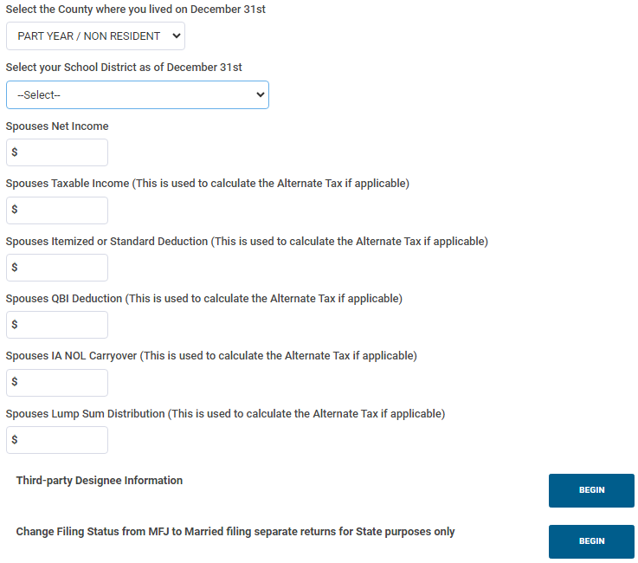
Basic Information – Spouse
These are staying, but VITA will not deal with this
This is gone

Slide 7
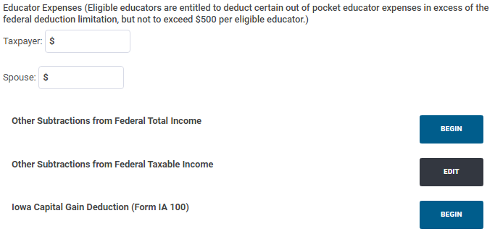
Subtractions from Income
Educator Expenses has it’s own field(s) for Taxpayer and Spouse.
Will show a message with any Federal $s. Only enter additional $s
Ignores Fed $ for total and any excess if an entry is >$500
Still shows on IA Sched 1 Line 19 and on the additional explanation sheet, but it’s not a drop-down input

Slide 8
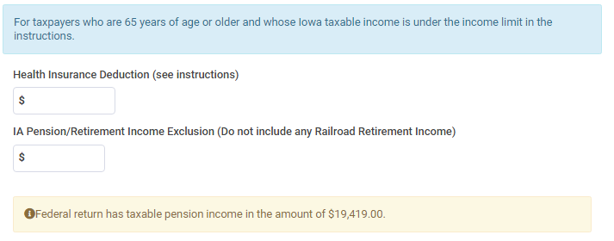
Subtractions from Income
Taxslayer total includes RR funds, which ARE taxable at the Fed level. This msg contradicts IAExpInstr. May be carryover from 2022 messages
Health Insurance
Nothing pulled from Federal return
Taxslayer knows if you are 65+ or if your qualifying income is > $100K
Retirement Exclusion
Taxslayer shows total retirement from Federal 1040, but does not default the field (Social Security exclusion for IA Sched 1 IS carried over)
Will ignore excess if you enter more than what is shown

Slide 9
Overall Tax Process

Slide 10
Intake/Interview
Applies to both F2F and NIP

Slide 11
Starting Out
Verify Photo ID, Taxpayer and Spouse (if a joint return)
Gov’t Issued Document
Do this even if there is a greeter
Verify SSNs or ITINs, including dependents
For NIP, get copies of Photo and Tax IDs
Make sure the client understands the process, especially for NIP

Slide 12
Starting Out – 13614-C
Go through the 13614-C
Verify all birthdays
Resolve illegible entries
Verify dependent status
Resolve unanswered or “Unsure” questions.
Verify choices for refund or payments AND DATE
If you are not busy, it is OK for the incoming client to fill out the 13614-C at your table.
You may need to directly help the client with the 13614-C (especially if there is no greeter)

Slide 13
Starting out – misc.
Do they prefer text or call for contacting them?
Capture on 13614-C and/or the supplemental intake forms, indicating “T” or “Text” above the phone #, or “L” for landline or “No Text” or “Call”
If no phone # can be provided, consult the Site Coordinator on what contact info to capture
Explain about signing Carry-Forward (F15080)
Accepting this means their data is available to ANY VITA site (Through Nov 2024 if they ask)
Does not affect doing their current taxes if they don’t sign
Note: signature is on F15080, not 13614-C

Slide 14
Options for SSN/ITIN
If they do not have a Social Security or ITIN card with them, the following are acceptable:
SSA-1099
Letter from Social Security Office or IRS with name and full SSN or ITIN on it.
We have accepted the SSN/ITIN from the previous year’s return, especially for spouse or dependents
Verify the earlier return was not changed
If you use something besides the original cards, it’s helpful to note for QR or NIP what you used
Verify the name for primary taxpayer

Slide 15
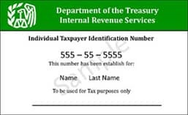
ITIN Card

Slide 16
Do you have all the documents?
Based on the 13614-C, do you have everything?
If data is sent to the IRS (financial institution, employer, etc.) there should be an IRS form.
If something is missing, follow the process outlined later in this presentation
Other documents are helpful, if not required.
Receipts from Colleges
Car registration
Property Tax
For documents we don’t need, kindly thank them for being thorough, but return them.

Slide 17
Capture/Summarize other data
Use the Intake Form(s) for capturing data, especially if there is no other documentation
The more information in one place for the NIP preparers/QR and F2F QR people, the better.
Take notes on Intake Forms, 13614-C, photocopies
Examples
Bank information
Debit cards do NOT have bank account information
Deposit slips are NOT reliable for bank routing #
Cash income
Self-employed expenses
Out-of-Pocket Medical expenses and premiums
Charity
College or K-12 school expenses

Slide 18
Out-of-Scope
If at any time you come across something that appears to be Out-of-Scope
Double-check in Pub 4012
Consult with the Site Coordinator
If it is OOS, explain and apologize to the client
Return all their documents
Any photocopies or notes we made can be returned to the client or set aside for shredding
We do not recommend other places to go for tax preparation
Keep the 13614-C, but clearly note on it that this was an Out-of-Scope situation

Slide 19
Tax Preparation

Slide 20
Face-to-Face Preparation
Input the data in Taxslayer
Resolve anything that comes up that was missed in the initial interview
When done, the client is usually curious to know what the refund is or what they owe.
Remind them QR still needs to review it
Set the Taxslayer status flag to “Ready for Review”
Do NOT flag “Complete”

Slide 21
In-Person Prep (con’t)
Prepare their VITA/TCE envelope
Write their name, phone #, and text/notext choice
Make sure the tax year and site name are on the envelope
Put in all their relevant documents, the 13614-C, and your notes
Give them the envelope and let them know where to wait for an available QR person.
If there’s a greeter, let the greeter know.
Preparer’s initials are not needed on envelope
Since many sites are doing NIP in some manner, colored label envelopes will be standard

Slide 22
Not-In-Person Preparation
Explain and have the client sign F14446
This is our permission to keep their documents
Prepare their VITA/TCE envelope
Write their name, phone #, and text/notext choice
Make sure the tax year and site name are on the envelope
Put all their relevant documents, signed forms, and your notes inside
Initial/Date the log label for Intake
Put the promise date (2 weeks) on the log label

Slide 23
Not-In-Person Prep (con’t)
Give the client a return-reminder half-sheet
Write the date and client’s name
Enter the date two weeks out when they can return
Verify check the date to use at the start of your shift
They can come anytime 2 weeks out or later when the site is open
Make sure the site days and hours are on the sheet
Put the VITA envelope in the assigned location to go to the preparation site.

Slide 24
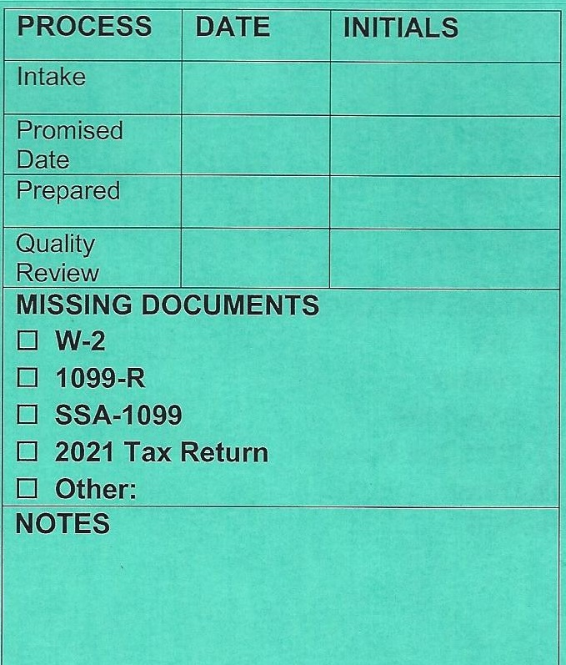
VITA Envelope
319-555-5555
TEXT
CLIENT NAME
2023
SITE NAME

Slide 25
Not-In-Person Preparation Site
Site Coordinator will indicate the priority for envelopes to be processed
Remove all documents from the envelope
Review 13614-C, documents, and all intake notes
Enter the data in Taxslayer
Add any new notes useful for QR

Slide 26
NIP Tax Preparation Site (con’t)
Set the Taxslayer status flag to “Ready for Review”
Do NOT check “Complete”
Put everything back in the envelope
Date and initial the log label as the preparer
Put the envelope in the designated location for QR

Slide 27
Not-In-Person Issues
Issues can happen in preparation or QR
Examples are if you discover:
Missing documents not caught at the interview
Needed information is not in the notes
The return is out-of-scope
Try to resolve questions among the preparer, QR, and Site Coordinator
If that isn’t possible, contact the client
If you don’t get in contact quickly;
Set the envelope aside with a clear note as to what the issue is.
Create an e-note in Taxslayer

Slide 28
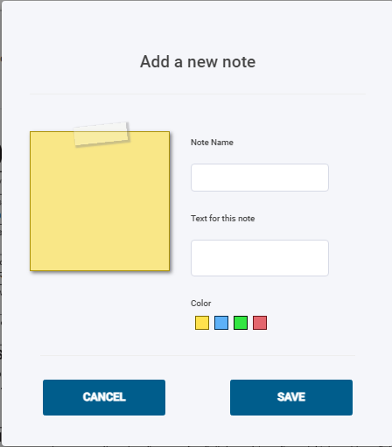
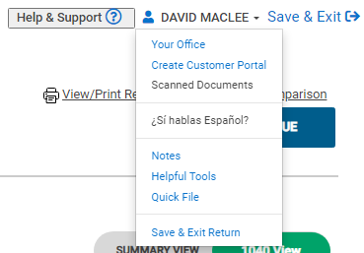
Taxslayer e-notes
When a client record is open, use the drop-down
Notes carry forward to the next year for a client
Helpful to let next year’s preparer know about something for next year’s taxes
Can be accessed from the client selection menu

Slide 29
NIP Issues – Missing Document
Envelope stays at the NIP Preparation site
Clearly identify the issue on the envelope
When you do get in touch with the client, they have the same options as if this was discovered during the intake (covered later)
The physical documents can be brought to the intake site or to the preparation site
If brought to the intake site, site coordinators need to communicate for where it goes

Slide 30
NIP Issues – Notes not Complete
Envelope stays at the NIP Preparation site
If the client is not immediately available, note the issue on the envelope and set aside
When you do get in touch with the client, have them provide the missing information and update the notes
Complete the return and finish the process

Slide 31
NIP Issues - Out-of-Scope
Put everything back in the envelope and clearly mark it as to what the problem is
Have the envelope returned to the intake site
At the Intake Site:
Contact the client; let them know the situation and that they need to come back and pick up their documents (no appointment)
Make sure the 13614-C is marked as Out-of-Scope
When they come to pick it up:
Keep the 13614-C and F14446 (Consent form)
Return the envelope with the other documents
The F14446 can be shredded

Slide 32
Quality Review

Slide 33
Face-to-Face QR
Pull up the return in Taxslayer
QR the return
Verify data with the client as appropriate
If there are issues, discuss with the preparer
Correct as appropriate
Print the return (VITA print setup)
Mark the return as “Approved” and “Complete” in Taxslayer
Pull out the e-file forms and any vouchers
Do NOT transmit

Slide 34
Not-In-Person QR
Pull up the return in Taxslayer
QR the return
If there are issues, discuss with the preparer
If the client needs to be involved, try to contact them
Correct as appropriate
Print the return (VITA print setup)
Pull out the e-file forms and any vouchers
Staple the return

Slide 35
Not-In-Person QR (con’t)
Mark the return as “Approved” and “Complete” in Taxslayer
Do NOT transmit
Put all documents, forms, and the printed return into the envelope
Recommend putting return inside 13614-C
Date and Initial the log label for QR
Put the envelope in the appropriate place to go back to the intake site

Slide 36
Giving the Client their Return
Applies to both F2F QR and NIP Intake/Return site

Slide 37
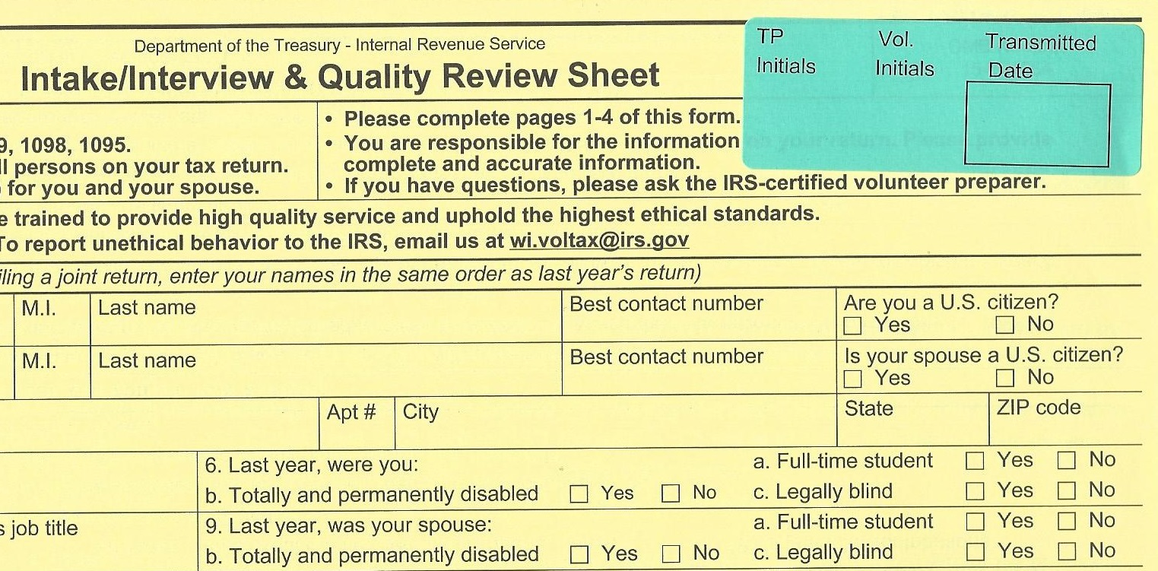
Giving the Client their Return
Go through the return with the client
Verify bank refund/payment options and account information (especially DATE if using auto-debit)
Remind them again this is their return
If anything will be e-filed:
WITNESS the client signing Fed 8879 and/or IA 8453
Those forms are being kept by the client
You and the client initial the sticker in the upper right corner of the 13614-C to indicate those forms were signed
That is the confirmation for e-file transmit

Slide 38
Giving the Client their Return (con’t)
If any return or voucher will be mailed in:
Make sure they have the correct address
Fed addresses can vary (printed with voucher)
Iowa address is usually written on the document
Show them where to sign the return
Make sure they know the deadlines
E-filing but using a voucher:
Explain the tax return goes in now, they can send the voucher later
Mailing return with a voucher:
Not required, but maybe easier to mail both at the same time

Slide 39
Giving the Client their Return (con’t)
Staple the return, if that’s not already done
Put all their documents, the tax return/voucher, and any signed e-file forms in the VITA envelope
All our notes and photocopies can either be put in the envelope or set aside for shredding
Other signed forms (14446) should be shredded
Remind the client to bring the return with them when they have taxes done next year
Put the 13614-C in the designated location for later e-file transmission

Slide 40
Missing Documents

Slide 41
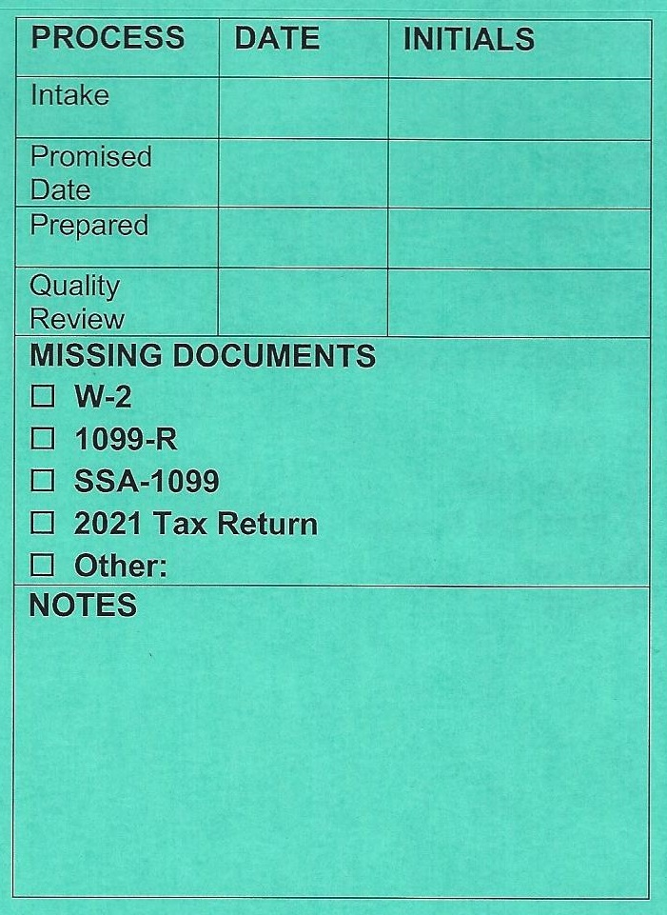
Missing Documents
The most common missing documents are identified
It could be more than 1
Add any others in the “Other” field or in Notes
Cross out, date, and initial when the document is brought in

Slide 42
Missing Documents–Intake or F2F
Try to identify all missing information
There may be multiple documents
Capture all missing docs on the envelope label
Ok to hilite or circle them to remind the client
Complete the interview and/or intake for all other information
Make sure the client understands what is missing and their options. They can:
Bring the documents back to the current site, no new appointment needed
Email the documents (explain that is not secure)
We have a VITA United Way gmail account

Slide 43
Missing Documents – F2F
Prepare the VITA envelope as normal, with a label added if not already there
Discuss the choices below with the client, Site Coordinator and possibly QR:
It may be impossible to proceed further until the client provides the documents
It may be possible to prepare and QR the tax return to a temporary holding point without the missing documents

Slide 44
Missing Documents– F2F No Prep
Put all the client documents, all photo copies, and all notes into the envelope
The envelope goes with the client
Keep the 13614-C with a clear note what is missing
The 13614-C is stored in a designated location
Make sure the missing items are clearly indicated on the envelope label
Explain to the client their return may be done as NIP when they come back instead of F2F
Make sure the client knows the site availability, and they don’t need a new appointment

Slide 45
Missing Documents– F2F Prepare
Prepare the tax return as far as possible with existing documents
Put everything into the envelope as you would for a standard QR
Make sure the missing items are clearly indicated on the envelope label
Flag as “Ready for Review” in Taxslayer
Add a note in Taxslayer about the issue
Have them wait with the envelope for the next QR person, same as a normal process

Slide 46
Missing Documents – F2F QR
Perform QR with the client using the available information and documents
Do NOT
Set the “Approved” or “Complete” flags
Keep the 13614-C with a clear note what is missing and that initial QR was done
The 13614-C is stored in a designated location
Remind the client about the days/hours for the site, and that no new appointment is needed
The client leaves with the VITA envelope and all their information

Slide 47
Missing Documents– NIP at Intake
Prepare the VITA envelope as normal
Put all the client documents, all photo copies, all notes and the F14446 into the envelope
The envelope stays with the client
Keep the 13614-C with a clear note what is missing
The 13614-C is stored in a designated location
Make sure the missing items are clearly indicated on the envelope label
Remind the client about the days/hours for the site, and that no new appointment is needed
No 2-week promise date: the clock starts when they return with the documents

Slide 48
Missing Documents Arrive

Slide 49
Missing Documents Arrive – F2F
Verify all documents are now there
Update the envelope label
If emailed, acknowledge receipt of the info and print the document(s)
Even if emailed, the client will still need to come in for QR
Find the matching 13614-C
Have a preparer enter the additional data
Client may have to wait
The client waits for QR (still need 2 people)
QR finishes the process as normal

Slide 50
Missing Documents Arrive - NIP
Verify all documents are now there
Update the envelope label
If emailed, the documents will need to be printed
Give the client a 2-week reminder sheet (or email)
Did the physical document come to the NIP prep site or a F2F site?
Site coordinators communicate to locate appropriate 13614-C
F2F site arranges for completion at an NIP site
Physical document came to the NIP intake site?
Site Coordinator arranges getting documents to the prep site with the 13614-C
That site matches with appropriate 13614-C
Process continues as normal

Slide 51
Finishing and e-filing

Slide 52
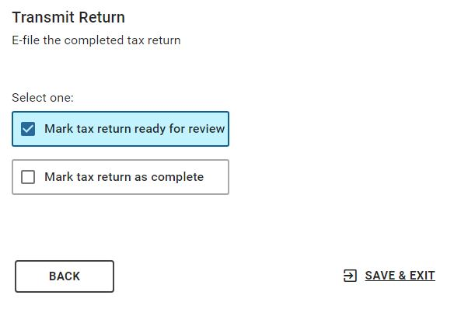
Review and Complete Flags
Setting these two flags at the right time is important to our process
BE CAREFUL of the TRANSMIT Button
It may not be active while “In Review”

Slide 53
Process Summary
The 13614-C never goes with the client
The client holds onto all their documents if they leave because of an issue
Site Coordinator communication keeps things from getting lost or ignored
Make sure the client knows what is needed and the options if there is an issue
Make sure any issues or status with a return is clearly documented
In multiple places if appropriate

Slide 54
Injured Spouse Form 8379

Slide 55
Injured Spouse
This when one spouse’s financial debts or penalties can reduce a joint refund even though the other spouse is not legally responsible
That other spouse is the “injured” spouse
This form allows the portion of the income sourced from the injured spouse to not be affected
Do this as the last form for their taxes

Slide 56
Injured Spouse
It is accessed from the Misc Forms option on the Fed main menu, and then the Form 8379 link
The questions and inputs are straightforward
Joint accounts and Fed Std Deduction are split 50/50
I’ll put a list of the questions in the resource folder
These are the key areas which only one spouse could be responsible for from past debts
The client needs to be aware of this warning

Slide 57
Injured Spouse for Iowa
Iowa does not recognize Federal injured spouse for income tax processing
Independent from filing taxes, in Iowa the injured spouse can request Innocent Spouse Relief
It is filed online
https://govconnect.iowa.gov/tap/_/#1
This is govconnect.iowa.gov, find it under the “Individuals” section on the home page
This is not a VITA function, and it is not in scope to assist them as a VITA volunteer
We can inform them of the option and point them to the web site

Slide 58
Amended and Prior Years

Slide 59
Amended and Requests for Prior Tax Years
Make sure you are in the correct Taxslayer TY
For every return created, a separate 13614-C is needed and a separate VITA folder should be used.
Make sure all intake forms and VITA envelopes are clearly marked with the appropriate tax year and if it is amended or not

Slide 60
Amended and Requests for Prior Years
Use year-appropriate 13614-C and intake forms
We will try to have those available at each site
If you run low, photo-copies are acceptable and there will be a Google folder with the last two year’s forms.
TY 2020 or earlier
Try to find the form 13614-C form on the IRS website
Use a later 13614-C, but clearly mark what tax year it is for
If it’s consistent, it’s OK to copy the TY 2023 13614-C
Taxslayer goes back to TY 2018
For TY 2020 and earlier, efiling is not an option
If more than one return is involved, rubber-band the VITA envelopes so they stay together

Slide 61
Requests for Prior Years – Face-to-Face
If the client has multiple returns to process:
..and they made an appointment for each return
Proceed as normal for each return
..and they did NOT make extra appointments
Site Coordinator/Leader decision:
Can we inconvenience other clients to spend the time to deal with all those returns now?
If not, then process one return using that appointment time (recommend TY 2023 if included), then either
See if they can set up other appointments
Complete interviews for the other returns, but put those into a NIP flow, and the client returns in 2 weeks for pickup

Slide 62
Requests for Prior Years – Not-in-Person
If the client has multiple returns to process:
..and they made an appointment for each return
Proceed as normal for each return
..and they did NOT make extra appointments
Site Coordinator/Leader decision:
Can we inconvenience other clients to spend the time to deal with all those returns now?
NIP will typically not be as much of an impact on other clients as F2F.
A good amount of the interview information overlaps for each tax year
Unless they can make further appointments, your options besides taking the time then are limited

Slide 63
Amended Returns – 1040-X
The 1040-x is fairly straightforward
Column A is Original Information
Loaded from an existing efile accepted return when you start the amendment process, or…
Manually entered
Column C is the Amended Information
Uses what is currently in the Federal data

Slide 64
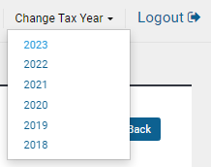
Amended Returns - General
Pub 4012 has a fairly complete set of instructions in section M
To amend, the return must have been accepted by the IRS and/or state (efile or paper)
If the original return WAS done and accepted using VITA Taxslayer
Select the Taxslayer TY being amended, for the correct site and year
Can amend a return for 3 years after it’s filing date (some exceptions)
If the prior year return was NOT done in VITA Taxslayer, we have to create a new return
Always provide an explanation (details later)

Slide 65
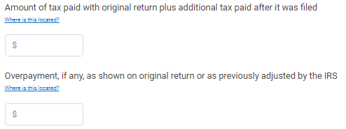
Amended Returns – Accepted in Taxslayer
Select the client.
Their menu will have an option to amend
Select the Original Federal Return
The fields should be filled in.
If not, it’s an exception (covered later)
Adjust the tax and overpayment fields as appropriate

Slide 66
Amended Returns – Accepted in Taxslayer
When all original fields are correct, CONTINUE
This is the data that populates Column A
It is defaulted when you first start the amended return
Select the Make Corrections option
You are directed to go to the standard Federal input areas and make the amended changes
This is the data that goes into Column C
If you print-preview, you will see the 1040-X

Slide 67
Amended Returns – No Taxslayer Entry
You need a full copy of the original return
Verify you are in the correct tax year at your own site
Create a new return using the amended information
This will populate Column C
Now select the option to amend
Select Original Federal Return option
Fill in all the original fields manually based on the original return
Adjust the tax and overpayment fields as appropriate
This will populate Column A

Slide 68
Amended Returns - Exceptions
The return was created in VITA Taxslayer but never accepted by the IRS
Cannot amend anything
Started/never sent or rejected (paper or efile)
Cannot create a new return, so edit old record to use the latest data (including correcting any rejection)
Submit as a new return or resubmit (if a rejection)
Return was accepted by the IRS, but VITA did not efile it (paper return) or..
No initial data in Column A for some reason
Follow the process as if Taxslayer did not have a return, but…
Do not create a new return. Edit the old return.
If original return was paper, so is the amendment

Slide 69
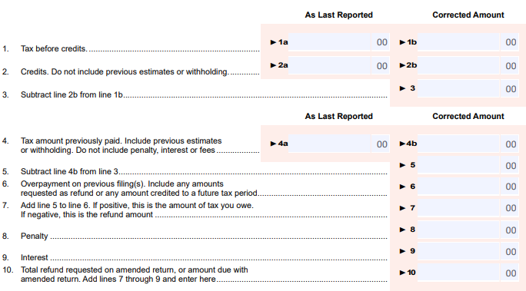
Iowa Amended Returns – Form IA102
New - Replaces IA 1040X
Similar to Fed 1040-X, but does not show net change
Same as Fed Columns A C

Slide 70
Iowa Amended Returns
If you amend your Federal return, you almost always will need to amend state returns
From the Fed amendment screen, choose to amend a state
Choose to edit or start a state amendment
This adds an option at the bottom of the Iowa main menu

Slide 71
Iowa Amended Returns
Beginning the IA amendment has one more menu
The screen opened from here functions the same as the “Original Federal Information”, filling Column A
You edit the existing Iowa data for IA specific amended changes in the same manner as you did for Federal, setting up Column C

Slide 72
Iowa Amended Returns
You can amend an Iowa return for a reason that does NOT affect the Federal return
You still have to go through the amended return link from the Federal menu to start the amendment
Do NOT start the Federal amendment process
Go straight to the link for amending a state return
If you efile, file state-only
Once an Iowa amendment is started, the link to access it stays at the bottom of the Iowa main menu
You don’t need to go through the Federal menu again

Slide 73
General Notes for Fed and Iowa
You need to add an explanation, both on the Federal and State
There is a similar link on the IA amended menu
For Iowa, there is the text box for details plus drop-down lists for selecting a reason
For the drop down list, the only options that would apply to us are “Federal amendment” and “Other”
Check Pub 4012 Section M for what needs to be sent if mailing the return
IA requires a copy of the Fed return

Slide 74
General Notes for Fed and Iowa
We can amend a 2023 return, HOWEVER
We must wait until the original return has been accepted
Make sure any payments or refunds are processed and settled
As near as I can tell, efiling options for amended returns are the same for Iowa as the Fed, and match the general efiling years
If the original return was paper, you can’t efile amendments
There are other reasons you can’t efile in Pub 4012
Per Pub 4491, if the only change is for injured spouse, only submit Form 8379 with no 1040-X

Slide 75
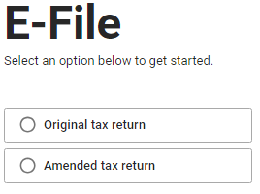
Finishing the Amended Return
When you select the efile process from the Federal Menu, you will see

Slide 76
Iowa Part-Year Resident
Form IA 126

Slide 77
Iowa Part-Year Resident Overview
If someone did not live in Iowa for the entire tax year, they are a Part-Year resident
It can be they moved out or moved in, but I’ve never dealt with someone who moved out of Iowa coming to us to file their tax return
We’ll assume they moved into Iowa and were here on 12/31
It is not mandatory to file another state besides IA.
If they have little income and no withholding from another state, they may not need to file
The intent is to legally redirect any Federal taxable income from counting toward Iowa

Slide 78
Iowa Part-Year Resident - Starting
You create an entirely new return in Taxslayer or add IA through the “Add a State” screen
You will be presented with these options:
You only get this choice once when you start the Iowa return
I’ve never run into a client in the Non-Resident category

Slide 79
Iowa Part-Year Resident - Starting
This is the next screen that appears
Enter the date in the TY they moved into IA.
The “moved OUT of state” dates can be left empty for IA, or use 12/31
Other states may not give you the option to not enter anything
Input the county and school district

Slide 80
Iowa Part-Year Resident – New Screens
Once a Part-Year IA return is started two new screen links appear on the IA main menu:
The Part-Year Resident process for every state I’ve dealt with have screens similar to these

Slide 81
Iowa Part-Year Resident – Return Type
The Taxslayer state selection screen shows the return type for a state return
If you chose wrong, you have to delete the state return and create a new one

Slide 82
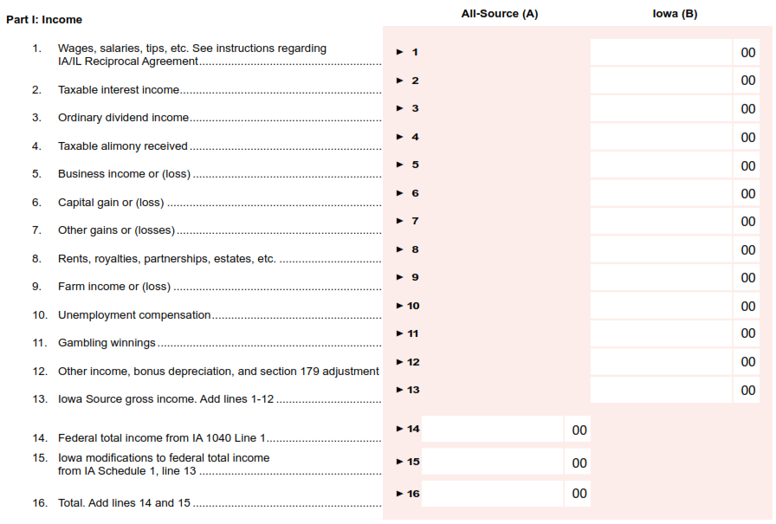
Iowa Part-Year Resident – Form IA 126
These fields start with the Federal totals based on state

Slide 83
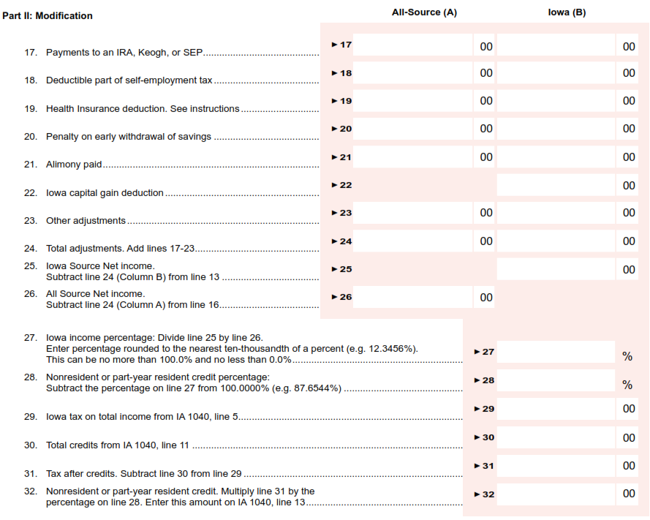
Iowa Part-Year Resident – Form IA 126
These fields start with the Federal totals based on state

Slide 84
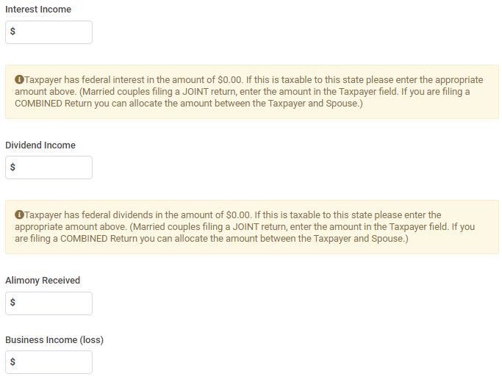
Iowa PY Resident – Income Subject to Tax
Taxslayer does let you know what the Federal amount is for many of the fields

Slide 85
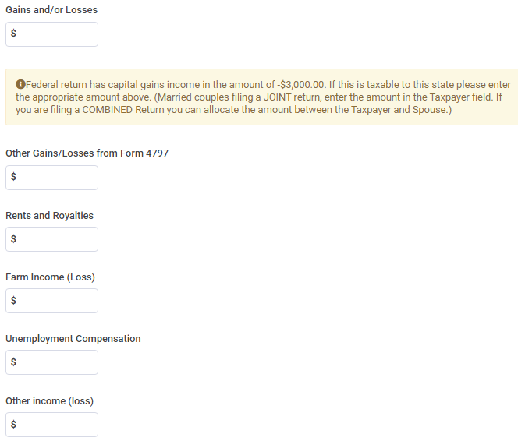
Iowa PY Resident – Income Subject to Tax
You can make negative entries for many of these fields when appropriate

Slide 86
Iowa PY – How do you allocate?
Taxslayer will default allocate to a state based on any state information on the W-2, 1099-R, etc.
For monthly payments (pension, SSA, insurance premiums) allocate based on the time living in each state
For stand-alone Fed-only transactions (401K, IRA, etc.) – where were they living when they made the withdrawal or contribution?
1099-INT, 1099-DIV:
If it’s a local financial institution, keep it in Iowa
If it’s one from the other PY state, keep it in that state
Anything else, allocate based on time in each state
Iowa and the states I’ve dealt with do not change the actual incomes on the 1040’s, but calculate a tax credit to reduce the full state tax

Slide 87
Training Scenario 7
Tiana Edwards

Slide 88
Discussion – What changed for Iowa?
Daughter Mary is 5 years older
This makes it more likely for K-12 qualified expenses, but she is no longer eligible for any Dependent Care Credit
The W-2 has no employer contribution for Dependent Care
Added the final portion of a 2022 Fed 1040 to illustrate calculating the refund income for Iowa
Added expenses for the K-12 Tuition Credit
This goes under the Credits option from the IA main menu
She can use the rest of her Educator expenses
This has it’s own field under “Subtractions from Income”
Retention bonus moved from 1099-NEC to W-2
Input from other volunteers indicates this is not likely
This goes under “Other Total Federal Tax” subtractions, Line 11 IA Sched 1

Slide 89
Training Scenario 8
Shamus O’Connor

Slide 90
Discussion – What changed for Iowa?
Estimated Payments
Added for both Federal and Iowa
Both Federal and Iowa are input from the Federal screens
Only 2 Iowa payments. Not required to make 4 of them.
Changed the Self-Employment numbers and 1099-NEC
Taxslayer bug makes you create an IA entry in the 1099-NEC
More detailed work with Health Insurance Premiums
Medicare and what he paid for his ACA insurance are both out-of-pocket expenses
Tried putting insurance both in the IA adjustments and as self-employed health insurance
With Iowa new tax structure, will usually be better as self-employed insurance
Self-employed entered with Schedule C, but ends up on Fed Sched 1
Can’t use it for self-employed insurance if you are eligible for ANY employer coverage
You cannot use it in both places

Slide 91
Next Steps

Slide 92
Real Taxes Start on Jan 29, 2024
Make sure you can log into the site(s) you will be supporting
If you are not sure where and when you are signed-up, verify with Patti
I’ll work on more resource sheets in the next week or so
Never be afraid to ask questions

Slide 93
Questions?
Good Luck, and Thank You again for helping VITA!

